Slide 2
understand various sampling techniques,
.

Slide 3
Definition of Sampling Theory
The sampling theory definition of the statistic is the creation of a sample set. This is recognized as one of the major processes. It retains the accuracy in bringing out the correct statistical information. The population tree is a huge set and it turns out to be exhausting for the actual study and estimation process. Both money and time get exhausted in the process. The creation of the sample set saves time and effort and is a vital theory in the process of statistical data analysis

Slide 4
Difference Between Population and Sample
Once you know the difference between these two terms, you are eligible to understand the information laid ahead. In this part, you will learn how to identify the population and sample. The population can be referred to as the whole group of which you want to have a conclusion after making a statistical analysis. Samples are the groups within a population from which the data are to be collected.

Slide 5
Population
The population can be categorized in terms of geographical locations, income, age groups, and many other categories. The population can be a narrow or a broad group as per the requirement. It would appear clearer with sampling theory examples. For instance, if you are willing to conclude making statistical analysis about a topic on the adults, then the population can be a huge broad group. And on the other hand, if you are researching a particular company, then the population is a narrow one. The whole set of elements or entities is referred to as Population.

Slide 6
Sample
The sample frame is nothing but the set of sample elements that are under observation. The creation of samples is all that defines sampling theory. This is precisely the set of people that will be actively participating in the process of statistical analysis. The sampling model is when the set of the population has infinite elements.

Slide 7
Process of Sampling
The first step is a wise choice of the population set.
The second step is focusing on the sample set and the size of it.
Then, one needs to choose an identifiable property based on which the samples will be created out of the population set.

Slide 8
Process of Sampling
Then, the samples can be chosen using any of the types of sampling theory – Simple random, systematic, or stratified. Each of them is thoroughly discussed ahead.
Checking the inaccuracy, if there is any.
Hence, the set is achieved in the result.

Slide 9
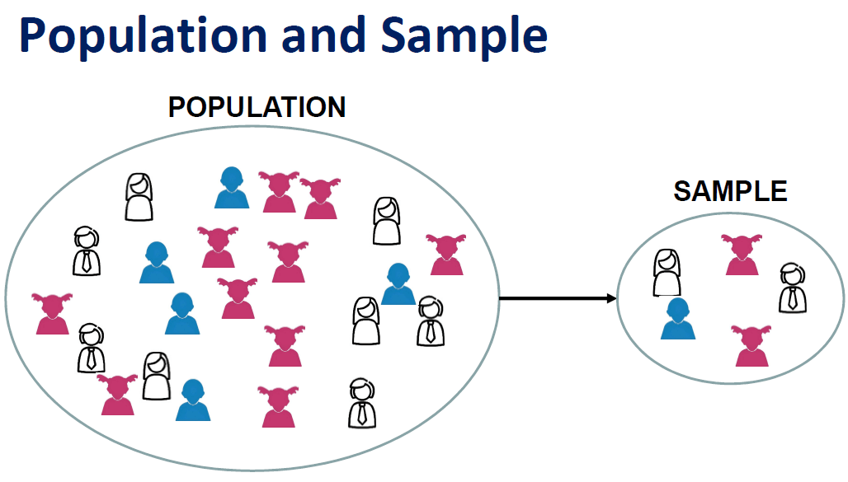
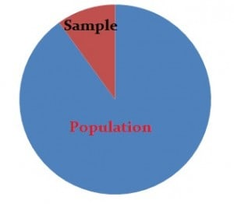
Samples
Samples are parts of a population.
For example, you might have a list of information on 100 people (your “sample”) out of 10,000 people (the “population”). You can use that list to make some assumptions about the entire population’s behavior.

Slide 10
Samples
However, it’s not that simple. When you do stats, your sample size has to be ideal—not too large or too small. Then once you’ve decided on a sample size, you must use a sound technique to collect the sample from the population

Slide 11
Sampling Types
Probability Sampling uses randomization to select sample members. You know the probability of each potential member’s inclusion in the sample. For example, 1/100. However, it isn’t necessary for the odds to be equal. Some members might have a 1/100 chance of being chosen, others might have 1/50.

Slide 12
Sampling Types
Non-probability sampling uses non-random techniques (i.e., the judgment of the researcher). You can’t calculate the odds of any particular item, person or thing being included in your sample.

Slide 13
Simple Random Sampling
In this case each individual is chosen entirely by chance and each member of the population has an equal chance, or probability, of being selected. One way of obtaining a random sample is to give each individual in a population a number, and then use a table of random numbers to decide which individuals to include.

Slide 14
Simple Random Sampling
For example, if you have a sampling frame of 1000 individuals, labelled 0 to 999, use groups of three digits from the random number table to pick your sample. So, if the first three numbers from the random number table were 094, select the individual labelled “94”, and so on.

Slide 15
Systematic Sampling
Individuals are selected at regular intervals from the sampling frame. The intervals are chosen to ensure an adequate sample size. If you need a sample size n from a population of size x, you should select every x/n^{th} individual for the sample.
For example, if you wanted a sample size of 100 from a population of 1000, select every 1000/100 = 10th member of the sampling frame.

Slide 16
Systematic Sampling
Systematic sampling is often more convenient than simple random sampling, and it is easy to administer. However, it may also lead to bias, for example if there are underlying patterns in the order of the individuals in the sampling frame, such that the sampling technique coincides with the periodicity of the underlying pattern.

Slide 17
Stratified Sampling
In this method, the population is first divided into subgroups (or strata) who all share a similar characteristic. It is used when we might reasonably expect the measurement of interest to vary between the different subgroups, and we want to ensure representation from all the subgroups.

Slide 18
Stratified Sampling
For example, in a study of stroke outcomes, we may stratify the population by sex, to ensure equal representation of men and women. The study sample is then obtained by taking equal sample sizes from each stratum. In stratified sampling, it may also be appropriate to choose non-equal sample sizes from each stratum.

Slide 19
Clustered Sampling
In a clustered sample, subgroups of the population are used as the sampling unit, rather than individuals. The population is divided into subgroups, known as clusters, which are randomly selected to be included in the study. Clusters are usually already defined, for example individual GP practices or towns could be identified as clusters. In single-stage cluster sampling, all members of the chosen clusters are then included in the study.

Slide 20
Clustered Sampling
In two-stage cluster sampling, a selection of individuals from each cluster is then randomly selected for inclusion. Clustering should be taken into account in the analysis. The General Household survey, which is undertaken annually in England, is a good example of a (one-stage) cluster sample. All members of the selected households (clusters) are included in the survey

Slide 21
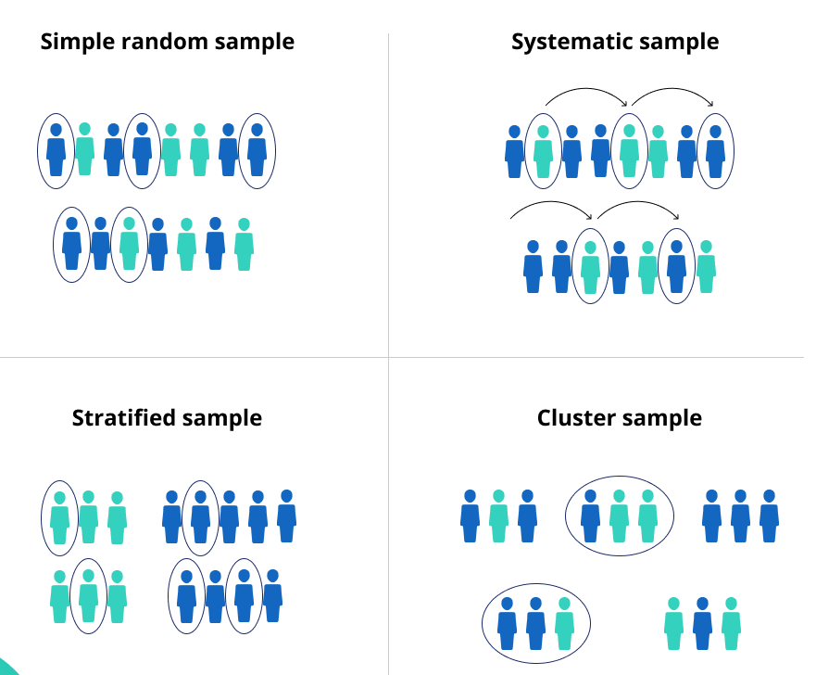
Comparison

Slide 22
Non-Probability Sampling Methods
Convenience sampling
Convenience sampling is perhaps the easiest method of sampling, because participants are selected based on availability and willingness to take part.

Slide 23
Non-Probability Sampling Methods
Convenience sampling
Useful results can be obtained, but the results are prone to significant bias, because those who volunteer to take part may be different from those who choose not to (volunteer bias), and the sample may not be representative of other characteristics, such as age or sex. Note: volunteer bias is a risk of all non-probability sampling methods.

Slide 24
Quota Sampling
This method of sampling is often used by market researchers. Interviewers are given a quota of subjects of a specified type to attempt to recruit. For example, an interviewer might be told to go out and select 20 adult men, 20 adult women, 10 teenage girls and 10 teenage boys so that they could interview them about their television viewing. Ideally the quotas chosen would proportionally represent the characteristics of the underlying population.

Slide 25
Quota Sampling
While this has the advantage of being relatively straightforward and potentially representative, the chosen sample may not be representative of other characteristics that weren’t considered (a consequence of the non-random nature of sampling).

Slide 26
Judgment (or Purposive) Sampling
Also known as selective, or subjective, sampling, this technique relies on the judgment of the researcher when choosing who to ask to participate. Researchers may implicitly thus choose a “representative” sample to suit their needs, or specifically approach individuals with certain characteristics. This approach is often used by the media when canvassing the public for opinions and in qualitative research.

Slide 27
Judgment (or Purposive) Sampling
Judgment sampling has the advantage of being time-and cost-effective to perform whilst resulting in a range of responses (particularly useful in qualitative research). However, in addition to volunteer bias, it is also prone to errors of judgment by the researcher and the findings, whilst being potentially broad, will not necessarily be representative.

Slide 28
Snowball Sampling
This method is commonly used in social sciences when investigating hard-to-reach groups. Existing subjects are asked to nominate further subjects known to them, so the sample increases in size like a rolling snowball. For example, when carrying out a survey of risk behaviors amongst intravenous drug users, participants may be asked to nominate other users to be interviewed.

Slide 29
Snowball Sampling
Snowball sampling can be effective when a sampling frame is difficult to identify. However, by selecting friends and acquaintances of subjects already investigated, there is a significant risk of selection bias (choosing a large number of people with similar characteristics or views to the initial individual identified).

Slide 30
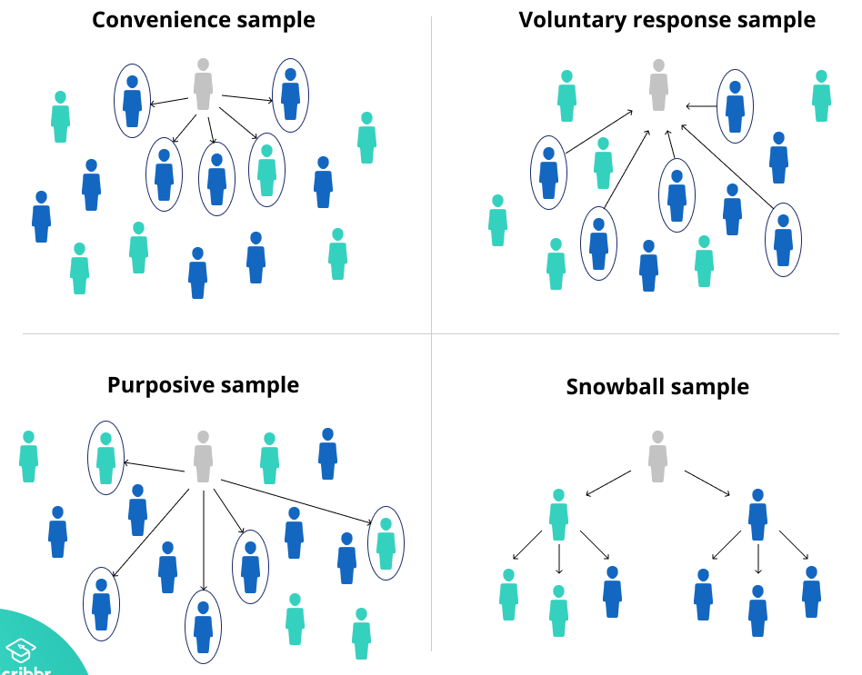
Comparison

Slide 31
Experimental Design
Experimental design is a way to carefully plan experiments in advance so that your results are both objective and valid. The terms “Experimental Design” and “Design of Experiments” are used interchangeably and mean the same thing. However, the medical and social sciences tend to use the term “Experimental Design” while engineering, industrial and computer sciences favor the term “Design of experiments.”

Slide 32
Experimental Design
Design of experiments involves:
The systematic collection of data
A focus on the design itself, rather than the results
Planning changes to independent (input) variables and the effect on dependent variables or response variables
Ensuring results are valid, easily interpreted, and definitive.

