Slide 2
understand about market and marketing
basic concepts of marketing .
nature and scope of marketing

Slide 3
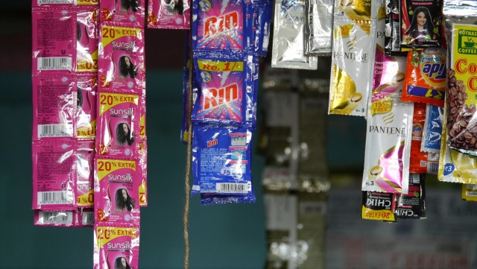
Why Sachets?

Slide 4
Ruling The Market
SACHETS ARE CHEAPER
MORE Convenient
Pocket friendly

Slide 5
Marketing
“Marketing is an organisational function and a set of processes for creating, communicating, and delivering value to customers and for managing customer relationships in ways that benefit the organisation and its stakeholders.”
(The American Marketing Association)

Slide 6
Definition
“Marketing is a total system of business activities designed to plan, price, promote, and distribute want- satisfying products to target markets to achieve organizational objectives”.
(William J. Stanton, Michael J. Etzel, and Bruce J. Walker)

Slide 7
Definition
Marketing is the creation, communication and delivery of value, as well as the management customer relationships for a lifetime.
(Luman Learning)

Slide 8
Market vs Marketing
Market is an arrangement to provide an opportunity to exchange goods.
Marketing is sum total of all those activities that are related to flow of goods from production to consumption.

Slide 9
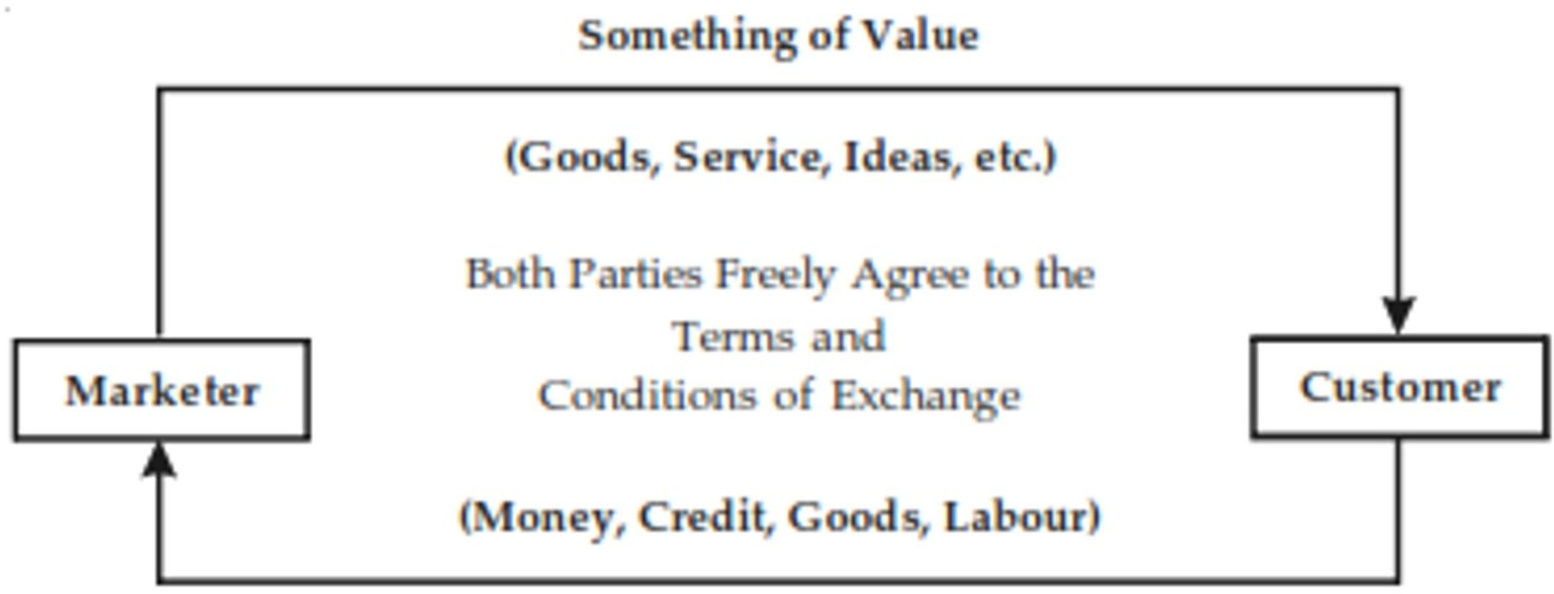
Concept of Exchange

Slide 10

Selling

Slide 11

Marketing

Slide 12
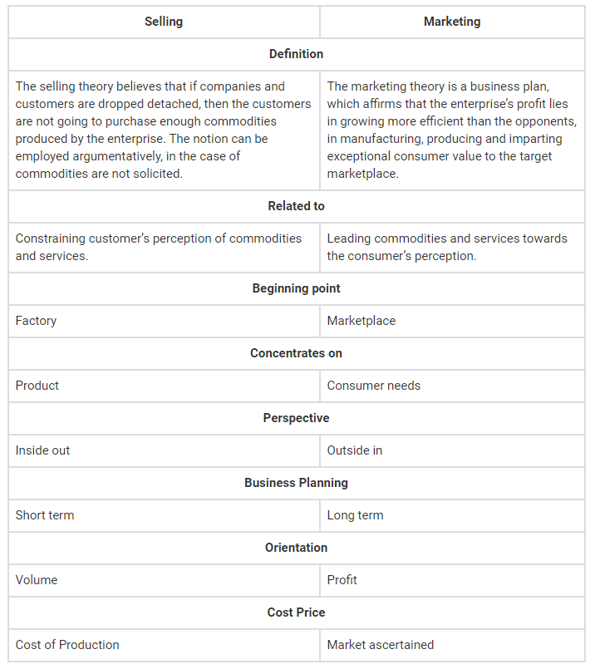
Selling Vs Marketing

Slide 13
Nature of Marketing
1. Customer Focus
2. Creates Market offering
3. Exchange Oriented
4. Continuous Activity
5. Goal Oriented
6. Manages 4 P’s
7. Creates Utilities
8. Economic Process

Slide 14
Nature of Marketing
1. Customer Focus
2. Creates Market offering
3. Exchange Oriented
4. Continuous Activity
5. Goal Oriented
6. Manages 4 P’s
7. Creates Utilities
8. Economic Process

Slide 15
Nature of Marketing
1. Customer Focus
2. Creates Market offering
3. Exchange Oriented
4. Continuous Activity
5. Goal Oriented
6. Manages 4 P’s
7. Creates Utilities
8. Economic Process

Slide 16
Nature of Marketing
1. Customer Focus
2. Creates Market offering
3. Exchange Oriented
4. Continuous Activity
5. Goal Oriented
6. Manages 4 P’s
7. Creates Utilities
8. Economic Process

Slide 17
Nature of Marketing
1. Customer Focus
2. Creates Market offering
3. Exchange Oriented
4. Continuous Activity
5. Goal Oriented
6. Manages 4 P’s
7. Creates Utilities
8. Economic Process

Slide 18
Nature of Marketing
1. Customer Focus
2. Creates Market offering
3. Exchange Oriented
4. Continuous Activity
5. Goal Oriented
6. Manages 4 P’s
7. Creates Utilities
8. Economic Process

Slide 19
Nature of Marketing
1. Customer Focus
2. Creates Market offering
3. Exchange Oriented
4. Continuous Activity
5. Goal Oriented
6. Manages 4 P’s
7. Creates Utilities
8. Economic Process

Slide 20
Nature of Marketing
1. Customer Focus
2. Creates Market offering
3. Exchange Oriented
4. Continuous Activity
5. Goal Oriented
6. Manages 4 P’s
7. Creates Utilities
8. Economic Process

Slide 21
Scope of Marketing
1. Creates Awareness
2. Studies Customer Wants
3. Product Planning
4. After Sales Services
5. Pricing Policies

Slide 22
Scope of Marketing
1. Creates Awareness
2. Studies Customer Wants
3. Product Planning
4. After Sales Services
5. Pricing Policies

Slide 23
Scope of Marketing
1. Creates Awareness
2. Studies Customer Wants
3. Product Planning
4. After Sales Services
5. Pricing Policies

Slide 24
Scope of Marketing
1. Creates Awareness
2. Studies Customer Wants
3. Product Planning
4. After Sales Services
5. Pricing Policies

Slide 25
Scope of Marketing
1. Creates Awareness
2. Studies Customer Wants
3. Product Planning
4. After Sales Services
5. Pricing Policies

Slide 26
Scope of Marketing
6.Distribution
7. Selling
8. Packaging
9. Advertising
10. Collects The feedback

Slide 27
Scope of Marketing
6.Distribution
7. Selling
8. Packaging
9. Advertising
10. Collects The feedback

Slide 28
Scope of Marketing
6.Distribution
7. Selling
8. Packaging
9. Advertising
10. Collects The feedback

Slide 29
Scope of Marketing
6.Distribution
7. Selling
8. Packaging
9. Advertising
10. Collects The feedback

Slide 30
Scope of Marketing
6.Distribution
7. Selling
8. Packaging
9. Advertising
10. Collects The feedback

