Slide 2
understand exchange process
marketing concepts
analyze detailed functions of marketing

Slide 3
Marketing
Marketing is the creation , communication and delivery of value as well as the management of customer relationships for a lifetime.

Slide 4
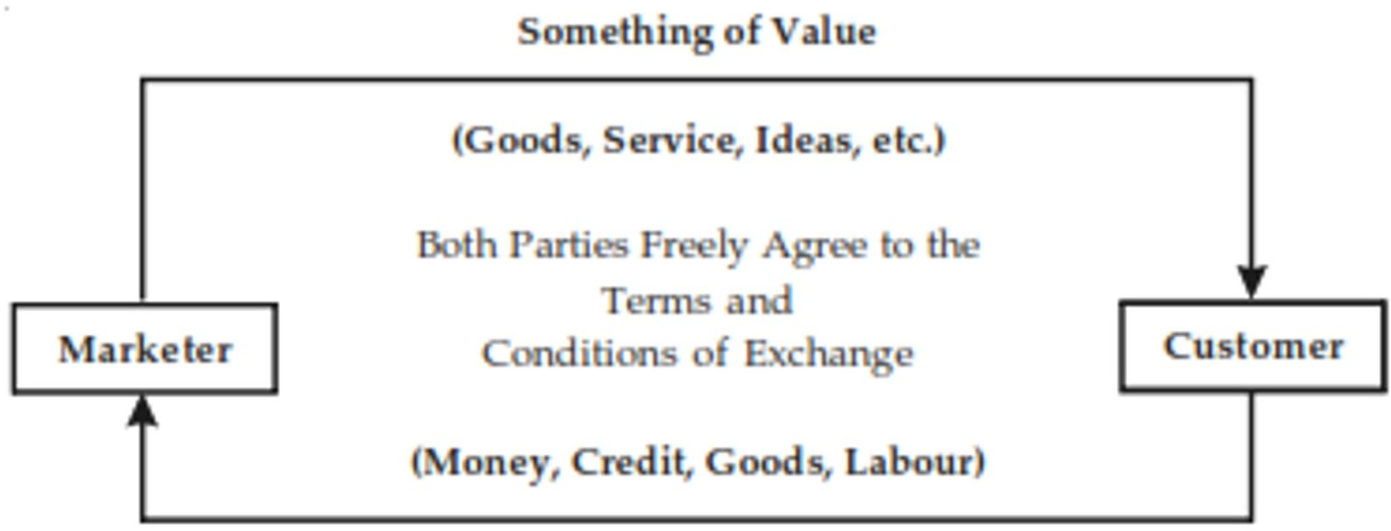
Concept of Exchange

Slide 5
Need & Want
One of the most fundamental concepts that drive your marketing efforts.

Slide 6
Need
A functional benefit like food or an emotional benefit like happiness.
Let us assume there is an individuals and he is hungry; his need is
Food
Emotional benefits are stronger driver's for customer's to take action vs functional benefits. Functional benefits are easily to replicate for the competitor's.

Slide 7


MKT503 – MARKETING MANAGEMENT

Slide 8
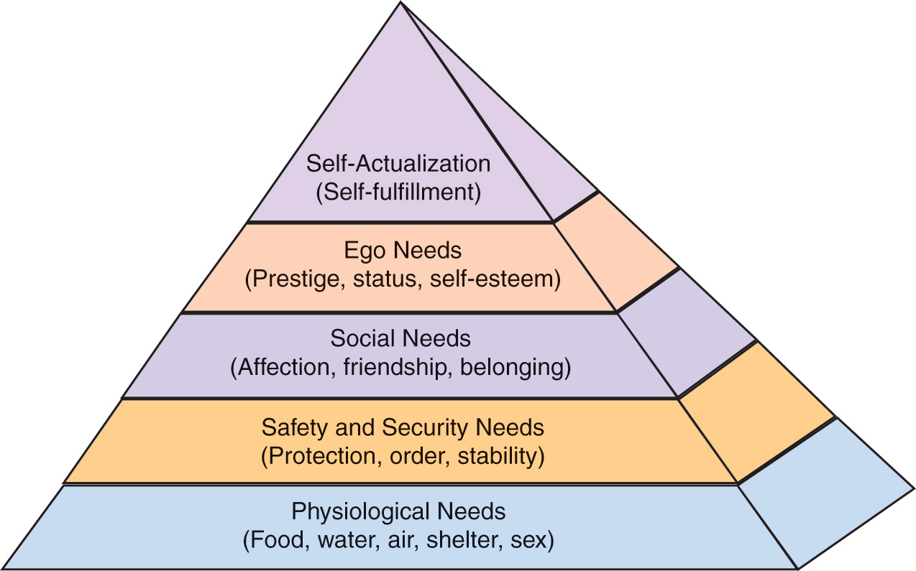
Maslow Hierarchy
Recapitulate Activity-Maslow’s Hierarchy of Needs

Slide 9
Types of Need
Stated needs (The customer wants an inexpensive car.)
Real needs (The customer wants a car whose operating cost, not initial price, is low.)
Unstated needs (The customer expects good service from the dealer.)
Delight needs (The customer would like the dealer to include an onboard GPS system.)
Secret needs (The customer wants friends to see him or her as a savvy consumer.)

Slide 10
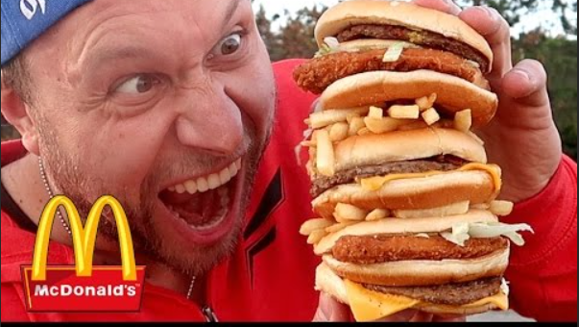
Want
Wants are desires for a product or service. The specific satisfier that an individual look for defines the want .

Slide 11

Need and Want

Slide 12
Demand
Demand is customer desire, willingness and ability to pay for a specific product or service, that would help fulfill their wants.
Suppose he is having money to buy the burger; he goes to McDonald’s and orders a vegetable burger.
Any business, through its offering aims to cater to this demand.

Slide 13
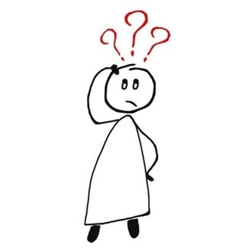
Needs, Wants and Demands
Needs: It is a state of felt deprivation.
Wants: specific objects that might satisfy the need.
Demands: wants for specific products backed by an ability to pay.

Slide 14
MARKETING ORIENTATIONS (Marketing Concept or Customer Focus)
The one that allows the wants and needs of customers and potential customers to drive all the firms strategic decisions.

Slide 15

Production Concept
One of the oldest of managerial orientations and aimed at achieving as high

Slide 16
Production Concept
An output as possible. Assumes that customers are interested in purchasing products that are:
Conveniently Available
Reasonably Priced
Well-made Products

Slide 17

Product Concept
Proposition that consumers will favor those products that offer attributes like:
Quality
Performance
Other innovative features

Slide 18

Selling Concept
Customers will not buy the product in sufficient quantities unless aggressively pressurized. Selling concept is geared towards converting existing product(s) into cash rather than first finding and then satisfying customer needs.
Heavy reliance on their promotional capabilities
Hard sell approach

Slide 19
Marketing Concept
Customer centric Sense & Respond philosophy
As per Benson P. Shapiro, company is customer focused If:
It is east for customer to do business with it.
Keep its promises
Meet the set standards
Responsive to customer needs

Slide 20
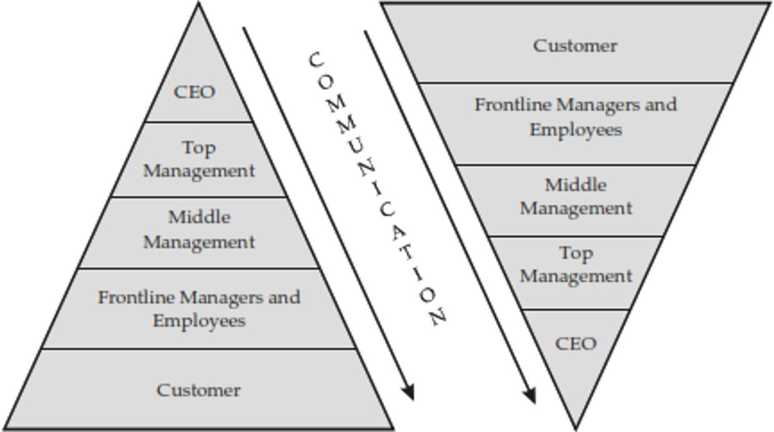
A Typical Marketing Concept Driven Company

Slide 21
Functions of Marketing
Distribution
Selling
Financing
Market information Management
Pricing
Product/Service Management
Promotion

