Slide 2

understand varied marketing concepts.

Slide 3
Let’s Revise: What is Marketing ?
Marketing is a process by which companies create customer interest in products and services.
Generates the strategic plans about sales techniques, business communication and business development.
Its an integrated process through which companies build strong customer relationships and create value for their customers and for themselves.

Slide 4
Let’s Revise: What is Marketing?
It helps to identify customer, to keep the customer and to satisfy the customer.
The adoption of marketing strategies requires businesses to shift their focus from production to the perceived needs and wants of their customers as the means of staying profitable.

Slide 5
Let’s Revise: What is Marketing?
The term marketing concept deals with achieving organizational goals which depends on understanding need and wants of the target markets and delivering the desired satisfactions.

Slide 6
Definition
“Marketing is an organizational function and a set of processes for creating, communicating and delivering value to customer relationships in ways that benefit the organization and its stake holders.”
American Marketing Association

Slide 7
Core Marketing Concepts
Needs , wants & Demands
Target Market, Positioning and Segmentation
Offerings and Brands
Value and satisfaction
Marketing Channels
Supply Chain
Competition
Marketing Enviroment

Slide 8
Need , want and Demand
Need
Marketing
Demand
Want

Slide 9
STP
Targeting
Positioning
Segmentation

Slide 10
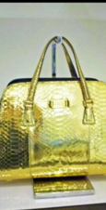
Offerings and Brands
A consistent brand offering, and experience is essential to build a brand personality.
Michael Kors delivers consistent products within the brand promise of glamorous, urban fashion .

Slide 11
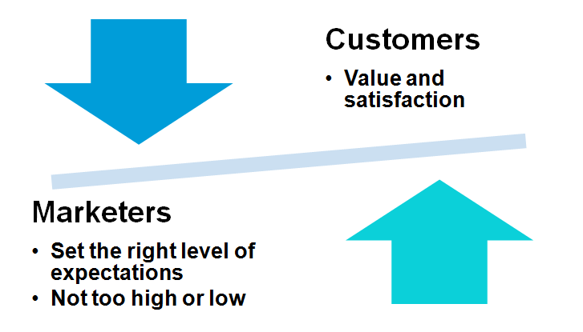
Value and satisfaction

Slide 12
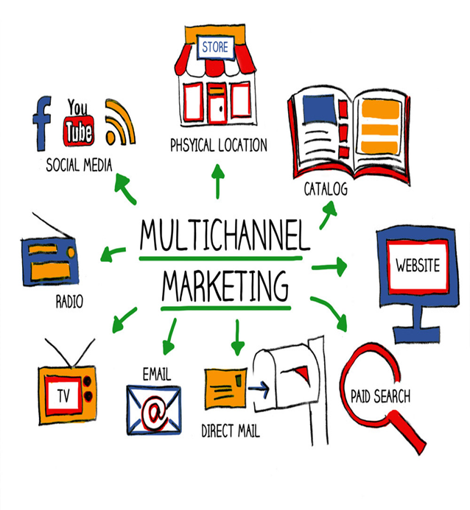
Marketing Channels
Communication Channels
Distribution Channel
Service Channel

Slide 13

Supply Chain

Slide 14

Competition

Slide 15
Marketing Environment
Political and regulatory environment
Political and regulatory enviroment
Economic Environment
Social and cultural environmental
Competitive environment
Technological environment

Slide 16
Evolved Marketing Concepts
The Production concept
The Product concept
The Selling Concept
The Marketing Concept

Slide 17
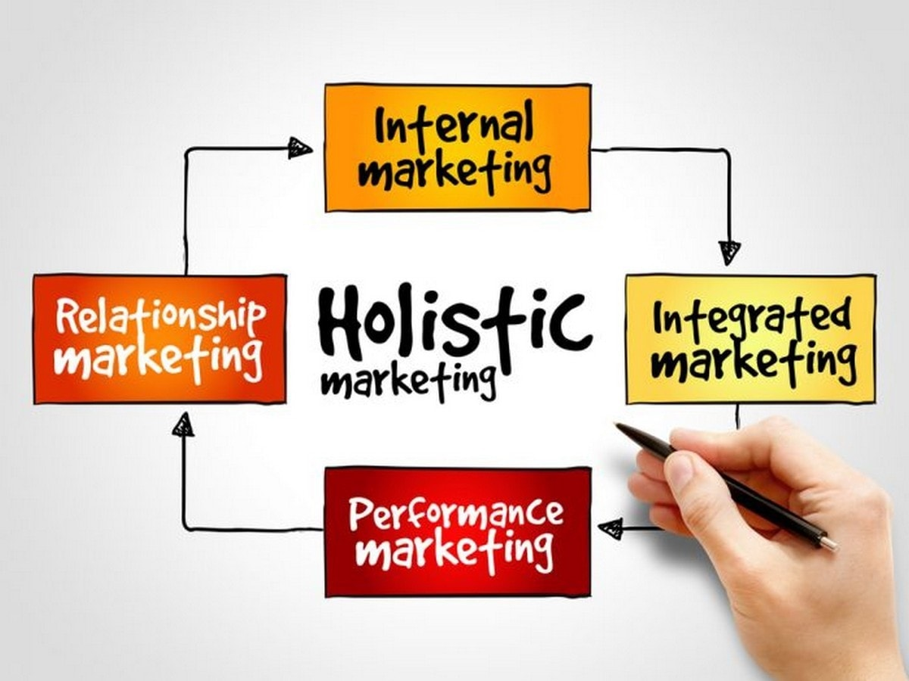
Holistic Marketing

Slide 18
Market
Wholesale Market
Spot Market
Retail Market
Future Market

Slide 19
Purchase Decision
User Experience
Brand Loyalty
Consumer Behavior
Affect
Brand Switching
Conformity
Performance

