Slide 2
evolution of modern marketing concept
elaborate holistic marketing concept

Slide 3
Marketing
Marketing is managing profitable customer relationships.

Slide 4
Marketing (Goals:)
1. Attract new customers
2. Keep and grow current customers.

Slide 5

Example- 1

Slide 6
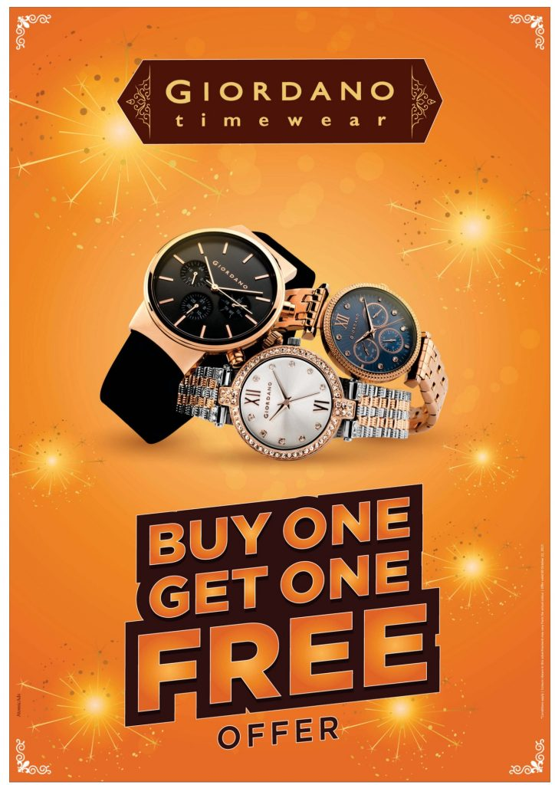
Example- 2

Slide 7
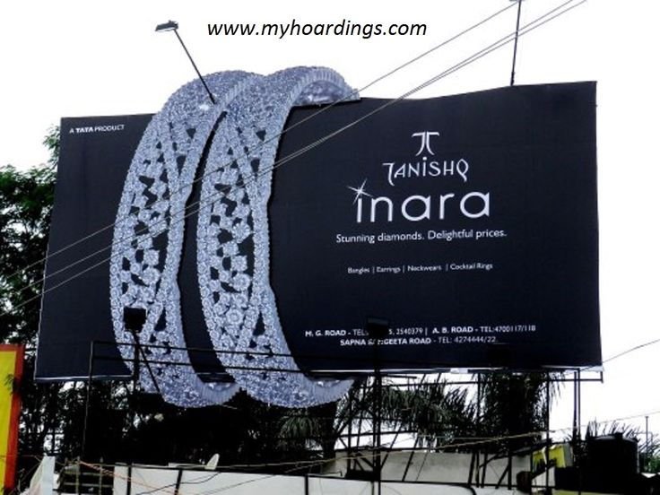
Example- 3

Slide 8
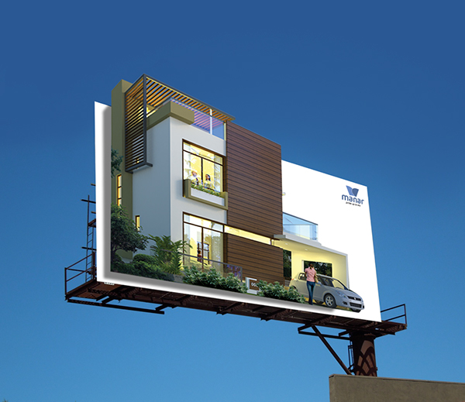
Example- 4

Slide 9
American Marketing Association (AMA)
American Marketing Association (2007) defined Marketing as “the activity , set of institutions and processes for creating , communicating , delivering and exchanging offerings that have value for customers, clients, partners and society at large”.

Slide 10
Evolution of Marketing Concept
Production Concept
Product Concept
Selling Concept
Marketing Concept
Holistic Marketing Concept

Slide 11
Production Concept
Oldest concept
Believed that customers favor products that are easily available and highly affordable.
Focus on improving production and mass distribution This orientation makes sense in developing countries.
Efforts on reducing costs to provide inexpensive goods.

Slide 12
Production Concept
Ford’s automobiles are a very good example of production.
When Ford pushed a large number of automobiles in the market, more people bought its vehicles.

Slide 13
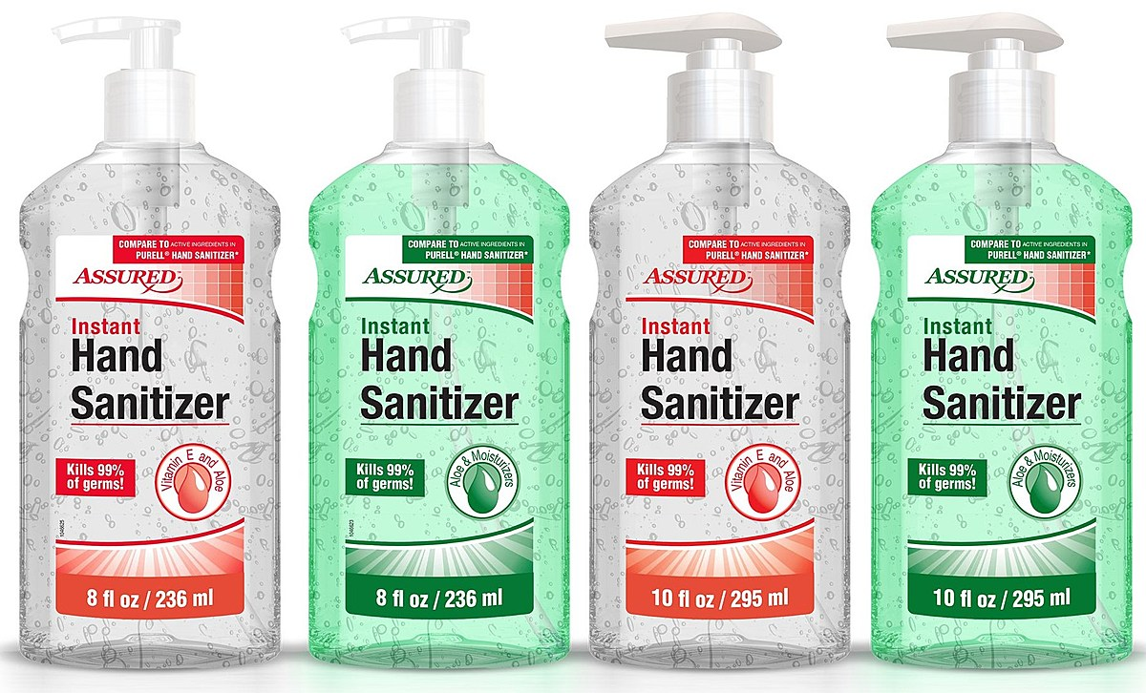
Production Concept: Example

Slide 14
Production Concept
It is useful when:
1. The demand for the product exceeds the supply.
2. the product cost is too high.
The Core Emphasis is on producing goods.

Slide 15
Product Concept
Focus is on making Superior Goods.
Believed that customers prefer goods with best quality & Innovative Features
Importance is given to improving the product
Goods sell themselves.

Slide 16
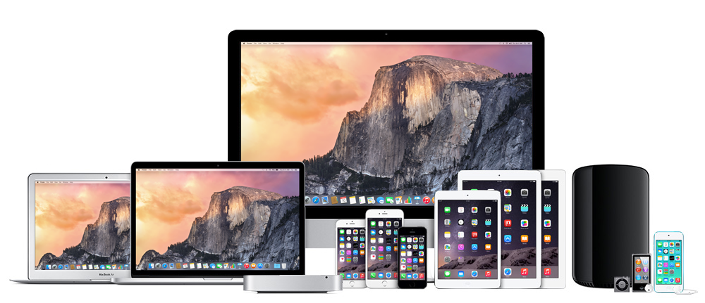
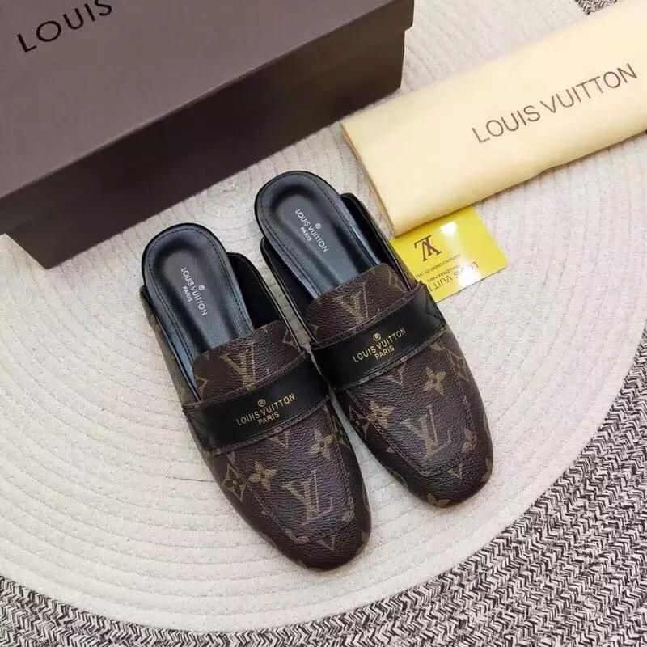
Examples:

Slide 17
Examples
Apple: Apple is one of the world’s largest tech companies and it falls under the category of top 5 tech companies of the world. iPhone, TV, Store, Music, Videos, and iPad are some of the main products of Apple. The company also follows the product concept by the focus on delivering a quality product. The customer market of Apple doesn’t care about the price.

Slide 18
Examples
Gucci: Gucci is one of the world’s leading luxury fashion brands. The company offers quality makeup, handbags, ready-to-wear clothes, shoes, fragrance, home decoration, and many other accessories. The brand also follows the product concept by offering the latest fashionable products to the customers. The customers are willing to pay a higher price for the Gucci products.

Slide 19
Examples
Louis Vuitton: Louis Vuitton is also a French fashion brand. Luxury ready-to-wear watches, shoes, clothes, jewelry, sunglasses, accessories, leather goods, and books are some of the main products of Louis Vuitton. The company also provides quality products to its customers, and they’re willing to anything to get the Louis Vuitton product. Factors like quality, luxury, fashion, and status are more important to the customers of the brand than price.

Slide 20
Selling Concept
Aggressive selling and Promotion Efforts
Sell more stuff to more people and more often
Used with goods which buyers usually don’t think of buying (Unsought Goods) Such as insurance.
Sell what is made not what market wants.
Carries high risk as can result into negative word of mouth .

Slide 21

Examples

Slide 22

Examples

Slide 23
Marketing Concept
Emerged in Mid 1950s
Find Right Product for the customers
Focus in on creating, communicating and delivering customer value
Build profit through customer satisfaction and loyalty.
Begins with well defined market and ends with long term relationships.

Slide 24
Marketing Concept
Instead of focusing on everyone, the marketing concept focuses only on a specific segment of the market.
Your business would profitable if your products have satisfied the needs and want of customers.
If the business environment is competitive, then you should follow the marketing concept because it would be favorable in such an environment.

Slide 25
Marketing Concept
This concept follows the integrated approach. Where the customer is the boss, and he would define the price, and the price would define cost. They keep in mind long term planning.
Automobiles, Dell Computers, and designer clothes are some of the main examples of the marketing concept.

Slide 26
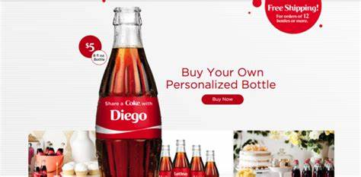
Example

Slide 27
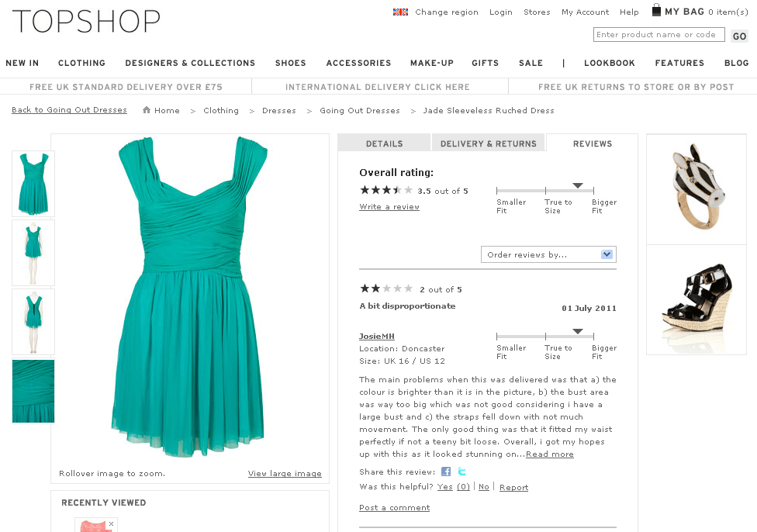
Example

