Slide 2
understand concept of profit loss.
understand cost price and selling price.
solve problems based on cost price and selling price

Slide 3
Introduction
Cost Price: The price, at which an article is purchased, is called its cost price, abbreviated as C.P.
Selling Price: The price, at which an article is sold, is called its selling price, abbreviated as S.P.
Profit or Gain: If S.P. is greater than C.P., the seller is said to have a profit or gain.
Loss: If S.P. is less than C.P., then the seller is said to have incurred a loss.

Slide 4
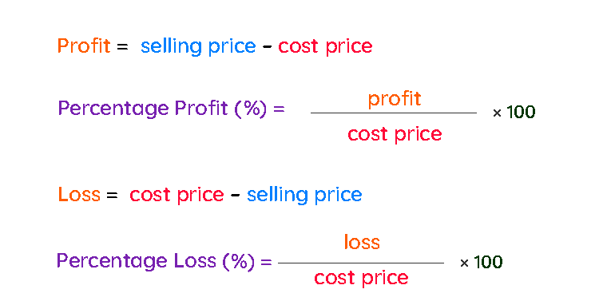

Slide 5
MP= Rs. 600
Discount =Rs.100
Mark up= Rs. 200
SP= Rs.500
Profit
= Rs.100
CP= Rs.400
A shopkeeper buys a T-shirt from whole sale market at Rs.400 and marked that article Rs.200 above the CP. After giving a discount of Rs.100 he sold it at Rs.500.

Slide 6
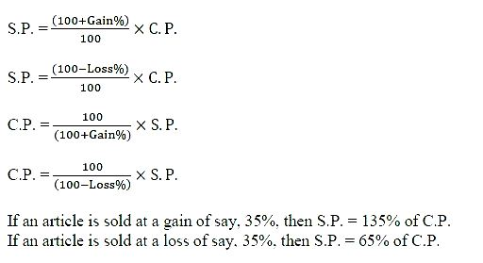

Slide 7
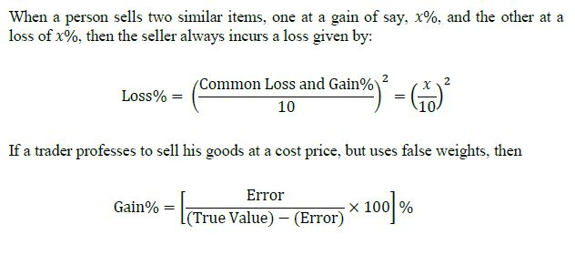

Slide 8
Problems without applying formula
SP IN TERMS OF CP
If the profit is 10%,
SP = CP + 10%CP
= 110% CP
∴ SP = 110% CP or SP = 1.10 CP
If the profit is 20%,
SP = 120% CP or SP = 1.20 CP
If the loss is 25%,
SP = 75% CP or SP = 0.75 CP

Slide 9
Example 1:
Q. A dealer loses 20% if an article is sold at the price of 16000. At what price he/she has to sell to gain 20%?
In the first case the loss is 20% ∴ SP = 80% CP
In the second case the gain has to be 20%
∴ SP = 120% CP
Substituting the given values
80% CP = 16000
120% CP = 80% + 40%= 16000 + 8000= 24000
∴ He/she has to sell the article at Rs 24000 to gain 20%.

Slide 10
Example 2. A dealer loses 40% if the plot is sold at the price of 32000. At what price he/she has to sell to gain 50%?
Ans. Rs. 80000

Slide 11
Difference in percentage
Example: 3 A man sold an article at 10% profit. Had it been sold for Rs. 50 more, he would have gained 15%. Find the cost price of the article.
Here the difference in percentage is 5%
The difference in price is Rs 50
5% CP= Rs 50 CP = Rs 1000

Slide 12
Example 4. A man sells a book at 7% loss. Had he sold it for Rs.72 more he could have gained 5%. What is the cost price of the article?
a) 500 b) 600 c) 622 d) 700
Ans. (b)

Slide 13
If the selling price is unknown
Example:5 A man buys an article for Rs. 1400 and sells it at a profit of 15%. What is the selling price of the article?
CP = 1400
Profit = 15%
15% +
CP
SP
10% = 140
5% = 70
15% = 210
15% +
1400
1610

Slide 14
Example 6. A man buys a cycle for Rs. 2400 and sells it at a loss of 20%. What is the selling price of the cycle?
Ans. Rs. 1920

Slide 15
If the cost price is unknown
Example: 7 By selling an article of Rs. 1200 a man makes profit of 25%. What is the C.P?
SP = 1200
Profit = 25%
25% +
25% + = 1/4 +
Increase = 1/4
Decrease = 1/5
= 20% -
CP
SP
20% -
960
1200
10% = 120
20% = 240
20% -

Slide 16
Example 8. By selling a shirt of Rs. 3300 a man makes loss of 25%. What is the C.P?
Ans. Rs. 4400

Slide 17
CP = Rs.500
P = 20 %
SP = ?
CP = Rs.800
L = 30 %
SP = ?
Ans. Rs. 600
Ans. Rs. 560

Slide 18
SP = Rs.720
P = 20 %
CP = ?
SP = Rs. 810
L = 10 %
CP = ?
Ans. Rs. 600
Ans. Rs. 900

Slide 19
Practice Questions
Q.1. When a plot is sold for Rs. 18,700, the owner loses 15%. At what price must that plot be sold in order to gain 15%?
[A] Rs.21000
[B] Rs.22500
[C] Rs.25300
[D] Rs.25800
Ans. (C)

Slide 20
Q.2. A bicycle is sold at 10% profit. Had it been sold for Rs. 10 less, the profit would have been 5% only. What is the cost price of the bicycle?
Rs 190
Rs 200
Rs 210
Rs 2000
Ans. (b)

Slide 21
Q.3. A shopkeeper selling his goods at 7% loss. Had he sold it for Rs.800 more then he would get 9% profit. Find the CP of that article.
[A] 500
[B] 6000
[C] 5000
[D] 4500
Ans. (C)

Slide 22
Q.4. A shopkeeper selling his goods at 20% profit. Had he purchase it 10% less and sold it for Rs.18 less then he would get 30% profit. Find the initial CP of that article.
[A] 540
[B] 600
[C] 1200
[D] 720
Ans. (B)

Slide 23
Q.5. A shopkeeper selling his goods at 10% profit. Had he purchase it 20% less and sold it for Rs.20 more then he would get 40% profit. Find the initial SP of that article.
[A] 1000
[B] 2000
[C] 1100
[D] 720
Ans. (C)

Slide 24
Q.6. A shopkeeper selling his goods at 30% profit. Had he purchase it for Rs.2700 less and sold it for Rs.2700 less then he would get 10% more profit. Find the initial CP of that article.
[A] 10000
[B] 10800
[C] 12500
[D] None
Ans. (B)

Slide 25
Q.7. A shopkeeper sold an article at 25% profit. If the CP and SP are decreased by Rs.20 and Rs.40 respectively then the profit percent would be decreased by 15 %. Find CP of the articles.
[A] 120
[B] 200
[C] 180
[D] 240
Ans. (A)

Slide 26
Q.8. A man purchase some number of articles at the rate of 11 articles for Rs.1. How many articles should he sell for Rs.1 to gain 10% profit.
[A] 11
[B] 10
[C] 12
[D] 14
Ans. (B)

Slide 27
Q.9. A man purchase 25 articles for Rs.1. How many articles should he sell for Rs.1 to gain 25% profit.
[A] 21
[B] 28
[C] 20
[D] None
Ans. (C)

Slide 28
Q.10. By selling 32 articles for Rs.1 a man earn loss of 40 %. How many articles should he sell for Rs.1 to gain 20% profit.
[A] 16
[B] 17
[C] 18
[D] 19
Ans. (A)

Slide 29
Q.11. By selling 45 articles for Rs.40 a man earn loss of 20 %. How many articles should he sell for Rs.24 to gain 20% profit.
[A] 20
[B] 27
[C] 18
[D] None
Ans. (C)

Slide 30
Q.12. A shopkeeper purchase 2 articles for Rs.9600. He sold the first article at 20% loss and second article at 60% profit then he find that both the articles being sold on the same price. Find the CP of first article.
[A] 6400
[B] 3200
[C] 6000
[D] 5400
Ans. (A)

Slide 31
Q.13. A shopkeeper sells 2 articles. He sold the first article at 15% loss and second article at 19% profit. During the whole transaction he earn a loss of Rs90. Find the CP of second article if the SP of both articles are same.
[A] 5000
[B] 4500
[C] 2000
[D] None
Ans. (B)

Slide 32
Q.14. A shopkeeper sells 3 articles. He sold the first article at 20% profit, second article at 10% loss and third at 25% loss. During the whole transaction he earn a loss of Rs60. Find the SP of first article if the SP of all the articles are same.
[A] 216
[B] 180
[C] 240
[D] None
Ans. (A)

