Slide 2
Find average of numbers and arithmetic mean
Understand concept behind weighted average
Solve real life and application based questions of average

Slide 3
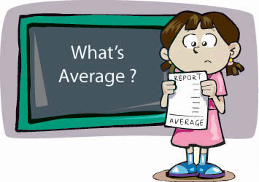
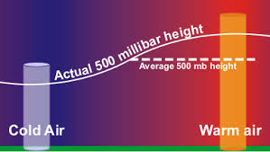
INTRODUCTION
What is an average ??
Average of n values is equal to the sum of n values divided by the total divide by number of values (n)
Averages = Sum of Observations /Number of Observation
Avg = Sum/n

Slide 4
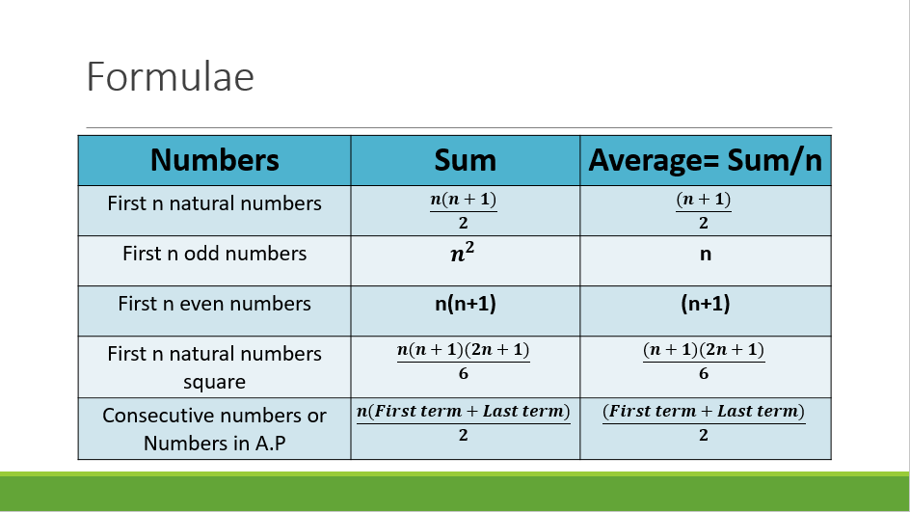
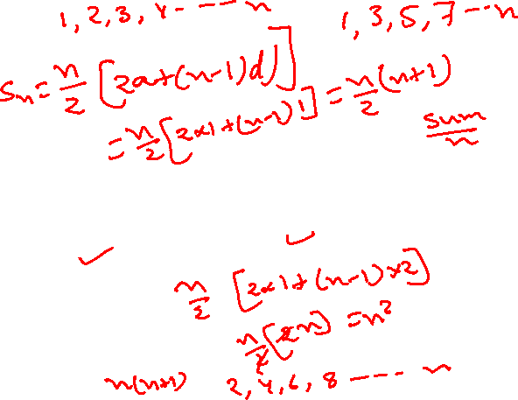
If the terms are consecutives or are in A.P then average is always the middle term of the sequence if the number of observations are odd.
If number of observations are even then average is the average of two middle numbers.

Slide 5

Some properties of Average:
If we have N number of observation as a1, a2, a3, a4 …………aN and their average is A, then
If we add or subtract the same value (suppose x) from all the observations then average will be directly added or subtracted by x.
If we multiply or divide each observation by a same value (Suppose x), then average also multiplied or divided by the same value x.

Slide 6
If terms are in A.P or consecutives
An arithmetic progression (AP) is a sequence where the differences between every two consecutive terms are the same. For example, the sequence 2, 6, 10, 14, … is an arithmetic progression (AP) because it follows a pattern where each number is obtained by adding 4 to the previous term. A real-life example of an AP is the sequence formed by the annual income of an employee whose income increases by a fixed amount of $5000 every year.
If the terms are consecutives or are in A.P then average is always the middle term of the sequence if the number of observations are odd.
If number of observations are even then average is the average of two middle numbers.
Note: Average of consecutive numbers can also be written as
(2nd term + 2nd last term)/2 or (3rd term + 3rd last term)/2 and so on.

Slide 7


Q. 1.Find the average of following number
1, 3, 5, 7, 9, 11, 13, 15, 17, 19, 21
A) 9
B) 11
C) 12
D) 13
Ans. B

Slide 8

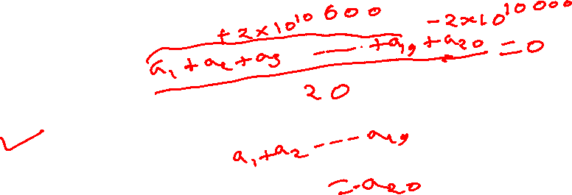
Q. 2. The average of 20 numbers is zero. Then, at the most, how many may be greater than zero?
A) 0
B) 1
C) 10
D) 19
Ans. D

Slide 9
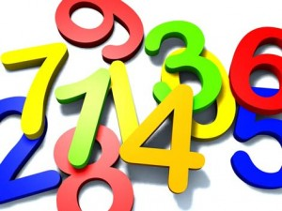
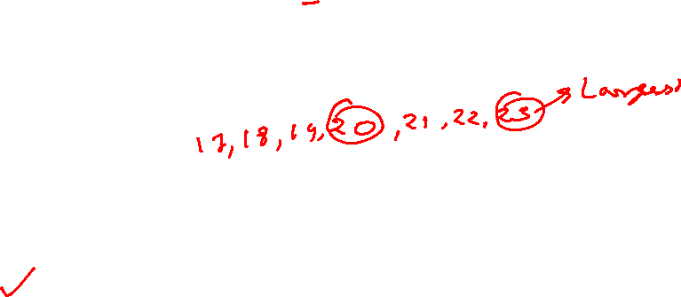
Q. 3. The average of 7 consecutive numbers is 20. The largest of these numbers is :
A)27
B)26
C)24
D)23
Ans. D

Slide 10

Q. 4. Find the average weight of 5 boys having weights 30kg, 40kg, 50kg, 60kg, 70kg?
50 kg
40 kg
45 kg
55 kg
Ans. A

Slide 11
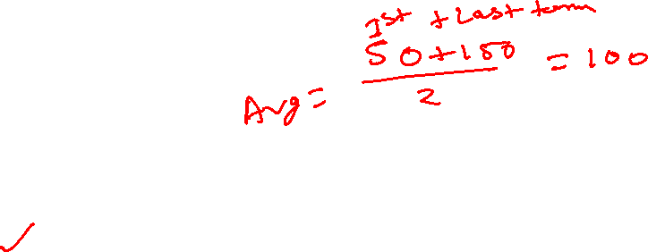
Q. 5. Find the average of 50, 52, 54, 56, …………150
80
90
100
110
Ans. C

Slide 12
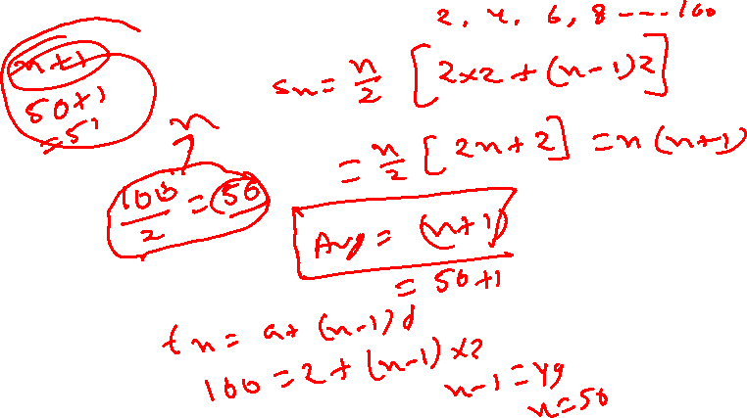
Q. 6. Find the average of all even numbers up to 100.
50
51
52
55
Ans. B

Slide 13
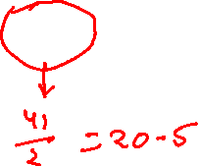
Q. 7. Find the average of 13, 16, 19, 22, 25, 28
22
19
19.5
20.5
Ans. D

Slide 14
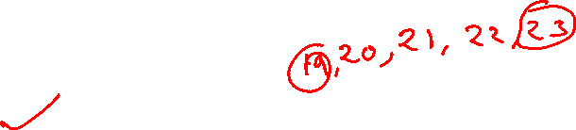
Q. 8. If the average of 5 consecutive number is 21. Find the largest number.
22
23
24
25
Ans. B

Slide 15
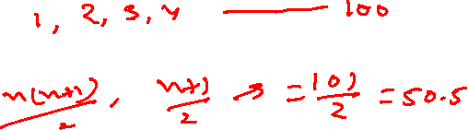
Q. 9. Find the average of first 100 natural numbers.
50
50.5
51
49
Ans. B

Slide 16
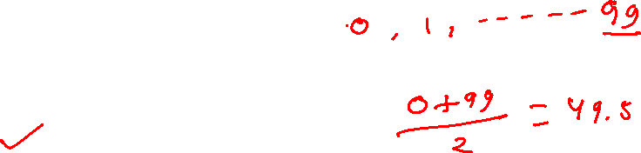
Q. 10. Find the average of first 100 whole numbers.
50
50.5
49.5
49
Ans. C

Slide 17
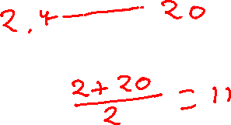
Q. 11. The average of first 10 even numbers is?
18
22
9
11
Ans. D

Slide 18
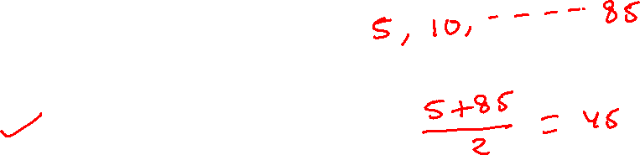
Q. 12. Find the average of first 17 multiples of 5?
50
85
45
60
Ans. C

Slide 19
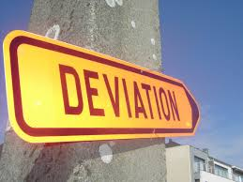
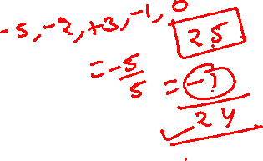
DEVIATION METHOD
Example: Find the average of 20,23,28,24,25
Assume any number as the average, say 25.
Find the deviation for all the given values
Numbers - 20 23 28 24 25
Deviation - -5 -2 +3 -1 0
Total deviation - -5
Average deviation - -5/5
(total/n) = -1
Final average = assumed average + average deviation
= 25 + (-1) = 24
Note: It is better to assume the average between the highest value and the lowest value because it will always be between them.

Slide 20

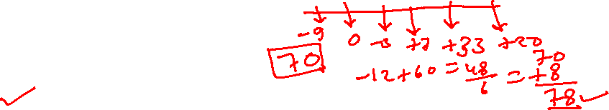
Q. 13. Find the Averages of 61,70,67,77,103,90
A)78
B)88
C)98
D)None
Ans. A

Slide 21
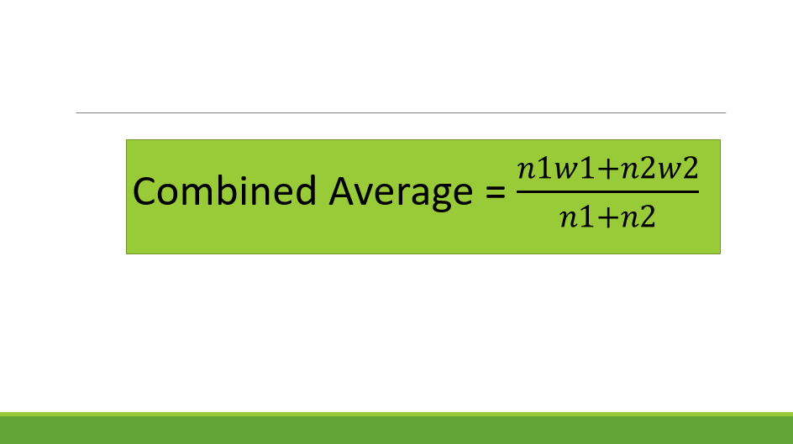
COMBINED AVERAGE
Class A
0
Class B
100
What is the combined average?
50 marks??
NO
We cannot determine the average without knowing the number of students in each class
The combined average depends on the number of students and the average in each class

Slide 22


Q. 14. There are 36 students in a class A whose average weight is 30kg and 24 students in class B whose average is 40kg. What will be the average if the classes are combined?
35
34
36
32
Ans. B

Slide 23

Q. 15. In a class there are 20 boys and 40 girls. The average age of boys is 18 years and that of girls is 15 years. What will be the average age of the whole class?
16.5 Years
17 years
16 years
14.2 Years
Ans. C

Slide 24


Q. 16. There are 63 students in a class A whose average weight is 32kg and 21 students in class B whose average is 44kg. What will be the average if the classes are combined??
33
35
36
38
Ans. B

Slide 25
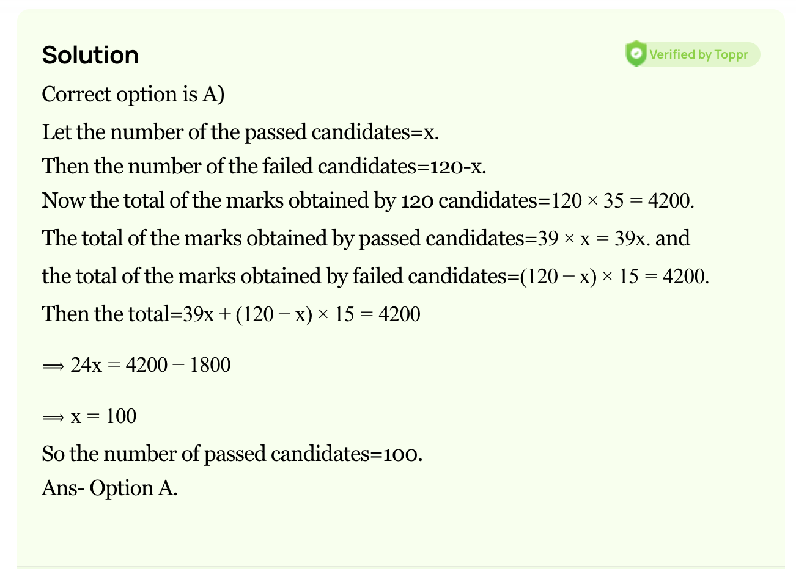
Q. 17. The average of marks obtained by 120 candidates was 35. If the average of passed candidate was 39 and that of failed candidate was 15, the number of candidates who passed the examination is?
100
110
120
150
Ans. A

Slide 26
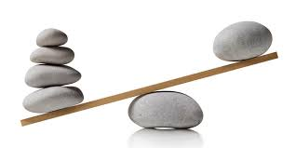
BALANCE METHOD:
The principle of this concept is that the weight in the balance is inversely proportional to the distance of the pivot.
Where,
W_{a} – Class A weight W_{b} – Class B weight
Avg_{a} – Class A average Avg_{b} – Class B average
Avg_{c} – combined average
W_{a}
W_{b}
Avg_{a}
Avg_{c}
Avg_{b}

Slide 27
Q. There are 36 students in class A whose average is 30kg and 24 students in class B whose average is 40kg. What will be the average if the classes are combined?
Step 1: Find the ratio of the weights of A and B
= 36:24 = 3:2
Step 2: Inverse the weights to get the distance ratio
= 2:3
36
3:2
24
30
40
36
3:2
24
30
2:3
40

Slide 28
Step 3: Split the distance between the averages in the ratio 2:3
Here the distance from 30 to 40 is 10. So 10 should be split in the ratio 2:3 as 4 and 6.
The combined average is (30+4) or (40-6) = 34
36
3:2
24
30
34
40
4
6
2:3

Slide 29
Q. 18. In a first 10 overs cricket game run rate was 3.2. what should be run rate in the remaining 40 overs to reach the target 282 runs?
A)6.25
B)6.5
C)6.75
D)7
Ans. A

Slide 30

Problems on Change in average
Example: Average of 5 students marks is 30. If one student having 90 mark is added to the team then what will be the new average ?
Avg₅ = 30
No of students = 5
Sum₅ = 30x5 = 150
Sum₆ = 150+90 = 240
Avg₆ = 240/6 = 40

Slide 31
EQUAL DISTRIBUTION method:
All the problems in this concept are solved by assuming all the values as average itself.
Step1: Assume all the values to be 30.
30 30 30 30 30
If the new mark is also 30 then the average will remain the same.
30 30 30 30 30
Step2: Finding the extra values-
But the actual new mark is 90, which means extra 60 is added to the values.
30 30 30 30 30
90
30
30
+60

Slide 32
Step3: Distributing the extra values equally-
The extra 60 should be divided equally among 6 values as 10 each.
30 30 30 30 30 30
+10 +10 +10 +10 +10 +10
40 40 40 40 40 40
∴ the new average is 40

Slide 33






Q. 19. Average of 4 students marks is 50 and one student having marks has 200, is added to the team , what is new average ?
A)70
B)80
C)90
D)None
Ans. B

Slide 34
Q. 20. Average of 6 students marks is 60 , what is the new average if a student of marks 110 is taken out ?
A50
B)55
C)60
D)None
Ans. A

Slide 35



Q. 21. If the average weight of 10 students in a class is 30Kg, when weight of teacher is also included new average becomes 33. Find weight of teacher.
63Kg
54Kg
66Kg
70Kg
Ans. A

Slide 36
Q. 22. The average weight of a class of 24 students is 30Kg when weight of the teacher is also included the average weight is increased by 1Kg.What is the weight of teacher in kg?
60Kg
61Kg
37Kg
55Kg
Ans. D

Slide 37
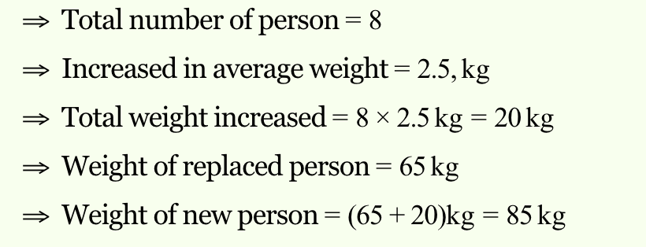
Q. 23. The average weight of 8 person increases by 2.5 kg when a new person comes in place of one of them weighing 65 kg. What might be the weight of the new person?
70Kg
80Kg
75Kg
85Kg
Ans. D

Slide 38
Q. 24. A teacher while calculating the average marks of 30 students of an examination, by mistake enter a student’s marks as 68, instead of 86 and obtained the average as 58. Find the actual average.
59
(b) 60
(c) 58.6
(d) 60.5
Ans. C

Slide 39
Q. 25. A Student’s marks were wrongly entered as 83 instead of 63. Due to that the average marks of the class got increased by 2. The number of students in class is?
10
12
15
18
Ans. A

Slide 40
Q. 26. The average age of a committee of 12 members is 48 Years. A member of age 62 retired and in place a new person aged 26 joined the committee. Find the new average of the committee.
44
45
46
47
Ans. B

Slide 41
Q. 27. Average of 5 numbers is 27, if one number is excluded the new average becomes 25. Find the excluded number.
35
30
38
25
Ans. A

Slide 42
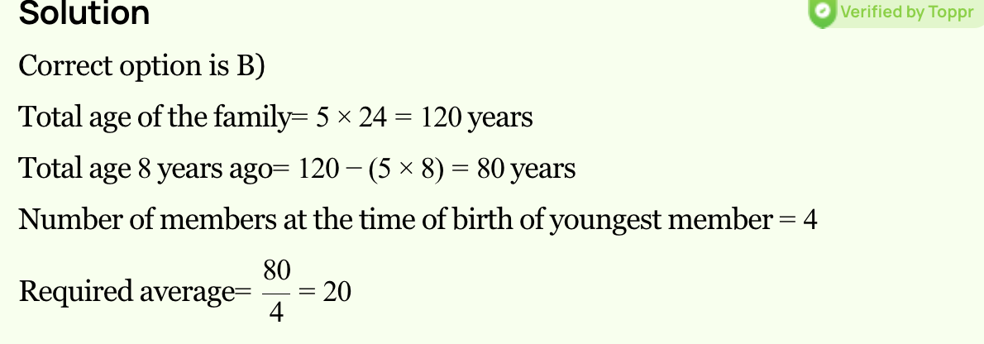
Q. 28. The average of a family is 24 years which is consisting of 5 members, out of which the youngest being 6 years old. What would be the average age of family just before his birth?
20
22
22.5
23.5
Ans. C

Slide 43
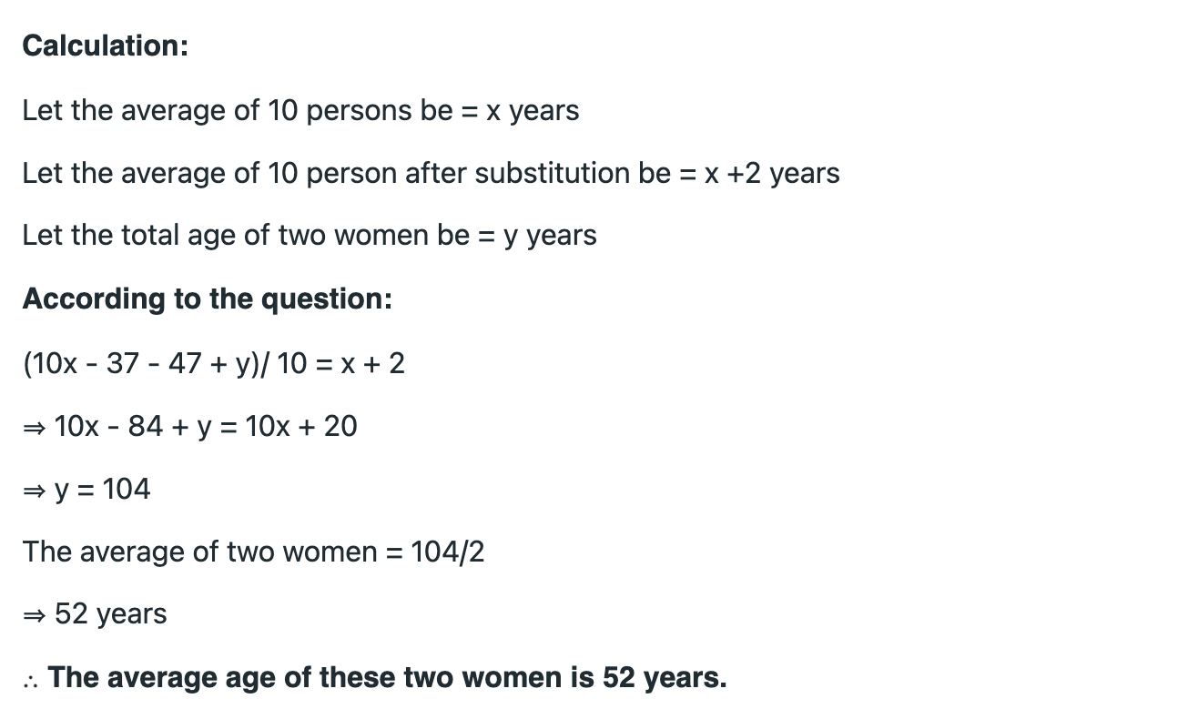
Q. 29. The average age of 10 members in a committee is increased by 3 years when two men whose ages are 25 years and 35 years are replaced by two new men. Find the average age of two new men.
40
45
48
52
Ans. B

Slide 44
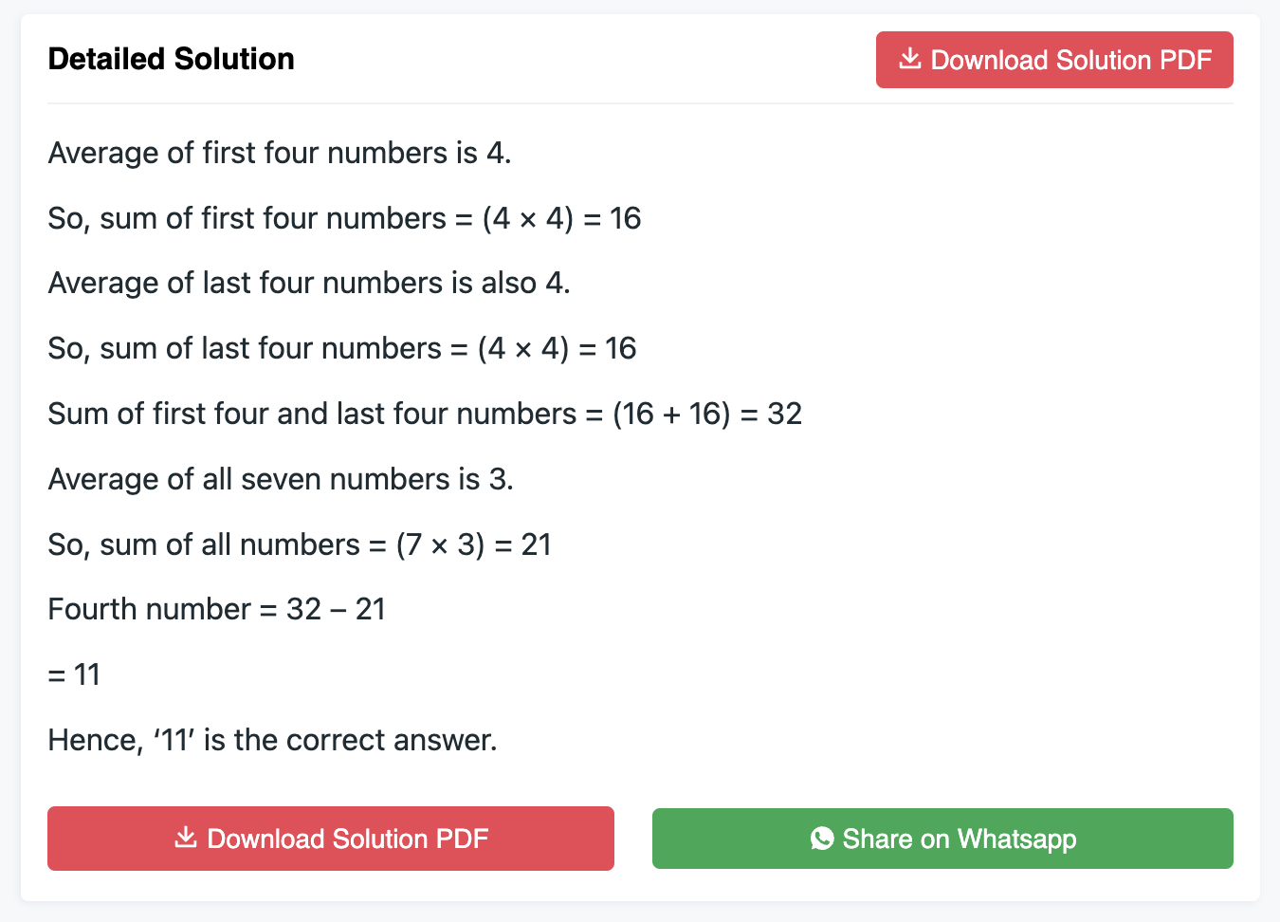
Q. 30. Average of 7 values is 20. If average of first 4 is 15 and that of last 4 is 25. Find the 4th number.
20
25
30
40
Ans. A

Slide 45
Q. 31. The average marks of some students is 40 and 10 of them get 60 marks instead of 90 marks by mistake. After correction, the new average becomes 50. Find the number of students.
20
30
25
35
Ans. B
Let's solve this problem step by step.
Let's assume the total number of students is "x".
Given that the average marks of the students is 40, we can calculate the total marks obtained by all the students:
Total marks = Average marks * Number of students Total marks = 40 * x
We are also given that 10 students received 60 marks instead of 90 marks by mistake. This means their total marks were lower by 30 marks each. So, we need to adjust the total marks by adding the missing 30 marks for each of these 10 students:
Adjusted total marks = Total marks + (30 * 10) Adjusted total marks = 40x + 300
We are given that after correcting the marks, the new average is 50. We can use this information to set up another equation:
New total marks = New average marks * Number of students New total marks = 50 * x
Now we can set up an equation by equating the adjusted total marks with the new total marks:
40x + 300 = 50x
Simplifying the equation:
300 = 10x
Dividing both sides by 10:
x = 30
Therefore, the total number of students is 30.

Slide 46
Q. 32. In a hostel there are 30 students and if the number of students increased by 5 then the expense is increased by 40 per day. But the average expenditure diminishes by 3. Find the original expenditure.
810
870
910
950
Ans. B

Slide 47
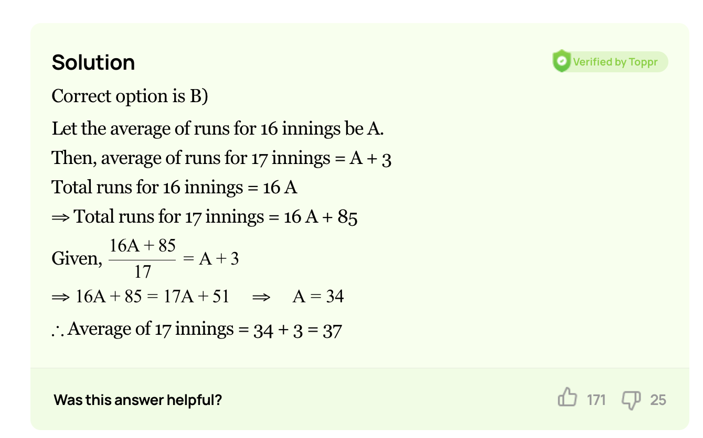
Q. 33. A batsman has a certain average of runs for 16 innings, In the 17th inning, he makes a score of 85 runs there by increasing the average by 3 What is the average of 17 innings?
38
37
36
34
Ans. B

Slide 48
Q. 34. If A batsman score 36 runs in his 18th innings so that his average is reduced by 3 run. Find the average of batsman in 18th inning.
(a) 90
(b) 85
(c) 87
(d) None
Ans. C

Slide 49
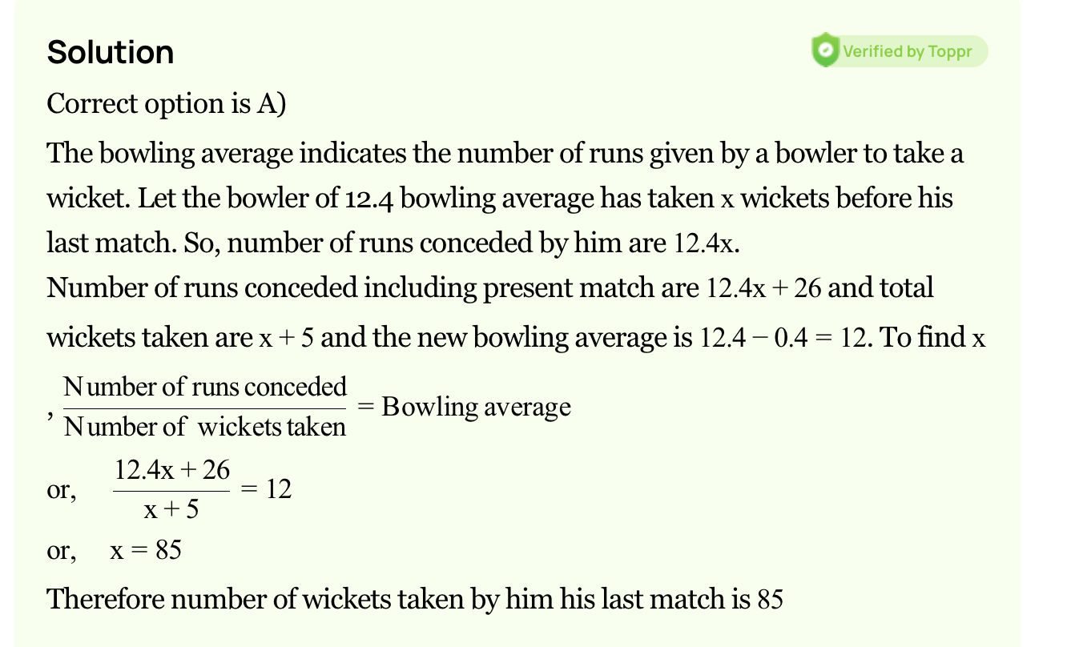
Q. 35. A baller whose balling average is 12.4 runs/wicket. He played his next match and takes 5 wickets for 26 runs; therefore, his average is reduced by 0.4. Find the total number of wickets taken by the baller.
(a) 80
(b) 85
(c) 90
(d) 75
Ans. B

Slide 50
Q. 36. The average temperature in Delhi for the first four days of the month was reported as 58°C. The average temperature reported as 60°C for 2nd, 3rd, 4th and 5th days. The ratio of the temperatures of 1st and 5th day was 7 : 8. Find the temperature on the first day.
(a) 42
(b) 46
(c) 63
(d) 56
Ans. D

Slide 51
Q. 37. The average temperature of Monday, Tuesday and Wednesday is 34°C. The average temperature of Tuesday, Wednesday and Thursday is 32°C. If the temperature of Thursday is 28°C, then find the temperature of Monday.
(a) 34
(b) 36
(c) 40
(d) 42
Ans. A
Let's solve this problem step by step.
Let's assume the temperature of Monday is "x"°C.
We are given that the average temperature of Monday, Tuesday, and Wednesday is 34°C. This means that the total temperature of these three days is 34 * 3 = 102°C.
Therefore, the sum of the temperatures of Tuesday and Wednesday is 102 - x.
We are also given that the average temperature of Tuesday, Wednesday, and Thursday is 32°C. This means that the total temperature of these three days is 32 * 3 = 96°C.
Therefore, the sum of the temperatures of Tuesday and Wednesday is 96 - 28 = 68°C.
Now we can set up an equation by equating the two sums of the temperatures:
102 - x = 68
Simplifying the equation:
x = 102 - 68
x = 34
Therefore, the temperature of Monday is 34°C.

Slide 52
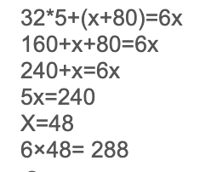
Q. 38. friends went to a hotel for taking their lunch. 5 of them spent Rs.32 each while the 6th person spent 80 more than the average expenditure of all the 6 person. Find the total money spend on lunch.
(a) 280
(b) 178
(c) 285
(d) 288
Ans. D

Slide 53
Q. 39. friends went to a hotel for taking their lunch. 6 of them spent Rs.60 each while the 7th person spent 240 more than the average expenditure of all the 7 person. Find the total money spend on lunch.
(a) 280
(b) 700
(c) 750
(d) 650
Ans. B

Slide 54
*If the number of values is unknown:
Avg_{n} = 30
Avg_{n+1} = 40
New number= 90
Old values 30 30 30…….
+10 +10 +10……
New values 40 40 40…….
Total extra value added is 60 (30 90)
This 60 is divided as 10 each which means there should be 60/10 = 6 values
∴ New values, n+1 = 6
Old values, n = 5

Slide 55
Q. 40. A batsman having average 40 makes 90 runs in his last inning thereby his average increases by 2. Find the number of matches he has played.
A)10
B)50
C)25
D)24
Ans. C

Slide 56
Q. 41. The average marks of 12 students increases by 3 if a new student having mark 79 is included. The average mark of the students is?
A) 37
B) 40
C) 43
D) 82
Ans. C

Slide 57
Q. 42. The average weight of 8 men having average weight 40 kg is increased by 2 kg when a new man is included. The weight of the new man is
A) 56
B) 58
C) 96
D) 98
Ans. B

