Slide 2
Understand different concept of direction test.
Solve problems based on direction test.
Solve problems based on shadow.

Slide 3
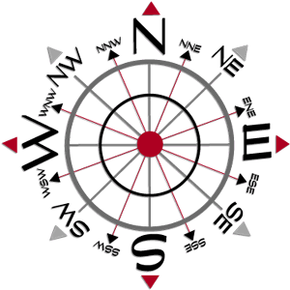
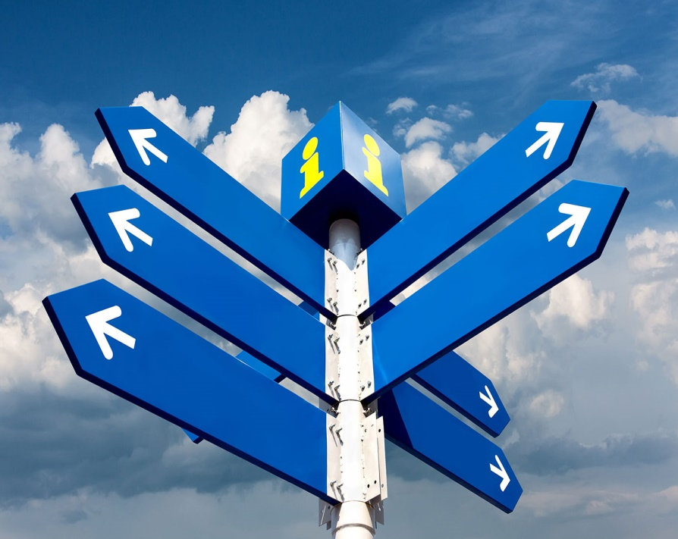
Direction Sense
Direction sense is one of the prime topics in logical reasoning.
Questions from this topic generally involve an individual travelling certain distances in certain directions.
The best way to solve these problems is to represent the traces of the path traversed by the person, as found in the information provided by the question.

Slide 4
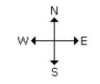

There are four main directions –
North, South, East and West.
There are four cardinal directions – North-East(N-E), North-West(N-W), South-East(S-E), South-West(S-W).

Slide 5
Things to be noted:
At the time of sunrise if a man stands facing the east, his shadow will be towards west.
At the time of sunset the shadow of an object is always in the east.
If a man stands facing the North, at the time of sunrise his shadow will be towards his left and at the time of sunset it will be towards his right.
At 12.00 noon, the rays of the sun are vertically downward hence there will be no shadow.
Always rainbow will occur opposite to the sun.
Always shortest distance should be calculated.

Slide 6

Practice Questions
Q.1. Ashiq walks southwards, then takes a half right turn and then a left turn. In which direction is he walking now?
South-East
South-West
South
North
Ans: A

Slide 7
Q.2. A man walks northwards. After a while he turns to his right and a little further to his left. Finally, after walking a distance of 1km, he turns towards his left again. In which direction is he moving now?
South
North
West
East
Ans: C

Slide 8
Q.3. A man started walking positioning his back towards the sun. After sometime, he turned left, then turned right and then towards the left again. In which direction is he going now?
North or South
East or west
North or West
South or West
Ans: A
If sun is in East If sun is in West

Slide 9
Q.4. A man went 10 kms towards south. Then turned East and covered 10 kms and turned to the right. Again after 10 kms he turned to the left and covered 10kms to reach the destination. How far and in which direction is he to his starting point?
20√2 km, South- East
20√2 km, North- East
20√2 m, South- East
20 km, South East
Ans: A

Slide 10
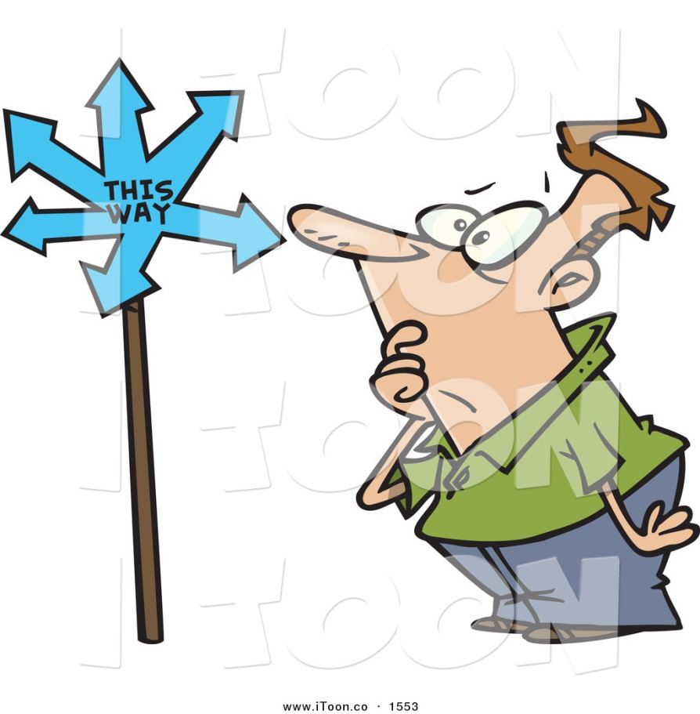
Q.5. A man went 15 kms to the North. Then he turned West and covered 10 kms. Then he turned south and covered 5 kms. Finally, turned to East, he covered 10 kms. In which direction is he from his house?
West
East
North
South
Ans: C

Slide 11
Q.6. Roshan walks 10 metres westwards, then turns left and walks 10 metres. He then again turns left and walks 10 metres. He takes a 45 degree turn to his right and walks straight. In which direction is he walking now?
South-East
South
South-West
East
Ans: A

Slide 12

Q.7. After his office hours in the evening, Gowtham starts walking facing the sun. First he turns to his right, then he turns to his left and after walking for some metres to his left, he turns to his right. In what direction is he moving now?
South
North
East
West
Ans: B

Slide 13
Q.8. Amit’s office is situated 5 kilometres North of Ben’s office. Ben starts from his office and walks 2 kilometres towards Amit’s office. He then turns right and walks 3 kilometres and then turns left and walks 3 kilometres. To which direction will he turn to reach Amit’s office?
West
North
South
East
Ans: A

Slide 14
Q.9. Santosh goes first 7 Km north then turns left and move 10 Km, again he turns left and moves 7 Km, how far is he from the starting point?
[A] 7 Km
[B] 10 Km
[C] 17 Km
[D] 24 Km
Ans. B

Slide 15
Q.10. Mohan travels 7 Km to north direction from where he is standing and turns to his right. He then walks straight for another 3 Km. Turning to his right he moves 7 Km. How many Km away from starting point is he?
[A] 1
[B] 2
[C] 3
[D] 5
Ans. C

Slide 16
Q.11. A man walks 5 Km towards south and then turns to the right. After walking 3 Km he turns to the left and walks 5 Km. Now in which direction is he from the starting place?
[A] West
[B] South
[C] North east
[D] South west
Ans. D

Slide 17
Q.12. Ranuka started walking from her house, she first walked for 3 Km towards west, then she turned towards north and moved 4 Km in that direction. How far is Ranuka from her house?
[A] 3 Km South
[B] 3 Km South-East
[C] 5 Km West
[D] 5 Km North-West
Ans. D

Slide 18
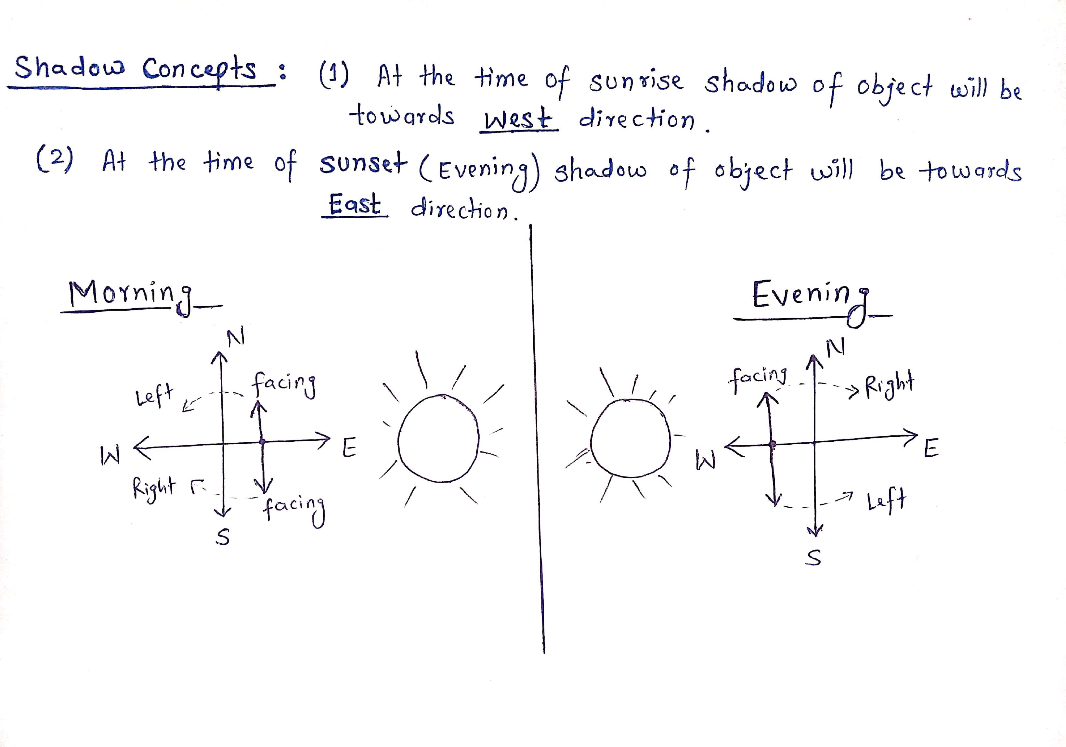
Shadow Type Questions:
Shadow of any object is always opposite of SUN, if it is the case of Morning then Shadow will fall in the WEST and if it is the case of Evening then shadow will fall in the EAST.

Slide 19
If a man stands facing North in the Morning his shadow will be towards his left and if he is facing North in Evening his shadow will be towards his Right.
If a man stands facing South in the Morning his shadow will be towards his Right and if he is facing South in Evening his Shadow will be towards his Left.

Slide 20
Q.13. One evening before sunset Rekha and Hema were talking to each other face to face. If Hema’s shadow was exactly to the right of Hema, which direction was Rekha facing?
[A] North
[B] South
[C] East
[D] West
Ans. B

Slide 21
Q.14. One morning Udai and Vishal were talking to each other face to face at a crossing. If Vishal’s shadow was exactly to the left of Udai, which direction was Udai facing?
[A] East
[B] West
[C] North
[D] South
Ans. C

Slide 22
Q.15. One evening before sunset, two friends Jane and Jackie were talking facing each other. If Jackie's shadow was exactly to his right side, which direction was Jane facing?
North
South
East
West
Ans: B

Slide 23
Q.16. One Morning after sunrise, Sumesh and Ratheesh were standing on a lawn with their back towards each other. Sumesh’s shadow fell exactly towards his left hand side. Which direction was Ratheesh facing?
East
West
South
North
Ans: C

