Slide 1
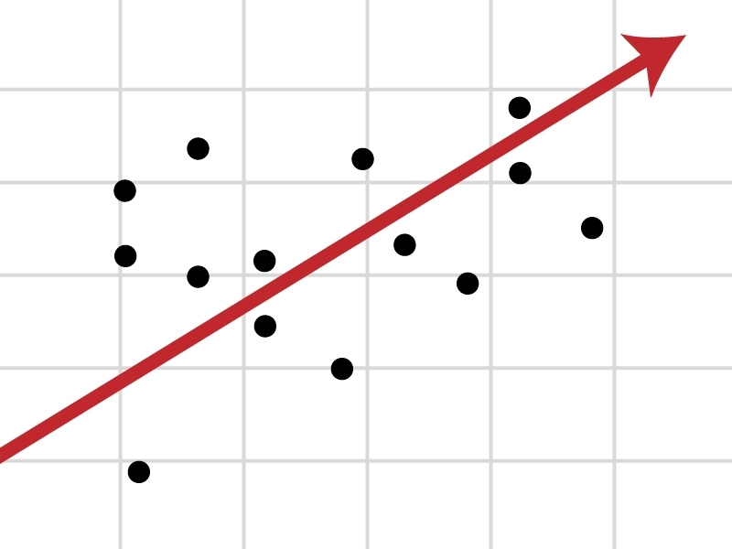
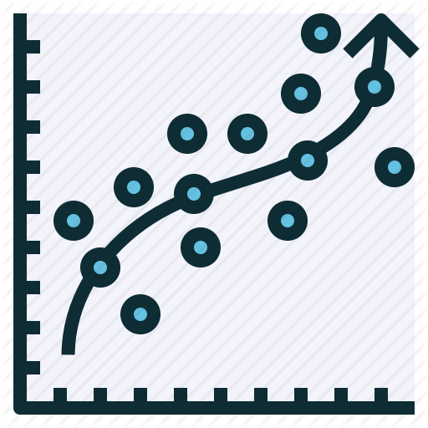
What is Regression
Regression models are used to predict a continuous value.

Slide 2
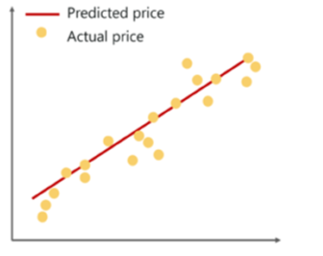
Line Regression
The goal is to predict the value of a dependent variable based on an independent variable.
Forecasting the values based on the present data.

Slide 3
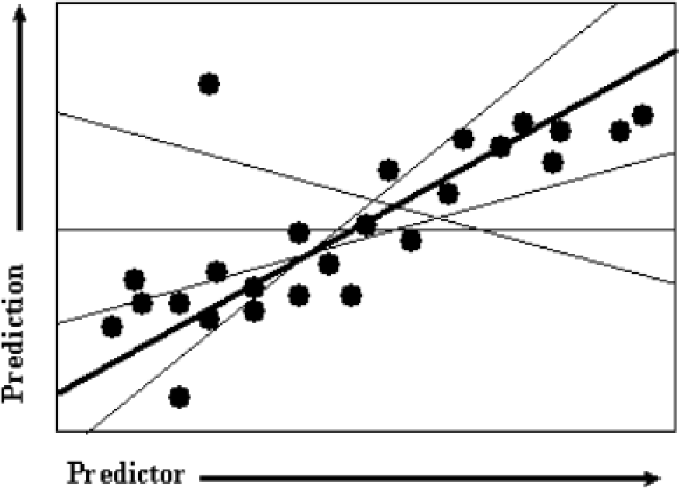
Regression Line
Least Squares Method is used as Metric to select the good regression line for the given data.

Slide 4
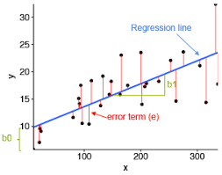
Method of Least Squares

Slide 5
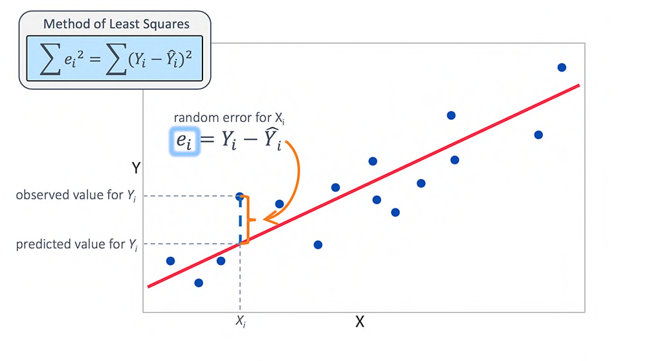
Method of Least Squares

Slide 6
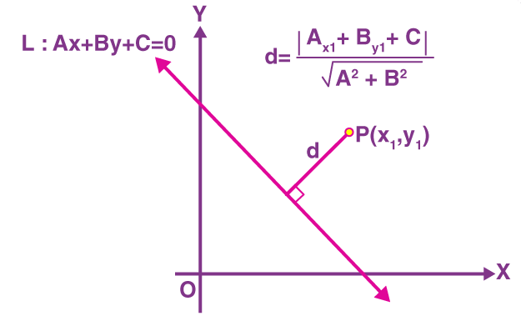
Distance between a point and a line

