Slide 2
understand concept of simple interest and formulae of S.I.,
solve questions based on S.I.

Slide 3
Simple Interest
If a person X borrows some money from another person Y for a certain period, then after that specified period, X (borrower) has to return the borrowed money with some additional money.
This additional money that X (borrower) has to pay is called Interest.
The actual borrowed money is called Principal or Sum.

Slide 4
Simple Interest
The Principle and interest together is called amount, and the time for which X the borrower has been used the borrowed money is called the time.
The interest that X has to pay for every 100 rupees each year is called rate percent per annum.
If the interest on a sum borrowed for a certain period is reckoned uniformly, then it is called Simple Interest and it is denoted by S.I.

Slide 5
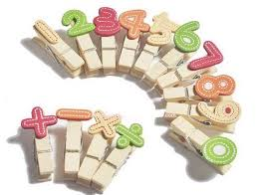
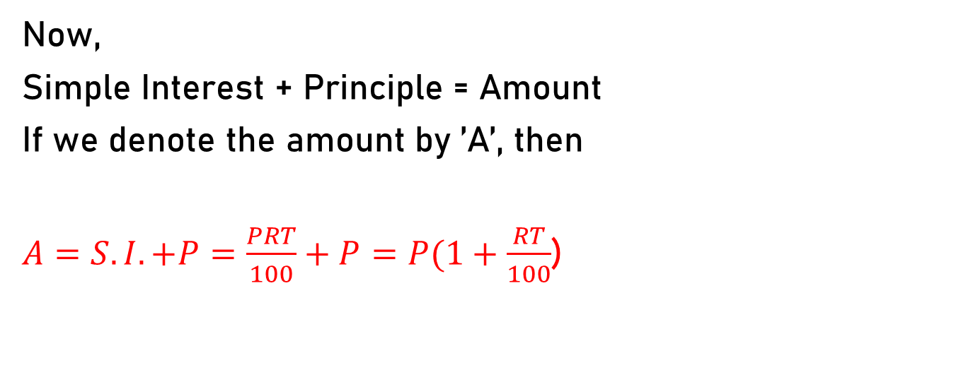
Let Principal = P, Rate = R% per annum (p.a.)
and Time = T years. Then
Simple Interest =(P x R x T)/100
Now,
Simple Interest + Principle = Amount
If we denote the amount by ’A’, then
$A=S.I.+P=\frac{PRT}{100}+P=P(1+\frac{RT}{100}$)

Slide 6
Example :1 If P= Rs.1000, R=10% p.a. T=3 years. Find Simple Interest for 3 years.

Slide 7
Practice Questions:
The Simple Interest on a certain sum of money at 4% p.a. for 3 1/2 years is Rs.2800.The sum is
a)Rs.24000
b) Rs.20000
c) Rs.18000
d) Rs.16000

Slide 8
The Simple interest on a sum of money at 4% p.a. for 2 years is Rs.3750. The sum is
a) Rs. 64875
b) Rs.46875
c) Rs.84675
d) Rs.48675

Slide 9
How much time will it take for an amount of Rs. 450 to yield Rs. 81 as interest at 4.5% per annum of simple interest?
a) 3.5 yrs
b) 4 yrs
c) 4.5 yrs
d) 5 yrs

Slide 10
A sum of money invested for a certain number of years at 8% p.a. Amount grows to Rs.180. The same sum of money invested for the same number of years at 4% p.a. Amount grows to Rs.120 only. For how many years was the sum invested?
a) 25
b) 15
c) 20
d) 22

Slide 11
A man invested 1/5 th of his capital at 5% p.a , 3/4 th of his capital at 12 % p.a. and the remaining at 20% p.a., all at SI. If his annual income from interest is Rs.660, then the amount invested by the man is ?
a)Rs.7500
b) Rs.10000
c) Rs.6000
d) Rs.9000

Slide 12
Anurag borrowed a total sum of Rs. 8000 from two banks A and B. Bank A lends at 12 % p.a and bank B at 10% p.a., both at simple interest. After two years he paid a total interest of Rs.1816. What sum did anurag borrow from bank A?
a) Rs. 4400
b) Rs. 2600
c) Rs. 3600
d) Rs. 5400

Slide 13
A sum of Rs. 800 amounts to Rs. 1040 in four years at simple interest. By how many percentage points should the rate of interest p.a be increased so that Rs.1200 would amount to Rs. 2400 in 8 years?
a) 4
b) 8
c) 5
d) None

Slide 14
A certain sum 3 times itself in ten years under S.I. How many years it will take to become 9 times the principal?
a) 40
b) 50
c) 60
d) 70

Slide 15
A sum of Rs.1200 amounts to Rs. 1800 in 10 years under S.I. What should be the rate of interest so that the same sum amounts to Rs.1800 in eight years under S.I?
a) 12.5 %
b)25%
c) 6.25%
d) 18 %

