Slide 2
understand basic concept of C.I.
understand difference between C.I. and S.I.
solve problems based on C.I. and S.I.

Slide 3
COMPOUND INTEREST:
When the borrower X and the lender Y agrees to fix up a certain time for example yearly, half yearly or quarterly to settle the previous money, then the difference between the amount and the money borrowed is said to be the Compound Interest and it denoted by C.I.
In these calculations, principal for the second unit of time is the amount of first unit of time and so on.

Slide 4
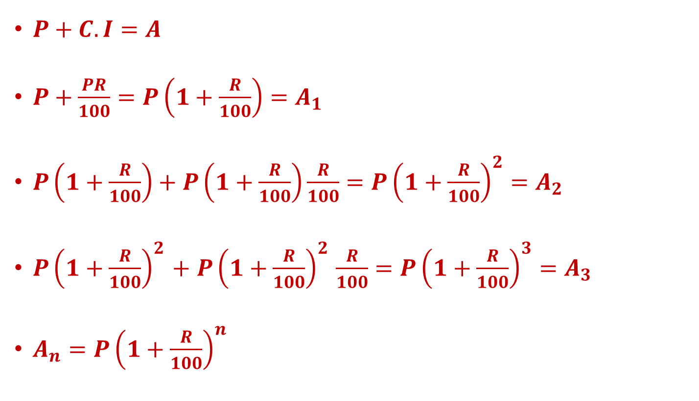
Amount in CI
$P+C.I=A$
$P+\frac{PR}{100}=P\left(1+\frac{R}{100}\right)=A_{1}$
$P\left(1+\frac{R}{100}\right)+P\left(1+\frac{R}{100}\right)\frac{R}{100}={P\left(1+\frac{R}{100}\right)}^{2}=A_{2}$
${P\left(1+\frac{R}{100}\right)}^{2}$ $+$ ${P\left(1+\frac{R}{100}\right)}^{2}$ $\frac{R}{100}={P\left(1+\frac{R}{100}\right)}^{3}=A_{3}$
$A_{n}$ $={P\left(1+\frac{R}{100}\right)}^{n}$

Slide 5
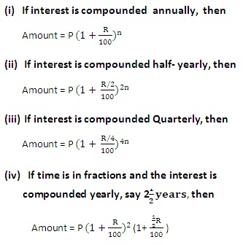
FORMULAE:
Let Principal = P, Time = n years

Slide 6
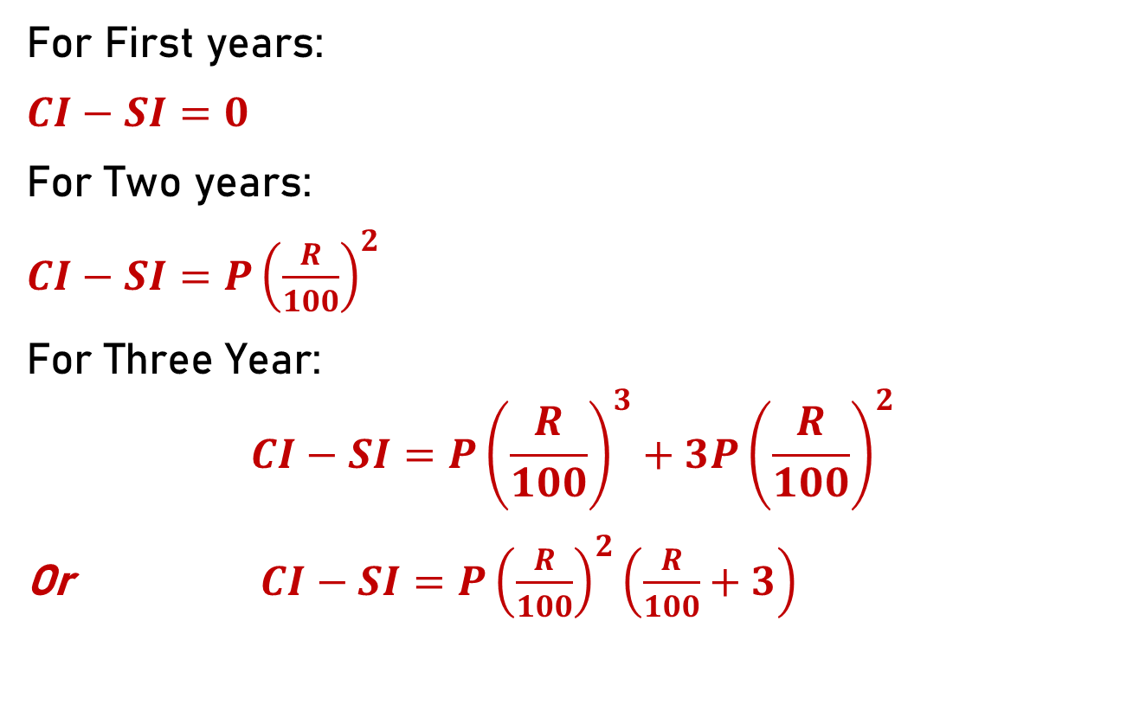
Difference between CI & SI Concept :
For First years:
$CI−SI=0$
For Two years:
$CI−SI=P{\left(\frac{R}{100}\right)}^{2}$
For Three Year:
$$CI−SI=P{\left(\frac{R}{100}\right)}^{3}+3P{\left(\frac{R}{100}\right)}^{2}$$
Or $CI−SI=P{\left(\frac{R}{100}\right)}^{2}\left(\frac{R}{100}+3\right)$

Slide 7

CALCULATION OF COMPOUND INTEREST USING PASCAL’S TRIANGLE
Concept of Pascal’s triangle
The Pascal’s triangle is a representation of numbers in the form of a triangle as follows

Slide 8
Each number in this triangle is obtained by adding the two numbers immediately above it.
For eg) Number 2 in the second line is obtained by adding the two 1s above it. Similarly the “6” in the fourth line is obtained by adding the two 3’s above it
This pattern of numbers has a unique application in the calculation of Compound Interest, and it simplifies the calculation tremendously.
Let’s take the following example to calculate the Compound Interest using Pascal’s triangle

Slide 9
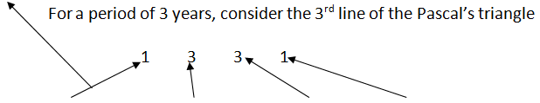
Example:
What is the Amount obtained on a principal amount of 8000 rupees with a rate of 5% for a period of 3 years compounded annually?
Solution:
Principal = 8000 Rate= 5%
Amount is =8000(1) + (5% of 8000=400)(3) + (5% of 400=20)(3) + (5% of 20 =1)(1)
Answer= 8000 + 1200 + 60 + 1 =9261
If we need to only find the interest, subtract the principal from the amount 9261- 8000 = 1261

Slide 10
PRACTICE QUESTIONS:
Q.1) How much will Rs.7500 amount to in two years at the rate of 12% p.a. compound interest?
a) Rs.8904
b) Rs.9048
c) Rs.9408
d) Rs.9804

Slide 11
Q.2) A sum of money quadruples at a certain rate of compound interest in six years. In how many years will it become sixteen times itself?
a)10
b)12
c)18
d)24

Slide 12
Q.3) Find the CI on a sum of Rs.6000 at 16% p.a. for 9 months when interest is compounded quarterly (approx)?
a) Rs.762.80
b) Rs.854.10
c) Rs.749.20
d) Rs.924.10

Slide 13
Q.4) The value of a car depreciates at the rate of 12% p.a. every year. If the present value of the car is Rs.154880. its value two years ago was ?
a) Rs.360000
b) Rs.240000
c) Rs.200000
d) Rs.300000

Slide 14
Q.5) The compound interest on a sum of money for 2 years is rs.832 and the simple interest on the same sum for the same period is rs.800 .the difference between the compound interest and simple interest for 3 years is
a) 48
b) 66.56
c) 98.56
d) None

Slide 15
Q.6) A sum of rupees 10000 becomes 14400 compounded annually with rate of interest 20%. Find the number of years?
a) 1 yrs
b) 2 yrs
c) 3 yrs
d) 4 yrs

Slide 16
Q.7) The difference between compound interest and simple interest on a sum for 2 years at 10% per annum, when the interest in compounded annually is Rs.16. If the interest were compounded half yearly, the difference in two interests will be
a) Rs.24.81
b) Rs.31.61
c) Rs.32.40
d) Rs.36.90

Slide 17
Q.8) A sum is being lent at 20% p.a. compound interest. What is the ratio of increase in amount of 4th year to 5th year?
a) 4 : 5
b) 5 : 4
c) 5 : 6
d) Cannot be determined

Slide 18
Q.9) The compound interest and the simple interest for two years on a certain sum of money at a certain rate of interest are Rs. 2257.58, Rs. 2100 respectively. Find the principal and rate percent:
a) 6000, 7%
b) 7500, 8%
c) 14000, 10%
d) 7000, 15%

Slide 19
Q.10) The ratio of the amount for two years under CI annually and for one year under SI is 6 :5. When the rate of interest is same, then the value of rate of interest is:
a) 12.5%
b) 18%
c) 20%
d) 16.66%

