Slide 2
solve application based questions of simple interest.

Slide 3
Practice Questions
Q.1) Reena took a loan of Rs. 1200 with simple interest for as many years as the rate of interest. If she paid Rs. 432 as interest at the end of the loan period, what was the rate of interest?
[A] 3.6
[B] 6
[C] 18
[D] Can not be determined
Ans. B

Slide 4
Q.2) A man took loan from a bank at the rate of 12% p.a. simple interest. After 3 years he had to pay Rs. 5400 interest only for the period. The principal amount borrowed by him was:
[A] Rs.2000
[B] Rs.10000
[C] Rs.15000
[D] Rs.20000
Ans. C

Slide 5
Q.3) The interest for the 3rd year on a certain sum at a certain rate of simple interest is Rs.3000. find the sum of the interests accrued on it in the 6th, 7th and 8th years.
[A] Rs.6000
[B] Rs.9000
[C] Rs.4500
[D] Rs.12000
Ans. B

Slide 6
Q.4) A sum was invest for 2 years. It will give Rs. 300 more, if invested at 3% higher rate. Find the sum.
[A] Rs.4000
[B] Rs.5000
[C] Rs.6000
[D] Rs.10000
Ans. B

Slide 7
Q.5) A sum amounts to Rs.1008 in 2 years and amounts to Rs.1112 in 3 years at SI. Find the sum and rate of interest per annum.
[A] Rs.800, 13% pa
[B] Rs.600, 12 % pa
[C] Rs.800, 12% pa
[D] Rs.600, 13% pa
Ans. A

Slide 8
Q.6) S.I. On Rs 400 for 5 years together with that on Rs. 600, for 4 year to Rs. 132. If the Rate is same in both the case. Find rate % of interest?
[A] 2% pa
[B] 3% pa
[C] 5% pa
[D] 8% pa
Ans. B

Slide 9
Q.7) A shopkeeper borrow Rs. 20,000 from two money lenders. For one loan, he paid 12% pa and for other 14% pa. After one year he paid Rs. 2560 as total interest. How much did he borrow each?
[A] Rs.8000, Rs.12000
[B] Rs.12000, Rs.8000
[C] Rs.6000, Rs.14000
[D] Rs.14000, Rs.6000
Ans. B

Slide 10
Q.8) Rs. 1500 is invested in two such parts that if one part be invested at 6% and other at 5%, S.I= Rs. 85 for one year. Then how much was invested at 5%?
[A] Rs.1000
[B] Rs.500
[C] Rs.600
[D] Rs.800
Ans. B

Slide 11
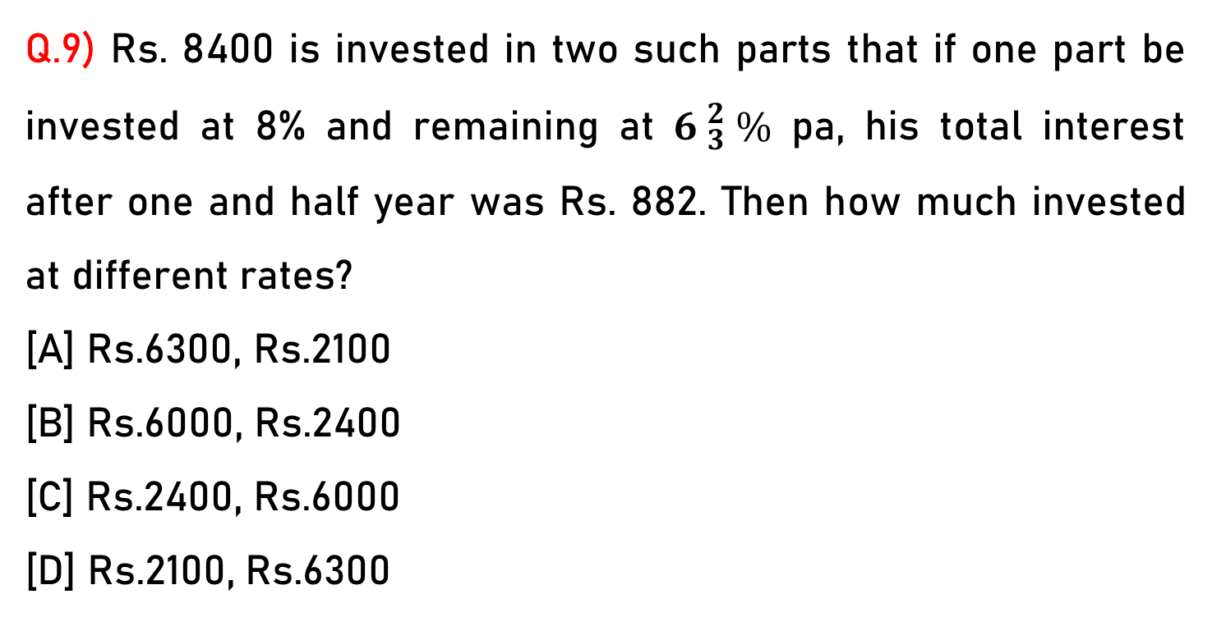
Q.9) Rs. 8400 is invested in two such parts that if one part be invested at 8% and remaining at ${6 }_{3}^{2} \%$ pa, his total interest after one and half year was Rs. 882. Then how much invested at different rates?
[A] Rs.6300, Rs.2100
[B] Rs.6000, Rs.2400
[C] Rs.2400, Rs.6000
[D] Rs.2100, Rs.6300
Ans. D

Slide 12
Q.10) Rs. 950 is lend in two ways. The rate of S.I given on one part is 6% and on other part is 4%. If the S.I of 5 years is Rs. 200 then how much is given on 6%?
[A] Rs.500
[B] Rs.400
[C] Rs.200
[D] Rs.100
Ans. D

Slide 13
Q.11) If a sum of money at simple interest doubles in 6 years, it will become 4 times in:
[A] 12 years
[B] 14 years
[C] 16 years
[D] 18 years
Ans. D

Slide 14
Q.12) If a sum of money at simple interest doubles in 8 years, it will become 4 times in:
[A] 16 years
[B] 24 years
[C] 64 years
[D] 32 years
Ans. B

Slide 15
Q.13) Find the present value (in Rs.) of Rs.3000 due after 5 years at 10% p.a. simple interest.
[A] Rs.1500
[B] Rs.1800
[C] Rs.2000
[D] Rs.2500
Ans. C

