Slide 2
understand concept of client side scripting.
understand basics of JavaScript.

Slide 3
Client-side Scripting
A client-side script is a program that is processed within the client browser.
These kinds of scripts are small programs which are downloaded , compiled and run by the browser.
JavaScript is an important client-side scripting language and widely used in dynamic websites.

Slide 4
Why use Client-side Programming?
Client-side scripting (javascript) benefits:
Usability: can modify a page without having to post back to the server (faster UI)
Efficiency: can make small, quick changes to page without waiting for server
Event-driven: can respond to user actions like clicks and key presses

Slide 5
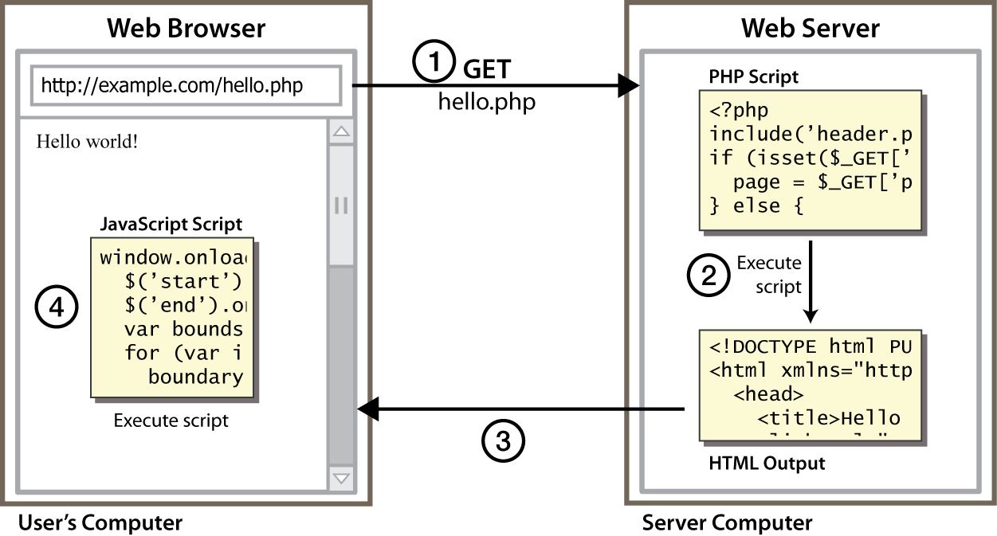
Client Side Scripting
Notes:
client-side script: code runs in browser after page is sent back from server
often this code manipulates the page or responds to user actions

Slide 6
What is Javascript?
A lightweight programming language ("scripting language")
used to make web pages interactive
insert dynamic text into HTML (ex: user name)
react to events (ex: page load user click)
get information about a user's computer (ex: browser type)
perform calculations on user's computer (ex: form validation)

Slide 7
What is Javascript?
JavaScript was first known as LiveScript, but Netscape changed its name to JavaScript, possibly because of the excitement being generated by Java.
JavaScript made its first appearance in Netscape 2.0 in 1995 with the name LiveScript. The general-purpose core of the language has been embedded in Netscape, Internet Explorer, and other web browsers.

Slide 8
Why to Learn Javascript
Javascript is the most popular programming language in the world and that makes it a programmer’s great choice.
Once you learnt Javascript, it helps you developing great front-end as well as back-end softwares using different Javascript based frameworks like jQuery, Node.JS etc

Slide 9
Why to Learn Javascript
Javascript is everywhere, it comes installed on every modern web browser and so to learn Javascript you really do not need any special environment setup.
For example Chrome, Mozilla Firefox , Safari and every browser you know as of today, supports Javascript.

Slide 10
Why to Learn Javascript
Javascript helps you create really beautiful and crazy fast websites.
You can develop your website with a console like look and feel and give your users the best Graphical User Experience.

Slide 11

Why to Learn Javascript
Great thing about Javascript is that you will find tons of frameworks and Libraries already developed which can be used directly in your software development to reduce your time to market.

Slide 12
Applications of Javascript Programming
Manipulating HTML Pages - Javascript helps in manipulating HTML page on the fly.
This helps in adding and deleting any HTML tag very easily using javascript and modify your HTML to change its look and feel based on different devices and requirements.
User Notifications - You can use Javascript to raise dynamic pop-ups on the webpages to give different types of notifications to your website visitors

Slide 13
Applications of Javascript Programming
Back-end Data Loading - Javascript provides Ajax library which helps in loading back-end data while you are doing some other processing. This really gives an amazing experience to your website visitors.

Slide 14
Applications of Javascript Programming
Presentations - JavaScript also provides the facility of creating presentations which gives website look and feel. JavaScript provides RevealJS and BespokeJS libraries to build a web-based slide presentations.

Slide 15
Applications of Javascript Programming
Client side validation - This is really important to verify any user input before submitting it to the server and Javascript plays an important role in validting those inputs at front-end itself.

Slide 16
Linking to a JavaScript File: script
<script src="filename" type="text/javascript"></script> HTML
script tag should be placed in HTML page's head
script code is stored in a separate .js file
JS code can be placed directly in the HTML file's body or head (like CSS)
but this is bad style (should separate content, presentation, and behavior)

Slide 17
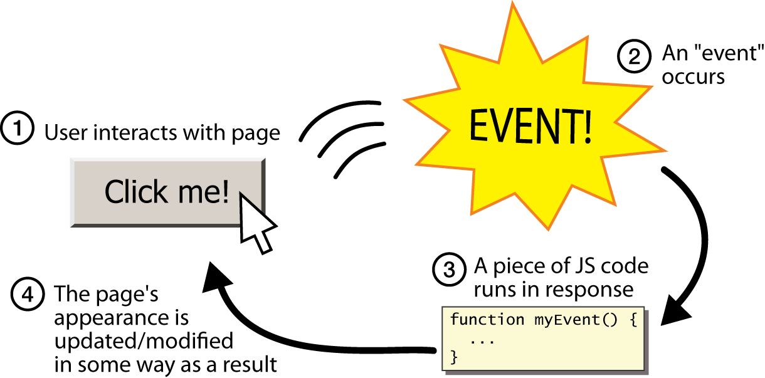
Event-driven Programming

Slide 18
Event-driven Programming
Split breaks apart a string into an array using a delimiter
can also be used with regular expressions (seen later)
Join merges an array into a single string, placing a delimiter between them

Slide 19
Javascript Frameworks and Libraries
There are many useful Javascript frameworks and libraries available:
Angular
React
jQuery
Vue.js
Ext.js

Slide 20

Javascript syntax
JavaScript can be implemented using JavaScript statements that are placed within the <script>... </script> HTML tags in a web page.
You can place the <script> tags, containing your JavaScript, anywhere within your web page, but it is normally recommended that you should keep it within the <head> tags.
The <script> tag alerts the browser program to start interpreting all the text between these tags as a script

Slide 21
Javascript syntax
A simple syntax of your JavaScript will appear as follows.
<script ...>
JavaScript code
</script>

Slide 22
Script tag
The script tag takes two important attributes −
Language − This attribute specifies what scripting language you are using. Typically, its value will be javascript. Although recent versions of HTML (and XHTML, its successor) have phased out the use of this attribute.
Type − This attribute is what is now recommended to indicate the scripting language in use and its value should be set to "text/javascript".

Slide 23
Script Tag
<script language = "javascript" type = "text/javascript">
JavaScript code
</script>

Slide 24
First JavaScript Code
Let us take a sample example to print out "Hello World“
. <html>
<body>
<script language = "javascript" type = "text/javascript">
document.write("Hello World!")
</script>
</body>
</html>

Slide 25
Advantages of JavaScript
Speed. Client-side JavaScript is very fast because it can be run immediately within the client-side browser. Unless outside resources are required, JavaScript is unhindered by network calls to a backend server.
Simplicity. JavaScript is relatively simple to learn and implement.
Popularity. JavaScript is used everywhere on the web.

Slide 26
Advantages of JavaScript
Interoperability. JavaScript plays nicely with other languages and can be used in a huge variety of applications.
Server Load. Being client-side reduces the demand on the website server.
Gives the ability to create rich interfaces.

Slide 27
JavaScript offers procedural programming features
Even though the language is simple to discover, it offers all the procedure-based features that make it a well-liked and influential programming language. With JavaScript, if you have options to generate branches, initiate conditional checking, loops and much more, which will make your website much more exciting t to use.

Slide 28
Practical

