Slide 2
go over relevant history of HTML and difference of HTML vs HTML5.
understand anatomy of Html tag .
practical implementation of HTML <table> Tag

Slide 3
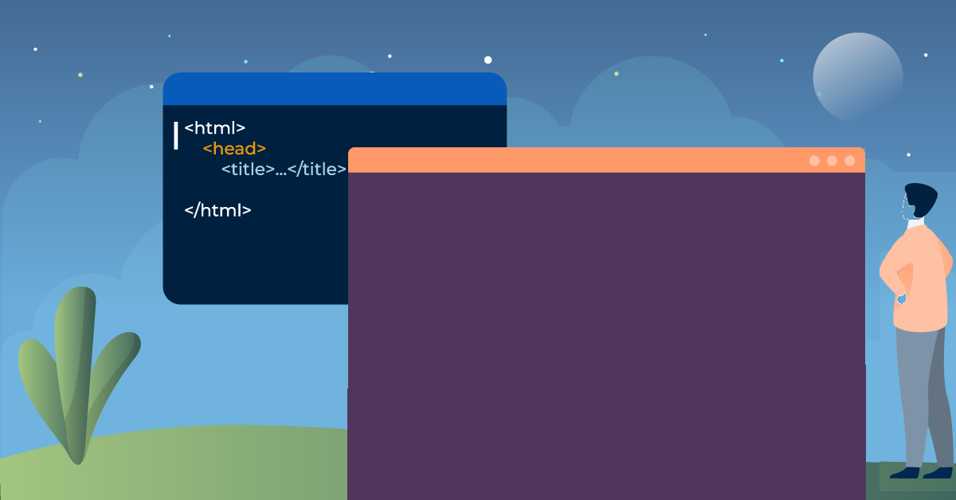
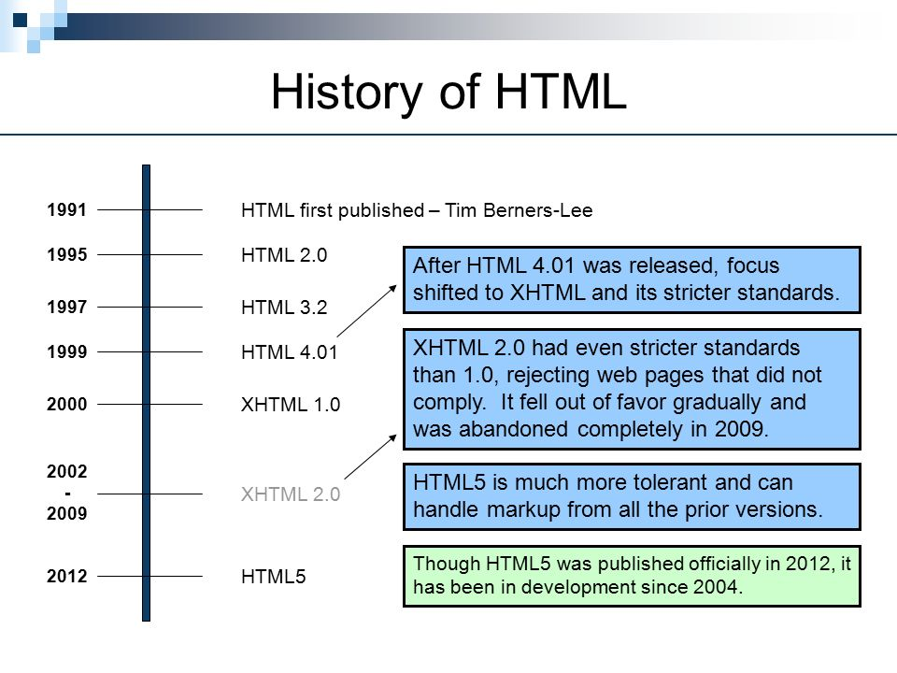
HTML History

Slide 4
Difference between HTML and HTML5?
HTML5 is more complete and easier than HTML4, it has lots of new tags like <header>, <footer>, <navy>, <Audio>, <video>, <main>
It also supports graphics.
HTML is referred to as the primary language of the World Wide Web. HTML has many updates over time, and the latest HTML version is HTML5.

Slide 5
Difference between HTML and HTML5?
HTML5 is more complete and easier than HTML4, it has lots of new tags like <header>, <footer>, <navy>, <Audio>, <video>, <main>
It also supports graphics.
HTML is referred to as the primary language of the World Wide Web. HTML has many updates over time, and the latest HTML version is HTML5.

Slide 6
Difference between HTML and HTML5?
HTML5 is more complete and easier than HTML4, it has lots of new tags like <header>, <footer>, <navy>, <Audio>, <video>, <main>
It also supports graphics.
HTML is referred to as the primary language of the World Wide Web. HTML has many updates over time, and the latest HTML version is HTML5.

Slide 7
Difference between HTML and HTML5?
HTML5 supports both audio and video .
HTML cannot allow JavaScript to run within the web browser, while HTML5 provides full support for running JavaScript.
In HTML5, inline mathML and SVG can be used in a text, while in HTML it is not possible.

Slide 8
Difference between HTML and HTML5?
HTML5 supports both audio and video .
HTML cannot allow JavaScript to run within the web browser, while HTML5 provides full support for running JavaScript.
In HTML5, inline mathML and SVG can be used in a text, while in HTML it is not possible.

Slide 9
Difference between HTML and HTML5?
HTML5 supports both audio and video .
HTML cannot allow JavaScript to run within the web browser, while HTML5 provides full support for running JavaScript.
In HTML5, inline mathML and SVG can be used in a text, while in HTML it is not possible.

Slide 10
Difference between HTML and HTML5?
HTML5 supports new types of form controls, such as date and time, email, number, category, title, Url, search, etc.
Many elements have been introduced in HTML5. Some of the most important are time, audio, description, embed, fig, shape, footer, article, canvas, navy, output, section, source, track, video, etc.

Slide 11
Difference between HTML and HTML5?
HTML5 supports new types of form controls, such as date and time, email, number, category, title, Url, search, etc.
Many elements have been introduced in HTML5. Some of the most important are time, audio, description, embed, fig, shape, footer, article, canvas, navy, output, section, source, track, video, etc.

Slide 12
Difference between Html and Html5
Features | Html | Html5
Definition | A hypertext markup language (HTML) is the primary language for developing web pages. | HTML5 is a new version of HTML with new functionalities with markup language with Internet technologies.
Multimedia support | Language in HTML does not have support for video and audio. | HTML5 supports both video and audio.
Storage | The HTML browser uses cache memory as temporary storage. | HTML5 has the storage options like:application cache, SQL database, and web storage.

Slide 13
Difference between Html and Html5
Content
Browser compatibility | HTML is compatible with almost all browsers because it has been present for a long time, and the browser made modifications to support all the features. | In HTML5, we have many new tags, elements, and some tags that have been removed/modified, so only some browsers are fully compatible with HTML5.
Graphics support | In HTML, vector graphics are possible with tools LikeSilver light, Adobe Flash, VML, etc. | In HTML5, vector graphics are supported by default.
Threading | In HTML, the browser interface and JavaScript running in the same thread. | The HTML5 has the JavaScript Web Worker API, which allows the browser interface to run in multiple threads.

Slide 14
Difference between Html and Html5
Content
Doc type | Doctype declaration in html is too long <! DOCTYPE HTML PUBLIC "- // W3C // DTD HTML 4.01 // EN" "http://www.w3.org/TR/html4/strict.dtd"> | The DOCTYPE declaration in html5 is very simple "<! DOCTYPE html>
Character Encoding | Character encoding in HTML is too long. <! DOCTYPE HTML PUBLIC "- // W3C // DTD HTML 4.0 Transitional // EN"> | Character encoding declaration is simple <meta charset = "UTF-8">
Multimedia support | Audio and video are not the part of HTML4. | Audio and video are essential parts of HTML5,like: <Audio>, <Video>.

Slide 15
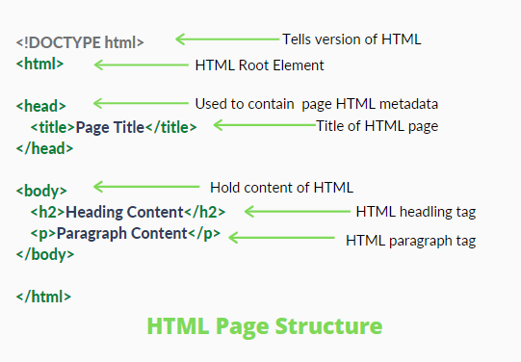
Explanation of Page Structure

Slide 16

HTML Tables The <table>…</table>
Attributes
background
bgcolor
border
cellspacing
cellpadding
width
height

Slide 17
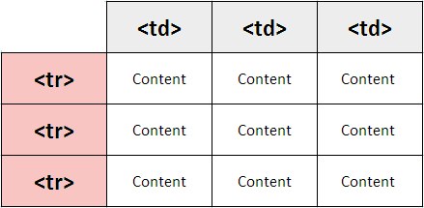
The <tr>…</tr>
Defines a table row
Structural tag only (no content)
Attributes
align
bgcolor

Slide 18
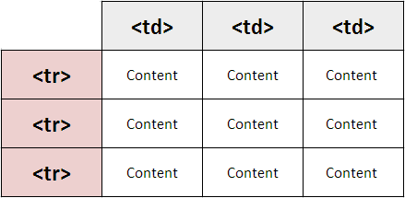
The <td>…</td>
Defines a data cell in a table
Can contain any content, including another, nested table

Slide 19
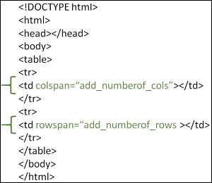
Rowspan and Colspan
The rowspan and colspan are <td> tag attributes.
These are used to specify the number of rows or columns a cell should span.
The rowspan attribute is for rows as well as the colspan attribute is for columns.

Slide 20
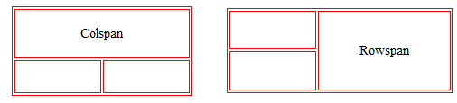
Rowspan and Colspan

Slide 21
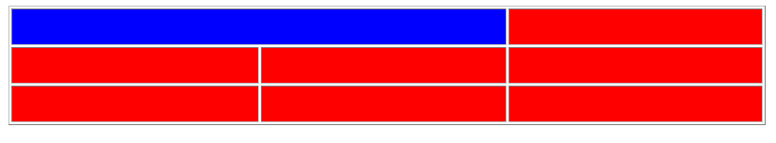
<td colspan …> Example
<tr> <td colspan=“2” bgcolor=“blue”> </td> <td> … </td> </tr>

Slide 22
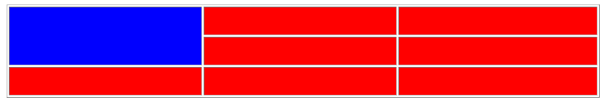
<td rowspan …> Example
<tr> <td rowspan=“2” bgcolor=“blue”> </td> <td> … </td> </tr>

Slide 23
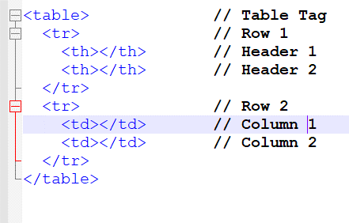
<th>…</th>
Defines a header cell
Acts just like a <td>…</td>
The text is normally centered vertically and horizontally AND the text is bold
Attributes are the same as <td>…</td>

Slide 24
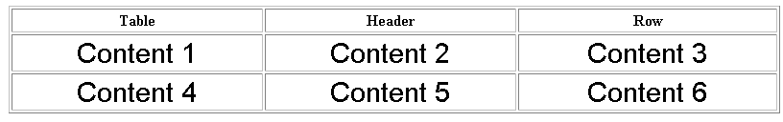
<th>…</th> Example
<tr> <th> Table </th> <th> … </th> </tr>

Slide 25
<caption>…</caption>
Provides a summary of the table’s purpose
MUST immediately follow <table>
Attributes:
align
summary

Slide 26
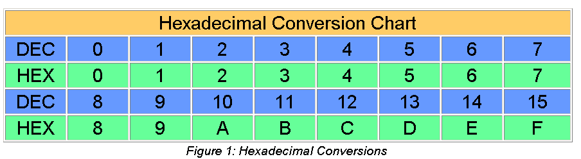
<caption>…</caption> Example
<caption align=“center” summary=“Long Description goes here” valign="bottom"> Figure 1: Hexadecimal Conversions </caption>

Slide 27
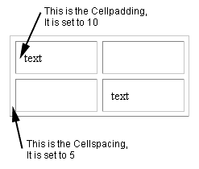
HTML Table Padding & Spacing
Cell padding is the space between the cell edges and the cell content.
By default the padding is set to 0.
Cell spacing is the space between each cell.
By default the space is set to 2 pixels

Slide 28
What is Cellpadding?
It only associates with individual (single) cells.
Using Cellpadding, one can easily control the white space present between a cell border and the content present in it.
It is a very effective method.

Slide 29
What is Cellpadding?
It has a default value of 1.
One can create Cellpadding using the tag of HTML <table>.
Here, we set the type of attribute to cellpadding.

Slide 30
What is Cellspacing?
It associates with multiple cells- not just a single one.
Using Cellspacing, you can set the spaces between various cells.
It is comparatively less effective than the process of cell padding.

Slide 31
What is Cellspacing?
In this case, the spacing value by default becomes 2.
One can easily create Cellspacing by using the tag of HTML <table>.
Here, we set the type of attribute to cellspacing.

Slide 32
Practical

