Slide 2
Understand basic of HTML and HTML5.
Know briefly history of HTML
Realize basic features of HTML5.

Slide 3
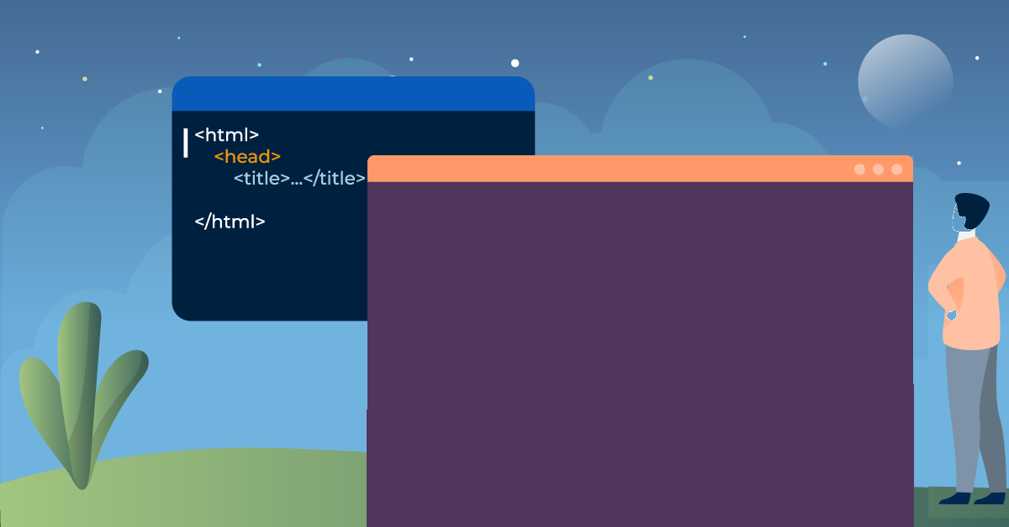
What is html…?
HTML is Hyper Text Mark-up Language where mark-up language is used to define the text document within tag which defines the structure of web pages.
So HTML is the combination of Hypertext and Mark-up language.

Slide 4
What is html used for?
HTML (Hypertext Markup Language) is the code that is used to structure a web page and its content.
For example, content could be structured within a set of paragraphs, a list of bulleted points, or using images and data tables.

Slide 5
Why to learn html?
Create Web site - You can create a website or customize an existing web
Become a web designer - If you want to start a carrier as a professional web designer
Understand web - If you want to optimize your website, to boost its speed and performance,
Learn other languages - other related technologies like javascript , php, or angular are become easier to understand

Slide 6
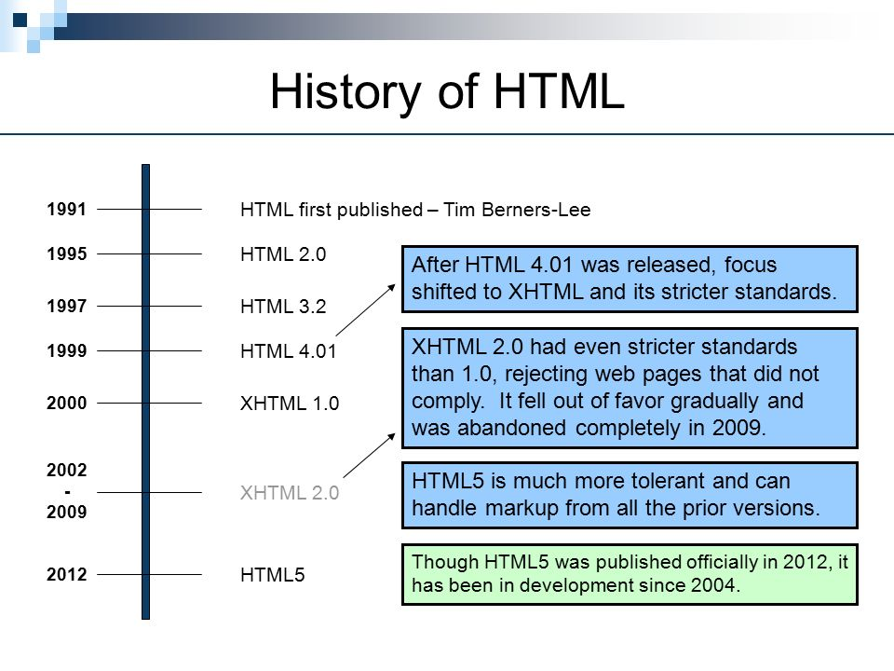
HTML History

Slide 7
Tags In HTML
The essence of HTML programming is tags
A tag is a keyword enclosed by angle brackets
Example: <I>
There are opening and closing tags .
The affected text is between the two tags

Slide 8
Opening and Closing Tags
The opening and closing tags use the same command except the closing tag contains and additional forward slash /.
For example, the expression <B> Warning </B> would cause the word ‘Warning’ to appear in bold face on a Web page.

Slide 9
Opening and Closing Tags
The opening and closing tags use the same command except the closing tag contains and additional forward slash /.
For example, the expression <B> Warning </B> would cause the word ‘Warning’ to appear in bold face on a Web page.

Slide 10
Nested Tags
Whenever you have HTML tags within other HTML tags, you must close the nearest tag first.

Slide 11
Nested Tags
Whenever you have HTML tags within other HTML tags, you must close the nearest tag first
Example:
<H1> <I> The Nation </I> </H1>

Slide 12
Title Tag
The <TITLE> Tag
Choose the title of your Web page carefully; The title of a Web page determines its ranking in certain search engines.
The title will also appear on Favorite lists, History lists, and Bookmark lists to identify your page.

Slide 13
TITLE TAG
The <TITLE> Tag
Choose the title of your Web page carefully; The title of a Web page determines its ranking in certain search engines.
The title will also appear on Favorite lists, History lists, and Bookmark lists to identify your page.

Slide 14
Text Formatting
Manipulating text in HTML can be tricky; Oftentimes, what you see is NOT what you get
For instance, special HTML tags are needed to create paragraphs, move to the next line, and create headings
<<B> Bold Face </B>
<I> Italics </I>
<U> Underline </U>
<P> New Paragraph </P>
<BR> Next Line

Slide 15
Comments Statements
Comment statements are notes in the HTML code that explain the important features of the code.
The comments do not appear on the Web page itself but are a useful reference to the author of the page and other programmers
To create a comment, statement use the
<!-- …. --> tags.

Slide 16
Comments Statements
Comment statements are notes in the HTML code that explain the important features of the code.
The comments do not appear on the Web page itself but are a useful reference to the author of the page and other programmers
To create a comment, statement use the
<!-- …. --> tags.

Slide 17
Comments Statements
Comment statements are notes in the HTML code that explain the important features of the code.
The comments do not appear on the Web page itself but are a useful reference to the author of the page and other programmers
To create a comment, statement use the
<!-- …. --> tags.

Slide 18
Comments Statements
Comment statements are notes in the HTML code that explain the important features of the code.
The comments do not appear on the Web page itself but are a useful reference to the author of the page and other programmers
To create a comment, statement use the
<!-- …. --> tags.

Slide 19
Page Formatting
To define the background color, use the BGCOLOR attribute in the <BODY> tag
To define the text color, use the TEXT attribute in the <BODY> tag
To define the size of the text, type <BASEFONT SIZE=n>

Slide 20
Page Formatting
To define the background color, use the BGCOLOR attribute in the <BODY> tag
To define the text color, use the TEXT attribute in the <BODY> tag
To define the size of the text, type <BASEFONT SIZE=n>

Slide 21
Page Formatting
To define the background color, use the BGCOLOR attribute in the <BODY> tag
To define the text color, use the TEXT attribute in the <BODY> tag
To define the size of the text, type <BASEFONT SIZE=n>

Slide 22
Page Formatting-Example
<HTML>
<HEAD>
<TITLE> Example </TITLE>
</HEAD>
<BODY BGCOLOR=“black” TEXT=“white”>
<BASEFONT SIZE=7>This is where you would include the text and images on your Web page.
</BODY>
</HTML>

Slide 23
Inserting Images
Type <IMG SRC = “image.ext”>, where image.ext indicates the location of the image file
The WIDTH=n and HEIGHT=n attributes can be used to adjust the size of an image
The attribute BORDER=n can be used to add a border n pixels thick around the image

Slide 24
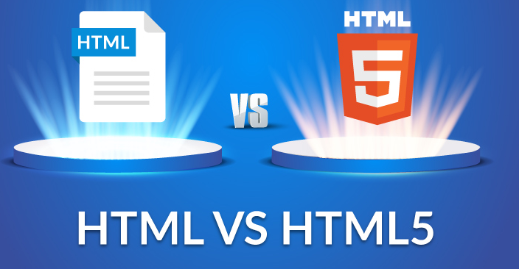
What Is HTML5 ?

Slide 25
What Is HTML5 ?
HTML5 is a markup language used for structuring and presenting content on the World Wide Web.
It is the fifth and last major HTML version that is a World Wide Web Consortium (W3C) recommendation.

Slide 26
Why HTML5 ?
Video and Audio Support
Doctype
Smarter Storage
Cleaner Code
Better Interactions
Game Development
Legacy/Cross Browser Support
Mobile, Mobile, Mobile
It’s the Future, Get With It!

Slide 27
Backward Compatibility
HTML5 is designed, as much as possible, to be backward compatible with existing web browsers. Its new features have been built on existing features and allow you to provide fallback content for older browsers.

Slide 28
Video and Audio
Forget about Flash Player and other third party media players, make your videos and audio truly accessible with the new HTML5 <video> and <audio> tags. Getting your media to play correctly has always been pretty much a nightmare, you had to use the <embed> and <object> tags and assign a huge list of parameters just to get the thing visible and working correctly/

Slide 29
DOCTYPE
Yup that’s it, that is the doctype, nothing more, nothing less. Pretty simple right? No more cutting and pasting some long unreadable line of code and no more dirty head tags filled with doctype attributes. You can simply and easily type it out and be happy. The really great thing about it though, beyond the simplicity, is that it works in every browser

Slide 30
Smarter Storage
One of the coolest things about HTML5 is the new local storage feature. It’s a little bit of a cross between regular old cookies and a client-side database. It’s better than cookies because it allows for storage across multiple windows, it has better security and performance and data will persist even after the browser is closed. Because it’s essentially a client side data base you don’t have to worry about the user deleting cookies and it is been adopted by all the popular browsers.

Slide 31
Better Interactions
We all want a more dynamic website that responds to the user and allows the user to enjoy/interact your content instead of just look at it. Enter <canvas>, the drawing HTML5 tag that allows you to do most (if not more) interactive and animated possibilities than the previous rich internet application platforms like Flash.
Beyond <canvas>, HTML5 also comes with a slew of great APIs that allow you to build a better user experience and a beefier, more dynamic web application.

Slide 32
Game Development
That is correct, you can develop games using HTML5’s <canvas> tag. HTML5 provides a great, mobile friendly way to develop fun, interactive games. If you’ve built Flash games before, you’ll love building HTML5 games./

Slide 33
Legacy/cross browser support
Modern, popular browsers all support HTML5 (Chrome, Firefox, Safari IE9 and Opera) and the HTML5 doctype was created so that all browsers, even the really old and annoying ones, er, IE6 can use it. But just because old browsers recognize the doctype that doesn’t mean they can use all the new HTML5 tags and goodies.

Slide 34
It’s the future, get with it!
The reason why you should start using HTML5 today is this: it’s the future, start using it now so you don’t get left behind. HTML5 is not going anywhere and as more and more elements get adopted more and more companies will start to develop in HTML5. HTML5 is essentially just HTML

Slide 35
HTML Documents
All HTML documents must start with a document type declaration: <!DOCTYPE html>.
The HTML document itself begins with <html> and ends with </html>.
The visible part of the HTML document is between <body> and </body>.

Slide 36
HTML Documents
The <!DOCTYPE> declaration represents the document type, and helps browsers to display web pages correctly.
It must only appear once, at the top of the page (before any HTML tags).
The <!DOCTYPE> declaration is not case sensitive.

Slide 37
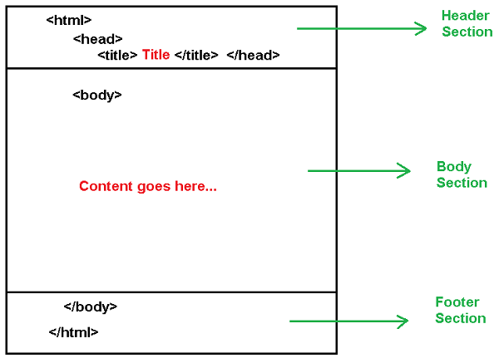
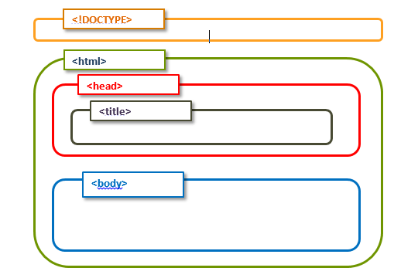
Structure of Webpage

Slide 38
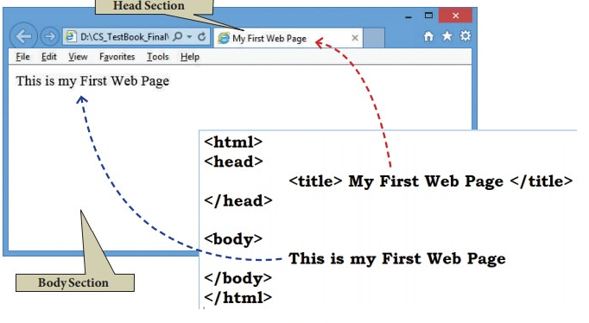
Structure of Webpage

Slide 39
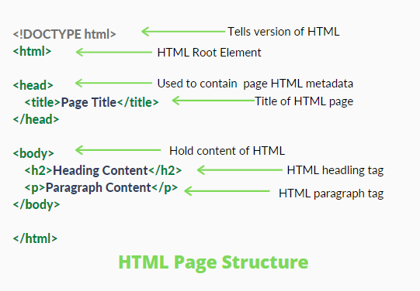
Explanation of Page Structure

Slide 40
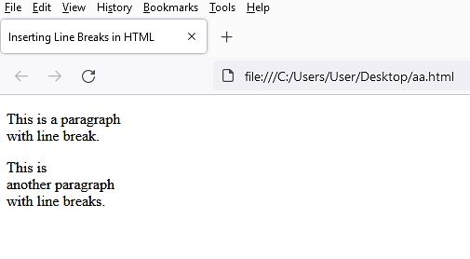
Basic HTML Code
Html code
Output in Browser
<!DOCTYPE html>
<html lang="en">
<head>
<title>Inserting Line Breaks in HTML</title>
</head>
<body>
<p>This is a paragraph <br> with line break.</p>
<p>This is <br>another paragraph <br> with line breaks.</p>
</body>
</html>

