Slide 2
understand Class and ID selectors in CSS
understand CSS Borders

Slide 3

What is Class and ID selectors in CSS ?
In CSS, class and ID selectors are used to identify various HTML elements.
The main benefit of setting class or ID is that you can present the same HTML element differently, depending on its class or ID.

Slide 4
Class selector
The class selector selects elements with a specific class attribute. It matches all the HTML elements based on the contents of their class attribute. The . symbol, along with the class name, is used to select the desired class.

Slide 5
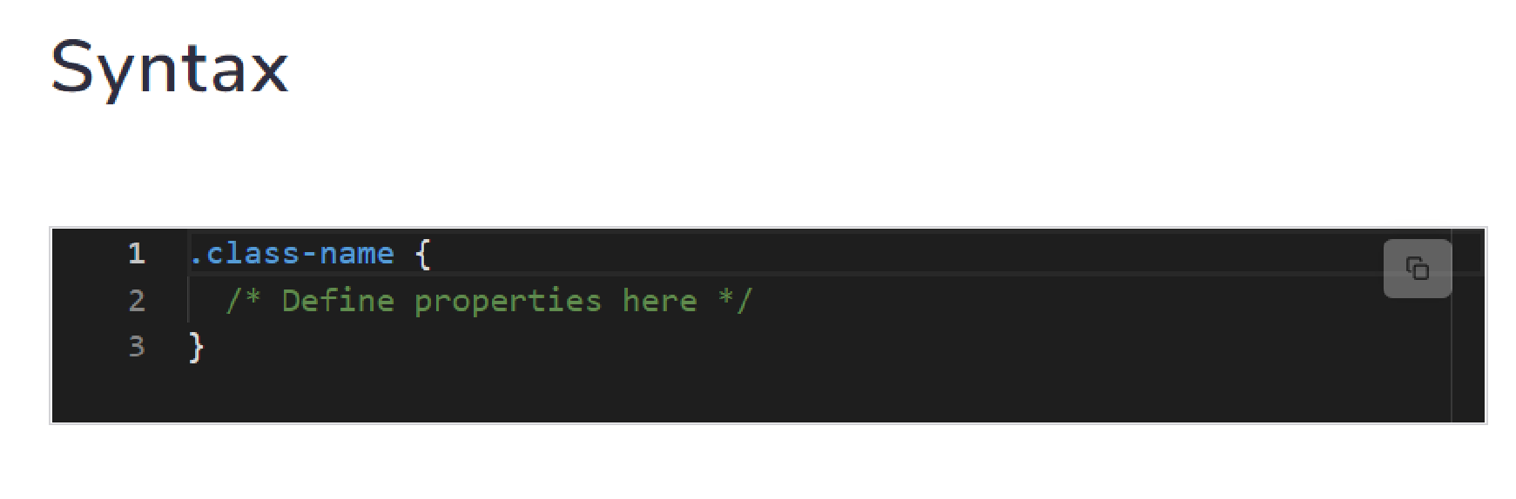
Syntax
Syntax

Slide 6
ID selector
The ID selector matches an element based on the value of its id attribute. In order for the element to be selected, its ID attribute must exactly match the value given in the selector. The # symbol and the id of the HTML element name are used to select the desired element.

Slide 7
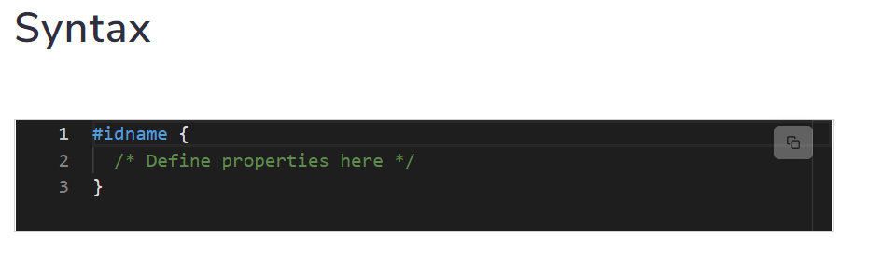
Syntax

Slide 8
The difference between Class and ID selector
The difference between an ID and a class is that an ID is only used to identify one single element in our HTML. IDs are only used when one element on the page should have a particular style applied to it. However, a class can be used to identify more than one HTML element.

Slide 9

Difference

Slide 10
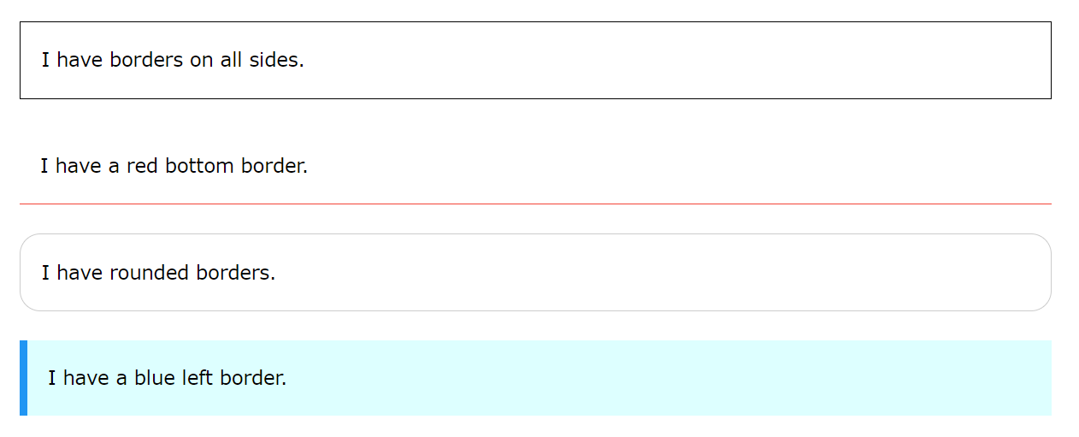
CSS Borders
The CSS border properties allow you to specify the style, width, and color of an element's border.

Slide 11
CSS Border Style
The border-style property specifies what kind of border to display.

Slide 12
CSS Border Style
The border-style property specifies what kind of border to display.
The following values are allowed:
dotted - Defines a dotted border
dashed - Defines a dashed border
solid - Defines a solid border
double - Defines a double border
groove - Defines a 3D grooved border. The effect depends on the border-color value

Slide 13
Demonstration of the different border styles
p.dotted {border-style: dotted;}
p.dashed {border-style: dashed;}
p.solid {border-style: solid;}
p.double {border-style: double;}
p.groove {border-style: groove;}
p.ridge {border-style: ridge;}
p.inset {border-style: inset;}
p.outset {border-style: outset;}

Slide 14
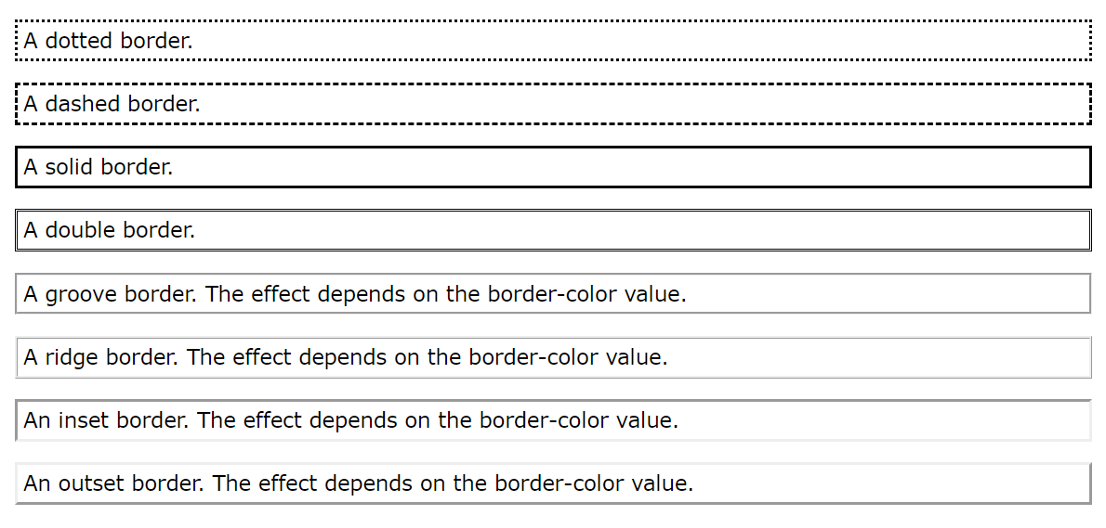
Borders ..

Slide 15
CSS Border Width
The border-width property specifies the width of the four borders.
The width can be set as a specific size (in px, pt, cm, em, etc) or by using one of the three pre-defined values: thin, medium, or thick.

Slide 16
Example
p.one
{
border-style: solid;
border-width: 5px;
}
p.two {
border-style: solid;
border-width: medium;
}

Slide 17
CSS Border Color
The border-color property is used to set the color of the four borders.
The color can be set by:
name - specify a color name, like "red"
HEX - specify a HEX value, like "#ff0000"
RGB - specify a RGB value, like "rgb(255,0,0)"
HSL - specify a HSL value, like "hsl(0, 100%, 50%)"
transparent

Slide 18
Example
p.one
{
border-style: solid;
border-color: red;
}

Slide 19
CSS Border - Individual Sides
p {
border-top-style: dotted;
border-right-style: solid;
border-bottom-style: dotted;
border-left-style: solid;
}

Slide 20
CSS Border - Shorthand Property
Like you saw in the previous page, there are many properties to consider when dealing with borders.
To shorten the code, it is also possible to specify all the individual border properties in one property.

Slide 21
CSS Border - Shorthand Property
The border property is a shorthand property for the following individual border properties:
border-width
border-style (required)
border-color
p { border: 5px solid red; }

Slide 22
CSS Rounded Borders
p
{
border: 2px solid red;
border-radius: 5px;
}

Slide 23
Practical

