Slide 2
understand basic HTML elements and tags .
Understand practical implementation .

Slide 3
The Body Element
The BODY element of a web page is an important element in regard to the page’s appearance.
This element contains information about the page’s background color, the background image, as well as the text and link colors.

Slide 4
The Body Element
The BODY element of a web page is an important element in regard to the page’s appearance.
This element contains information about the page’s background color, the background image, as well as the text and link colors.

Slide 5
Headings, <Hx> </Hx>
Inside the BODY element, heading elements H1 through H6 are generally used for major divisions of the document.
Headings are permitted to appear in any order, but you will obtain the best results when your documents are displayed in a browser if you follow these guidelines:

Slide 6
Headings, <Hx> </Hx>
H1: should be used as the highest level of heading, H2 as the next highest, and so forth.
You should not skip heading levels: e.g., an H3 should not appear after an H1, unless there is an H2 between them.

Slide 7
Headings, <Hx> </Hx>
Heading 1
Heading 2
Heading 3
Heading 4
Heading 5
Heading 6
<HTML>
<HEAD>
<TITLE> Example Page</TITLE>
</HEAD>
<BODY>
<H1> Heading 1 </H1>
<H2> Heading 2 </H2>
<H3> Heading 3 </H3>
<H4> Heading 4 </H4>
<H5> Heading 5 </H5>
<H6> Heading 6 </H6>
</BODY>
</HTML>

Slide 8
Paragraphs, <P> </P>
Paragraphs allow you to add text to a document in such a way that it will automatically adjust the end of line to suite the window size of the browser in which it is being displayed. Each line of text will stretch the entire length of the window.

Slide 9
Paragraphs, <P> </P>
<HTML><HEAD>
<TITLE> Example Page</TITLE>
</HEAD>
<BODY></H1> Heading 1 </H1>
<P> Paragraph 1, ….</P>
<H2> Heading 2 </H2>
<P> Paragraph 2, ….</P>
<H3> Heading 3 </H3>
<P> Paragraph 3, ….</P>
<H4> Heading 4 </H4>
<P> Paragraph 4, ….</P>
<H5> Heading 5 </H5>
<P> Paragraph 5, ….</P>
<H6> Heading 6</H6>
<P> Paragraph 6, ….</P>
</BODY></HTML>
Heading 1
Paragraph 1,….
Heading 2
Paragraph 2,….
Heading 3
Paragraph 3,….
Heading 4
Paragraph 4,….
Heading 5
Paragraph 5,….
Heading 6
Paragraph 6,….

Slide 10
Break, <BR>
Line breaks allow you to decide where the text will break on a line or continue to the end of the window.
A <BR> is an empty Element, meaning that it may contain attributes, but it does not contain content.
The <BR> element does not have a closing tag.

Slide 11
Break, <BR>
Line breaks allow you to decide where the text will break on a line or continue to the end of the window.
A <BR> is an empty Element, meaning that it may contain attributes, but it does not contain content.
The <BR> element does not have a closing tag.

Slide 12
Break, <BR>
Line breaks allow you to decide where the text will break on a line or continue to the end of the window.
A <BR> is an empty Element, meaning that it may contain attributes, but it does not contain content.
The <BR> element does not have a closing tag.

Slide 13
Break, <BR>
<HTML>
<HEAD>
<TITLE> Example Page</TITLE>
</HEAD>
<BODY>
<H1> Heading 1 </H1>
<P>Paragraph 1, <BR>
Line 2 <BR> Line 3 <BR>….
</P>
</BODY>
</HTML>
Heading 1
Paragraph 1,….
Line 2
Line 3
….

Slide 14
Horizontal Rule, <HR>
The <HR> element causes the browser to display a horizontal line (rule) in your document.

Slide 15
Horizontal Rule, <HR>
<HTML>
<HEAD>
<TITLE> Example Page</TITLE>
</HEAD>
<BODY>
<H1> Heading 1 </H1>
<P>Paragraph 1, <BR>
Line 2 <BR>
<HR>Line 3 <BR>
</P>
</BODY>
</HTML>
Heading 1
Paragraph 1,….
Line 2
___________________________
Line 3

Slide 16
Bold, Italic and other Character Formatting Elements
<EM> Emphasis </EM> Browsers usually display this as italics.
<STRONG> STRONG </STRONG> Browsers display this as bold.
<TT> TELETYPE </TT> Text is displayed in a mono-spaced font. A typewriter text, e.g. fixed-width font.
<CITE> Citation </CITE> represents a document citation (italics). For titles of books, films, etc. Typically displayed in italics

Slide 17
Bold, Italic and other Character Formatting Elements
<EM> Emphasis </EM> Browsers usually display this as italics.
<STRONG> STRONG </STRONG> Browsers display this as bold.
<TT> TELETYPE </TT> Text is displayed in a mono-spaced font. A typewriter text, e.g. fixed-width font.
<CITE> Citation </CITE> represents a document citation (italics). For titles of books, films, etc. Typically displayed in italics

Slide 18
Bold, Italic and other Character Formatting Elements
<EM> Emphasis </EM> Browsers usually display this as italics.
<STRONG> STRONG </STRONG> Browsers display this as bold.
<TT> TELETYPE </TT> Text is displayed in a mono-spaced font. A typewriter text, e.g. fixed-width font.
<CITE> Citation </CITE> represents a document citation (italics). For titles of books, films, etc. Typically displayed in italics

Slide 19
Bold, Italic and other Character Formatting Elements
<EM> Emphasis </EM> Browsers usually display this as italics.
<STRONG> STRONG </STRONG> Browsers display this as bold.
<TT> TELETYPE </TT> Text is displayed in a mono-spaced font. A typewriter text, e.g. fixed-width font.
<CITE> Citation </CITE> represents a document citation (italics). For titles of books, films, etc. Typically displayed in italics

Slide 20
Alignment
Some elements have attributes for alignment (ALIGN) e.g. Headings, Paragraphs and Horizontal Rules.
The Three alignment values are : LEFT, RIGHT, CENTER.

Slide 21
Special Characters & Symbols
These Characters are recognized in HTML as they begin with an ampersand and end with with a semi-colon e.g. &value; The value will either be an entity name or a standard ASCII character number. They are called escape sequences.
The next table represents some of the more commonly used special characters.

Slide 22
Special Characters & Symbols
Special Character | Entity Name | Special Character | Entity Name
Ampersand | &amp; & | Greater-than sign | &gt; >
Asterisk | &lowast; ∗∗ | Less-than sign | &lt; <
Cent sign | &cent; ¢ | Non-breaking space | &nbsp;
Copyright | &copy; © | Quotation mark | &quot; "
Fraction one qtr | &frac14; ¼ | Registration mark | &reg; ®
Fraction one half | &frac12; ½ | Trademark sign | &trade; ™

Slide 23
Lists
Upon completing this section, you should be able to
Create an unordered list.
Create an ordered list.
Create a defined list.
Nest Lists.

Slide 24
List elements
HTML supplies several list elements. Most list elements are composed of one or more <LI> (List Item) elements.
UL : Unordered List. Items in this list start with a list mark such as a bullet. Browsers will usually change the list mark in nested lists.
<UL>
<LI> List item …</LI>
<LI> List item …</LI>
</UL>

Slide 25
List elements
You have the choice of three bullet types: disc(default), circle, square.
These are controlled in Netscape Navigator by the “TYPE” attribute for the <UL> element.
<UL TYPE=“square”>
<LI> List item …</LI>
<LI> List item …</LI>
<LI> List item …</LI>
</UL>

Slide 26
List elements
OL : Ordered List. Items in this list are numbered automatically by the browser.
<OL>
<LI> List item …</LI>
<LI> List item …</LI>
<LI> List item …</LI>
</OL>

Slide 27
List Elements
TYPE | Numbering | Styles
1 | Arabic numbers | 1,2,3, ……
a | Lower alpha | a, b, c, ……
A | Upper alpha | A, B, C, ……
i | Lower roman | i, ii, iii, ……
I | Upper roman | I, II, III, ……

Slide 28
List elements
You can specify a starting number for an ordered list.
<OL TYPE =“i”>
<LI> List item …</LI>
<LI> List item …</LI>
</OL>
<P> text ….</P>
<OL TYPE=“i” START=“3”>
<LI> List item …</LI>
</OL>

Slide 29
List elements
DL: Definition List. This kind of list is different from the others. Each item in a DL consists of one or more Definition Terms (DT elements), followed by one or more Definition Description (DD elements).
<DL>
<DT> HTML </DT>
<DD> Hyper Text Markup Language </DD>
<DT> DOG </DT>
<DD> A human’s best friend!</DD>
</DL>
HTML
Hyper Text Markup Language
DOG
A human’s best friend!

Slide 30
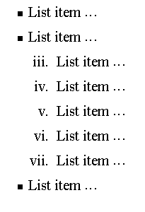
Nesting Lists
You can nest lists by inserting a UL, OL, etc., inside a list item (LI).
Example
<UL TYPE = “square”>
<LI> List item …</LI>
<LI> List item …
<OL TYPE=“i” START=“3”>
<LI> List item …</LI>
<LI> List item …</LI>
<LI> List item …</LI>
<LI> List item …</LI>
<LI> List item …</LI>
</OL>
</LI>
<LI> List item …</LI>
</UL>

Slide 31
What will be the output?
<H1 ALIGN="CENTER">SAFETY TIPS FOR CANOEISTS</H1> <OL TYPE=“a” START=“2”> <LI>Be able to swim </LI> <LI>Wear a life jacket at all times </LI> <LI>Don't stand up or move around. If canoe tips,
<UL> <LI>Hang on to the canoe </LI> <LI>Use the canoe for support and </LI> <LI>Swim to shore </UL> </LI>
<LI>Don't overexert yourself </LI> <LI>Use a bow light at night </LI> </OL>

Slide 32
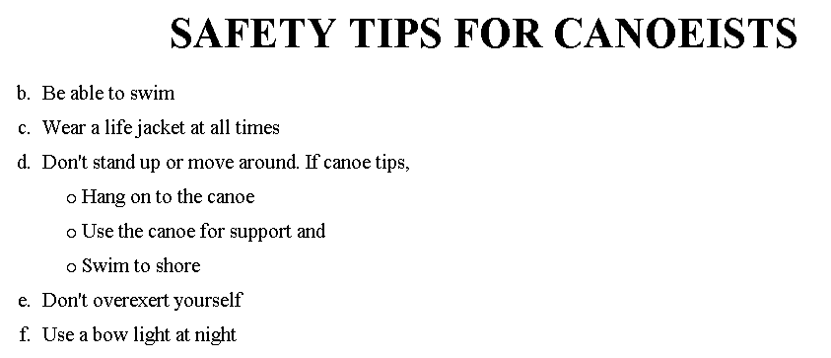
The output….

Slide 33
Practical

