Slide 2
understand what is BIG DATA,
know the characteristics of BIG DATA,
explore benefits of BIG DATA,
understand importance of BIG DATA.

Slide 3
What is BIG DATA?

Slide 4
What is DATA?
quantities,
characters,
or symbols

Slide 5

What is DATA?
quantities,
characters,
or symbols

Slide 6

What is DATA?
Electronically data stored in computer

Slide 7

What is DATA?
Recorded on magnetic, optical or mechanical recording media

Slide 8

What is BIG DATA
Large volume of data

Slide 9
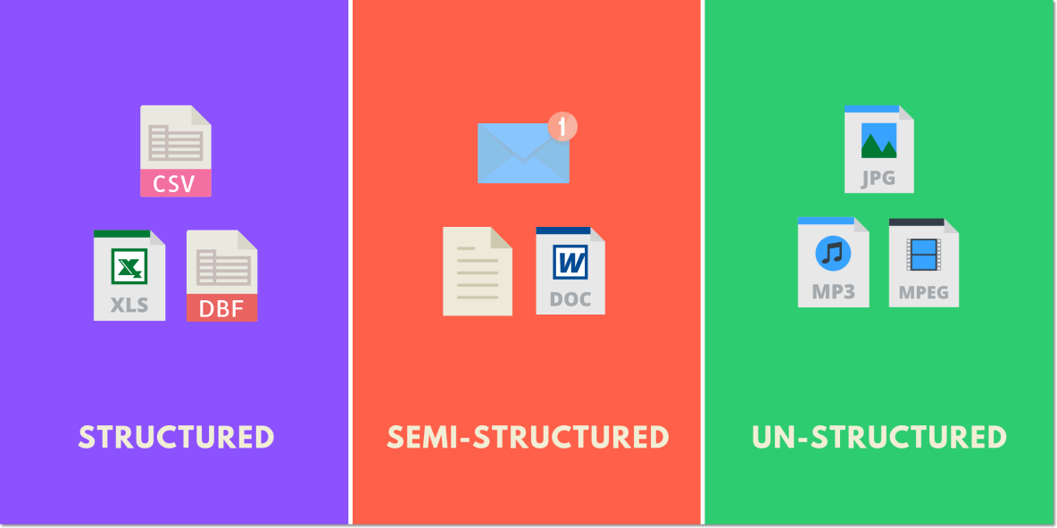
What is BIG DATA

Slide 10
What is BIG DATA

Slide 11
What is BIG DATA

Slide 12
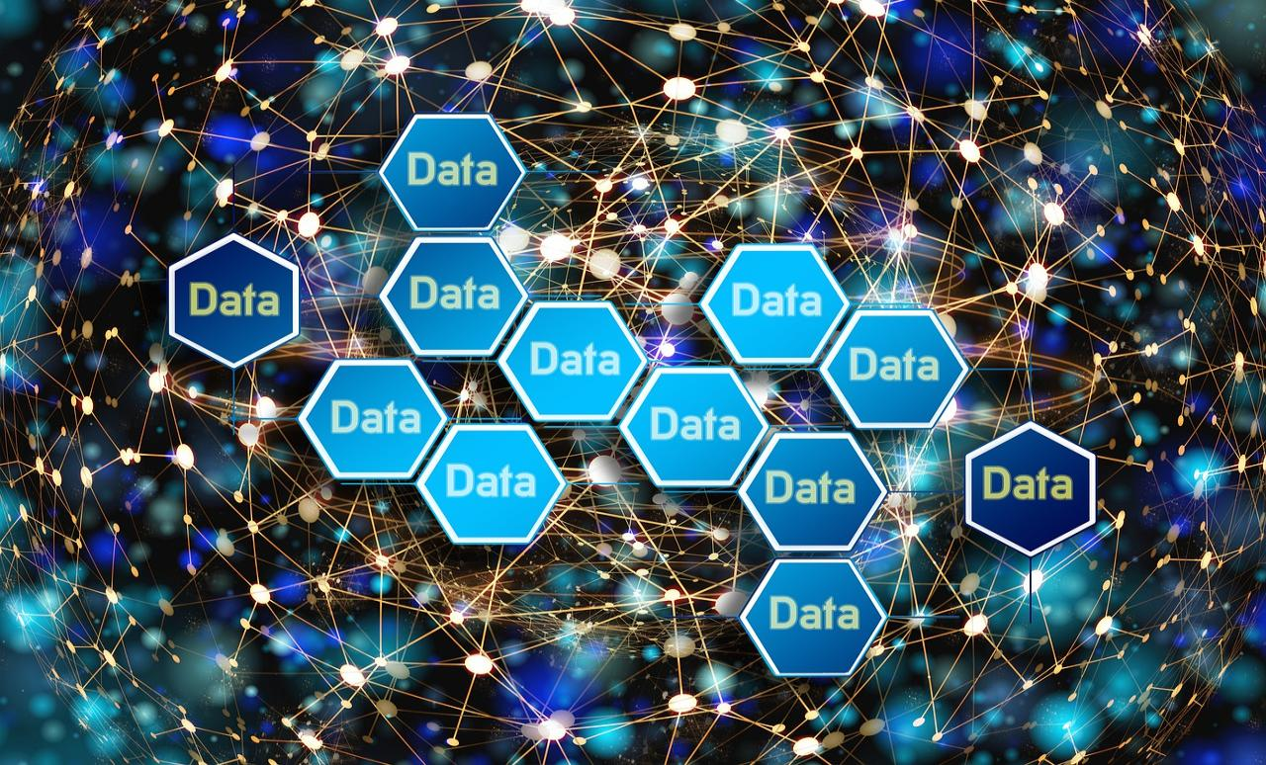
What is BIG DATA
inundates a business on a day-to-day basis

Slide 13

It’s not the amount of data that’s important.
It’s what organizations do with the data that matters.
Big data can be analyzed for insights that lead to better decisions and strategic business moves.

Slide 14
What is BIG DATA
Big data is a combination of structured, semi- structured and unstructured data collected by organizations that can be mined for information and used in machine learning projects, predictive modeling and other advanced analytics applications.

Slide 15



Examples of BIG DATA
Social media site Facebook
Single Jet Engine
New York Stock Exchange

Slide 16
Characteristics of BIG DATA
Volume
Variety
Velocity
BIG DATA

Slide 17
Volume
Amount of data generated
Online and offline transactions
In kilobytes or terabytes
Saved in records, tables, files

Slide 18
Velocity
Speed of generating data.
Generated in real-time.
Online and offline data.
In streams, batch or bits

Slide 19
Variety
Structured and unstructured
Online images & videos
Human generated – texts
Machine generated - readings

Slide 20
Benefits of Big Data Processing
Businesses can utilize outside intelligence while taking decisions
Improved customer service
Early identification of risk to the product/services, if any
Better operational efficiency

Slide 21
Benefits of Big Data Processing
Businesses can utilize outside intelligence while taking decisions
Improved customer service
Early identification of risk to the product/services, if any
Better operational efficiency

Slide 22
Benefits of Big Data Processing
Businesses can utilize outside intelligence while taking decisions
Improved customer service
Early identification of risk to the product/services, if any
Better operational efficiency

Slide 23
Benefits of Big Data Processing
Businesses can utilize outside intelligence while taking decisions
Improved customer service
Early identification of risk to the product/services, if any
Better operational efficiency

Slide 24
Why is Big Data Important ?
Cost Savings
Time Reductions
Understand the market conditions
Social media listenings
Using Big Data Analytics to Boost Customer Acquisition and Retention
Using Big Data Analytics to Solve Advertisers Problem and Offer Marketing Insights
Big Data Analytics As a Driver of Innovations and Product Development

Slide 25
Why is Big Data Important ?
Cost Savings
Time Reductions
Understand the market conditions
Social media listenings
Using Big Data Analytics to Boost Customer Acquisition and Retention
Using Big Data Analytics to Solve Advertisers Problem and Offer Marketing Insights
Big Data Analytics As a Driver of Innovations and Product Development

Slide 26
Why is Big Data Important ?
Cost Savings
Time Reductions
Understand the market conditions
Social media listenings
Using Big Data Analytics to Boost Customer Acquisition and Retention
Using Big Data Analytics to Solve Advertisers Problem and Offer Marketing Insights
Big Data Analytics As a Driver of Innovations and Product Development

Slide 27
Why is Big Data Important ?
Cost Savings
Time Reductions
Understand the market conditions
Social media listenings
Using Big Data Analytics to Boost Customer Acquisition and Retention
Using Big Data Analytics to Solve Advertisers Problem and Offer Marketing Insights
Big Data Analytics As a Driver of Innovations and Product Development

Slide 28
Why is Big Data Important ?
Cost Savings
Time Reductions
Understand the market conditions
Social media listenings
Using Big Data Analytics to Boost Customer Acquisition and Retention
Using Big Data Analytics to Solve Advertisers Problem and Offer Marketing Insights
Big Data Analytics As a Driver of Innovations and Product Development

Slide 29
Why is Big Data Important ?
Cost Savings
Time Reductions
Understand the market conditions
Social media listenings
Using Big Data Analytics to Boost Customer Acquisition and Retention
Using Big Data Analytics to Solve Advertisers Problem and Offer Marketing Insights
Big Data Analytics As a Driver of Innovations and Product Development

Slide 30
Why is Big Data Important ?
Cost Savings
Time Reductions
Understand the market conditions
Social media listenings
Using Big Data Analytics to Boost Customer Acquisition and Retention
Using Big Data Analytics to Solve Advertisers Problem and Offer Marketing Insights
Big Data Analytics As a Driver of Innovations and Product Development

