Slide 2
understand applications of BIGDATA

Slide 3
Introduction
Recording and processing all data requires much talent, resources and time.
The data can be use imaginatively and meaningfully to derive business benefit.

Slide 4
Applications of BIG DATA
Three major types of business applications with different levels of transformational potential:
1. Monitoring and tracking applications
2. Analysis and Insight Applications
3. New Product Development

Slide 5
Monitoring and tracking applications
Public health monitoring
Consumer Sentiment Monitoring.
Asset Tracking
Supply chain monitoring
Preventive machine maintenance

Slide 6
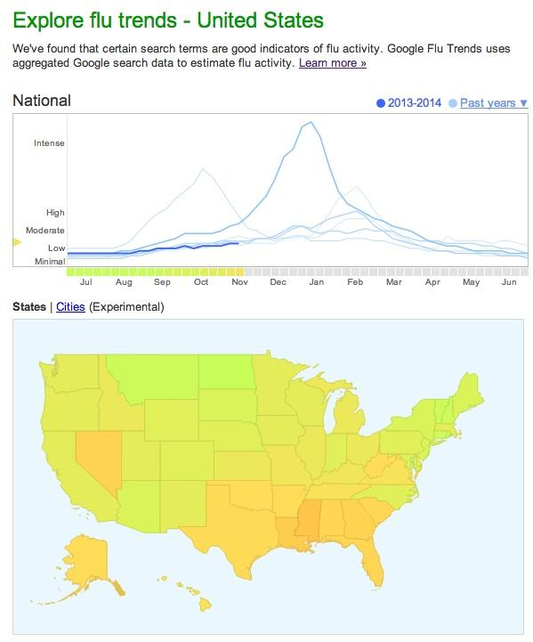
Public health monitoring

Slide 7
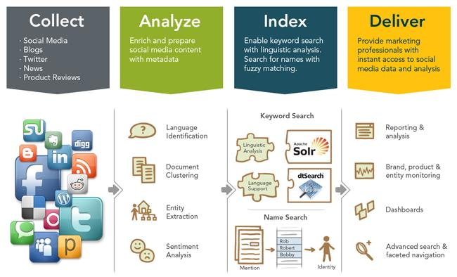
Consumer Sentiment Monitoring

Slide 8

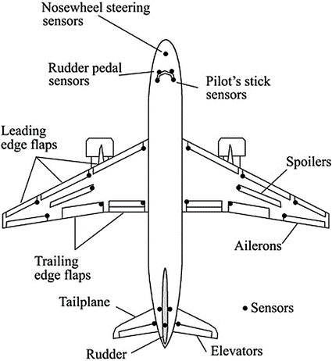
Asset Tracking

Slide 9
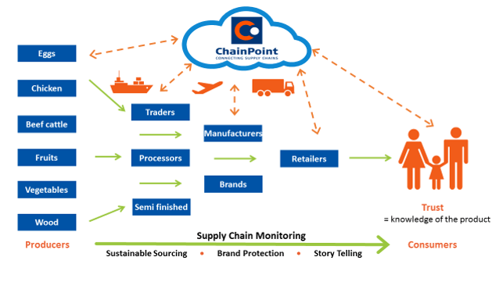
Supply Chain Monitoring

Slide 10

Preventive machine maintenance

Slide 11
Analysis and Insight Applications
Predictive Policing
Winning political elections
Personal Health

Slide 12

Predictive Policing

Slide 13

Winning political elections

Slide 14
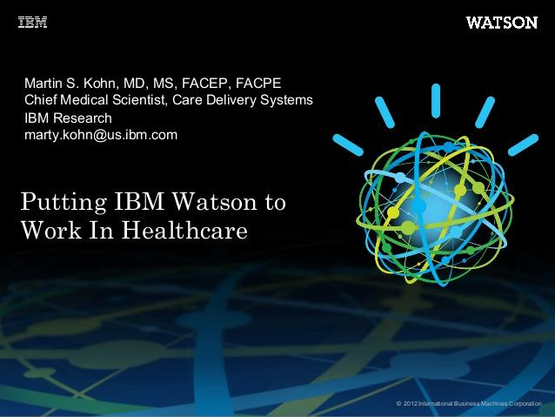
Personal Health

Slide 15
New Product Development
Flexible Auto Insurance
Location based retail promotion
Recommendation service

Slide 16
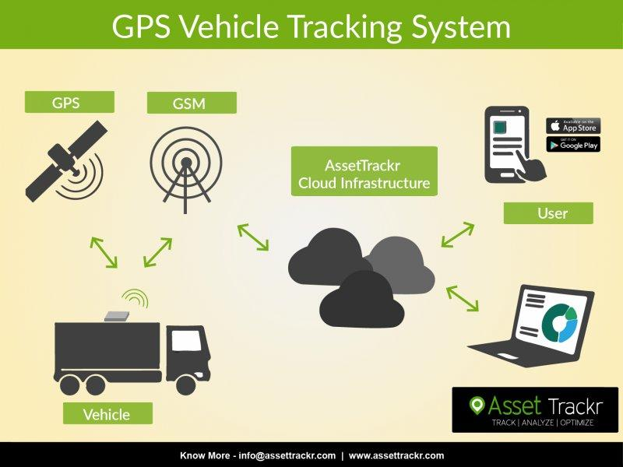
Flexible Auto Insurance

Slide 17
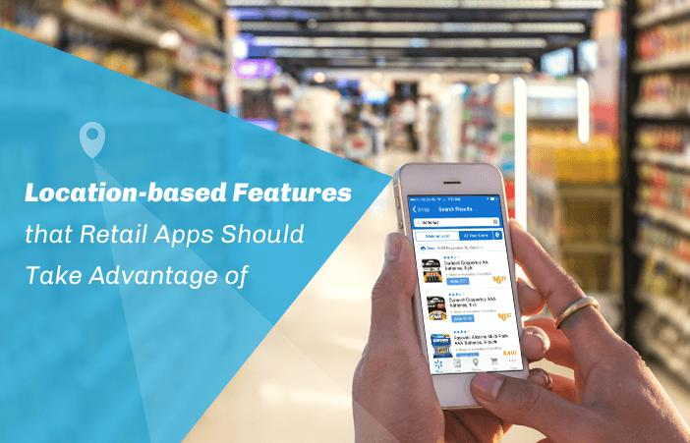
Location based retail promotion

Slide 18

Recommendation service

