Slide 2
understand what is data format.
learn data model and tips for creating effective big data models.
understand data mart and types of data mart.
differentiate between data warehouse and data mart.

Slide 3
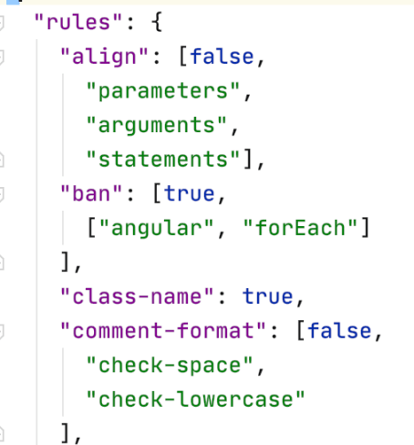
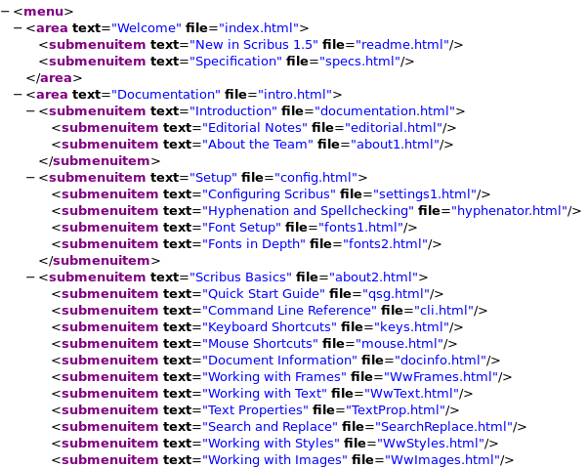
Introduction
JSON
XML

Slide 4
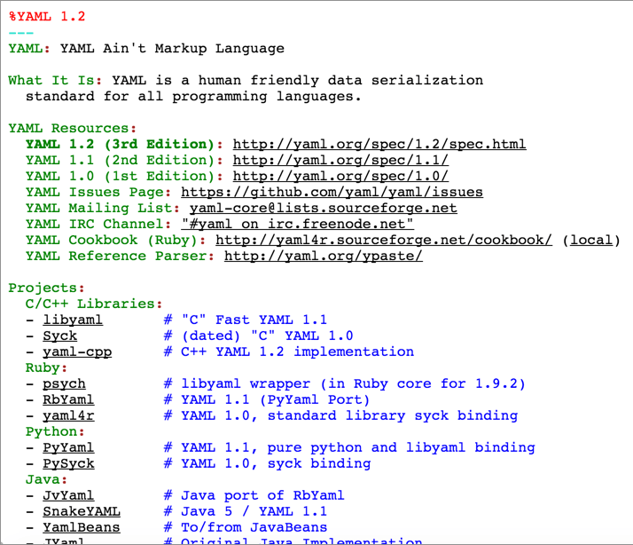
Introduction
YAML

Slide 5
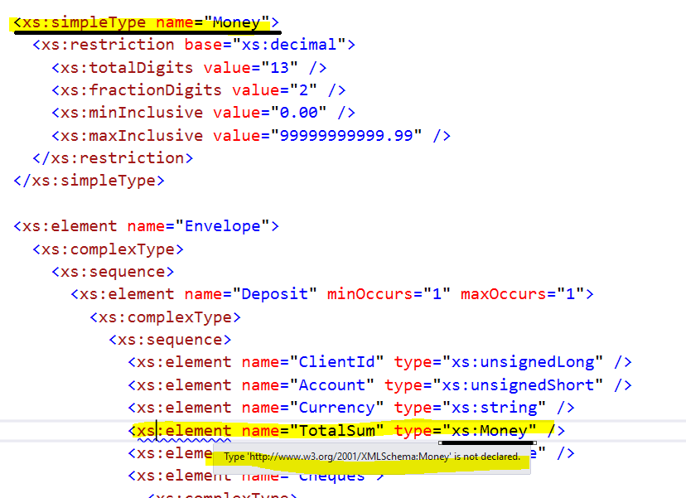
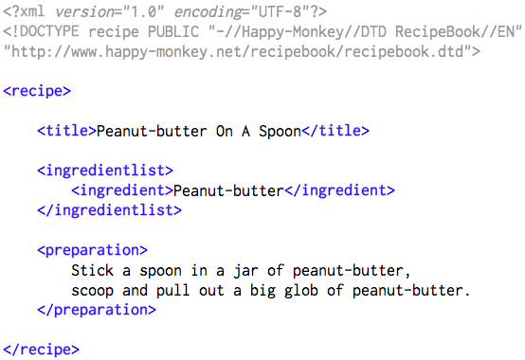
Introduction
XSD
Markup Language

Slide 6

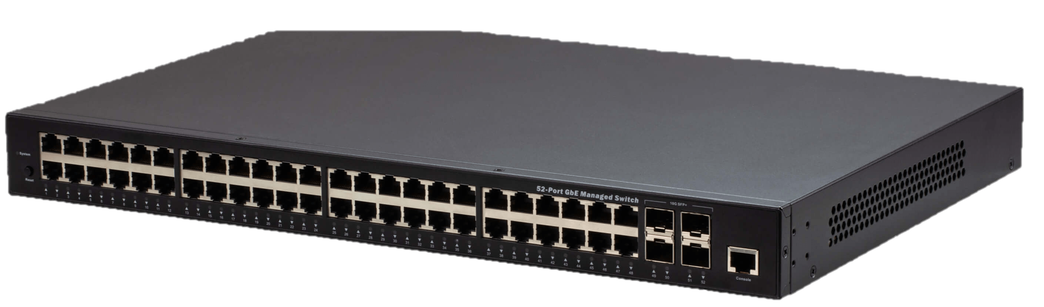
Introduction
Router
Switch

Slide 7
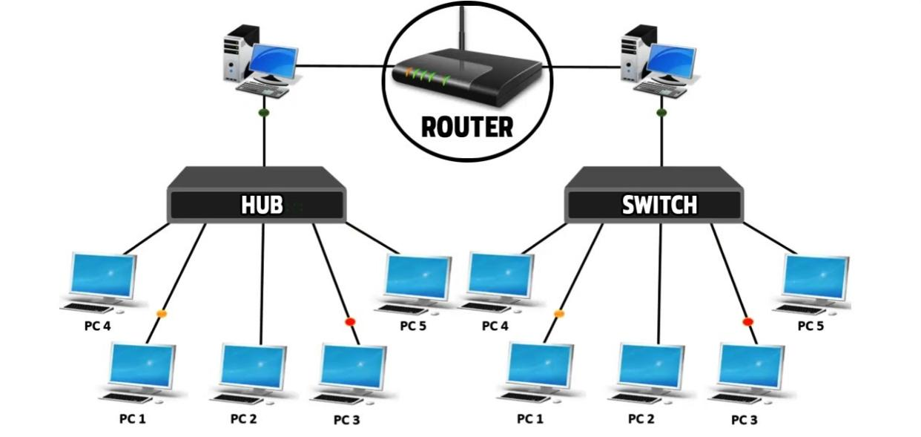
Introduction

Slide 8
Introduction to Data Formats
A computer programmer typically uses a wide variety of tools to store and work with data in the programs they build.
They may use simple variables (single value), arrays (multiple values), hashes (key-value pairs), or even custom objects built in the syntax of the language they’re using.

Slide 9
Data Format
Portable format is required.
Another program may have to communicate with this program in a similar way, and the programs may not even be written in the same language, as is often the case with something like traditional client-server communications.

Slide 10
Data Format
This is all perfectly standard within the confines of the software being written.
However, sometimes a more abstract, portable format is required.
For instance, a non-programmer may need to move data in and out of these programs.

Slide 11
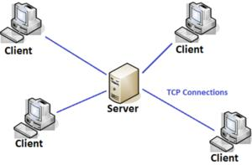
Data Format
Traditional client-server communications

Slide 12

What is Data Model?

Slide 13
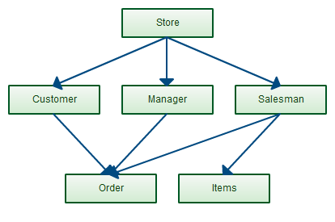

What is a Data Model?
Organize and Store data
Dewey Decimal System organizes the books

Slide 14

Bad programmers worry about the code. Good programmers worry about data structures and their relationships.
Linus Torvalds

Slide 15
Data Model
A data model explicitly determines the structure of data.
Data models are specified in a data modeling(link is external) notation, which is often graphical in form.

Slide 16
Data Model
A data model can be sometimes referred to as a data structure(link is external), especially in the context of programming languages(link is external).

Slide 17
How is Data-Model Built?
A data model is built using components that act as abstractions of real-world things.
The simplest data model consists of entities and relationships.

Slide 18
How is Data-Model Built?
As work on the data model progresses, additional detail and complexity are added, including attributes, domains, constraints, keys, cardinality, require­ments, relationships—and importantly, definitions of everything in the data model.
If we want to understand the data we have—and how to use it—a foundational model is required.

Slide 19
Benefits of Appropriate Models and Storage Environments to Big Data
Performance
Cost
Efficiency
Quality

Slide 20
Benefits of Appropriate Models and Storage Environments to Big Data
Performance
Cost
Efficiency
Quality

Slide 21
Benefits of Appropriate Models and Storage Environments to Big Data
Performance
Cost
Efficiency
Quality

Slide 22
Benefits of Appropriate Models and Storage Environments to Big Data
Performance
Cost
Efficiency
Quality

Slide 23
Therefore, it is without question that a big data system requires high-quality data modeling methods for organizing and storing data, allowing us to reach the optimal balance of performance, cost, efficiency, and quality.

Slide 24
Tips for Creating Effective Big Data Models
Don't try to impose traditional modeling techniques on big data.
Design a system, not a schema.
Look for big data modeling tools.
Focus on data that is core to your business.
Deliver quality data.
Look for key inroads into the data.

Slide 25
Tips for Creating Effective Big Data Models
Don't try to impose traditional modeling techniques on big data
Design a system, not a schema
Look for big data modeling tools
Focus on data that is core to your business
Deliver quality data
Look for key inroads into the data

Slide 26
Tips for Creating Effective Big Data Models
Don't try to impose traditional modeling techniques on big data
Design a system, not a schema
Look for big data modeling tools
Focus on data that is core to your business
Deliver quality data
Look for key inroads into the data

Slide 27
Tips for Creating Effective Big Data Models
Don't try to impose traditional modeling techniques on big data
Design a system, not a schema
Look for big data modeling tools
Focus on data that is core to your business
Deliver quality data
Look for key inroads into the data

Slide 28
Tips for Creating Effective Big Data Models
Don't try to impose traditional modeling techniques on big data
Design a system, not a schema
Look for big data modeling tools
Focus on data that is core to your business
Deliver quality data
Look for key inroads into the data

Slide 29
Tips for Creating Effective Big Data Models
Don't try to impose traditional modeling techniques on big data
Design a system, not a schema
Look for big data modeling tools
Focus on data that is core to your business
Deliver quality data
Look for key inroads into the data

Slide 30
What is Data Mart
It is a data store which is designed for a particular department of an organization, or data mart is a subset of Datawarehouse that is usually oriented to a specific purpose.

Slide 31
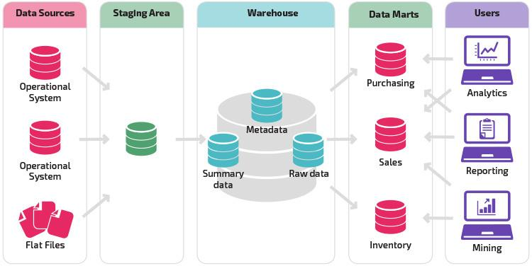
Example

Slide 32
Reasons for Using Data Mart
Easy access of frequent data.
Improved end user response time.
Easy creation of data marts.
Less cost in building the data mart.

Slide 33
Different Types of Data Mart
Dependent Data Mart
Independent Data Mart
Hybrid Data Mart

Slide 34
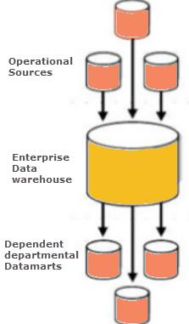
Dependent Data Mart
In this the data mart is built by drawing data from central data warehouse that already exists.

Slide 35
Dependent Data Mart
It is one of the data mart example which offers the benefit of centralization.

Slide 36
Dependent Data Mart
If you need to develop one or more physical data marts, then you need to configure them as dependent data marts.

Slide 37
Dependent Data Mart
Dependent data mart can be built in two different ways: -
Either where a user can access both the data mart and data warehouse, depending on need, or where access is limited only to the data mart

Slide 38
Dependent Data Mart
Dependent data mart can be built in two different ways: -
The second approach is not optimal as it produces sometimes referred to as a data junkyard. In the data junkyard, all data begins with a common source, but they are scrapped, and mostly junked.

Slide 39
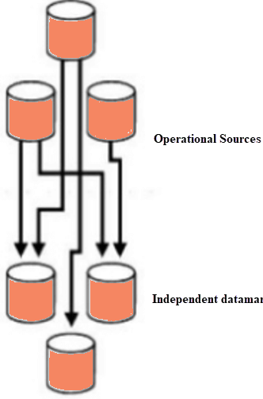
Independent Data Mart
In this, the data mart is built by drawing from operational or external sources of data or both.

Slide 40
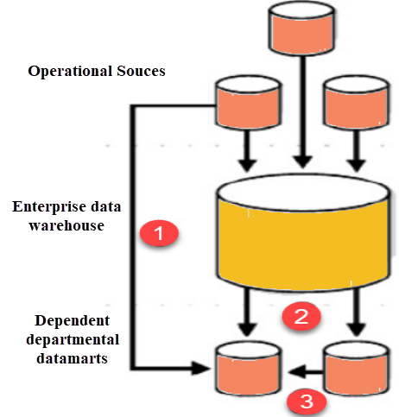
Hybrid Data Mart
A hybrid data mart combines input from sources apart from Data warehouse.

Slide 41
Hybrid Data Mart
It also requires least data cleansing effort.

Slide 42
Hybrid Data Mart
Hybrid Data mart also supports large storage structures, and it is best suited for flexible for smaller data-centric applications.

Slide 43
Advantages of Data mart
Simpler, more focused & flexible.
Low cost for both h/w and s/w.
Faster and cheaper to build.
Stores data closer that enhances performance.

Slide 44
Advantages of Data mart
Simpler, more focused & flexible.
Low cost for both h/w and s/w.
Faster and cheaper to build.
Stores data closer that enhances performance.

Slide 45
Advantages of Data mart
Simpler, more focused & flexible.
Low cost for both h/w and s/w.
Faster and cheaper to build.
Stores data closer that enhances performance.

Slide 46
Advantages of Data mart
Simpler, more focused & flexible.
Low cost for both h/w and s/w.
Faster and cheaper to build.
Stores data closer that enhances performance.

Slide 47
Disadvantages of data mart
Many a times enterprises create too many disparate and unrelated data marts without much benefit. It can become a big hurdle to maintain.
Data Mart cannot provide company-wide data analysis as their data set is limited.
Unorganized development

Slide 48
Disadvantages of data mart
Many a times enterprises create too many disparate and unrelated data marts without much benefit. It can become a big hurdle to maintain.
Data Mart cannot provide company-wide data analysis as their data set is limited.
Unorganized development

Slide 49
Disadvantages of data mart
Many a times enterprises create too many disparate and unrelated data marts without much benefit. It can become a big hurdle to maintain.
Data Mart cannot provide company-wide data analysis as their data set is limited.
Unorganized development

Slide 50
Disadvantages of data mart
Increase in datamart size leads to problems such as performance degradation, data inconsistency.
Big hurdle to maintain.
Data set is limited.
Unorganized development
Increase in datamart size leads to problems such as performance degradation, data inconsistency.

Slide 51
Disadvantages of data mart
Increase in datamart size leads to problems such as performance degradation, data inconsistency.
Big hurdle to maintain.
Data set is limited.
Unorganized development
Increase in datamart size leads to problems such as performance degradation, data inconsistency.

Slide 52
Disadvantages of data mart
Increase in datamart size leads to problems such as performance degradation, data inconsistency.
Big hurdle to maintain.
Data set is limited.
Unorganized development
Increase in datamart size leads to problems such as performance degradation, data inconsistency.

Slide 53
Disadvantages of data mart
Increase in datamart size leads to problems such as performance degradation, data inconsistency.
Big hurdle to maintain.
Data set is limited.
Unorganized development
Increase in datamart size leads to problems such as performance degradation, data inconsistency.

Slide 54
Disadvantages of data mart
Increase in datamart size leads to problems such as performance degradation, data inconsistency.
Big hurdle to maintain.
Data set is limited.
Unorganized development
Increase in datamart size leads to problems such as performance degradation, data inconsistency.

Slide 55
Difference between Data warehouse and Data mart
Data Warehouse | Data Mart
Data warehouse is a Centralized system. | While it is a Decentralized system
In data warehouse, lightly denormalization takes place. | While in Data mart, highly denormalization takes place
Data warehouse is top-down model. | While it is a bottom-up model.
To built a warehouse is difficult. | While to build a mart is easy

Slide 56
Difference between Data warehouse and Data mart
Data Warehouse | Data Mart
In data warehouse, Fact constellation schema is used. | While in this, Star schema and snowflake schema are used.
Data Warehouse is flexible. | While it is not flexible.
Data Warehouse is the data-oriented in nature. | While it is the project-oriented in nature.
Data Warehouse has long life. | While data-mart has short life than warehouse.

Slide 57
Difference between Data warehouse and Data mart
Data Warehouse | Data Mart
In Data Warehouse, Data are contained in detail form. | While in this, data are contained in summarized form.
Data Warehouse is vast in size. | While data mart is smaller than warehouse.

