Slide 2
Learn introduction about Hadoop.
Learn how Hadoop Improves on Traditional Databases
Understand Why is Hadoop important?
Understand what are the challenges of using Hadoop?
Learn benefits of Hadoop for bigdata

Slide 3


Introduction

Slide 4
Introduction
Two order one hour

Slide 5


Traditional Scenario
Data is generated at a steady rate and is structured in nature.
RDBMS

Slide 6

Introduction
Two order one hour

Slide 7






Introduction

Slide 8

Failure of traditional system
10 orders per hour
Receiving much more order than expected
Cook is not capable of cooking 10 dishes per hour.

Slide 9
Failure of Traditional Scenario
Heterogeneous data is being generated at an alarming stage by multiple sources
RDBMS
Velocity is really high.

Slide 10


Failure of Traditional Scenario

Slide 11
Issue1: Too many orders Per Hour
Solution: Hire multiple Cook

Slide 12

Introduction

Slide 13


Multipleprocessing unit for processing

Slide 14


Issue: Foodshelf become the bottleneck
Solution: Distributed and parallel processing

Slide 15



Introduction
MAP
Cooks friedrice
Cooks manchurian
Reduce
Final order
Fried rice + manchurian
Assemble fried rice+ manchurian
Distributed Food Shelf

Slide 16
Do we have a framework that works like that for storing and processing big data?

Slide 17

Framework to process BIG DATA

Slide 18
Introduction
Hadoop is a framework that allows us to store and process large datasets in parallel and distributed fashion.

Slide 19
Hadoop
Two major problems in dealing with BIG DATA
Storage
Processing

Slide 20
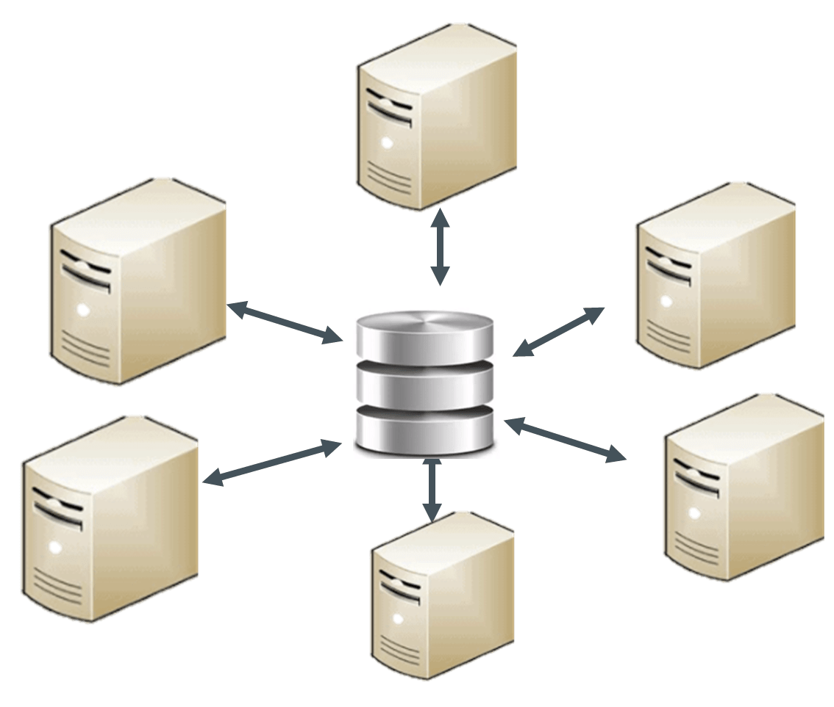
Hadoop
Storage problem resolved by
HDFS
Distributed File System

Slide 21
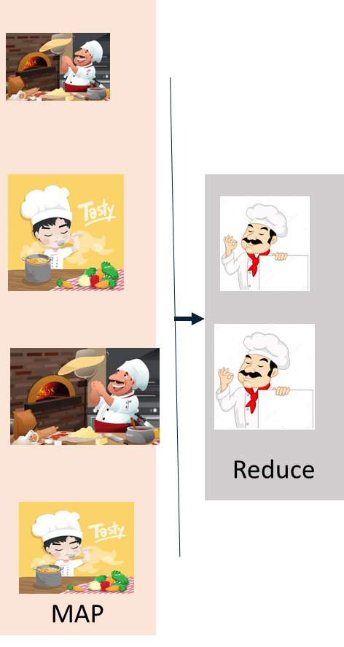
Hadoop
Processing problem resoved by
mapReduce
Processing:Allow distributed and parallel processing

Slide 22
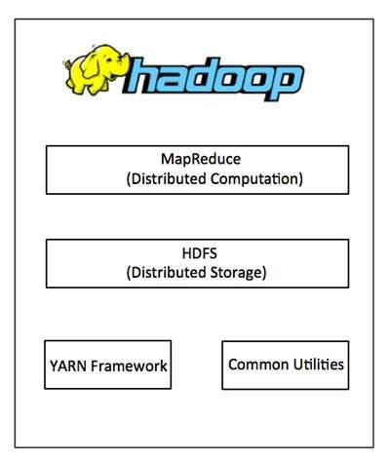
Hadoop Architecture

Slide 23
Hadoop Architecture
At its core, Hadoop has two major layers namely
Processing/Computation layer (MapReduce), and
Storage layer (Hadoop Distributed File System)

Slide 24

How Hadoop Improves on Traditional Databases
Capacity: Hadoop stores large volumes of data.

Slide 25
How Hadoop Improves on Traditional Databases
Capacity: Hadoop stores large volumes of data.
Speed: Hadoop stores and retrieves data faster.

Slide 26
Why is Hadoop important?
Ability to store and process huge amounts of any kind of data, quickly.
Computing power.
Fault tolerance.
Flexibility.
Low cost.
Scalability.

Slide 27
What are the challenges of using Hadoop?
MapReduce programming is not a good match for all problems.
There’s a widely acknowledged talent gap.
Data security.
Full-fledged data management and governance

Slide 28
Benefits of Hadoop for Big Data
Resilience
Scalability
Low cost
Speed
Data diversity

Slide 29
The Hadoop Ecosystem: Supplementary Components
HDFS: Hadoop Distributed File System
YARN: Yet Another Resource Negotiat or
MapReduce: Programming based Data Processing
Spark: In-Memory data processing
PIG,HIVE: Query based processing of data services

Slide 30
The Hadoop Ecosystem: Supplementary Components
HBase: NoSQL Database
Mahout,Spark MLLib: Machine Learning algorithm librarie
Solar,Lucene: Searching and Indexing
Zookeeper: Managing cluster
Oozie: Job Scheduling

