Slide 2
learn how to install java
learn how to install hadoop

Slide 3

Prerequisites to install Hadoop

Slide 4

Prerequisites to install Hadoop

Slide 5
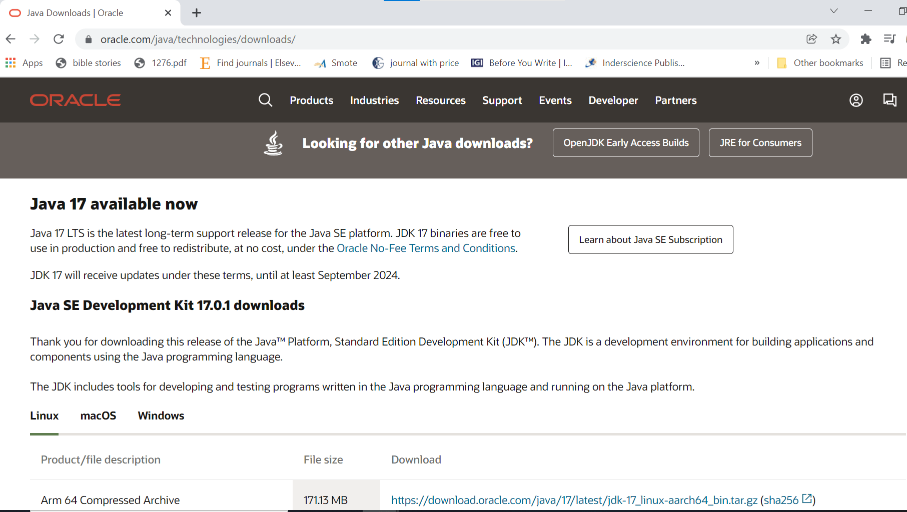
Steps to install Java

Slide 6
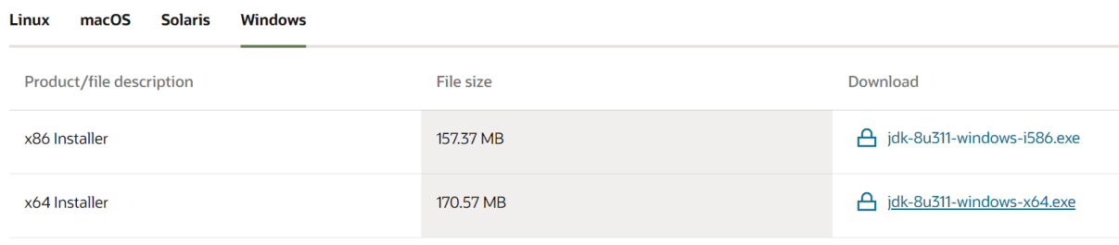
Steps to Install Java

Slide 7
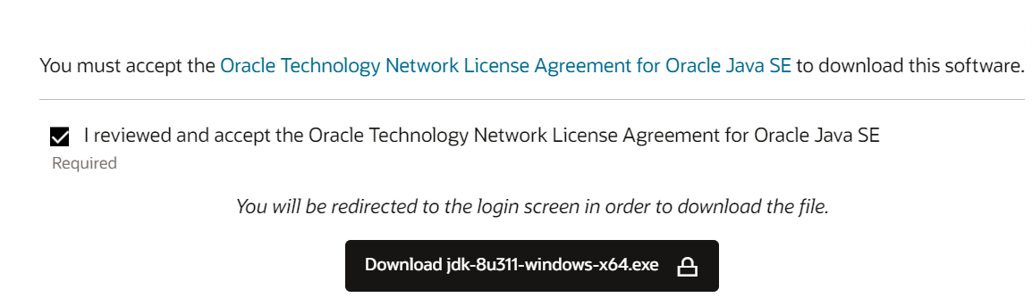
Steps to Install Java

Slide 8
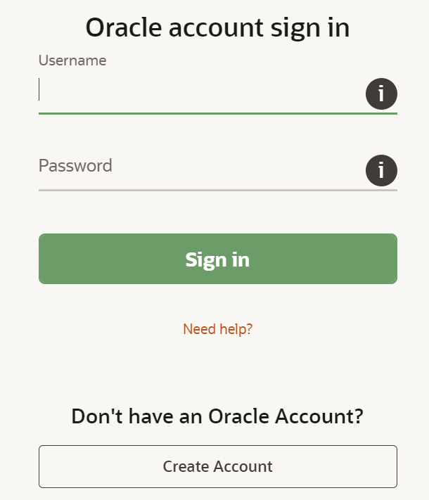
Steps to Install Java

Slide 9


Steps to Install Java

Slide 10
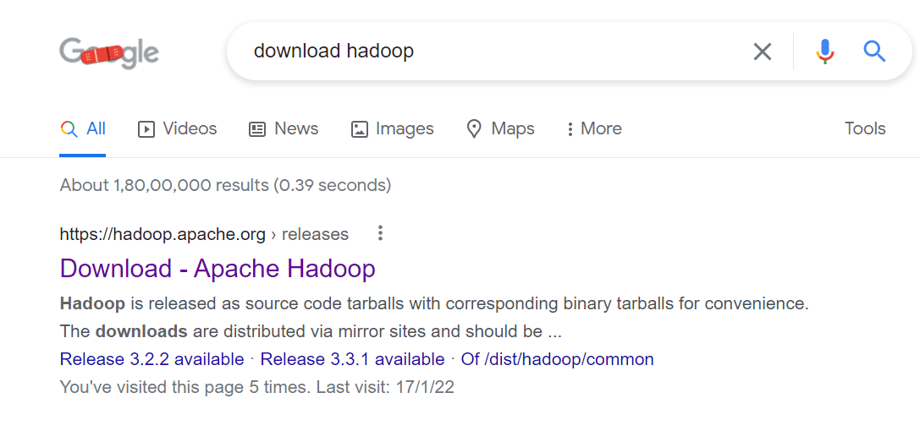
Steps to install hadoop
https://hadoop.apache.org ›

Slide 11
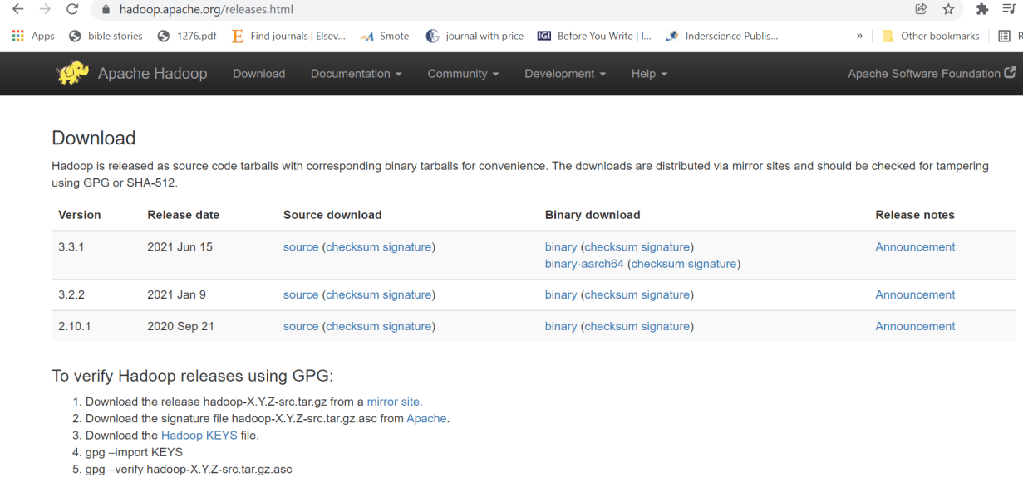
Steps to install hadoop

Slide 12
Steps to install hadoop

Slide 13

Steps to install hadoop

Slide 14
Steps to install hadoop

Slide 15



Steps to install hadoop

Slide 16
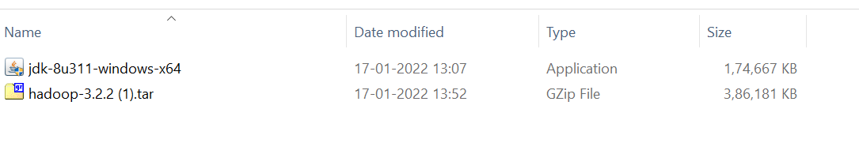
Steps to install hadoop

Slide 17
Installation of Java

Slide 18
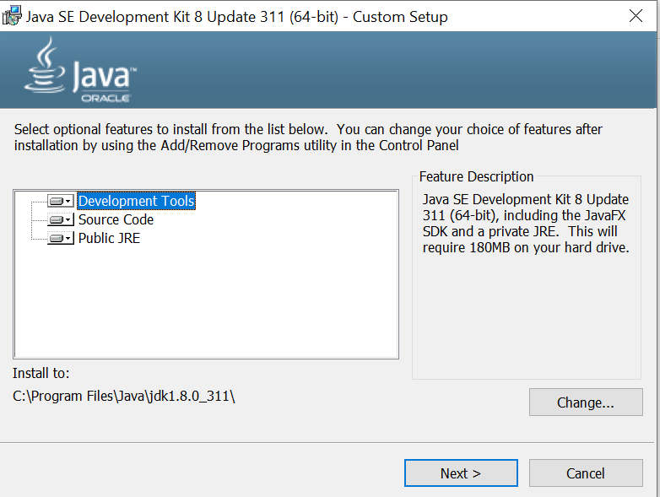
Installation of JAVA

Slide 19
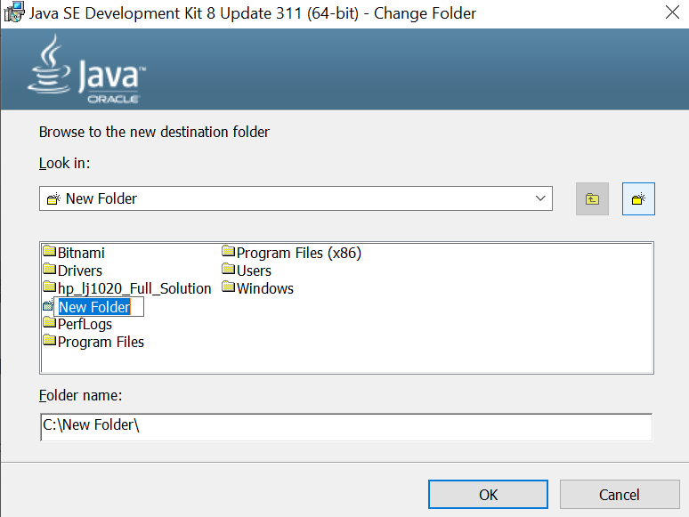
Installation of JAVA

Slide 20
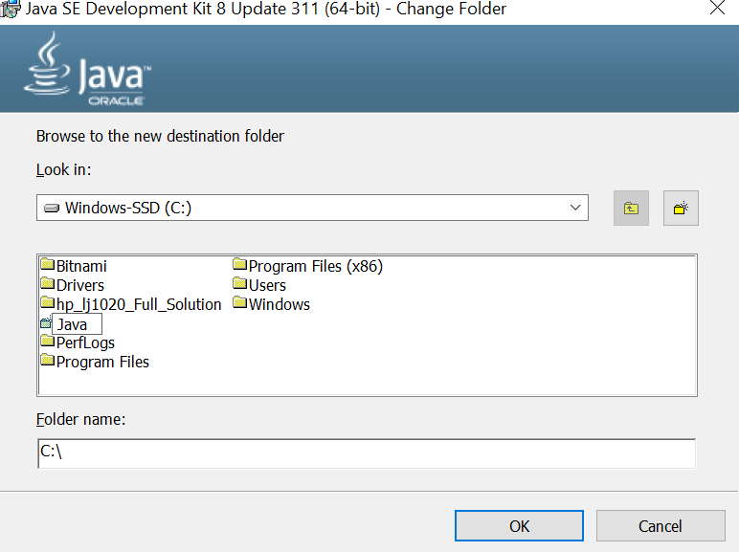
Installation of JAVA

Slide 21
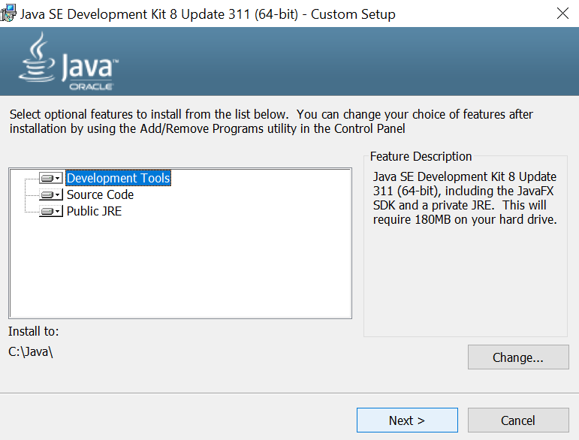
Installation of JAVA

Slide 22
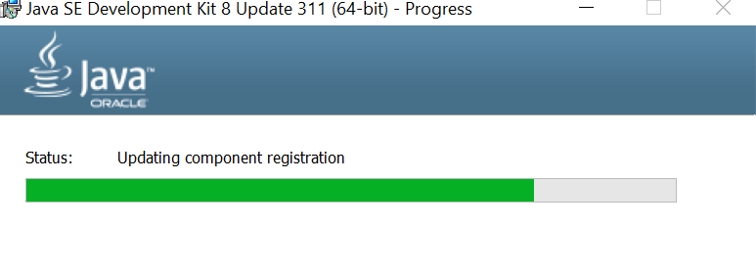
Installation of JAVA

Slide 23
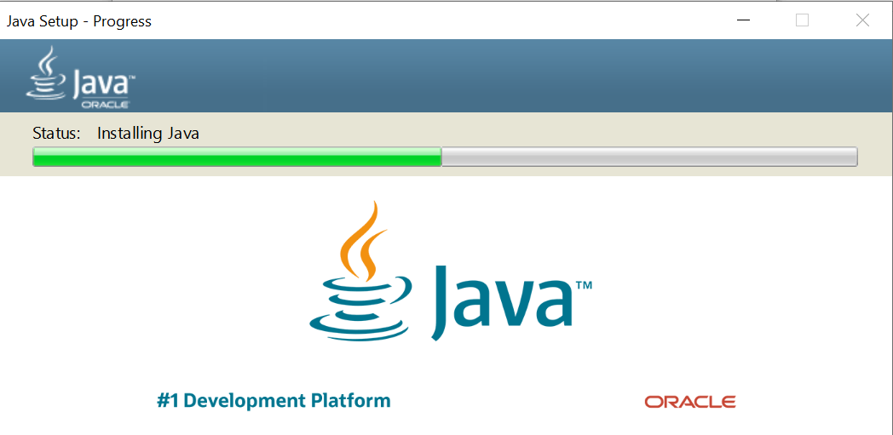
Installation of JAVA

Slide 24
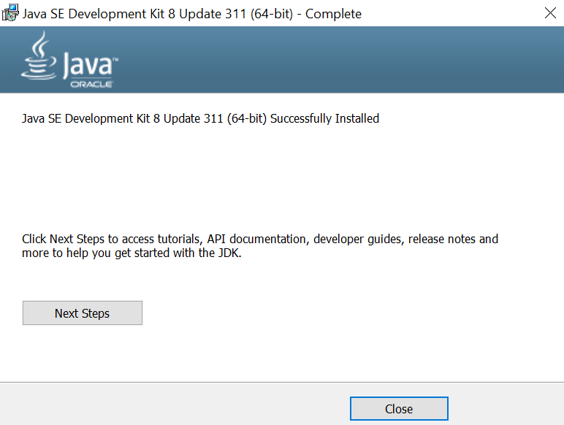
Installation of JAVA

Slide 25
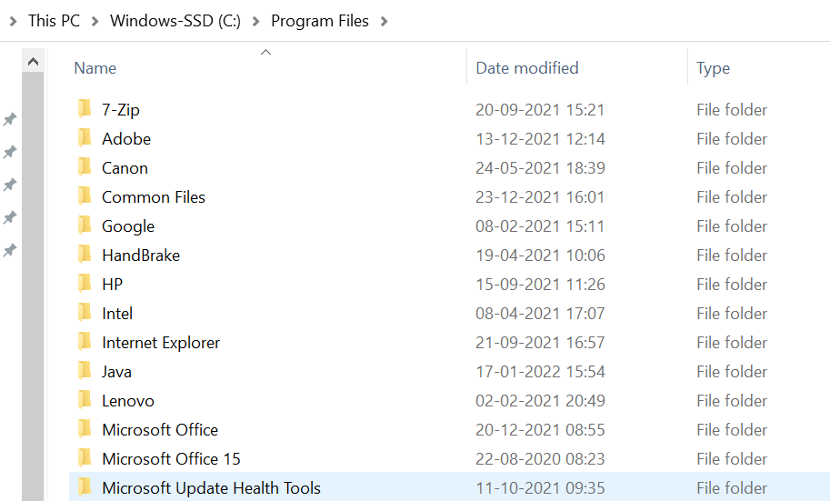
Installation of JAVA

Slide 26
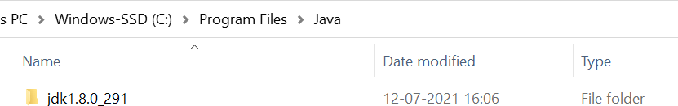
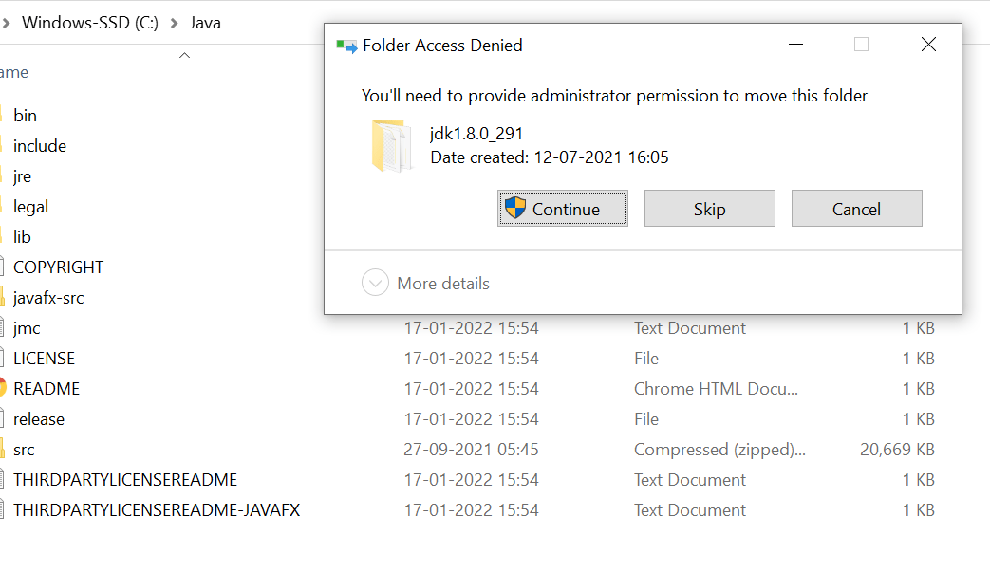
Installation of JAVA

Slide 27
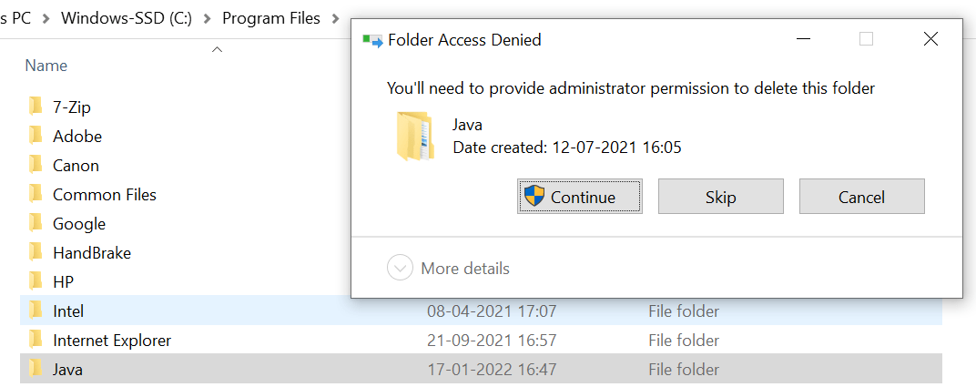
Installation of JAVA

Slide 28
How to set environment variable for JAVA

Slide 29

Set the Environment Variable for JAVA

Slide 30
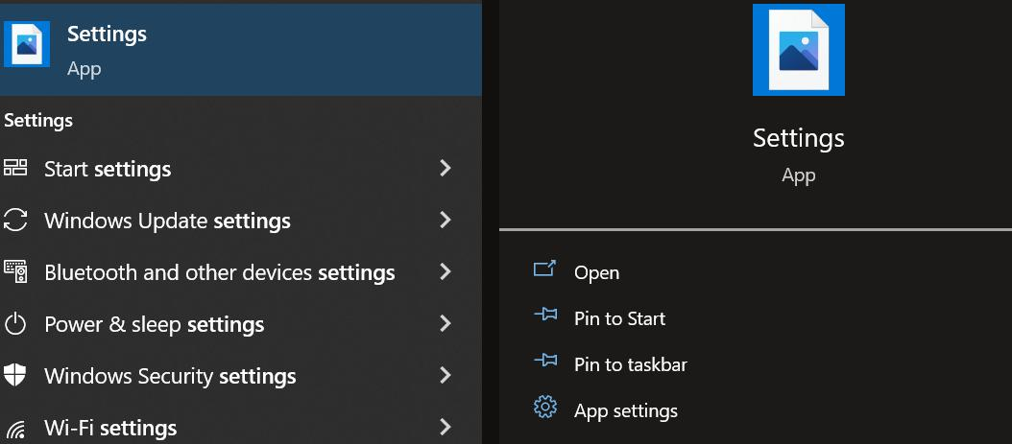
Set the Environment Variable for JAVA

Slide 31
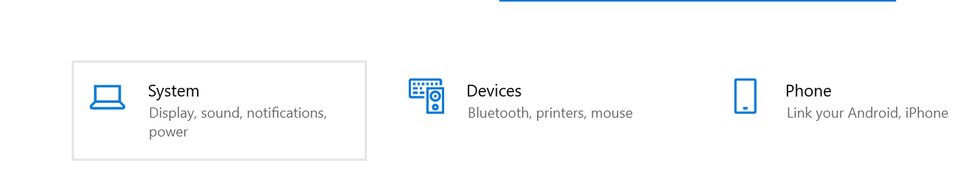
Set the Environment Variable for JAVA

Slide 32
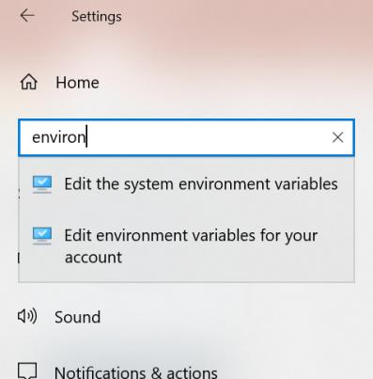
Set the Environment Variable for JAVA

Slide 33
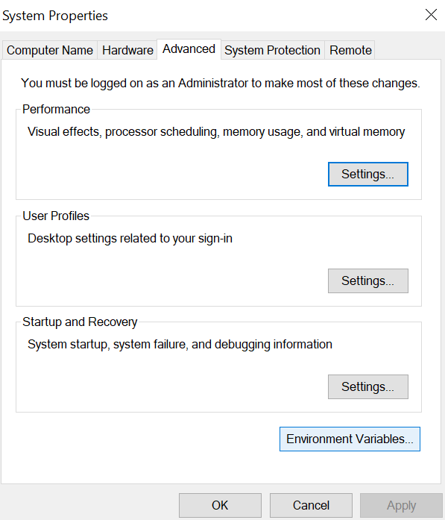
Set the Environment Variable for JAVA

Slide 34
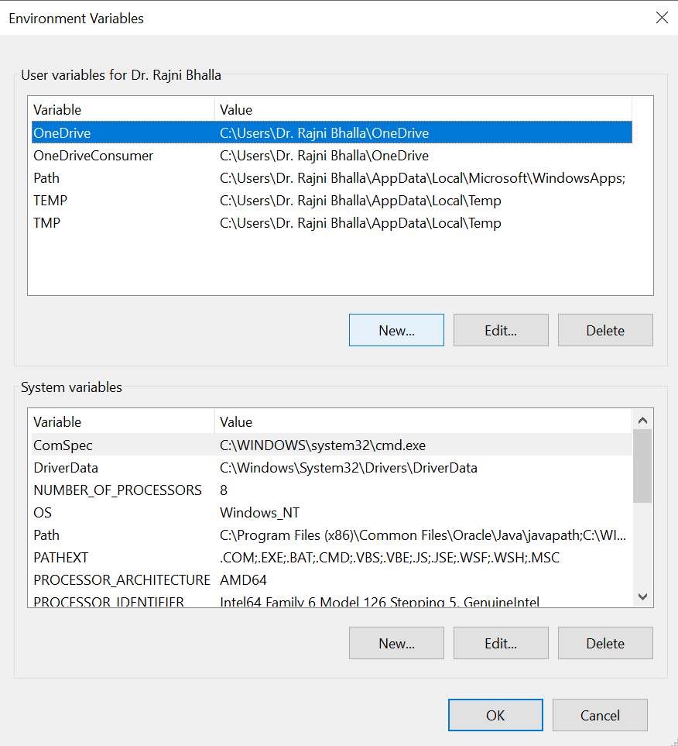
Set the Environment Variable for JAVA

Slide 35
Set the Environment Variable for JAVA

Slide 36
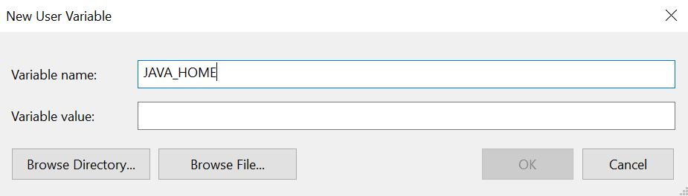
Set the Environment Variable for JAVA

Slide 37
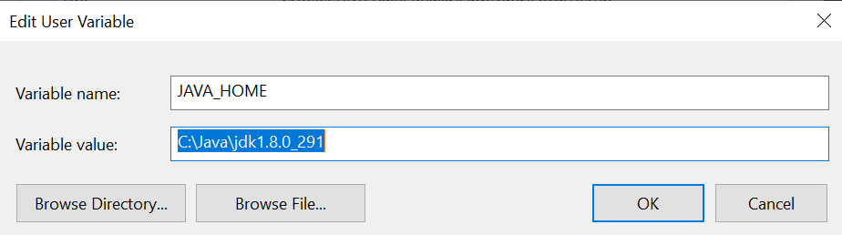
Set the Environment Variable for JAVA

Slide 38
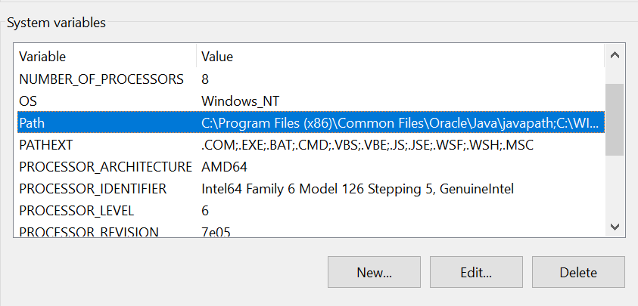
Set the Environment Variable for JAVA

Slide 39
Set the Environment Variable for JAVA

Slide 40
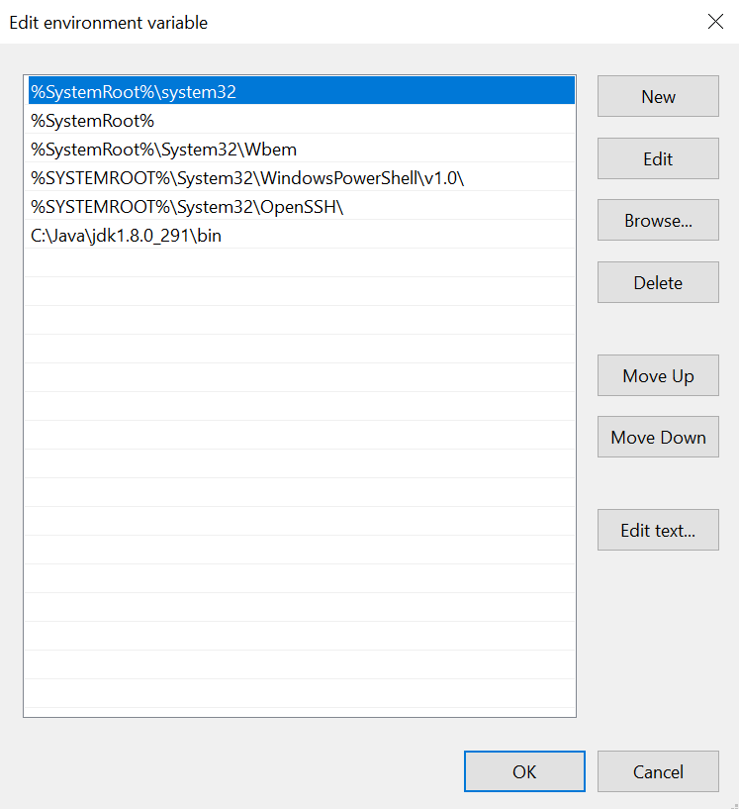
Set the Environment Variable for JAVA

Slide 41
Set the Environment Variable for JAVA

Slide 42
Set the Environment Variable for JAVA

Slide 43
Set the Environment Variable for JAVA

Slide 44
Check whether java is functional or not

Slide 45
Steps to check Java is functional or not
Windows + R

Slide 46
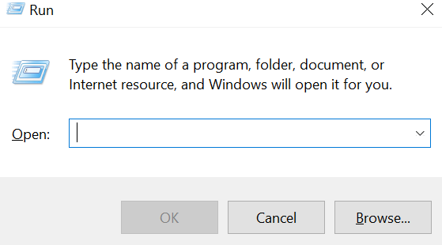
Steps to check Java is functional or not
Windows + R

Slide 47
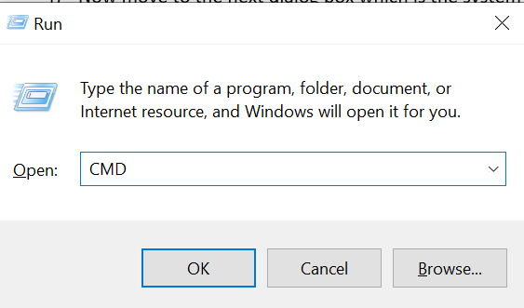
Steps to check Java is functional or not

Slide 48
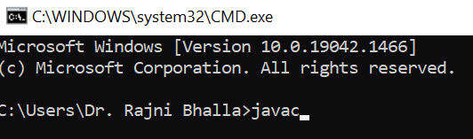
Steps to check Java is functional or not

Slide 49
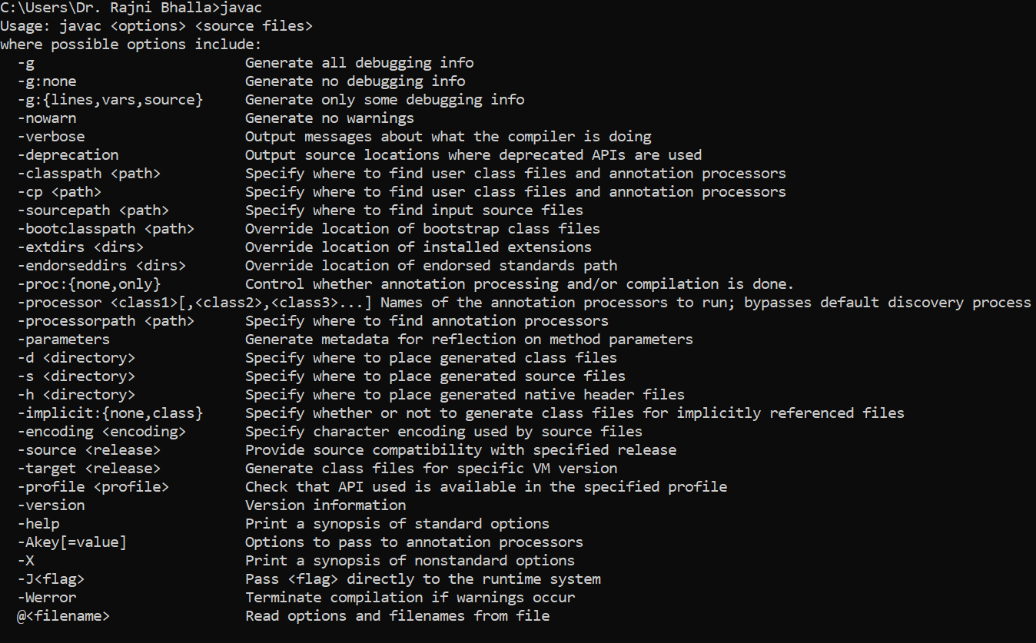
Steps to check Java is functional or not

Slide 50
To check version of JAVA

Slide 51

CMD

Slide 52
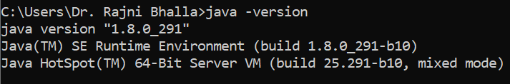
CMD

Slide 53
INSTALL HADOOP INTO OUR LOCAL SYSTEM

Slide 54
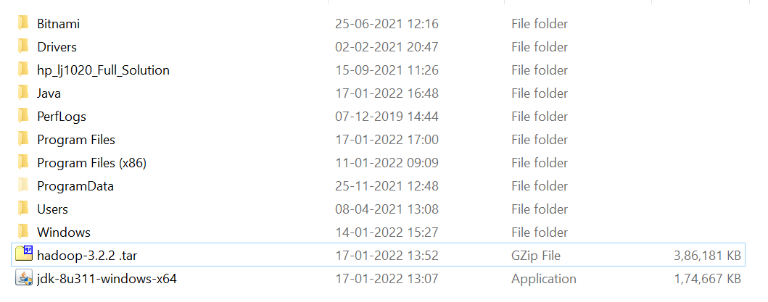
Steps to install Hadoop

Slide 55
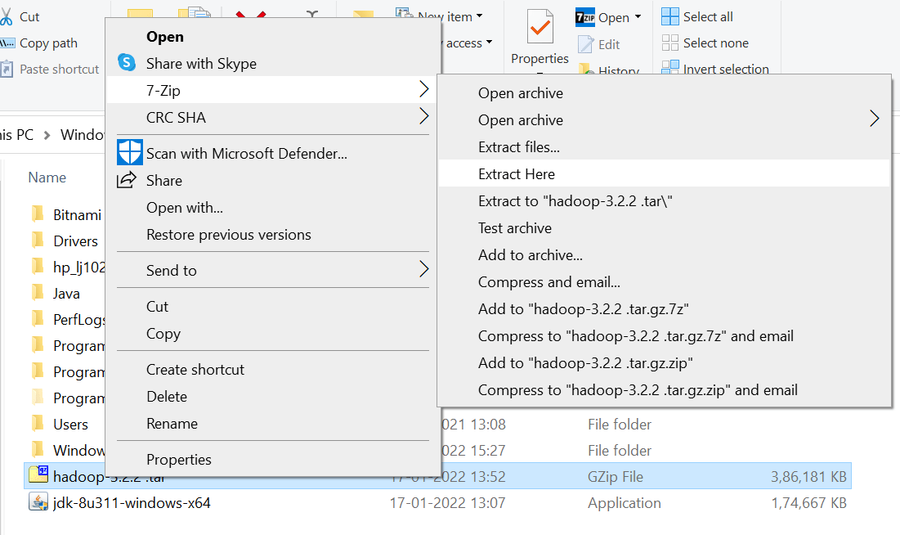
Steps to install Hadoop

Slide 56
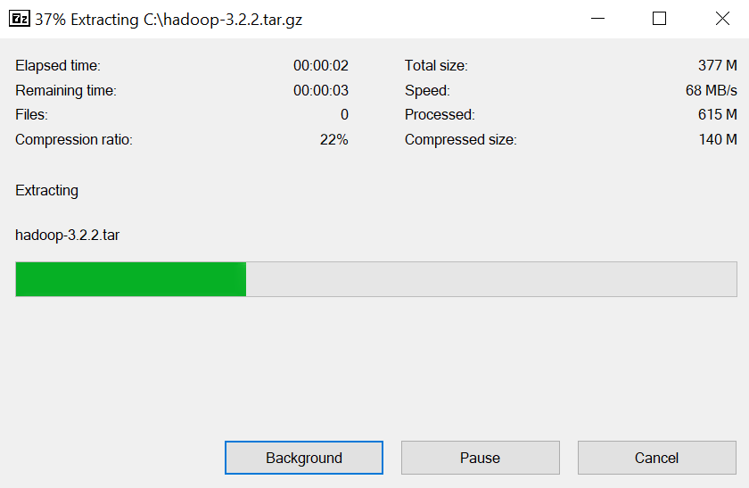
Steps to install Hadoop

Slide 57
Steps to install Hadoop
Ignore
Cannot create a symbolic link:….
Cannot create a symbolic link:….
Cannot create a symbolic link:….

Slide 58
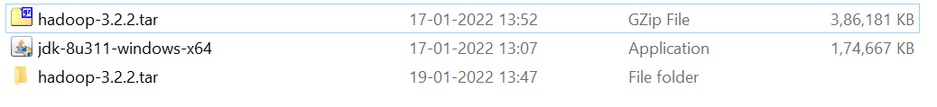
Steps to install Hadoop

Slide 59
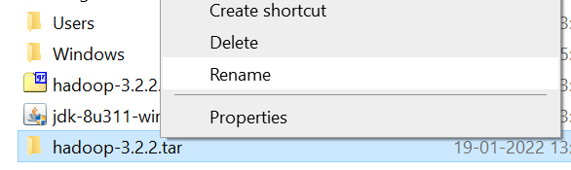
Steps to install Hadoop

Slide 60

Steps to install Hadoop

Slide 61
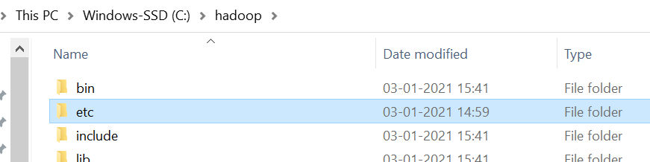
Steps to install Hadoop

Slide 62
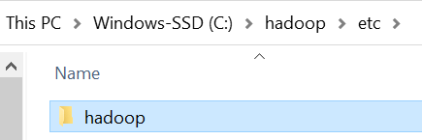
Steps to install Hadoop

Slide 63
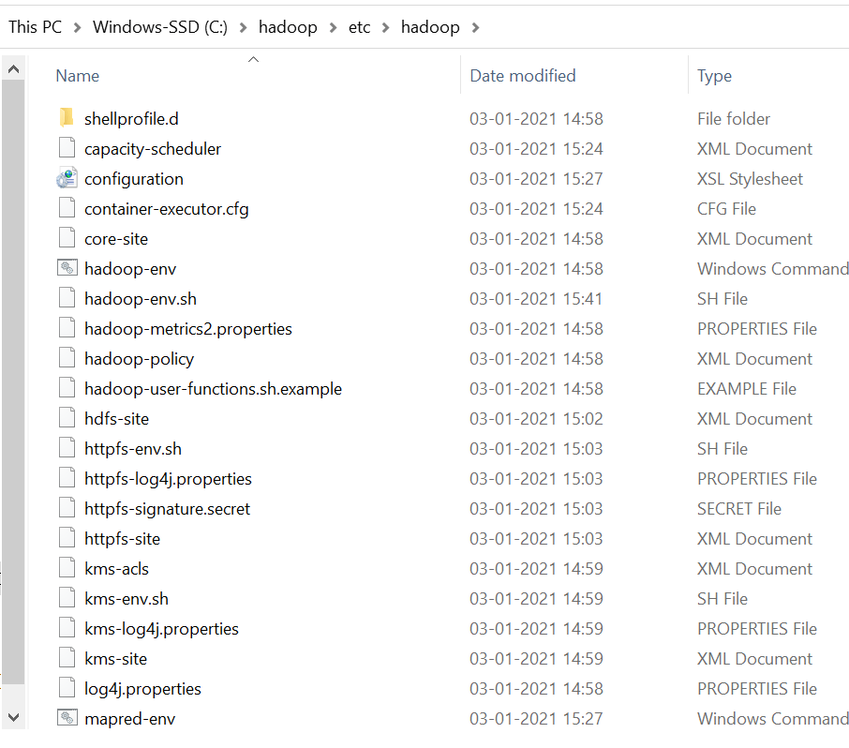
Steps to install Hadoop

Slide 64
Steps to install Hadoop

Slide 65
Steps to install Hadoop

Slide 66
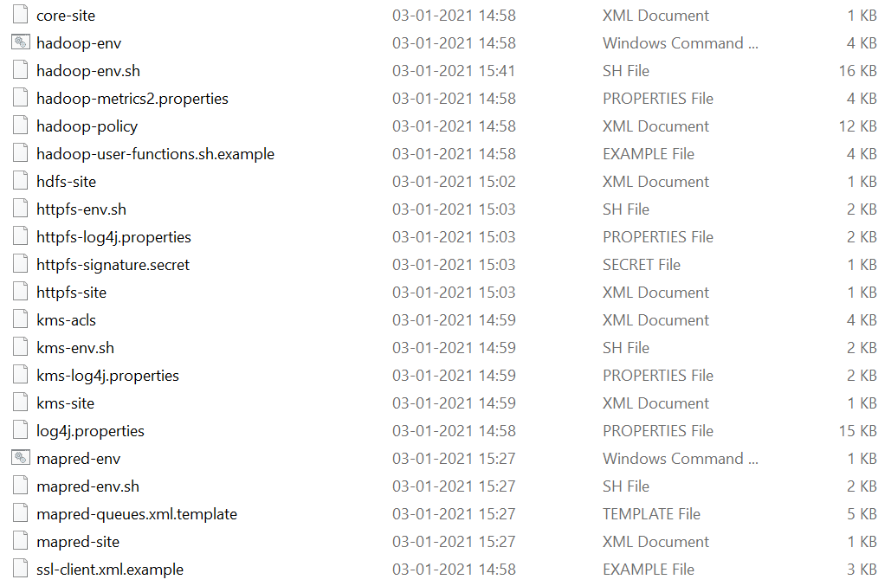
Steps to install Hadoop

Slide 67
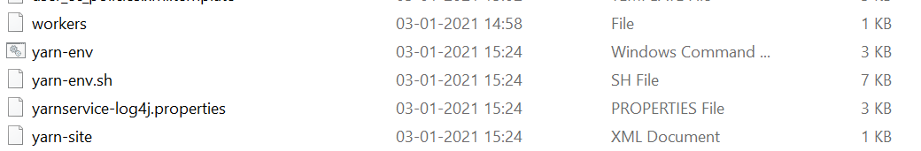
Steps to install Hadoop

Slide 68
Steps to install Hadoop

Slide 69
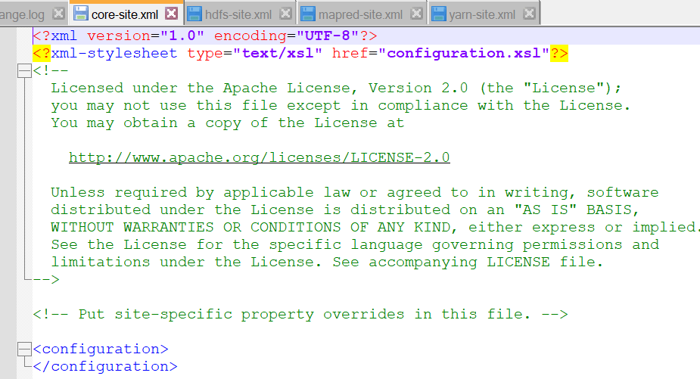
Steps to install Hadoop

Slide 70
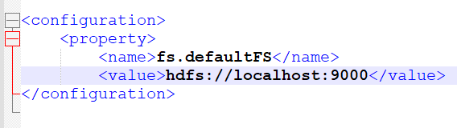
Steps to install Hadoop
core-site.xml

Slide 71
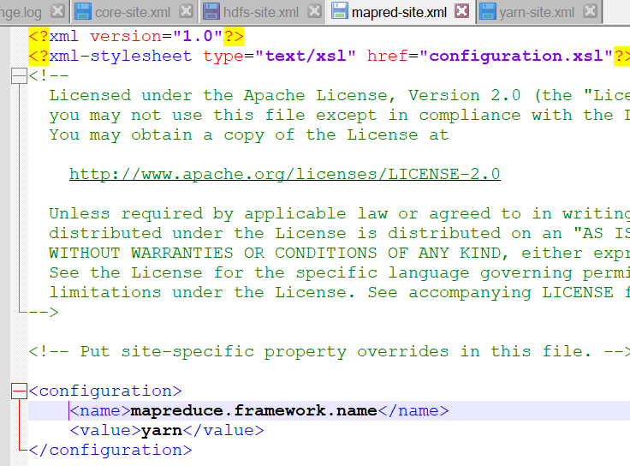
Steps to install Hadoop

Slide 72
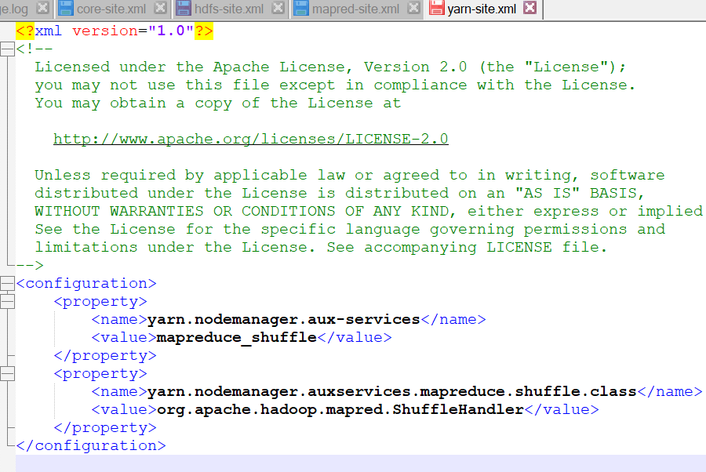
Steps to install Hadoop

Slide 73
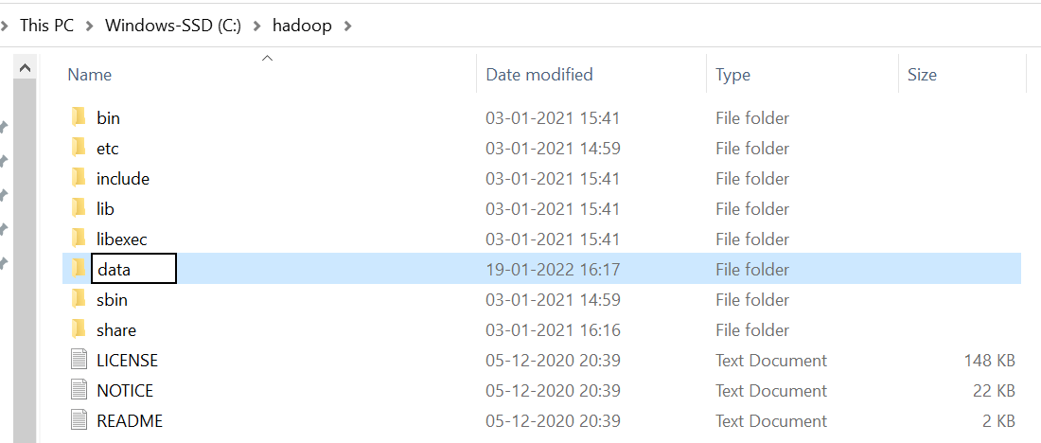
Steps to install Hadoop
C:\hadoop

Slide 74
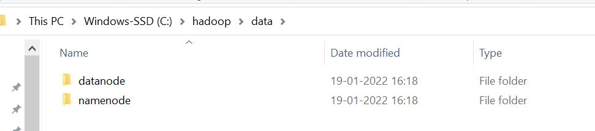
Steps to install Hadoop

Slide 75

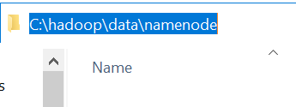
Steps to install Hadoop

Slide 76
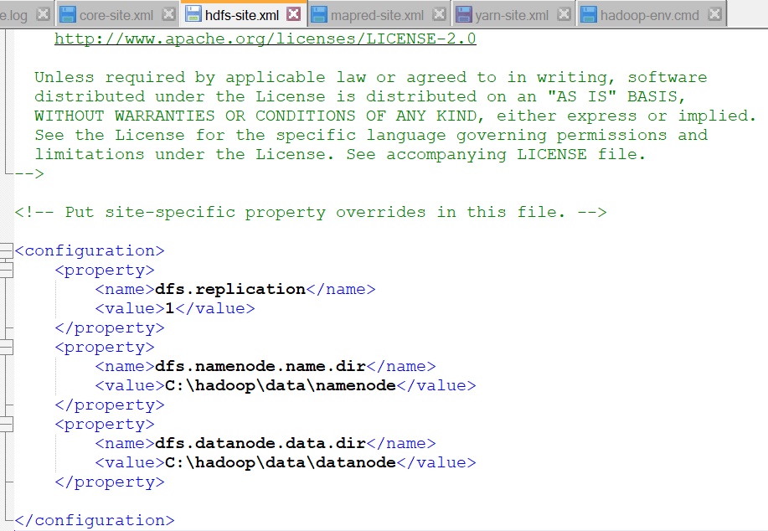
Steps to install hadoop

Slide 77

Steps to install hadoop
To get the correct location, copy from path

Slide 78

Steps to install hadoop

Slide 79

Steps to install hadoop

Slide 80

Steps to install hadoop

Slide 81

Steps to install hadoop

Slide 82

Steps to install hadoop

Slide 83

Steps to install Hadoop

Slide 84

Steps to install Hadoop

Slide 85

Steps to install Hadoop

Slide 86

Steps to install Hadoop

Slide 87

Steps to install Hadoop

Slide 88

Steps to install Hadoop

Slide 89

Steps to install Hadoop

Slide 90

Steps to install Hadoop

Slide 91

Steps to install Hadoop

Slide 92

Steps to install Hadoop

Slide 93

Steps to install Hadoop

Slide 94

Steps to install Hadoop

Slide 95

Steps to install Hadoop

Slide 96
CMD

