Slide 2
learn HDFS
HDFS Architecture
goals of HDFS

Slide 3

Introduction

Slide 4
Introduction
Large amount of data.
Easier access.
To store such huge data, the files are stored across multiple machines.
Stored in redundant fashion to rescue.
Makes applications available to parallel processing.

Slide 5
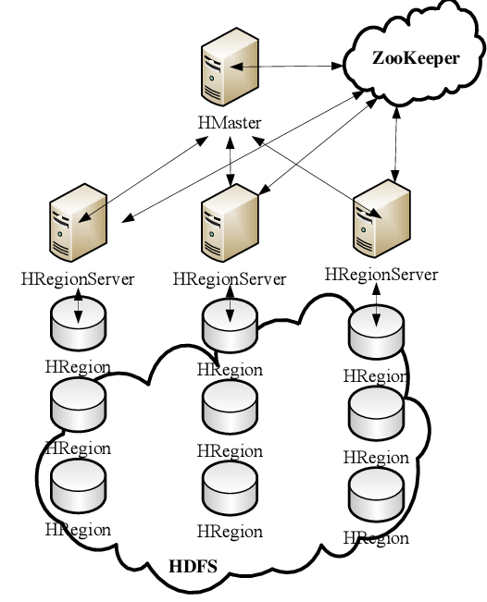
Features of HDFS
Distributed Storage and Processing.

Slide 6
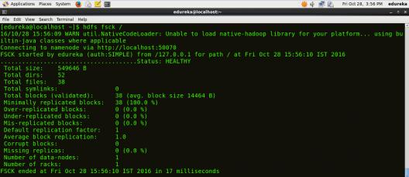
Features of HDFS (Command Interface)

Slide 7

Features of HDFS
Built-in Servers of Namenode and Datanode

Slide 8
Features of HDFS
Streaming access to file system data.

Slide 9
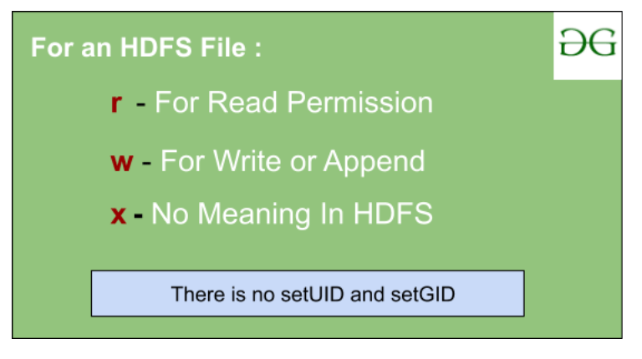
Features of HDFS
File Permissions and Authentication.

Slide 10
HDFS Architecture

Slide 11
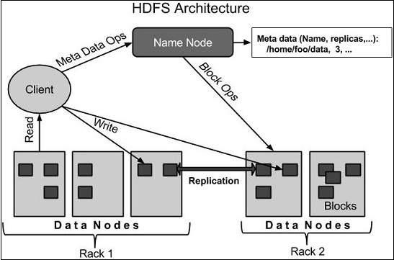
HDFS Architecture

Slide 12
HDFS Architecture
HDFS follows the master-slave architecture
Namenode
Datanode
Block

Slide 13
HDFS Architecture (Namenode)
Centerpiece of an HDFS file system.
Directory tree of all files in the file system.
Tracks where across the cluster the file data is kept.
It does not store the data of these files itself.
Client applications talk to the NameNode.
NameNode responds the successful requests.

Slide 14
HDFS Architecture
NAMENODE
Single Point of Failure
When the Name Node goes down, ______________
Optional SecondaryNameNode
Creates checkpoints of the namespace
BackupNameNode

Slide 15
HDFS Architecture
Name Node works as Master in Hadoop cluster. Below listed are the main function performed by Name Node:
Stores metadata of actual data.
Manages File system namespace.
Regulates client access request for actual file data file.

Slide 16
HDFS Architecture
Name Node works as Master in Hadoop cluster. Below listed are the main function performed by Name Node:
Assign work to Slaves (DataNode).
Executes file system name space operation like opening/closing files, renaming files and directories.

Slide 17
HDFS Architecture
Name Node works as Master in Hadoop cluster. Below listed are the main function performed by Name Node:
As Name node keep metadata in memory for fast retrieval, the huge amount of memory is required for its operation. This should be hosted on reliable hardware.

Slide 18
HDFS Architecture
Data Node works as Slave in Hadoop cluster. Below listed are the main function performed by Data Node:
Actually stores Business data.
his is actual worker node were Read/Write/Data processing is handled.
Upon instruction from Master, it performs creation/replication/deletion of data blocks.

Slide 19
HDFS Architecture
Data Node works as Slave in Hadoop cluster. Below listed are the main function performed by Data Node:
As all the Business data is stored on Data Node, the huge amount of storage is required for its operation. Commodity hardware can be used for hosting Data Node.

Slide 20
HDFS Architecture
Storing the actual data in HDFS.
DataNode is also known as the Slave
NameNode and DataNode are in constant communication.
When a DataNode starts up
When a DataNode is down

Slide 21
HDFS Architecture
DataNode is usually configured with a lot of hard disk space
DataNode periodically send HEARTBEATS to NameNode

Slide 22
HDFS Architecture
Block
Stored in the files of HDFS.
Divided into one or more segments.
HDFS can read or write.
Block size is 64MB.
Increased as per the need to change in HDFS configuration.

Slide 23
Goals of HDFS
Fault Detection and Recovery
Huge Datasets
Hardware at Data

