Slide 2
After this lecture, you will be able to
explore cloud computing fundamentals,
know about the history of cloud computing,
analyse the evolution of cloud computing,
learn about the different cloud components.

Slide 3
What is Cloud?
Cloud refers to a Network or Internet.
Cloud is something, which is present at a remote location.
Cloud can provide services over the network, that is, on public networks or on private networks, that is, Wide Area Networks (WANs), Local Area Networks (LANs), or Virtual Private Networks (VPNs).
Applications such as e-mail, web conferencing, customer relationship management (CRM), all run in the cloud.

Slide 4
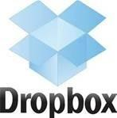


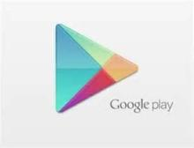








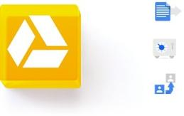
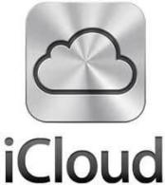
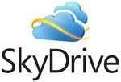

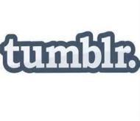





Do You Use Cloud?

Slide 5
What is Cloud Computing?
Embarked a revolution in accessing, provisioning and consumption of the information and computing in the ICT industry.
Novel paradigm of high-performance and large scale computing that actuates relocation of computing and data from desktops and personal computers to big data centers.

Slide 6
What is Cloud Computing?
Construct (or an infrastructure that allows to access application that actually resides at a remote location).
An abstraction (pooling physical resources and presenting them as a virtual resource).
New model for provisioning resources.

Slide 7
Cloud Computing: Definition as per NIST
“Cloud computing is a model for enabling ubiquitous, convenient, on-demand network access to a shared pool of configurable computer resources (networks, servers, storage, applications, and services) that can be rapidly provisioned and released with minimal management effort or service provider interaction.”

Slide 8
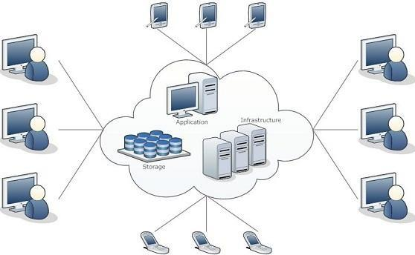
Cloud Computing Scenario

Slide 9
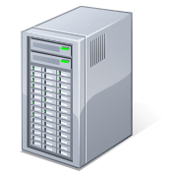
Detailed Cloud Computing Scenario
Applications
Services
Computer Network
Storage (Database)
SERvers

Slide 10
What is Cloud Computing?
Refers to manipulating, configuring, and accessing the applications online.
Offers online data storage, infrastructure and application.
Combination of software and hardware-based computing resources delivered as a network service.
Example:-

Slide 11
Cloud Scenario
If some other company hosts your application, that is, they handle the cost of servers, manage the software update.
Charge the customer as per their utilization, that is, as per the usage you will pay them.
Reduce the cost of using this software.
Reduce the cost of installation of heavy servers.
Reduce the cost of electricity bills.

Slide 12
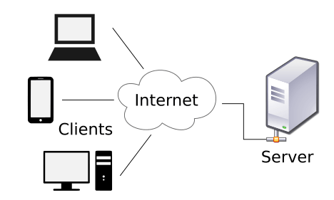
Cloud Scenario
The client don’t need to pay for hardware and maintenance
The service providers pays for hardware and maintenance

Slide 13
Cloud Computing Collaboration
With the growth of the Internet, there was no need to limit group collaboration to a single enterprise’s network environment.
Users from multiple locations within a corporation, and from multiple organizations, desired to collaborate on projects that crossed company and geographic boundaries.

Slide 14
Cloud Computing Collaboration
Projects have to be housed in the “cloud” of the Internet and accessed from any Internet-enabled location.
The concept of cloud-based documents and services took wing with the development of large server farms, such as those run by Google and other search companies.
Internet-based group collaboration.

Slide 15
Cloud Properties: Google’s Perspective
Cloud computing is User-centric
Cloud computing is Task-centric
Cloud computing is Powerful
Cloud computing is Accessible
Cloud computing is Intelligent
Cloud computing is Programmable

Slide 16
Traditional Infrastructure Model
Forecasted Infrastructure Demand
Capital
Time

Slide 17
Acceptable Surplus
Forecasted Infrastructure Demand
Surplus
Capital
Time

Slide 18
Actual Demand
Capital
Actual Infrastructure Demand
Time

Slide 19
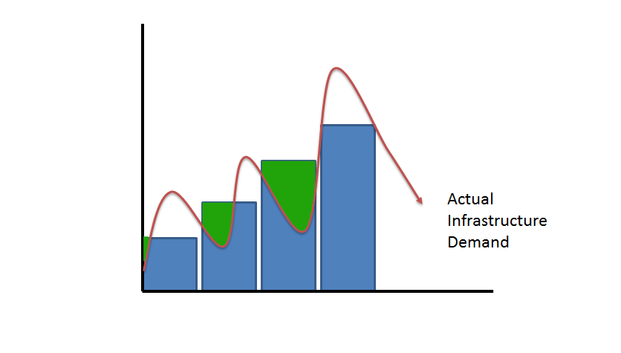
Unacceptable Surplus
Surplus
Capital
Time

Slide 20
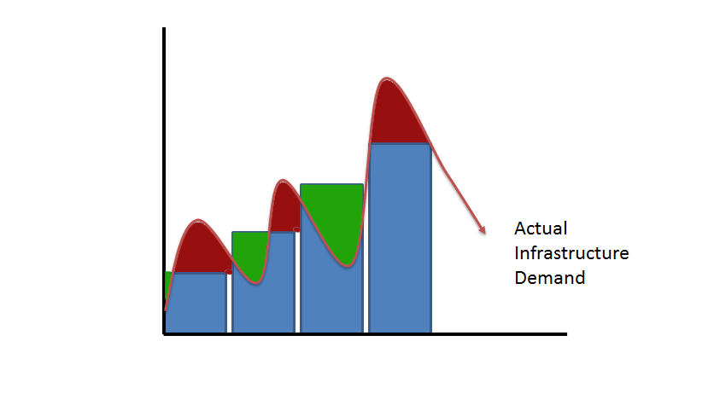
Unacceptable Deficit
Deficit
Capital
Time

Slide 21
History of Cloud Computing
Client-Server Computing
Centralized storage in which all the software applications, all the data and all the controls are resided on the server side.
Distributed Computing
All the computers are networked together and share their resources when needed.
Cloud Computing
Emergence of the concept of cloud computing

Slide 22
History of Cloud Computing
Cloud Computing was invented in the early 1960s by J.C.R Licklider (Joseph Carl Robnett Licklider).
During his network research work on ARPANet (Advanced Research Project Agency Network).
His interest in Information Technology made him appointed as Head of IPTO at ARPA (US Department of Defense Advanced Research Project Agency) in 1962.

Slide 23
History of Cloud Computing
At around 1961, John MacCharty suggested in a speech at MIT that computing can be sold like a utility, just like water or electricity.
In 1999, Salesforce.com
The beauty of the cloud computing phase went on running throughout the era of the 21st Century.

Slide 24
History of Cloud Computing
In 2002, Amazon started Amazon Web Services.
By 2008, Google too introduced its beta version of the search engine.
In 2009, Google Apps
In the year 2008, Microsoft Azure
In the year 2012, Google Compute Engine
By the end of 2013, Oracle Cloud
Currently, as per the record, Linux and Microsoft Azure share most of their work in parallel.

Slide 25
Evolution of Cloud Computing
Five intermediary stages, from mainframe computing to personal computing to the influx of network computing.
Network computing results in autonomic computing or follows client-server architectures, resulting in client-server computing.
Development of grid computing, followed by the rise of cloud computing.

Slide 26
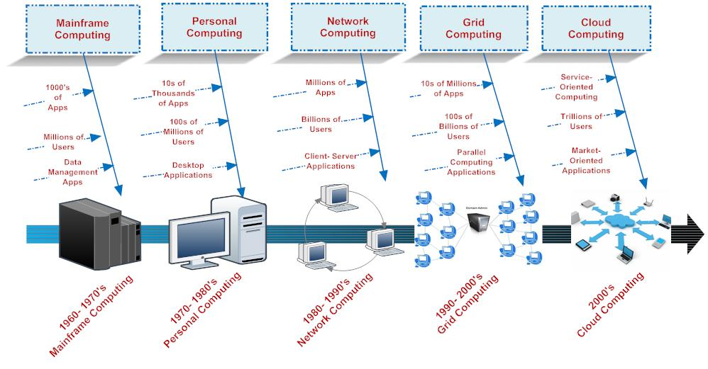
Evolution of Cloud Computing

Slide 27
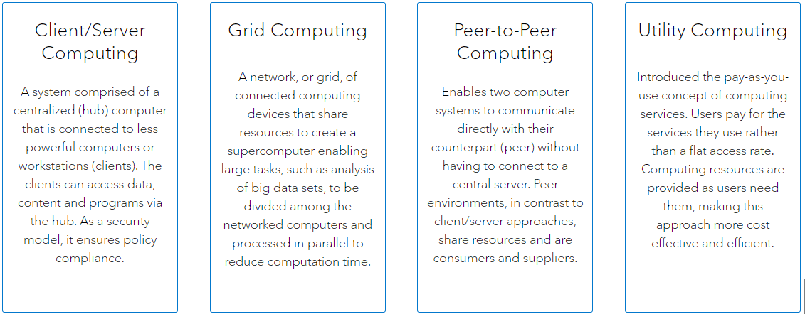
Evolution of Cloud Computing

Slide 28
Evolution of Cloud Computing

Slide 29
Essential Cloud Computing Concepts
“Cloud” makes reference to the two essential concepts:
Abstraction
Virtualization

Slide 30
Who Benefits from Cloud Computing?
Collaborators
Road Warriors
Cost-Conscious Users
Cost-Conscious IT Departments
Users with Increasing Needs

Slide 31
Advantages of Cloud Computing
Cost Efficiency
High Speed
Excellent Accessibility
Back-up and Restore data
Manageability
Sporadic Batch Processing
Strategic Edge

Slide 32
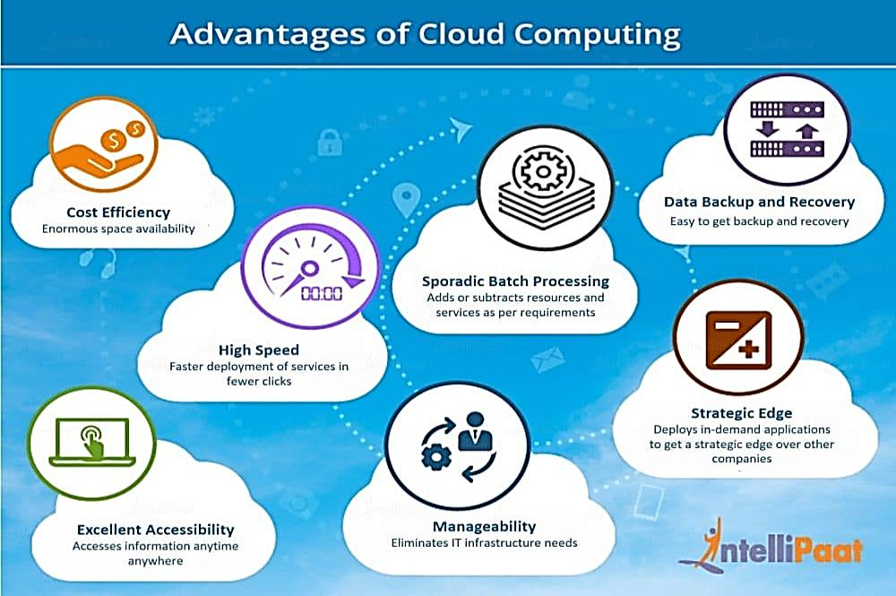
Summarization of Cloud Computing Advantages

Slide 33
Disadvantages of Cloud Computing
Vulnerability to Attacks
Network Connectivity Dependency
Downtime
Vendor Lock-In
Limited Control

Slide 34
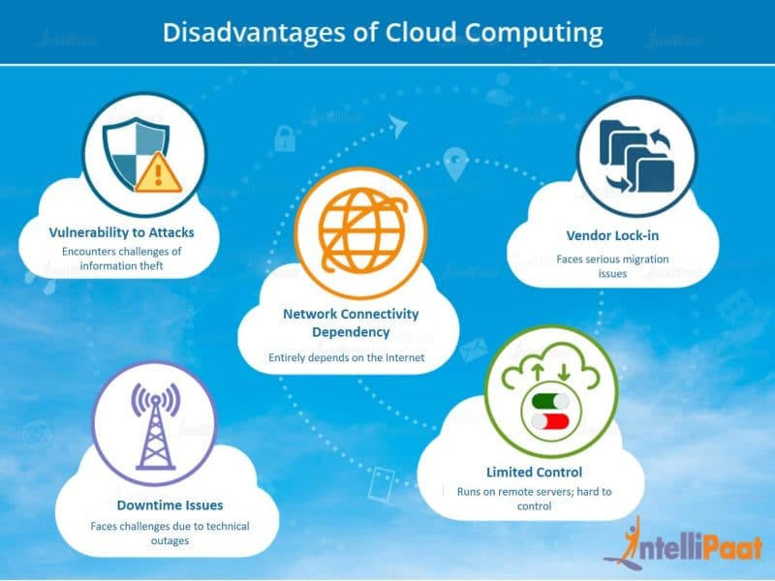
Summarization of Cloud Computing Disadvantages

Slide 35
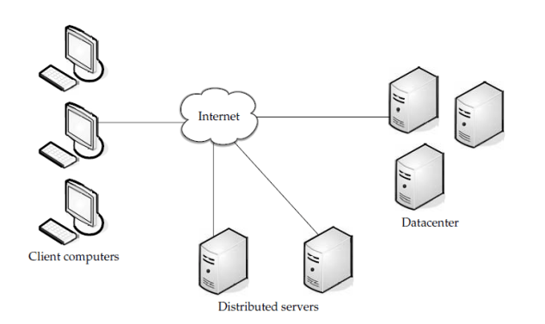
Components of Cloud Computing
Cloud computing solution is made up of several elements and these elements make up the three components of a cloud computing solution.
clients
the data center, and
distributed servers

Slide 36
Clients
Devices that end users interact with to manage their information on cloud.
Mobile Clients
Thin Clients
Thick Clients
Thin Clients vs Thick Clients
Advantages of Thin Clients

Slide 37
Datacenter
Collection of servers where the application to which you subscribe is housed.
A large room in the basement of your building or a room full of servers on the other side of the world that you can access via the Internet.
A growing trend in the IT world is virtualizing servers.

Slide 38
Distributed Servers
Servers are in Geographically Disparate Locations.

Slide 39
Other Components of Cloud Computing
Cloud Services
Example:
Identity - OpenID, OAuth, etc
Integration - Amazon Simple Queue Service
Payments - PayPal, Google Checkout
Mapping - Google Maps, Yahoo! Maps

Slide 40
Other Components of Cloud Computing
Cloud Applications
Example:
Peer-to-peer - BitTorrent, SETI, and others
Web Application - Facebook
SaaS - Google Apps, SalesForce.com, and others

Slide 41
Other Components of Cloud Computing
Cloud Platform
Example:
Web Application Frameworks - Python Django, Rubyon Rails, .NET
Web Hosting
Propietary- Force.com

Slide 42
Other Components of Cloud Computing
Cloud Storage
Example:
Database - Google Big Table, Amazon SimpleDB.
Network Attached Storage - Nirvanix CloudNAS, MobileMe iDisk.

Slide 43
Other Components of Cloud Computing
Cloud Infrastructure
Example:
Grid Computing - Sun Grid.
Full Virtualization - GoGrid, Skytap.
Compute - Amazon Elastic Compute Cloud

