Slide 2
After this lecture, you will be able to
Explore the Cloud Architecture.
Understand about Cloud Storage.

Slide 3
Cloud Architecture
How individual technologies are integrated to create clouds—IT environments that abstract, pool, and share scalable resources across a network.

Slide 4
Cloud Architecture
How individual technologies are integrated to create clouds—IT environments that abstract, pool, and share scalable resources across a network.
How all the components and capabilities necessary to build a cloud are connected in order to deliver an online platform on which applications can run.

Slide 5
Cloud Computing Technologies
Certain technologies that are working behind the cloud computing platforms make cloud computing flexible, reliable, usable. These include:
Virtualization.
Service-Oriented Architecture (SOA).
Grid Computing.
Utility Computing.

Slide 6
Virtualization
Virtualization.
Multitenant architecture.

Slide 7
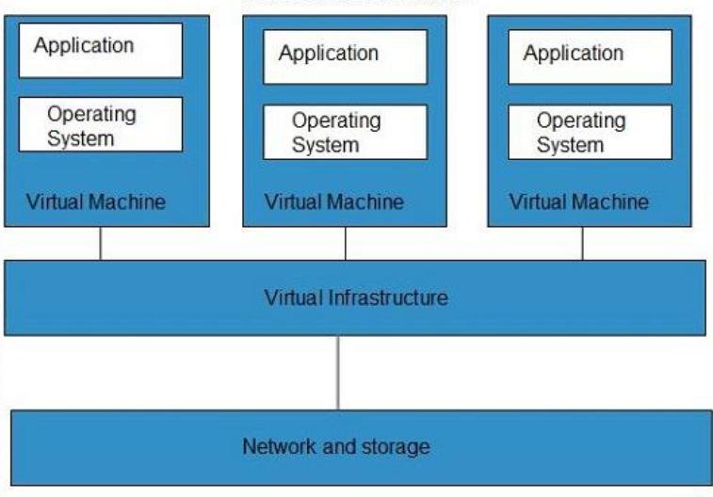
Virtualization
Application
Application
Application
Operating system
Operating system
Operating system
Virtual Machine
Virtual Machine
Virtual Machine
Virtual Infrastructure
Network and Storage

Slide 8
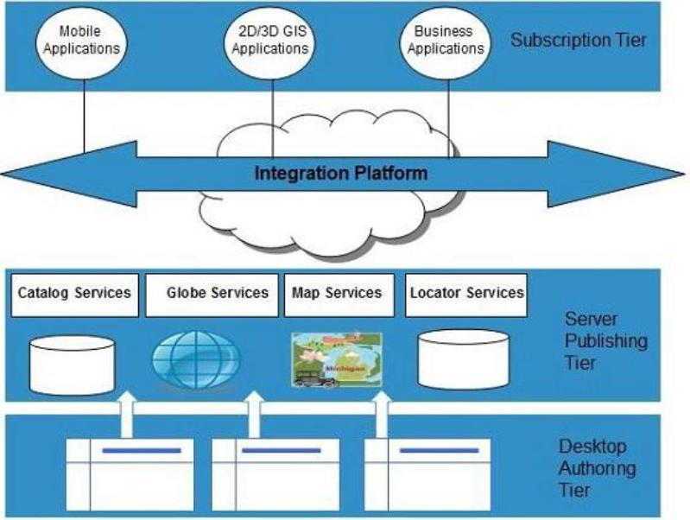
Service-Oriented Architecture (SOA)
Mobile Applications
2D/3D GIS Applications
Business Applications
Subscription Tier
Integration Platform
Catalog Services
Globe Services
Map Services
Locator Services
Server Publishing Tier
Desktop Authorising Tier

Slide 9
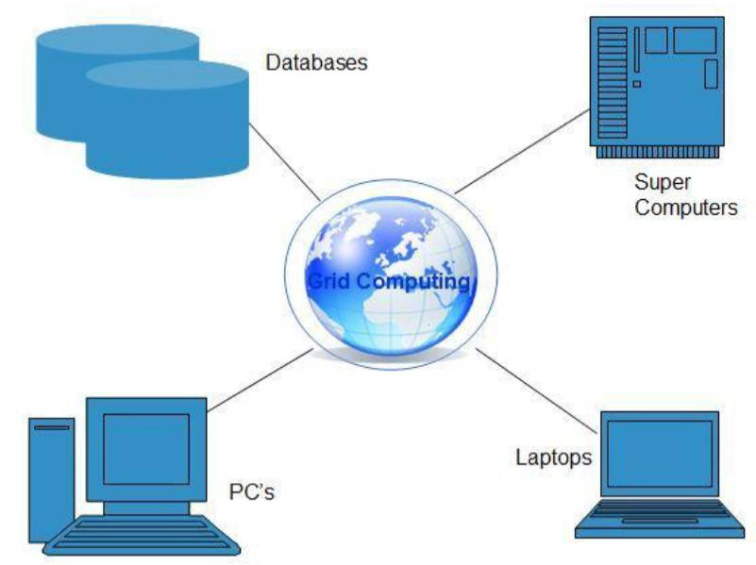
Grid Computing

Slide 10
Utility Computing
Based on Pay per Use model.

Slide 11
Cloud Computing-Architecture
Cloud computing architecture comprises of many cloud components, each of them are loosely coupled.
We can broadly divide the cloud architecture into two parts:
Front End.
Back End.

Slide 12
Cloud Layered Architecture
Cloud architecture describes its working mechanism.
Includes the dependencies on which it works and the components that work over it.
Cloud is a recent technology that is completely dependent on the Internet for its functioning.

Slide 13
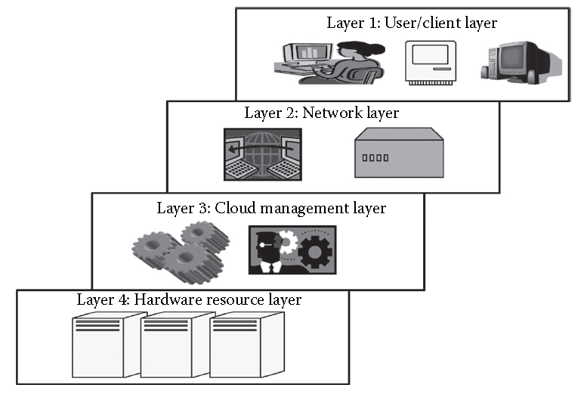
Cloud Layered Architecture
Cloud architecture can be divided into four layers based on the access of the cloud by the user.

Slide 14
Cloud Deployment Models
Cloud infrastructure may be operated in one of the following deployment models:
Public cloud.
Private cloud.
Community cloud.
Hybrid cloud.

Slide 15
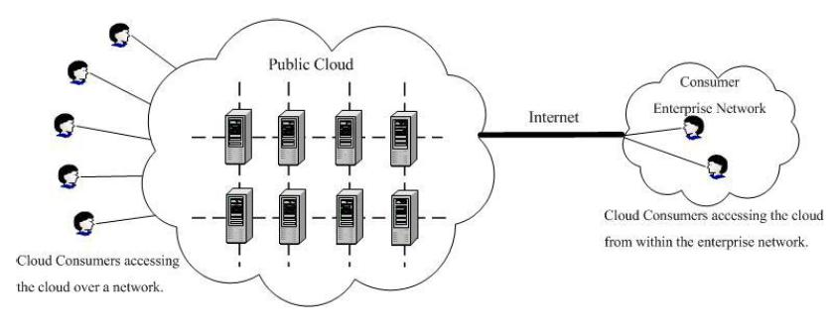
Public Cloud

Slide 16
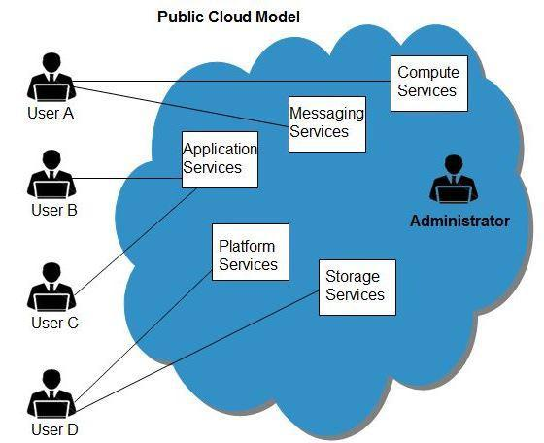
Public Cloud

Slide 17
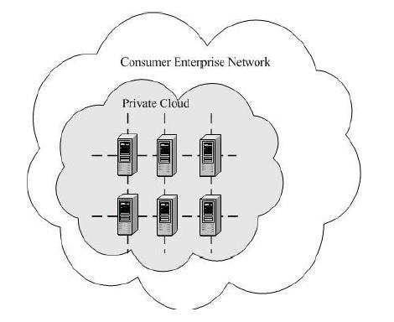
Private Cloud
On-site Private Cloud

Slide 18
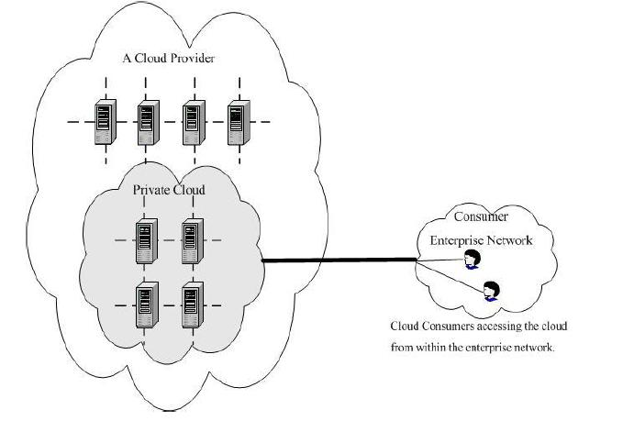
Private Cloud
Outsourced Private Cloud: Third party cloud, outsourced to a hosting company.
Outsourced Private Cloud

Slide 19
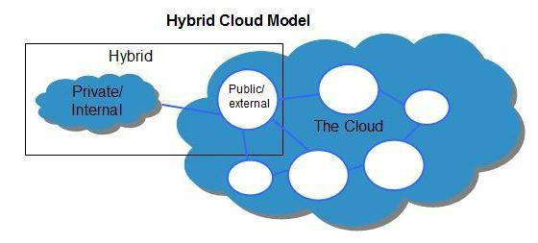
Hybrid Cloud
Hybrid Cloud Model

Slide 20
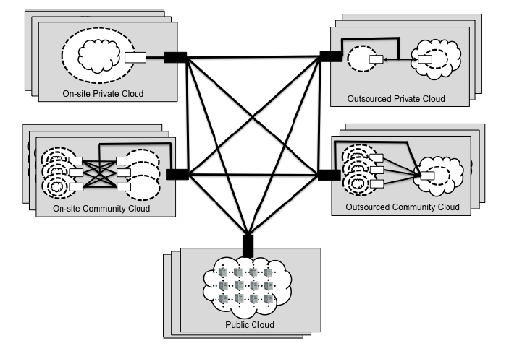
Hybrid Cloud
Hybrid Cloud

Slide 21
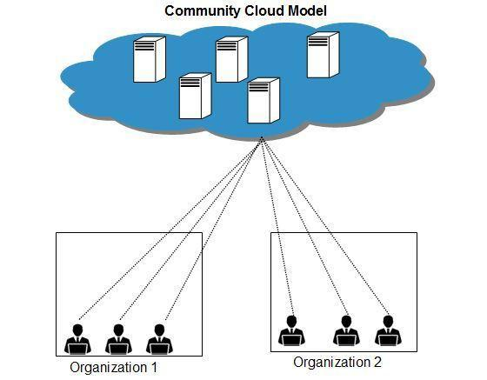
Community Cloud

Slide 22
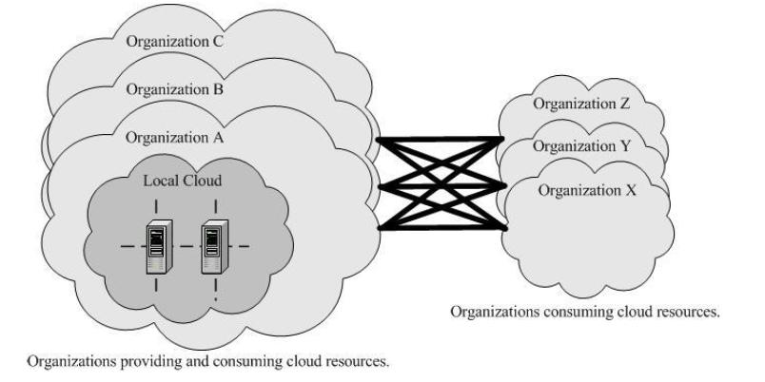
Community Cloud
On-site Community Cloud

Slide 23
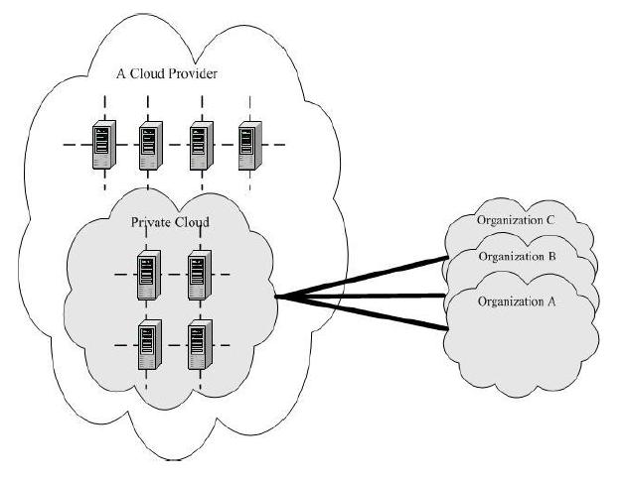
Community Cloud
Outsourced Community Cloud

Slide 24
Cloud Storage
Most innovative technology to store, access, and collaborate through scalable cloud technology.
Cloud computing model that stores valuable data through the web and operates it through a storage as a device service.

Slide 25
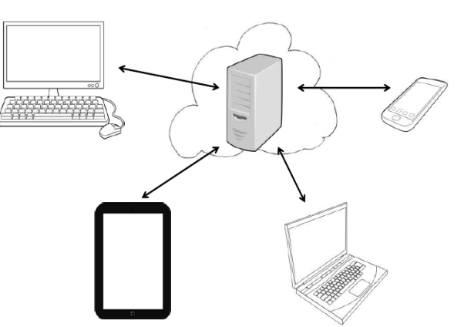
Cloud Storage
Delivered on-demand.
Pay-as-you-go model.
Third-party vendors.

Slide 26
Traditional Storage
Storage option in which we use local physical drives to store the data at the primary location of the client.
User generally uses the disk-based hardware to store data and these are used for copying, managing, and integrating the data to software.
Features of Traditional Storage

Slide 27
Cloud Storage vs Traditional Storage
Cloud Storage vs Traditional Storage.

Slide 28
Cloud Storage
Cloud Storage can be broadly classified into two categories:
Unmanaged Cloud Storage.
Managed Cloud Storage.

Slide 29
Cloud Storage
Cloud storage is a service that allows to save data on offsite storage system managed by third-party and is made accessible by a web services API.
Storage devices can be broadly classified into two categories:
Block Storage Devices.
File Storage Devices.

Slide 30
Creating Cloud Storage System
Cloud storage system stores multiple copies of data on multiple servers and in multiple locations.
If one system fails, then it only requires to change the pointer to stored object's location.
To aggregate storage assets into cloud storage systems, the cloud provider can use storage virtualization software, StorageGRID.

Slide 31
Creating Cloud Storage System
It creates a virtualization layer that fetches storage from different storage devices into a single management system.

Slide 32
Features of Cloud Storage
All platforms can easily be accessed via a web browser.
Offer apps for ease of access from a smartphone or tablet.

Slide 33
Features of Cloud Storage
Feature a directory structure similar to that of a computer drive; this facilitates navigation and organisation.
Ease of Access.
Online Editing.
Online Collaboration.

Slide 34
Considerations for Storing Data to Cloud
Various parameters that need to be taken into account whilst saving data on the cloud include:
Security.
Availability.

Slide 35
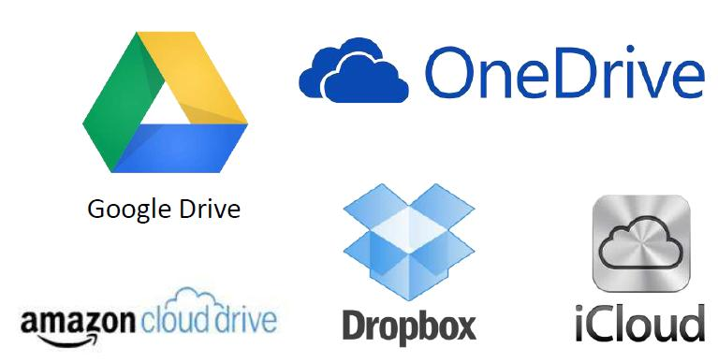
Examples of Cloud Storage

Slide 36
Examples of Cloud Storage
Google Drive.
Dropbox.
Apple iCloud.

Slide 37
Common Features of Google Drive, Dropbox, iCloud
All three platforms are third party services.
All offer a basic amount of free storage:
Dropbox: 5 GB
OneDrive (linked to Microsoft live account): 7 GB
Google Drive (linked to Gmail account): 15 GB

Slide 38
Common Features of Google Drive, Dropbox, iCloud
Post, user has to pay yearly or monthly subscription fee.
Example: Google Drive: 100 GB- $4.99/month; 200 GB - $9.99/month.

Slide 39
Challenges in Cloud Storage
Storing the data in cloud is not that simple task.
Apart from its flexibility and convenience, it also has several challenges faced by the consumers.
Consumers require ability to do several things.

