Slide 2
After this lecture, you will be able to
Know about NIST cloud computing reference model.
Explore the cloud cube model.

Slide 3
Cloud Business Models
Cloud business models are all built on top of cloud computing, a concept that took over around 2006 when former Google’s CEO Eric Schmit mentioned it.

Slide 4
Cloud Business Models
Most cloud-based business models can be classified as cloud services delivery.
While the models are primarily monetized via subscriptions, they are monetized via pay-as-you-go revenue models and hybrid models (subscriptions + pay-as-you-go).

Slide 5
Cloud Business Models
NIST Cloud Computing Reference Model.
Cloud Cube Model.

Slide 6
NIST Cloud Computing Reference Model
NIST's long-term goal is to provide leadership and guidance around the cloud computing paradigm to catalyse its use within industry and government.
NIST aims to shorten the adoption cycle, which will enable near-term cost savings and increased ability to quickly create and deploy safe and secure enterprise solutions.

Slide 7
NIST Cloud Computing Reference Model
NIST aims to foster cloud computing practices that support interoperability, portability, and security requirements that are appropriate and achievable for important usage scenarios.

Slide 8
NIST Cloud Computing Reference Model
Cloud computing is a model for enabling ubiquitous, convenient, on-demand network access to a shared pool of configurable computing resources (e.g., networks, servers, storage, applications, and services) that can be rapidly provisioned and released with minimal management effort or service provider interaction.

Slide 9
NIST Cloud Computing Reference Model
Promotes availability.
Composed of five essential characteristics.
Three service models.
Four deployment models.

Slide 10
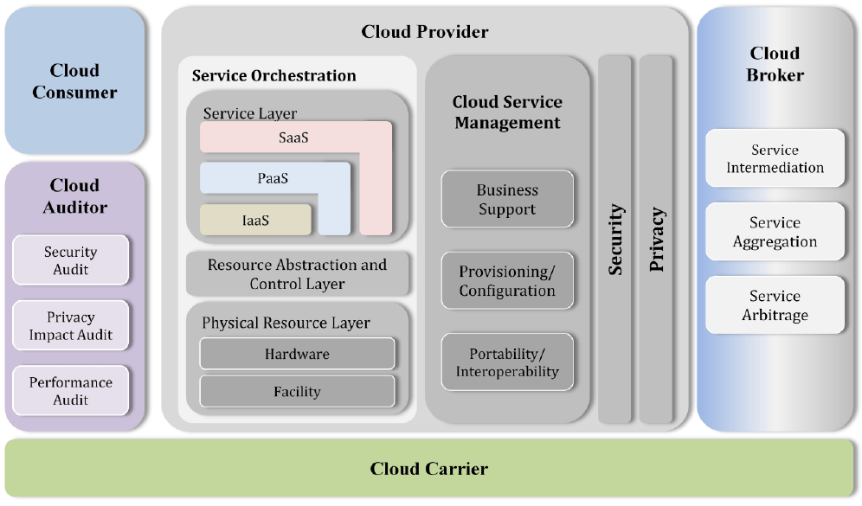
NIST Cloud Computing Reference Model

Slide 11
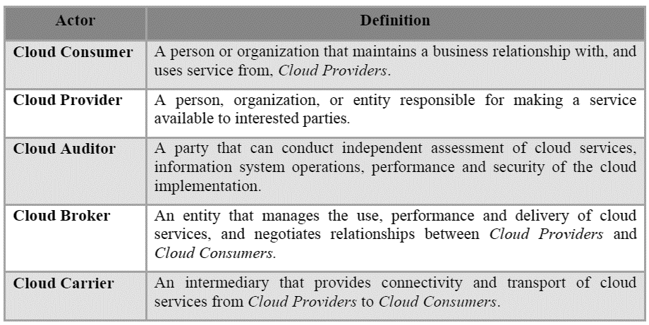
Actors in Cloud Computing Reference Model

Slide 12
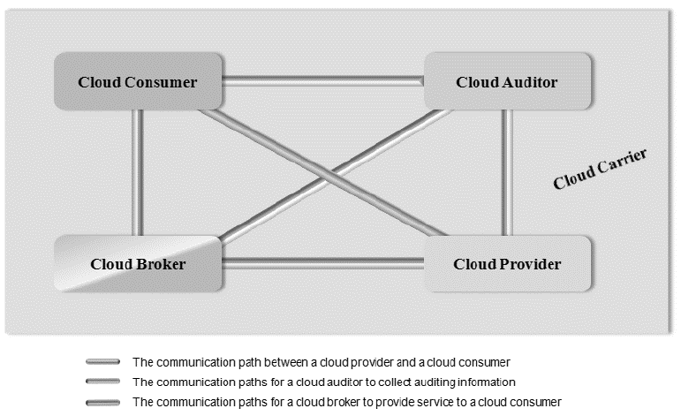
Interactions Between the Actors in Cloud Computing

Slide 13
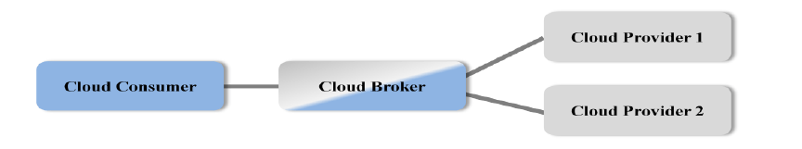
Usage Scenario for Cloud Brokers

Slide 14
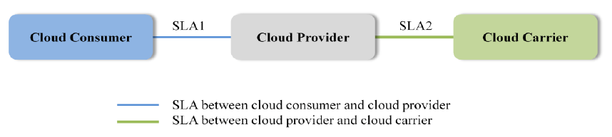
Usage Scenario for Cloud Carriers

Slide 15
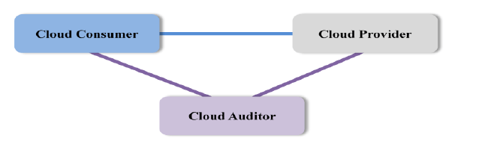
Usage Scenario for Cloud Auditors

Slide 16
Cloud Consumer
Principal stakeholder for cloud computing service.
Represents a person or organization that maintains a business relationship with, and uses the service from a cloud provider.

Slide 17
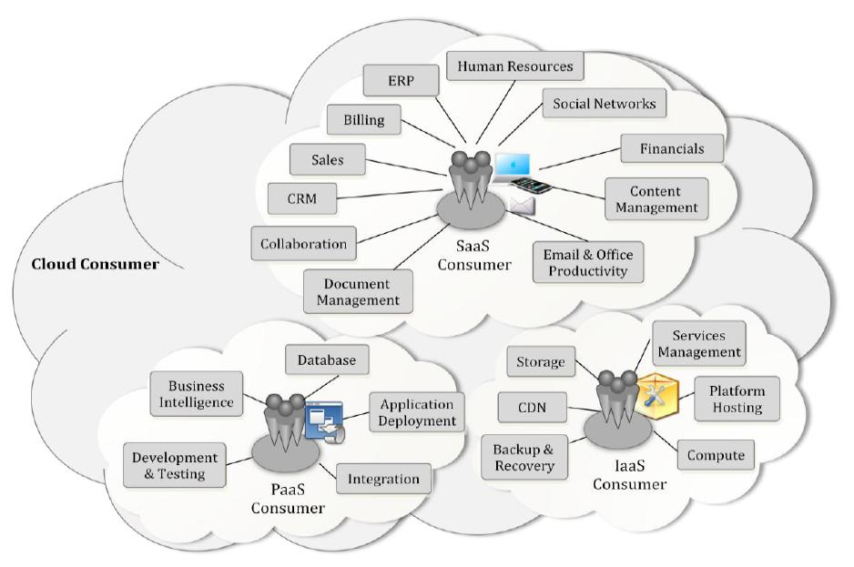
Cloud Consumer
Example Services Available
to a Cloud Consumer

Slide 18
Cloud Provider
A person, or an organization.
An entity responsible for making a service available to interested parties.
Cloud Provider:
acquires and manages the computing infrastructure required for providing the services,
runs the cloud software that provides the services, and
makes arrangement to deliver the cloud services to the Cloud Consumers through network access.

Slide 19
Cloud Provider
A cloud provider’s activities can be described in five major areas:
service deployment,
service orchestration,
cloud service management,
security, and
Privacy.

Slide 20
Cloud Auditor
Cloud auditor is a party that can perform an independent examination of cloud service controls with the intent to express an opinion thereon.
Audits are performed to verify conformance to standards through review of objective evidence.

Slide 21
Cloud Broker
Cloud broker is an entity that manages the use, performance and delivery of cloud services and negotiates relationships between cloud providers and cloud consumers.

Slide 22
Cloud Broker
A cloud broker can provide services in three categories:
Service Intermediation.
Service Aggregation.
Service Arbitrage.

Slide 23
Cloud Carrier
Cloud carrier acts as an intermediary that provides connectivity and transport of cloud services between cloud consumers and cloud providers.
Provide access to consumers through network, telecommunication and other access devices.

Slide 24
Cloud Cube Model
Jericho Forum has designed the Cloud Cube Model to help select cloud formations for secure collaboration.
There are several “cloud formations”- or forms of cloud computing.
Each offers
different characteristics,
varying degrees of flexibility,
different collaborative opportunities, and
different risks.

Slide 25
Four Dimensions of Cloud Cube Model
Cloud Cube
Model Dimensions
Physical Location of Data
Ownership
Security Range
Sourcing

Slide 26
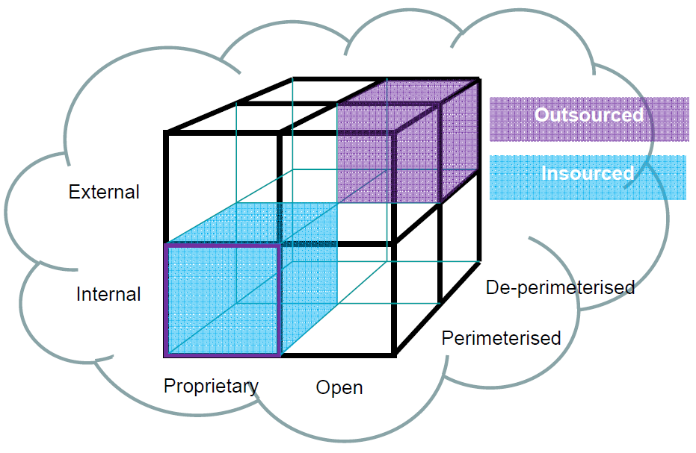
Four Dimensions of Cloud Cube Model
Cloud Cube Model effectively summarizes four dimensions:
Internal/External.
Proprietary/Open.
Perimeterised/
De-perimeterized.
Architectures
Insourced/Outsourced.

Slide 27
How to Secure Data in the Cloud Cube Model?
First you need to classify your data so as to know what rules must apply to protecting it:
it’s sensitivity, trust management.
what regulatory/compliance restrictions apply on it.

Slide 28
How to Secure Data in the Cloud Cube Model?
We can only meet this requirement if we have universally adopted standards for:
a data classification model.
an associated standard for managing trust levels.
standardised metadata that signals to “cloud security” what security needs be applied to each item of data.

Slide 29
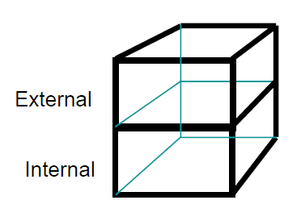
1. Dimension: Internal (I)/ External (E)
Defines the physical location of the data: where does the cloud form you want to use exist inside or outside your organization’s boundaries.
If it is within your own
physical boundary then it is
Internal.
If it is not within your own
physical boundary then it is External.

Slide 30
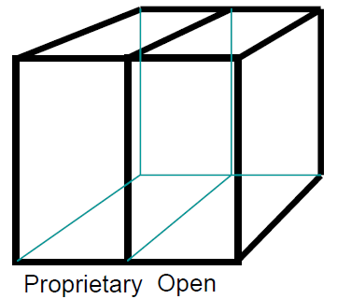
2. Dimension: Proprietary (P)/ Open (O)
This is the dimension that defines the state of ownership of the cloud technology, services, interfaces, etc.

Slide 31
2. Dimension: Proprietary (P)/ Open (O)
Indicates the degree of interoperability, as well as enabling “data/application transportability” between your own systems and other cloud forms.
Indicates the ability to withdraw your data from a cloud form or to move it to another without constraint.
Indicates any constraints on being able to share applications.

Slide 32
2. Dimension: Proprietary (P)/ Open (O)
Proprietary means that the organisation providing the service is keeping the means of provision under their ownership.
Clouds that are Open are using technology that is not proprietary.
Open services.

Slide 33
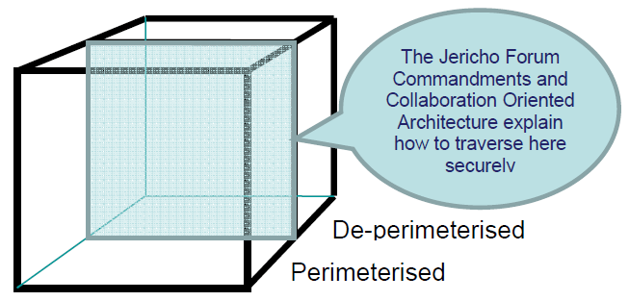
3. Dimension: Perimeterised (Per) / De-perimeterised (D-p) Architectures
Third dimension represents the “architectural mindset”:

Slide 34
3. Dimension: Perimeterised (Per) / De-perimeterised (D-p) Architectures
Perimeterised implies continuing to operate within the traditional IT perimeter, often signalled by “network firewalls”.
De-perimeterised, assumes that the system perimeter is architected following the principles outlined in the Jericho Forum’s Commandments and Collaboration-Oriented Architectures (COA) Framework.

Slide 35
4. Dimension: Insourced/ Outsourced
A 4th dimension that has 2 states in each of the 8 cloud forms: Per(IP,IO,EP,EO) and D-p(IP,IO,EP,EO), that responds to the question:
“Who do you want running your Clouds?”
Outsourced: the service is provided by a 3rd party.
Insourced: the service is provided by your own staff under your control.

