Slide 2
After this lecture, you will be able to,
know about cloud service providers.
learn about the services, platforms and technology offerings of different cloud service providers.

Slide 3
Service Providers
Also called as SERVICE VENDORS.
A vendor that provides IT solutions and/or services to end users and organizations. This broad term incorporates all IT businesses that provide products and solutions through services that are on-demand, pay per use or a hybrid delivery model.

Slide 4
Service Providers
Incorporates all IT businesses that provide products and solutions through services that are on-demand, pay-per-use or a hybrid delivery model.
A service provider's delivery model generally differs from conventional IT product manufacturers or developers.

Slide 5
Different Service Providers
Examples of different service providers include:
Hosting Service Provider,
Cloud Service Provider,
Storage Service Provider,
Software-as-a-Service (SaaS) Provider.

Slide 6
Cloud Service Providers
A third-party company offering a cloud-based platform, infrastructure, application, or storage services.
Cloud services can reduce business process costs when compared to on-premise IT. Such services are managed by the Cloud Service Provider (CSPs).

Slide 7
Cloud Service Providers
CSP companies establish public clouds, manage private clouds, or offer on-demand cloud computing components (also known as cloud computing services) like IaaS, PaaS, and SaaS.

Slide 8
Need for a Cloud Service Provider
Using a cloud provider is a helpful way to access computing services that you would otherwise have to provide on your own, such as:
Infrastructure.
Platforms.
Software.

Slide 9
CSP Platforms and Technologies
Development of a cloud computing application happens by leveraging platforms and frameworks of the CSPs.
CSPs provide different types of services, from the bare-metal infrastructure to customizable applications serving specific purposes.

Slide 10
CSP Platforms and Technologies
Google AppEngine.
NetApp.
Amazon Web Services (AWS).
Microsoft Azure.

Slide 11
CSP Platforms and Technologies
Force.com and Salesforce.com.
IBM.
Hadoop.
Manjrasoft Aneka.

Slide 12
CSP Platforms and Technologies- Google App Engine
Google App Engine
Often referred to as GAE or simply App Engine.
Is a Cloud-based PaaS for developing and hosting web applications in Google-managed data centers.

Slide 13
CSP Platforms and Technologies- Google App Engine
Google App Engine
Primarily supports Go, PHP, Java, Python, Node.js, .NET, and Ruby applications, although it can also support other languages via "custom runtimes".

Slide 14
CSP Platforms and Technologies- Google App Engine
First released as a preview version in April 2008 and came out of preview in September 2011.
Scale your applications from zero to planet scale without having to manage infrastructure.
Free up your developers with zero server management and zero configuration deployments.

Slide 15
CSP Platforms and Technologies- Google
Open-source
Allows web developers to create and maintain JavaScript front-end applications in Java.
Licensed under the Apache License 2.0.
Google Web Toolkit (GWT)

Slide 16
CSP Platforms and Technologies- NetApp
NetApp, Inc. is an American hybrid cloud data services and data management company headquartered in Sunnyvale, California.

Slide 17
CSP Platforms and Technologies- NetApp
NetApp Products:
Automation.
Docker.
Backup and Recovery.

Slide 18
CSP Platforms and Technologies- Amazon Web Services (AWS)
Amazon Web Services (AWS) is a subsidiary of Amazon providing on-demand cloud computing platforms and APIs to individuals, companies, and governments, on a metered pay-as-you-go basis.

Slide 19
CSP Platforms and Technologies- Amazon Web Services (AWS)
Amazon offers services on many different fronts, from storage to platform to databases.
As of 2021, AWS comprises over 200 products and services including computing, storage, networking, database, analytics, application services, deployment, management, machine learning, mobile, developer tools, and tools for the Internet of Things (IoT).

Slide 20
CSP Platforms and Technologies- Amazon Web Services (AWS)
Amazon Elastic Compute Cloud (Amazon EC2)
Amazon SimpleDB (Simple Database Service)
Amazon Simple Storage Service (Amazon S3)
Amazon CloudFront
Amazon Simple Queue Service (Amazon SQS)
Amazon Elastic Block Store (Amazon EBS)

Slide 21
CSP Platforms and Technologies- EMC
EMC Corporation is the world leader in products, services, and solutions for information storage and management that help organizations extract value from their information.
Offerings

Slide 22
CSP Platforms and Technologies- Microsoft
Microsoft Cloud Offerings:
Azure Services Platform,
SQL Services,
.NET Services,
Exchange Online,
SharePoint Services,
Microsoft Dynamics CRM.

Slide 23
CSP Platforms and Technologies-Salesforce.com
Three primary areas of focus:
Sales Cloud.
Service Cloud.
Your Cloud.

Slide 24
CSP Platforms and Technologies-Salesforce.com
Offerings:
Force.com.
Salesforce.com CRM.
AppExchange.

Slide 25
CSP Platforms and Technologies- IBM
IBM offers cloud computing services to help businesses of all sizes take advantage of this increasingly attractive computing model.

Slide 26
CSP Platforms and Technologies- IBM
Some of their services include:
Industry-specific business consulting services for cloud computing.
Technology consulting, design, and implementation services.
Cloud security.

Slide 27
CSP Platforms and Technologies- Hadoop
Apache Hadoop is a collection of open-source software utilities that facilitates using a network of many computers to solve problems involving massive amounts of data and computation.
Uses MapReduce programming model.

Slide 28
How does Cloud Play into This?- Hadoop
Cloud is ideally suited to provide the big data computation power required for the processing of these large parallel data sets.
An ideal platform for the on-demand analysis of structured and unstructured workloads.

Slide 29
CSP Platforms and Technologies- Aneka
ANEKA Cloud Platform-
Software platform and a framework for developing distributed applications on the cloud.

Slide 30
Collaborations and Partnerships in Cloud Computing
Collaborations and Partnerships in Cloud Computing
Yahoo! and Computational Research Laboratories (CRL)
SAP and IBM
HP, Intel, and Yahoo!
IBM and Amazon

Slide 31
Criteria for Choosing the Best Cloud Service Provider
First step in switching to cloud computing is determining what kind of cloud services you could be interested in.
Choosing a cloud computing service is a long-term investment.
Your application will heavily rely on third-party capacities, and you need to make sure that the provider is legitimate and fits your needs.

Slide 32
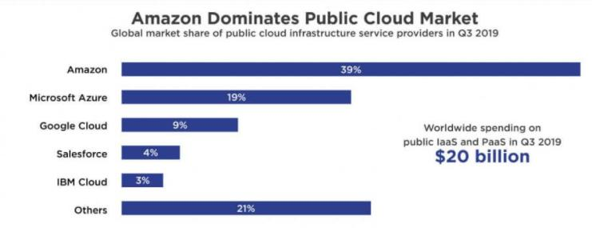
Criteria for Choosing the Best Cloud Service Provider

Slide 33
Criteria for Choosing the Best Cloud Service Provider
Financial Stability.
Industries that Prefer the Solution.
Datacenter Locations.
Security Programs.
Encryption Standards.
Check Accreditation and Auditing.
Look for solutions that offer Free Cloud Backup.

