Slide 2
After this lecture, you will be able to,
Explore the different cloud services such as Storage-as-a-Service, Data-as-a-Service, Database-as-a-Service, Communication-as-a-Service, Monitoring-as-a-Service, Network-as-a-Service, Healthcare-as-a-Service, Education-as-a-Service etc.

Slide 3
Cloud Service Providers Prospective Trends
Cloud services have been among the most popular platforms lately, with companies like Microsoft, Amazon, Google leading the way for technology growth.

Slide 4
Cloud Service Providers Prospective Trends
Let’s take a brief look at the statistics of the cloud computing market to see its latest trends:
In 2020, the market is expected to demonstrate the growth rate of 17%;
In 2019, Cloud infrastructure accounted for about 3% of overall IT infrastructure;

Slide 5
Cloud Service Providers Prospective Trends
IP traffic in Cloud services is expected to grow up to 19.5 zettabytes in 2021.
The trust of the number of businesses in cloud service is rapidly increasing.
We are looking at the future where the majority of companies will be using cloud providers regularly.

Slide 6
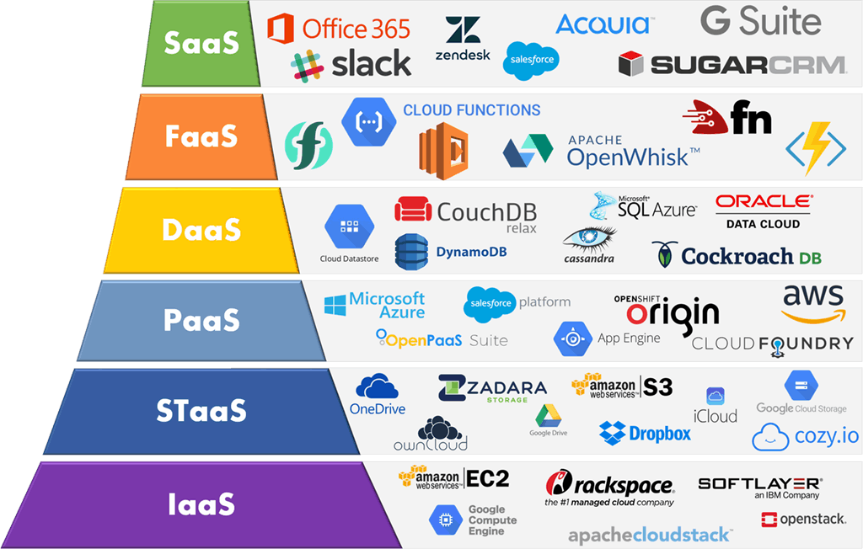
Cloud Services
Cloud computing offers large number of services.

Slide 7
Other Cloud Services
Storage-as-a-Service (STaaS)
Data-as-a-Service (DaaS)
Communication-as-a-Service (CaaS)
Monitoring-as-a-Service (MaaS)
Database-as-a-Service (DBaaS)

Slide 8
Other Cloud Services
Network-as-a-Service (NaaS)
Healthcare-as-a-Service (HaaS)
Education-as-a-Service (EaaS)
Function-as-a-Service (FaaS)

Slide 9
Storage-as-a-Service (STaaS)
Cloud service model in which a company leases or rents its storage infrastructure to another company or individuals to store either files or objects.
Economy of scale.
For an end-user-level cloud storage.
For enterprise-level cloud storage.

Slide 10
Data-as-a-Service (DaaS)
In the DaaS computing model (a more advanced, fine-grained form of STaaS), data (as opposed to files) is readily accessible through a Cloud-based platform.
Data (either from databases or object containers) is supplied “on-demand” via cloud platforms.

Slide 11
Data-as-a-Service (DaaS)
DaaS provides a dynamic infrastructure.
Eliminates redundancy and reduces associated expenditures.
Typical business applications .
Best-known enterprise-level DaaS providers.

Slide 12
Communication-as-a-Service (CaaS)
Communications as a Service (CaaS) is an outsourced enterprise communications solution that can be leased from a single vendor.

Slide 13
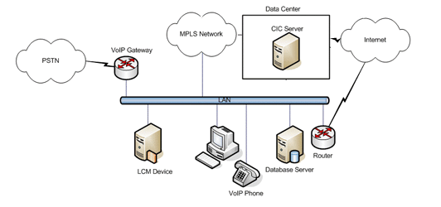
Communication-as-a-Service (CaaS)

Slide 14
Communication-as-a-Service (CaaS)
Such communications can include:
Voice over IP (VoIP or Internet telephony),
Instant messaging (IM).
Collaboration and Video conference applications using fixed and mobile devices.

Slide 15
Communication-as-a-Service (CaaS)
CaaS vendor is responsible for all hardware and software management and offers guaranteed Quality of Service (QoS).
Advantages of CaaS.

Slide 16
Monitoring-as-a-Service (MaaS)
Combines the benefits of cloud computing technology and traditional on-premise IT infrastructure monitoring solutions.
Suited for organizations looking to adopt a monitoring framework quickly with minimal investments.

Slide 17
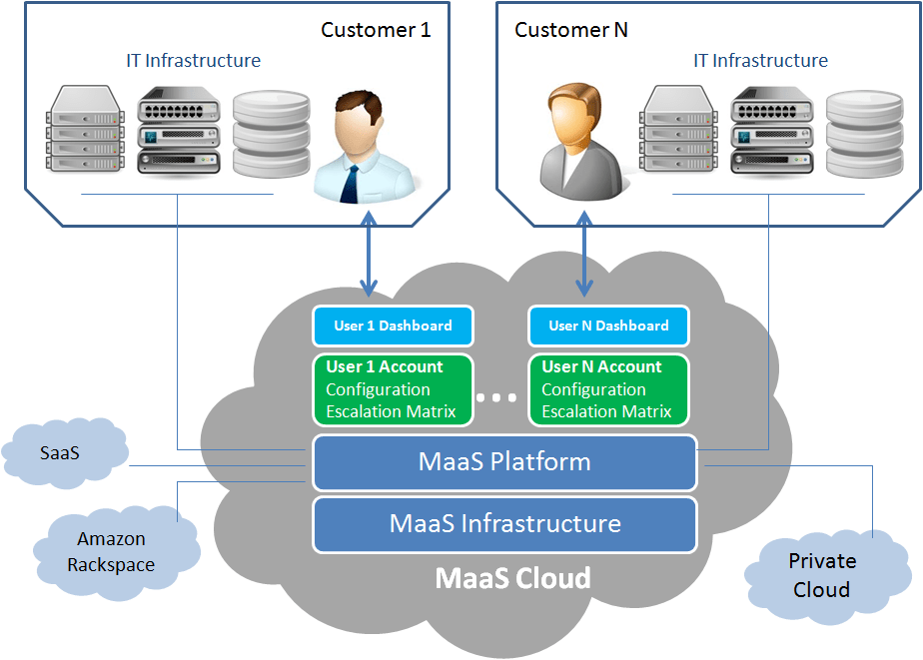
Monitoring-as-a-Service (MaaS)

Slide 18
Advantages of MaaS
Ready to Use Monitoring Tool Login.
Inherently Available 24x7x365.
Easy Integration with Business Processes.
Cloud Aware and Cloud Ready.
Zero Maintenance Overheads.

Slide 19
Assets Monitored by MaaS
Servers and Systems Monitoring.
Database Monitoring.
Network Monitoring.
Storage Monitoring.
Applications Monitoring.
Cloud Monitoring.
Virtual Infrastructure Monitoring.

Slide 20
Database-as-a-Service (DBaaS)
Database as a Service (DBaaS) is an architectural and operational approach enabling DBAs to deliver database functionality as a service to internal and/or external customers.

Slide 21
Database-as-a-Service (DBaaS)
DBaaS architectures support following required capabilities:
Customer side provisioning and management of database instances using on-demand, self-service mechanisms.

Slide 22
Database-as-a-Service (DBaaS)
Automation of monitoring with provider-defined service definitions, attributes and quality SLAs.
Fine-grained metering of database usage enabling show-back reporting or charge-back for both internal and external functionality for each individual consumer.

Slide 23
Why DBaaS?
DBaaS standardizes and optimizes the platform requirements which eliminates the need to deploy, manage and support dedicated database hardware and software for each project’s multiple development, testing, production, and failover environments.
DBaaS architectures are inherently designed for elasticity and resource pooling.

Slide 24
Why DBaaS?
DBaaS providers deliver production and non-production database services that support average daily workload requirements & are not impacted by:
Resource Limitations
Time Sensitive Projects
Hardware limitations/budgets

Slide 25
Setting up DBaaS
Super Administrator
Cloud Administrator
Define Rules and Users
Super Administrator
Install Management Agent on Unmanaged Hosts
Cloud Administrator
Configure Privilege Delegation Settings
Cloud Administrator
Configure the
Software Library
Setup Provisioning Credentials

Slide 26
Network-as-a-Service (NaaS)
Users who do not want to use their own networks take help from service providers to host the network infrastructure.
Represents the network as transport connectivity.
Network virtualization is done in this service.

Slide 27
Network-as-a-Service (NaaS)
NaaS is “an emerging procurement model to consume network infrastructure via a flexible operating expense (OpEx) subscription inclusive of hardware, software, management tools, licenses, and lifecycle services.”

Slide 28
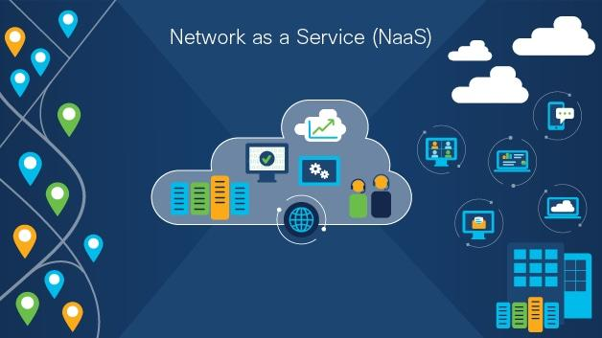
Network-as-a-Service (NaaS)

Slide 29
What's Driving the Trend Toward NaaS?
Traditional network model requires capital expenses (CapEx) for physical networks with switches, routers, and licensing.
The do-it-yourself IT model requires time for planning and deployment as well as expertise to install and configure infrastructure and to ensure security access policies are in place.

Slide 30
What's Driving the Trend Toward NaaS?
This model involves the following:
Diligent monitoring for updates and security patches is essential due to rapid changes in technology and security threats.
Provisioning a new service is a manual process that requires a technician to deploy and configure equipment at various locations.

Slide 31
NaaS Service Models
Connectivity Cloud.
Virtual Private Network (VPN).
Virtual Network Operation.

Slide 32
Benefits of NaaS
Benefits of NaaS
IT Simplicity and Automation
Access from Anywhere
Visibility and Insights
Enhanced Security
Flexibility and Scalability
Improved Application Experience

Slide 33
Benefits of NaaS
IT Simplicity and Automation.
Access from Anywhere.
Visibility and Insights.
Enhanced Security.
Flexibility.
Scalability.
Improved Application Experience.

Slide 34
Healthcare-as-a-Service (HaaS)
Gone are days when healthcare organizations used to store patient data in piles of papers and files.
Not only was that inconvenient and time-consuming, but also expensive in terms of both money and resources.
With exponential growth in technology, more and more healthcare businesses are moving to the cloud.

Slide 35
Healthcare-as-a-Service (HaaS)
Cloud computing has impacted the essential divisions of society, especially the healthcare industry.
Technology-enabled Healthcare includes telehealth, telecare, telemedicine, tele-coaching, mHealth and self-care services that can put people in control of their own health, wellbeing and support, keeping them safe, well and independent and offering them and their families peace of mind.

Slide 36
Healthcare-as-a-Service (HaaS)
Cloud Computing in Healthcare Market Segmentation-
Global Cloud Computing in Healthcare Market, By Type
Clinical Information Systems
Non-Clinical Information Systems

Slide 37
Healthcare-as-a-Service (HaaS)
Global Cloud Computing in Healthcare Market, By Pricing Model
Pay-As-You-Go
Spot Pricing Model

Slide 38
Healthcare-as-a-Service (HaaS)
Global Cloud Computing in Healthcare Market, By Service Model
Software-as-a-Service
Infrastructure-as-a-Service
Platform-as-a-Service

Slide 39
Benefits of Cloud-based HaaS
Faster Services.
Improved Collaboration.
Supports both consumer and specialized programs.
Cost-Efficient Operations.
Enhanced Patient Care Efficiency.
Better Data Management.
Improved Privacy.

Slide 40
Education as a Service (EaaS)
Providing learning and development to learners/teachers through various electronic media such as the internet, audio, video, etc.
EaaS learning is education done through Internet.
Often called "e-learning".
Offerings

Slide 41
Need for Education-as-a-Service (EaaS)
To revolutionise education.
Allow training providers to improve the delivery of their content.
Returns on Investment (ROI).

Slide 42
Benefits of EaaS
Learners pay for the Education They Want/ Need.
Advocates Flexible Learning.
Learner-centric.
Encourages Agile Content Development by Course Designers.

Slide 43
Function as a Service (FaaS)
Concept of serverless computing via serverless architectures where developers can leverage this to deploy an individual “function”, action, or piece of business logic.

Slide 44
Function as a Service (FaaS)
Principles of FaaS:
Complete abstraction of servers away from the developer.
Billing based on consumption and executions, not server instance sizes.
Services that are event-driven and instantaneously scalable.

Slide 45
Examples of FaaS
AWS Lambda
Azure Functions
IBM OpenWhisk

