Slide 2
After this lecture, you will be able to,
Learn about Big Data and its characteristics.
Understand the different V’s of Big Data.

Slide 3
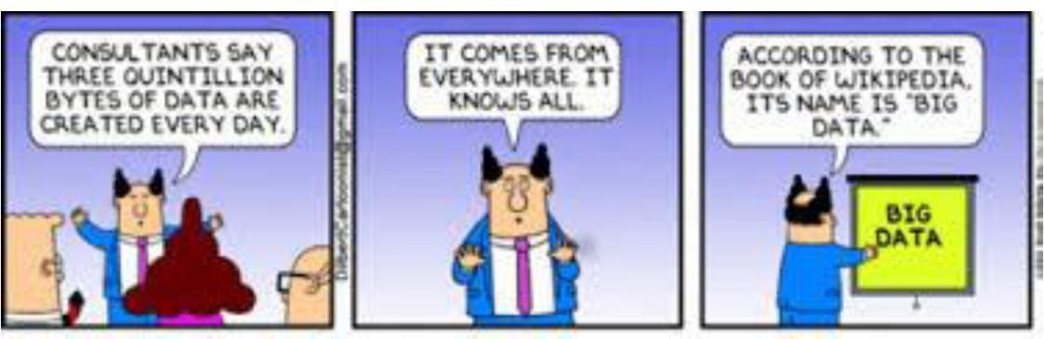
Big Data
Collection of data sets so large & complex that it becomes difficult to process using on-hand database management tools or traditional data processing applications.

Slide 4
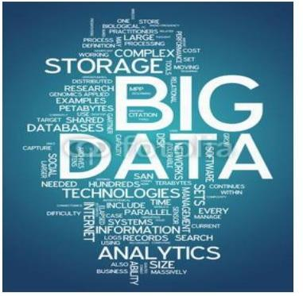
Big Data
Data whose scale, diversity, and complexity requires new architecture, techniques, algorithms, and analytics to manage it and extract value and hidden knowledge from it.

Slide 5
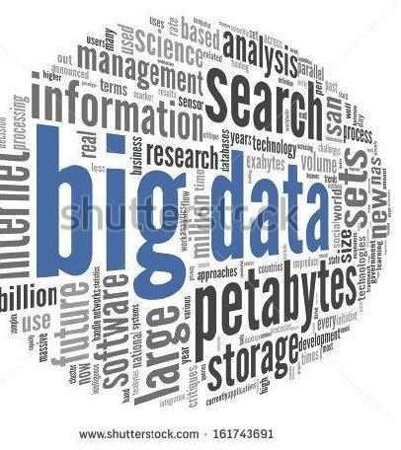
Big Data
Correlations exist.

Slide 6
Facts & Figures
Walmart
Facebook
AT/T Database

Slide 7
Facts & Figures
Walmart
Facebook
AT/T Database

Slide 8
Facts & Figures
Walmart
Facebook
AT/T Database

Slide 9
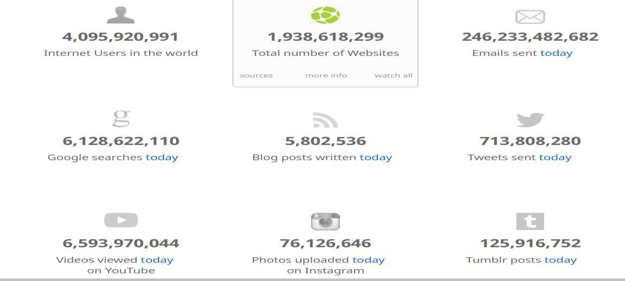
From Where So Much Data Comes Up
Sources

Slide 10

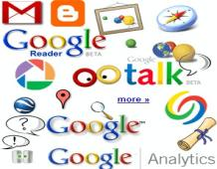

From Where So Much Data Comes Up
Data on the Internet:
Internet Live Stats - Internet Usage & Social Media Statistics
12+ TBs
of tweet data every day
? TBs of
data every day
25+ TBs of log data every day

Slide 11

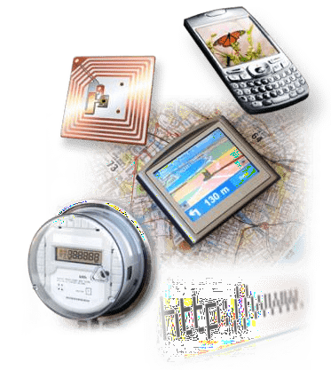
From Where So Much Data Comes Up
30 billion RFID tags today
(1.3B in 2005)
4.6 billion camera phones world wide
100s of millions of GPS enabled
Devices sold annually
2+ billion people on the Web by end 2011
76 million smart meters
in 2009…
200M by 2014

Slide 12
From Where So Much Data Comes Up
Progress & innovation is no longer hindered by the ability to collect data.
Big Data facilitates the ability to manage, analyse, summarize, visualize & discover knowledge from the collected data in a timely manner & in a scalable fashion at a faster pace.

Slide 13
From Where So Much Data Comes Up
Progress & innovation is no longer hindered by the ability to collect data.
Big Data facilitates the ability to manage, analyse, summarize, visualize & discover knowledge from the collected data in a timely manner & in a scalable fashion at a faster pace.

Slide 14


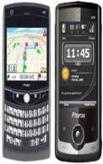
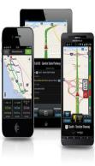


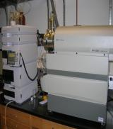
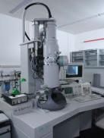
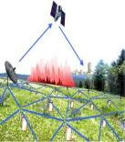
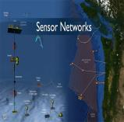
From Where So Much Data Comes Up
Mobile devices
(tracking all objects all the time)
Social media and networks
(all of us are generating data)
Scientific instruments
(collecting all sorts of data)
Sensor technology and networks
(measuring all kinds of data)

Slide 15
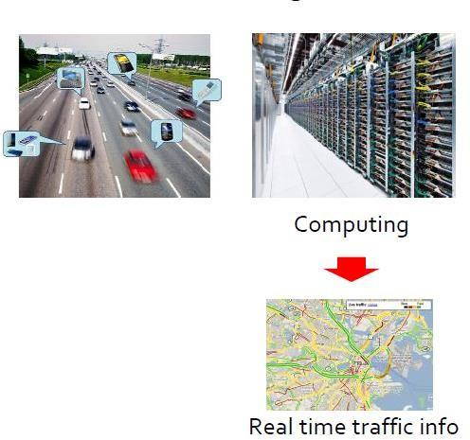
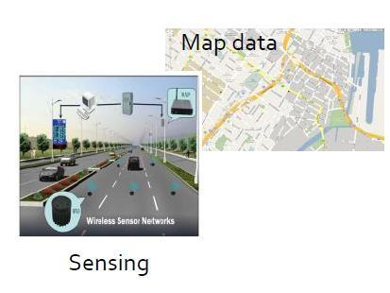
An Example of Big Data at Work
Crowdsourcing
Vu Pham

Slide 16
Issues with Traditional Database Methods
Traditional RDBMS queries
Traditional tools
Benefits of Big Data
Other issues

Slide 17
Issues with Traditional Database Methods
Traditional RDBMS queries
Traditional tools
Benefits of Big Data
Other issues

Slide 18
Issues with Traditional Database Methods
Traditional RDBMS queries
Traditional tools
Benefits of Big Data
Other issues

Slide 19
Issues with Traditional Database Methods
Traditional RDBMS queries
Traditional tools
Benefits of Big Data
Other issues

Slide 20

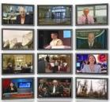



Traditional Model Has Changed
Model of Generating/Consuming Data has Changed.
Old Model

Slide 21



Traditional Model Has Changed
New Model

Slide 22
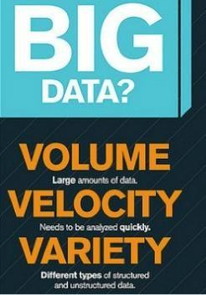
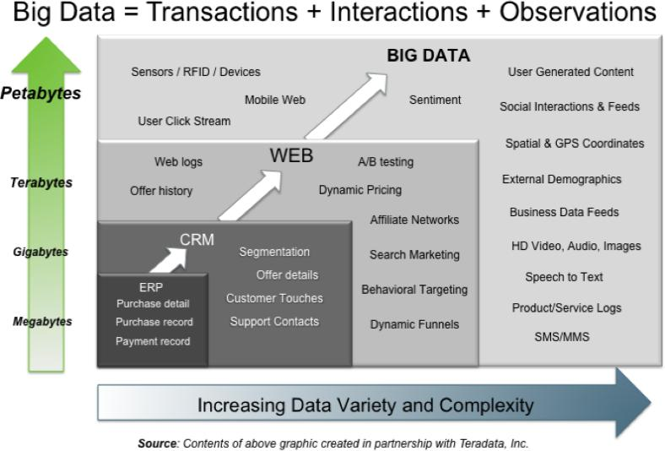
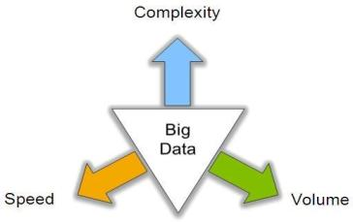
Big Data (3V’s)
3V’s: Volume, Velocity and Variety

Slide 23
Volume (Scale)
Ever-growing data of all types
Product sentiment analysis
Data Volume

Slide 24
Volume (Scale)
Ever-growing data of all types
Product sentiment analysis
Data Volume

Slide 25
Volume (Scale)
Ever-growing data of all types
Product sentiment analysis
Data Volume

Slide 26
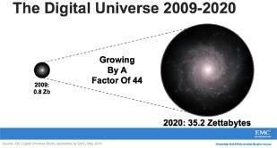

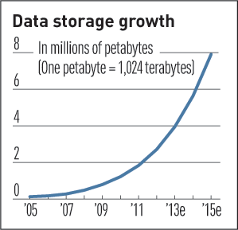
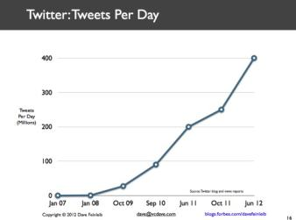


Volume (Scale)
Data Volume

Slide 27
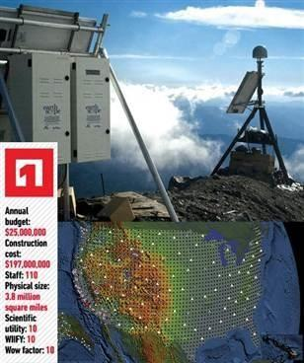
Volume (Scale)
Earthscope
World's largest science project.
Designed to track North America's geological evolution, this observatory records data over 3.8 million square miles amassing 67 terabytes of data.

Slide 28
Volume (Scale)
Earthscope
Analyzes seismic slips in San Andreas fault, but also plume of magma underneath Yellowstone & much more.

Slide 29
Velocity (Speed)
Sometimes 2 minutes is too late. For time-sensitive processes such as catching fraud, big data must be used.
Data is begin generated fast & needs to be processed fast.

Slide 30
Velocity (Speed)
Online Data Analytics
Late decisions→→missing opportunities
Examples:
E-Promotions
Healthcare monitoring

Slide 31
Variety (Complexity)
Big data can handle any type of data–
Structured Data: (example: tabular data) Unstructured Data: Text, sensor data, audio, video Semi Structured: Web data, log files

Slide 32
Variety (Complexity)
Relational Data (Tables/Transaction/Legacy Data)
Text Data (Web)
Semi-structured Data (XML) Graph Data
Social Network, Semantic Web (RDF), …
Streaming Data
A single application can be generating/ collecting many types of data
Big Public Data (online, weather, finance etc)
Vu Pham

Slide 33
Variety (Complexity)
Relational Data (Tables/Transaction/Legacy Data)
Text Data (Web)
Semi-structured Data (XML) Graph Data
Social Network, Semantic Web (RDF), …
Streaming Data
A single application can be generating/ collecting many types of data
Big Public Data (online, weather, finance etc)
Vu Pham

Slide 34
Variety (Complexity)
Relational Data (Tables/Transaction/Legacy Data)
Text Data (Web)
Semi-structured Data (XML) Graph Data
Social Network, Semantic Web (RDF), …
Streaming Data
A single application can be generating/ collecting many types of data
Big Public Data (online, weather, finance etc)
Vu Pham

Slide 35
Variety (Complexity)
Relational Data (Tables/Transaction/Legacy Data)
Text Data (Web)
Semi-structured Data (XML) Graph Data
Social Network, Semantic Web (RDF), …
Streaming Data
A single application can be generating/ collecting many types of data
Big Public Data (online, weather, finance etc)
Vu Pham

Slide 36
Variety (Complexity)
Relational Data (Tables/Transaction/Legacy Data)
Text Data (Web)
Semi-structured Data (XML) Graph Data
Social Network, Semantic Web (RDF), …
Streaming Data
A single application can be generating/ collecting many types of data
Big Public Data (online, weather, finance etc)
Vu Pham

Slide 37
Variety (Complexity)
Relational Data (Tables/Transaction/Legacy Data)
Text Data (Web)
Semi-structured Data (XML) Graph Data
Social Network, Semantic Web (RDF), …
Streaming Data
A single application can be generating/ collecting many types of data
Big Public Data (online, weather, finance etc)
Vu Pham

Slide 38
Variety (Complexity)
Relational Data (Tables/Transaction/Legacy Data)
Text Data (Web)
Semi-structured Data (XML) Graph Data
Social Network, Semantic Web (RDF), …
Streaming Data
A single application can be generating/ collecting many types of data
Big Public Data (online, weather, finance etc)
Vu Pham

Slide 39
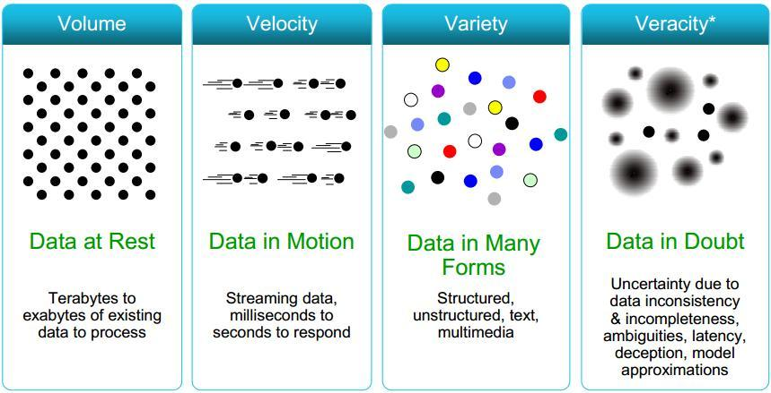
3 Big V’s (+1)

Slide 40
3 Big V’s (+1)
Plus 1:
Value

Slide 41
3 Big V’s (+1) (+ N more)
Veracity
Valence
Validity
Variability
Viscosity & Volatility
Viability
Venue
Vocabulary
Vagueness ….

Slide 42

Valence
Refers to the connectedness of big data.

Slide 43
Validity
Accuracy and correctness of the data relative to a particular use.
Example: Gauging storm intensity.

Slide 44
Variability
How meaning of the data changes over time
Language evolution
Data availability
Sampling processes
Changes in characteristics of the data source

Slide 45
Variability
How meaning of the data changes over time
Language evolution
Data availability
Sampling processes
Changes in characteristics of the data source

Slide 46
Variability
How meaning of the data changes over time
Language evolution
Data availability
Sampling processes
Changes in characteristics of the data source

Slide 47
Variability
How meaning of the data changes over time
Language evolution
Data availability
Sampling processes
Changes in characteristics of the data source

Slide 48
Variability
How meaning of the data changes over time
Language evolution
Data availability
Sampling processes
Changes in characteristics of the data source

Slide 49
Viscosity & Volatility
Both related to velocity
Viscosity
Volatility

Slide 50
Viscosity & Volatility
Both related to velocity
Viscosity
Volatility

Slide 51
Viscosity & Volatility
Both related to velocity
Viscosity
Volatility

Slide 52
More V’s
Viability
Venue
Vocabulary
Vagueness

Slide 53
More V’s
Viability
Venue
Vocabulary
Vagueness

Slide 54
More V’s
Viability
Venue
Vocabulary
Vagueness

Slide 55
More V’s
Viability
Venue
Vocabulary
Vagueness

Slide 56
Big Data Analytics
How to manage very large amounts of data and extract value and knowledge from them.
Big data is more real-time in nature than traditional Data Warehouse (DW) applications.

Slide 57
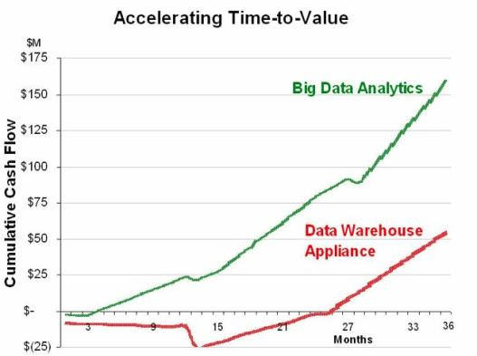
Big Data Analytics
Traditional DW architectures (Exadata, Teradata) are not well-suited for big data apps.

Slide 58
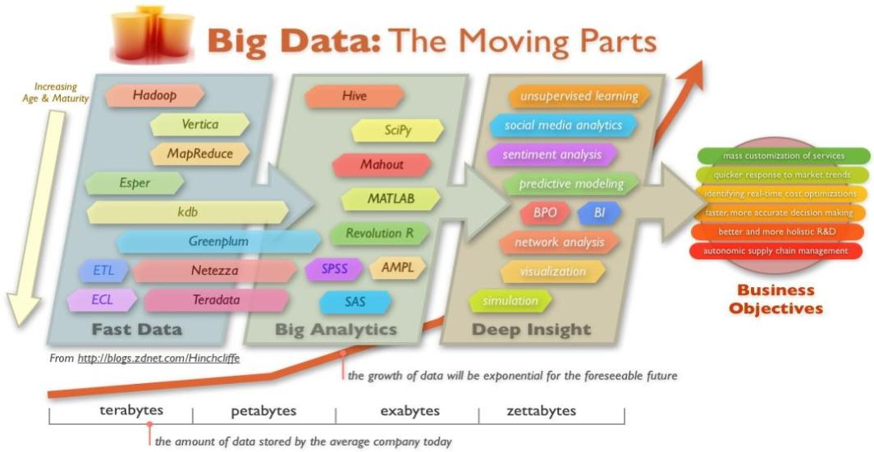
Big Data Analytics
Shared nothing, massively parallel processing, scale out architectures are well-suited for big data apps.

Slide 59
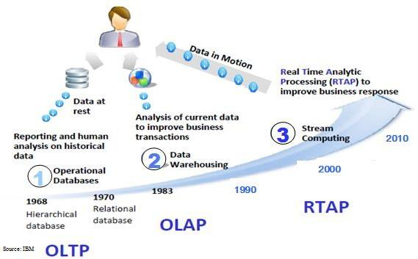
Harnessing Big Data
OLAP: Online Analytical Processing (DBMSs)
OLTP: Online Transaction Processing (Data Warehousing)
RTAP: Real-Time Analytics Processing (Big Data Architecture & Technology)

Slide 60
Big Data Processing
Stage 1: Business case

Slide 61
Big Data Processing
Stage 1: Business case
Stage 2: Identification of data

Slide 62
Big Data Processing
Stage 1: Business case
Stage 2: Identification of data
Stage 3: Data filtering

Slide 63
Big Data Processing
Stage 1: Business case
Stage 2: Identification of data
Stage 3: Data filtering
Stage 4: Data extraction

Slide 64
Big Data Processing
Stage 1: Business case
Stage 2: Identification of data
Stage 3: Data filtering
Stage 4: Data extraction
Stage 5: Data aggregation

Slide 65
Big Data Processing
Stage 1: Business case
Stage 2: Identification of data
Stage 3: Data filtering
Stage 4: Data extraction
Stage 5: Data aggregation
Stage 6: Data analysis

Slide 66
Big Data Processing
Stage 1: Business case
Stage 2: Identification of data
Stage 3: Data filtering
Stage 4: Data extraction
Stage 5: Data aggregation
Stage 6: Data analysis
Stage 7: Visualization of data

Slide 67
Big Data Processing
Stage 1: Business case
Stage 2: Identification of data
Stage 3: Data filtering
Stage 4: Data extraction
Stage 5: Data aggregation
Stage 6: Data analysis
Stage 7: Visualization of data
Stage 8: Final analysis result

Slide 68


Real-Time Analytics/ Decision Requirement
Product
Learning why Customers Switch to competitors and their offers; in
time to Counter
Recommendations that are Relevant & Compelling
Influence Behavior
Improving the Marketing Effectiveness of a Promotion while it is still in Play
Friend Invitations to join a
Game or Activity that expands business
Preventing Fraud as it is Occurring & preventing more
proactively

Slide 69
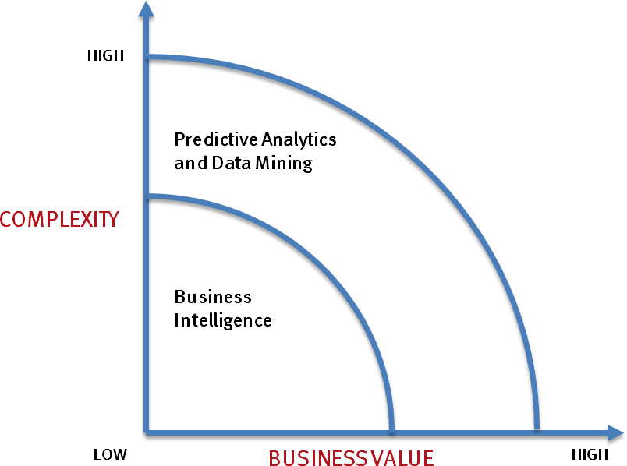

What’s Driving Big Data
Optimizations and predictive analytics
Complex statistical analysis
All types of data, and many sources
Very large datasets
More of a real-time
Ad-hoc querying and reporting
Data mining techniques
Structured data, typical sources
Small to mid-size datasets

Slide 70
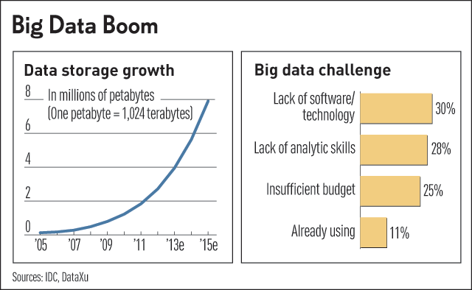
Challenges in Handling Big Data
Bottlenecks in technology
Technical skills
Other challenges

Slide 71
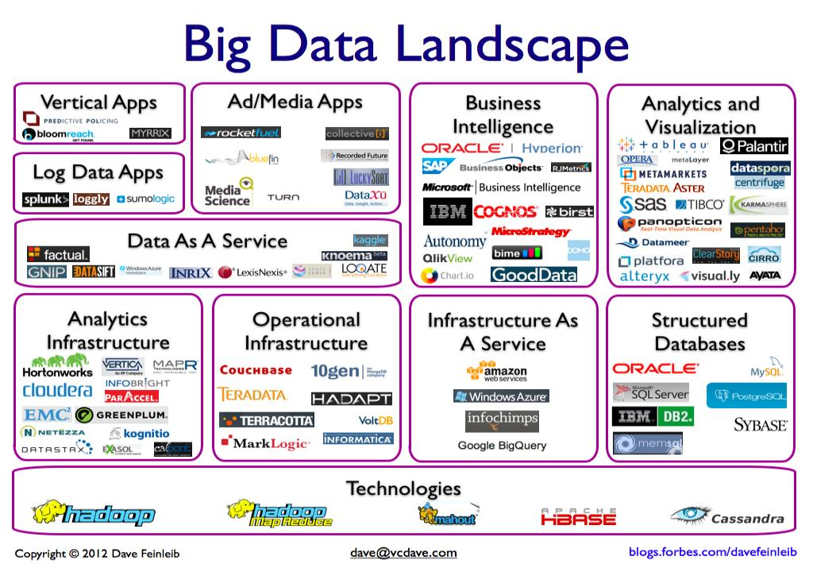
Big Data Landscape

