Slide 2
After this lecture, you will be able to,
Learn about data processing and Hadoop Processing.
Understand the Hadoop Framework and its modules.

Slide 3
Parallel Data Processing
Parallel data processing involves the simultaneous execution of multiple sub-tasks that collectively comprise a larger task.
Goal: To reduce the execution time by dividing a single larger task into multiple smaller tasks that run concurrently.

Slide 4
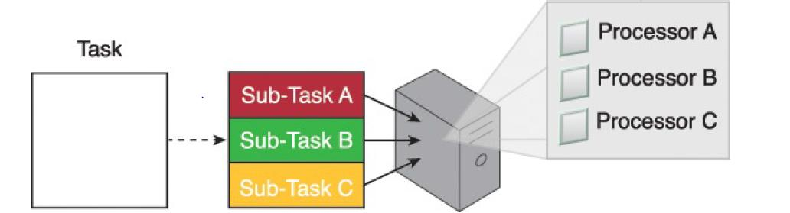
Parallel Data Processing

Slide 5
Distributed Data Processing
Closely related to parallel data processing.
Follows the principle of “divide-and-conquer”.
Always achieved through physically separate machines that are networked together as a cluster.

Slide 6
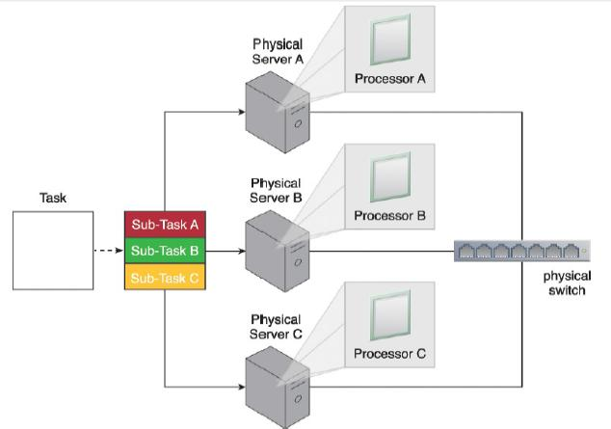
Distributed Data Processing
A task is divided into three sub-tasks that are then executed on three different machines sharing one physical switch.

Slide 7
Processing Workloads in Big Data
Amount and nature of data that is processed within a certain amount of time.
Workloads are usually divided into two types:
Batch
Transactional

Slide 8
Batch Processing Workload
Also known as offline processing.
In batch mode, data is processed offline in batches and the response time could vary from minutes to hours. As well, data must be persisted to the disk before it can be processed.
Involves processing data in batches and usually imposes delays, which in turn results in high-latency responses.

Slide 9
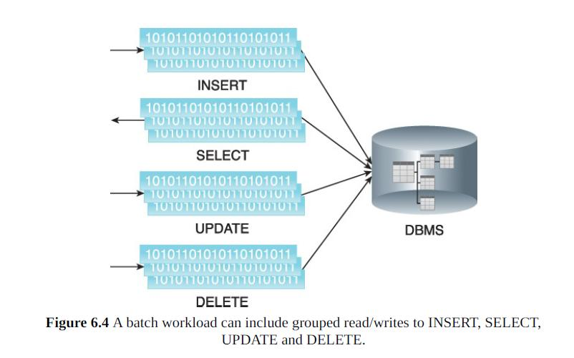
Batch Processing Workload

Slide 10
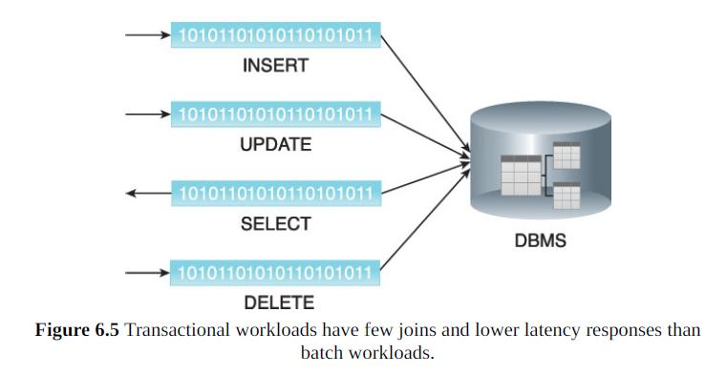
Transactional Processing Workload
Also known as online processing.
Follows an approach whereby data is processed interactively without delay, resulting in low-latency responses.

Slide 11
Cluster Processing
Provide necessary support to create horizontally scalable storage solutions.
Also provides the mechanism to enable distributed data processing with linear scalability.

Slide 12
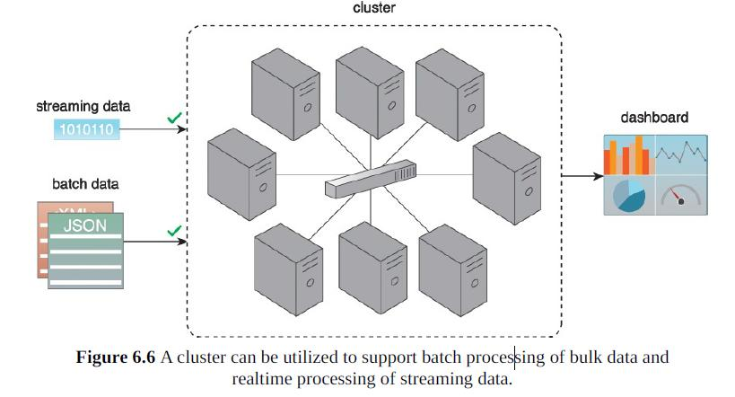
Cluster Processing

Slide 13
Hadoop Framework
Hadoop is an open-source framework for large-scale data storage and data processing that is compatible with commodity hardware.
A software framework for storage and large scale processing of data-sets on clusters of commodity hardware.

Slide 14

Hadoop Framework
Created by Doug Cutting and Mike Cafarella in 2005.
Named the project after son's toy elephant.

Slide 15
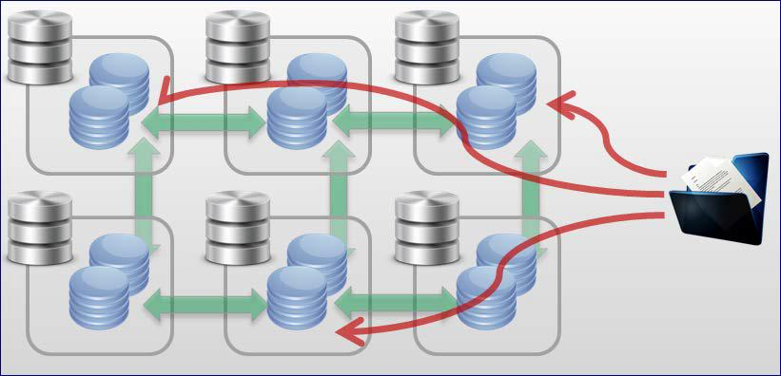
Hadoop Framework
Moving Computation to Data- Computation is moved to data.
Data
Computation

Slide 16

Hadoop Framework
Scalability Issues Resolved at Hadoop’s Core
Reliability Issues

Slide 17
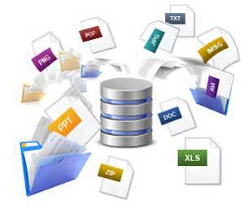

Hadoop Framework
Hadoop Offers:
New Approach to Data
New Kinds of Analysis
Unstructured Data
Schema-on Read Style

Slide 18
Hadoop Framework
Can be used as an ETL engine or as an analytics engine for processing large amounts of structured, semi structured and unstructured data.
From an analysis perspective, Hadoop implements the MapReduce processing framework.

Slide 19
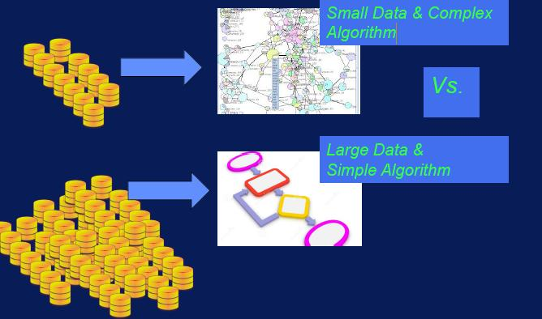
Hadoop Framework

Slide 20
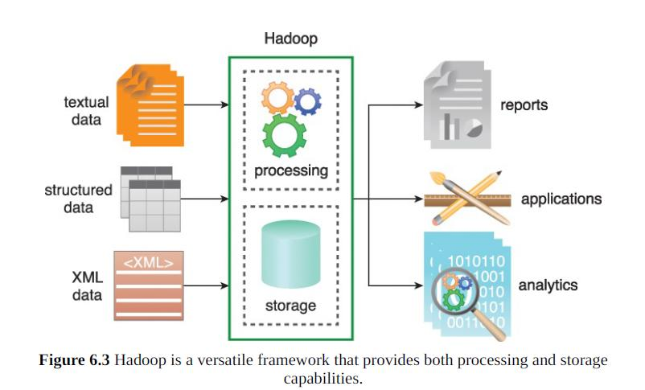
Hadoop Framework

Slide 21
Hadoop Modules
Hadoop Common
Hadoop YARN
Hadoop Distributed File System (HDFS)
Hadoop MapReduce

Slide 22
Hadoop Modules
Hadoop Common
Hadoop YARN
Hadoop Distributed File System (HDFS)
Hadoop MapReduce

Slide 23
Hadoop Modules
Hadoop Common
Hadoop YARN
Hadoop Distributed File System (HDFS)
Hadoop MapReduce

Slide 24
Hadoop Modules
Hadoop Common
Hadoop YARN
Hadoop Distributed File System (HDFS)
Hadoop MapReduce

Slide 25
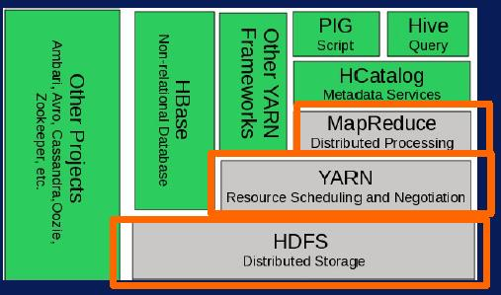
Hadoop Modules

Slide 26
Hadoop Modules- Hadoop Common
Hadoop Common refers to the collection of common utilities and libraries that support other Hadoop modules.
An essential part or module of the Apache Hadoop Framework, along with the Hadoop Distributed File System (HDFS), Hadoop YARN and Hadoop MapReduce.

Slide 27
Hadoop Modules- Hadoop Common
Assumes that hardware failures are common and that these should be automatically handled in software by the Hadoop Framework.
Also, known as Hadoop Core.

Slide 28
Hadoop Modules- Hadoop Common
Hadoop Common Package
Considered as the base/core of the framework as it provides essential services and basic processes such as abstraction of the underlying operating system and its file system.
Contains the necessary Java Archive (JAR) files and scripts required to start Hadoop.

Slide 29
Hadoop Modules- Hadoop Yarn
One of the main components in Hadoop.
Stands for Yet Another Resource Negotiator though it is called as Yarn by the developers.
Resource management platform responsible for managing compute resources in the cluster and using them in order to schedule users and applications.
Used for job scheduling and resource management.

Slide 30
Hadoop Modules- Hadoop Yarn
Yarn is the parallel processing framework for implementing distributed computing clusters that processes huge amounts of data over multiple compute nodes.
Hadoop Yarn allows for a compute job to be segmented into hundreds and thousands of tasks.

Slide 31
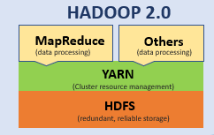
Hadoop Modules- Hadoop Yarn

Slide 32
Hadoop Modules- Hadoop Yarn
Major components responsible for all the YARN operations are as follows:
Resource Manager
Node Manager
Application Master

Slide 33
Hadoop Modules- Hadoop Yarn
Resource Manager- Resource Manager allocates the cluster resources.
Resource Management
Scheduling Management
Application Management
Containers in Hadoop
Resource Containers

Slide 34
Hadoop Modules- Hadoop Yarn
Yarn Operation- Yarn uses master servers and data servers. There is only one master server per cluster. It runs the resource manager daemon. There are many data servers in the cluster, each one runs on its own Node Manager daemon and the application master manager as required.

Slide 35
Hadoop Modules- Hadoop Yarn
Key Features of Yarn
Multi-Tenancy
Sharing Resources
Cluster Utilization
Fault Tolerance
Scalability
Compatibility

Slide 36
Hadoop Modules- Hadoop Distributed File System (HDFS)
Hadoop Distributed File System- Major component of Apache Hadoop
Handles large data sets running on commodity hardware.
Allows multiple files to be stored and retrieved at the same time at an unprecedented speed.
Used to scale a single Apache Hadoop cluster to hundreds (and even thousands) of nodes.

Slide 37
Hadoop Modules- Hadoop Distributed File System (HDFS)
Goals of HDFS:
Fast Recovery from Hardware Failures.
Access to Streaming Data.
Accommodation of Large Data Sets.
Portability.

Slide 38
Hadoop Modules- Hadoop Distributed File System (HDFS)
HDFS Key Features | Description
Storing bulks of data | HDFS is capable of storing terabytes and petabytes of data.
Minimum intervention | It manages thousands of nodes without operators’ intervention.
Computing | HDFS provides the benefits of distributed and parallel computing at once.
Scaling out | It works on scaling out, rather than on scaling up, without a single downtime.
Rollback | HDFS allows returning to its previous version post an upgrade.
Data integrity | It deals with corrupted data by replicating it several times.

Slide 39
An Example of HDFS
Example of HDFS

Slide 40
Hadoop Modules- Hadoop Distributed File System (HDFS)
IBM and Cloudera have partnered to offer an industry-leading, enterprise-grade Hadoop distribution, including an integrated ecosystem of products and services to support faster analytics at scale.

Slide 41
Why Should You Use HDFS?
HDFS stores the same data in multiple sets.
More suited for batch processing applications rather than for interactive use.
HDFS works exclusively well for large datasets, offering high-aggregate data bandwidth.
Highly Profitable

Slide 42
Hadoop Modules- MapReduce
A programming model that scales data across a lot of different processes.
MapReduce is defined as the framework of Hadoop, which is used to process a huge amount of data parallelly on large clusters of commodity hardware in a reliable manner.

Slide 43

Hadoop Modules- MapReduce
How does MapReduce in Hadoop make working so easy?

