Slide 2
After this lecture, you will be able to,
Learn about MapReduce and its phases.
Know about the MapReduce Algorithm.

Slide 3
Hadoop MapReduce
Framework of Hadoop used to process a huge amount of data parallelly on large clusters of commodity hardware in a reliable manner.
Allows the application to store the data in the distributed form and process large dataset across groups of computers using simple programming models.

Slide 4
Hadoop MapReduce
How does MapReduce in Hadoop make working so easy?
Scaling up the data processing

Slide 5
MapReduce Architecture
Hadoop cluster stores a large set of data which is parallelly processed mainly by MapReduce.
Provides parallelism, fault-tolerance, and data distribution.
Map Reduce provides API with features such as parallel processing of huge amounts of data, batch processing, and high availability.

Slide 6
MapReduce Architecture
Hadoop cluster stores a large set of data which is parallelly processed mainly by MapReduce.
Provides parallelism, fault-tolerance, and data distribution.
Map Reduce provides API with features such as parallel processing of huge amounts of data, batch processing, and high availability.

Slide 7
MapReduce Architecture
Hadoop cluster stores a large set of data which is parallelly processed mainly by MapReduce.
Provides parallelism, fault-tolerance, and data distribution.
Map Reduce provides API with features such as parallel processing of huge amounts of data, batch processing, and high availability.

Slide 8
MapReduce Architecture
Map Reduce programs are written by programmers when there is a need for an application for business scenarios.
Development of applications and deployment across Hadoop clusters is done by the programmers when they understand the flow pattern of MapReduce.

Slide 9
MapReduce Architecture
Map Reduce programs are written by programmers when there is a need for an application for business scenarios.
Development of applications and deployment across Hadoop clusters is done by the programmers when they understand the flow pattern of MapReduce.

Slide 10
MapReduce Architecture
Architecture of MapReduce basically has two main processing stages, Map and Reduce.
Intermediate processes will take place in between the Map and Reduce phases.
Sort and shuffle are the tasks taken up by Map and Reduce, which are done intermediate.

Slide 11
MapReduce Architecture
Architecture of MapReduce basically has two main processing stages, Map and Reduce.
Intermediate processes will take place in between the Map and Reduce phases.
Sort and shuffle are the tasks taken up by Map and Reduce, which are done intermediate.

Slide 12
MapReduce Architecture
Architecture of MapReduce basically has two main processing stages, Map and Reduce.
Intermediate processes will take place in between the Map and Reduce phases.
Sort and shuffle are the tasks taken up by Map and Reduce, which are done intermediate.

Slide 13
MapReduce Architecture
Map() Function
Reduce() Function

Slide 14
How MapReduce in Hadoop Works?
MapReduce program executes mainly in 4 steps:
Input splits
Map
Shuffle
Reduce

Slide 15
MapReduce- Map Step
Map Step- Combination of the input splits step and the Map step.
In the Map step, the source file is passed as line by line. Before input pass to the Map function job, the input is divided into the small fixed-size called Input splits.

Slide 16
MapReduce- Reduce Step
Reduce Step
This step is the combination of the Shuffle step and the Reduce.

Slide 17
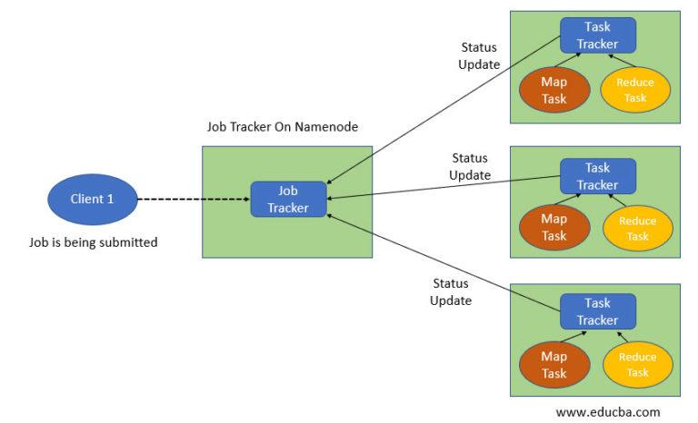
MapReduce Architecture Components
Working of MapReduce Organizers-

Slide 18
MapReduce Architecture Components
This is how MapReduce organizers work-
The job is divided into two components: Map tasks (Splits and mapping) and Reduce tasks (Reducing and shuffling).

Slide 19
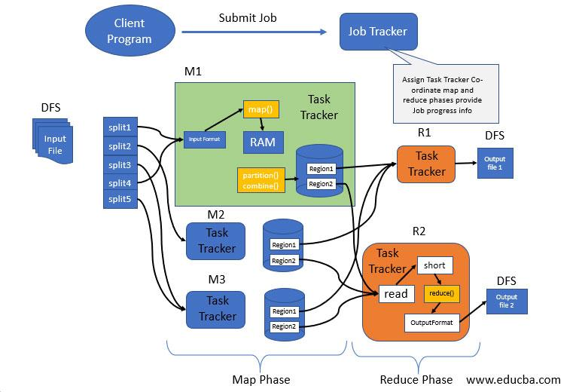
MapReduce Architecture Components

Slide 20
MapReduce Architecture Components
Map Phase-
Map phase splits input data into two parts- Keys & Values. Mini reducer which is commonly called a combiner, reducer code places input as combiner.

Slide 21
MapReduce Architecture Components
Processing in Intermediate-
In the intermediate phase, the map input gets into the sort and shuffle phase.

Slide 22
MapReduce Architecture Components
Reducer Phase-
The reducer takes in data input that is sorted & shuffled.
Output Phase-

Slide 23
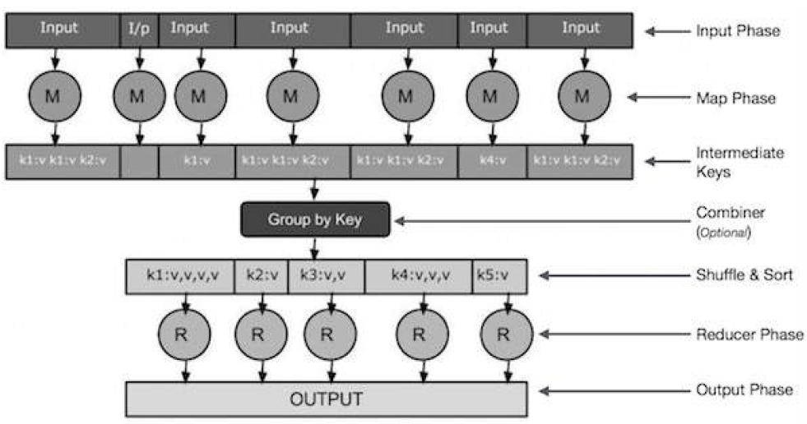
MapReduce Architecture Components

Slide 24
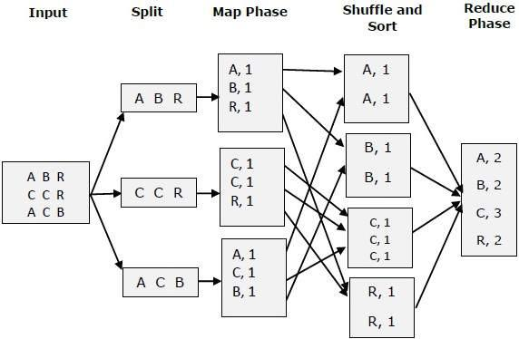
MapReduce Example

Slide 25
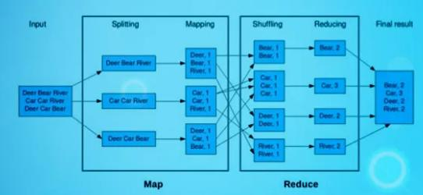
MapReduce Example

Slide 26
Traditional Approach
Traditional Enterprise Approach
In this approach, an enterprise will have a computer to store and process big data. For storage purpose, the programmers will take the help of their choice of database vendors such as Oracle, IBM, etc.

Slide 27
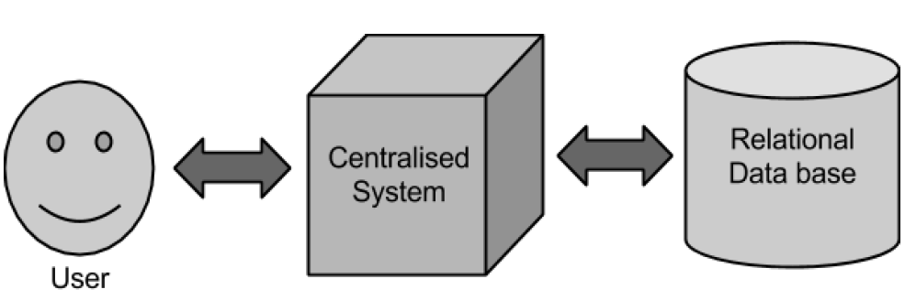
Traditional Approach
Traditional Enterprise Approach

Slide 28
Google’s Solution- MapReduce Algorithm
Traditional approach works fine with those applications that process less voluminous data that can be accommodated by standard database servers, or up to the limit of the processor that is processing the data.
Google solved this problem using an algorithm called MapReduce.

Slide 29
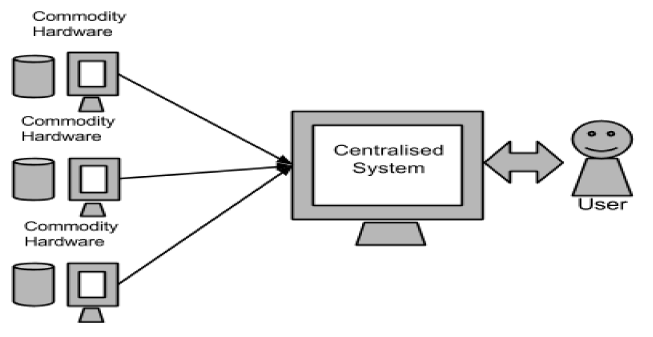
Google’s Solution- MapReduce Algorithm

Slide 30
MapReduce Example
Let us take a real-world example to comprehend the power of MapReduce.
Twitter receives around 500 million tweets per day, which is nearly 3000 tweets per second.
The following illustration shows how Twitter manages its tweets with the help of MapReduce.

Slide 31
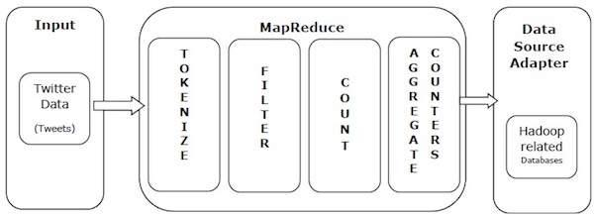
MapReduce Example

Slide 32
MapReduce Example
As shown in the illustration, MapReduce algorithm performs the following actions −
Tokenize
Filter
Count
Aggregate Counters

