Slide 2
After this lecture, you will be able to,
learn about Google File System (GFS).
Know the architecture and operations of GFS.

Slide 3
Google File System (GFS)
Scalable distributed file system for large distributed data-intensive applications.
Provides fault tolerance while running on inexpensive commodity hardware, and it delivers high aggregate performance to a large number of clients.
To meet the rapidly growing demands of Google’s data processing needs.

Slide 4
Google File System (GFS)
Scalable distributed file system for large distributed data-intensive applications.
Provides fault tolerance while running on inexpensive commodity hardware, and it delivers high aggregate performance to a large number of clients.
To meet the rapidly growing demands of Google’s data processing needs.

Slide 5
Google File System (GFS)
Scalable distributed file system for large distributed data-intensive applications.
Provides fault tolerance while running on inexpensive commodity hardware, and it delivers high aggregate performance to a large number of clients.
To meet the rapidly growing demands of Google’s data processing needs.

Slide 6
Google File System (GFS)
Initial exploration on design space before implementing GFS-
Component failures are the norm rather than the exception.
Files are huge by traditional standards.
Most files are mutated by appending new data rather than overwriting existing data.

Slide 7
Google File System (GFS)
Co-designing the applications and the file system API benefits the overall system by increasing the flexibility.
Multiple GFS clusters are currently deployed for different purposes.

Slide 8
GFS Assumptions
Hardware failures are common (commodity hardware)
Files are large (GB/TB) and their number is limited (millions, not billions)
Two main types of reads: large streaming reads and small random reads!
Workloads with sequential writes that append data to files
Once written, files are seldom modified. (!=append) again
Random modification in files possible, but not efficient in GFS
High sustained bandwidth trumps low latency

Slide 9
GFS Assumptions
Hardware failures are common (commodity hardware)
Files are large (GB/TB) and their number is limited (millions, not billions)
Two main types of reads: large streaming reads and small random reads!
Workloads with sequential writes that append data to files
Once written, files are seldom modified. (!=append) again
Random modification in files possible, but not efficient in GFS
High sustained bandwidth trumps low latency

Slide 10
GFS Assumptions
Hardware failures are common (commodity hardware)
Files are large (GB/TB) and their number is limited (millions, not billions)
Two main types of reads: large streaming reads and small random reads!
Workloads with sequential writes that append data to files
Once written, files are seldom modified. (!=append) again
Random modification in files possible, but not efficient in GFS
High sustained bandwidth trumps low latency

Slide 11
GFS Assumptions
Hardware failures are common (commodity hardware)
Files are large (GB/TB) and their number is limited (millions, not billions)
Two main types of reads: large streaming reads and small random reads!
Workloads with sequential writes that append data to files
Once written, files are seldom modified. (!=append) again
Random modification in files possible, but not efficient in GFS
High sustained bandwidth trumps low latency

Slide 12
GFS Assumptions
Hardware failures are common (commodity hardware)
Files are large (GB/TB) and their number is limited (millions, not billions)
Two main types of reads: large streaming reads and small random reads!
Workloads with sequential writes that append data to files
Once written, files are seldom modified. (!=append) again
Random modification in files possible, but not efficient in GFS
High sustained bandwidth trumps low latency

Slide 13
GFS Assumptions
Hardware failures are common (commodity hardware)
Files are large (GB/TB) and their number is limited (millions, not billions)
Two main types of reads: large streaming reads and small random reads!
Workloads with sequential writes that append data to files
Once written, files are seldom modified. (!=append) again
Random modification in files possible, but not efficient in GFS
High sustained bandwidth trumps low latency

Slide 14
GFS Assumptions
Hardware failures are common (commodity hardware)
Files are large (GB/TB) and their number is limited (millions, not billions)
Two main types of reads: large streaming reads and small random reads!
Workloads with sequential writes that append data to files
Once written, files are seldom modified. (!=append) again
Random modification in files possible, but not efficient in GFS
High sustained bandwidth trumps low latency

Slide 15
GFS Interface
GFS provides a familiar file system interface, though it does not implement a standard API such as POSIX. Files are organized hierarchically in directories and identified by pathnames.
Supports usual operations to create, delete, open, close, read, and write files.
GFS has snapshot and record append operations.

Slide 16
GFS Architecture
GFS cluster consists of a single master and multiple chunkservers and is accessed by multiple clients.
Files are divided into fixed-size chunks.
Chunkservers

Slide 17
GFS Architecture
Single Master
GFS client code
Chunk Size
Metadata
In-Memory Data Structures
Chunk Locations
Operation Log

Slide 18
GFS Architecture
Single Master
GFS client code
Chunk Size
Metadata
In-Memory Data Structures
Chunk Locations
Operation Log

Slide 19
GFS Architecture
Single Master
GFS client code
Chunk Size
Metadata
In-Memory Data Structures
Chunk Locations
Operation Log

Slide 20
GFS Architecture
Single Master
GFS client code
Chunk Size
Metadata
In-Memory Data Structures
Chunk Locations
Operation Log

Slide 21
GFS Architecture
Single Master
GFS client code
Chunk Size
Metadata
In-Memory Data Structures
Chunk Locations
Operation Log

Slide 22
GFS Architecture
Single Master
GFS client code
Chunk Size
Metadata
In-Memory Data Structures
Chunk Locations
Operation Log

Slide 23
GFS Architecture
Single Master
GFS client code
Chunk Size
Metadata
In-Memory Data Structures
Chunk Locations
Operation Log

Slide 24
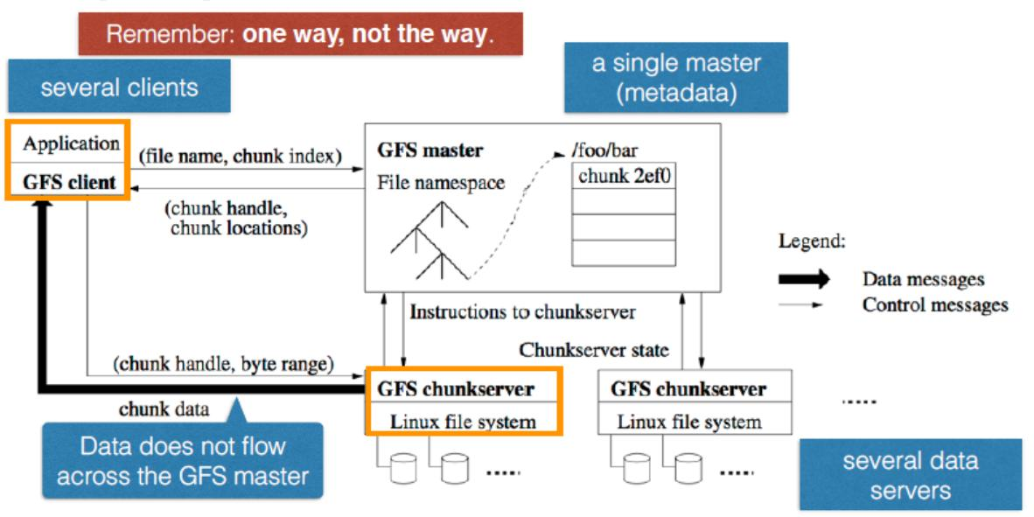
GFS Architecture

Slide 25
GFS Operation
First, using the fixed chunk size, the client translates the file name and byte offset specified by the application into a chunk index within the file.
Then, it sends the master a request containing the file name and chunk index.

Slide 26
GFS Consistency Model
GFS has a relaxed consistency model that supports the highly distributed applications well but remains relatively simple and efficient to implement.W

Slide 27
Detailed GFS Master Operation
The master executes all namespace operations. In addition, it manages chunk replicas throughout the system: it makes placement decisions, creates new chunks and hence replicas, and coordinates various system-wide activities to keep chunks fully replicated, to balance load across all the chunkservers, and to reclaim unused storage.

Slide 28
Detailed GFS Master Operation
Namespace Management and Locking
Replica Placement
Creation, Re-replication, Rebalancing

Slide 29
Conclusion
GFS demonstrates the qualities essential for supporting large-scale data processing workloads on commodity hardware. While some design decisions are specific to our unique setting, many may apply to data processing tasks of a similar magnitude and cost consciousness.

Slide 30
Conclusion
GFS provides fault tolerance.
GFS delivers high aggregate throughput to many concurrent readers and writers performing a variety of tasks.
GFS has successfully met the storage needs and is widely used within Google.

