Slide 2
After this lecture, you will be able to,
learn about the hadoop distributed file system (hdfs).
know the architecture and operations of hdfs.
explore the comparison of gfs and hdfs.

Slide 3
Distributed File System (DFS)
A set of client and server services that allow an organization using Microsoft Windows servers to organize many distributed SMB file shares into a distributed file system.
Two components to its service: Location transparency (via the namespace component) and redundancy (via the file replication component).

Slide 4
Distributed File System (DFS)
Microsoft's DFS is referred to interchangeably as 'DFS' and 'Dfs' by Microsoft and is unrelated to the DCE Distributed File System, which held the 'DFS' trademark but was discontinued in 2005.

Slide 5
Distributed File System (DFS)
DFS root can only exist on a server version of Windows (from Windows NT 4.0 and up) and OpenSolaris (in kernel space) or a computer running Samba (in user space.)
Enterprise and Datacenter Editions of Windows Server can host multiple DFS roots on the same server.

Slide 6
Distributed File System (DFS)
Two ways of implementing DFS on a server:
Standalone DFS Namespace.
Domain-based DFS Namespace.

Slide 7
Hadoop Distributed File System (HDFS)
HDFS is a distributed file system that handles large data sets running on commodity hardware.
Used to scale a single Apache Hadoop cluster to hundreds (and even thousands) of nodes.

Slide 8
Hadoop Distributed File System (HDFS)
One of the major components of Apache Hadoop, the others being MapReduce and YARN.
HDFS should not be confused with or replaced by Apache HBase, which is a column-oriented non-relational database management system that sits on top of HDFS and can better support real-time data needs with its in-memory processing engine.

Slide 9
Features of HDFS
Suitable for the distributed storage and processing.
Hadoop provides a command interface to interact with HDFS.
The built-in servers of namenode and datanode help users to easily check the status of cluster.
Streaming access to file system data.
Provides file permissions and authentication.

Slide 10
HDFS Goals
Goals of HDFS:
Fast Recovery from Hardware Failures.
Access to Streaming Data.
Accommodation of Large Data Sets.
Portability.

Slide 11
HDFS ASSUMPTIONS
Simple Coherency Model.
Moving Computation is Cheaper than Moving Data.

Slide 12
HDFS Key Features
HDFS Key Features | Description
Storing bulks of data | HDFS is capable of storing terabytes and petabytes of data.
Minimum intervention | It manages thousands of nodes without operators’ intervention.
Computing | HDFS provides the benefits of distributed and parallel computing at once.
Scaling out | It works on scaling out, rather than on scaling up, without a single downtime.
Rollback | HDFS allows returning to its previous version post an upgrade.
Data integrity | It deals with corrupted data by replicating it several times.

Slide 13
An Example of HDFS
Example of HDFS

Slide 14
Hadoop Distributed File System (HDFS)
IBM and Cloudera

Slide 15
HDFS Architecture
HDFS follows the master–slave data architecture.
Each cluster comprises a single Namenode.
Another component in the HDFS cluster is- Datanode, usually one per node in the HDFS cluster.

Slide 16
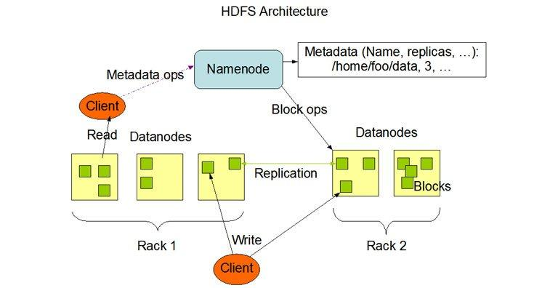
HDFS Architecture

Slide 17
HDFS Architecture - Namenode
Namenode is the commodity hardware that contains the GNU/Linux operating system and the namenode software. It is a software that can run on commodity hardware.

Slide 18
HDFS Architecture - Datanode
Datanode is a commodity hardware having the GNU/Linux OS and datanode software.

Slide 19
HDFS Architecture- Blocks
HDFS stores a file in a sequence of blocks. It is easy to configure the block size and the replication factor.

Slide 20
Data Organization in HDFS
Data Blocks
Staging
Replication Pipelining

Slide 21
The File System Namespace
HDFS data platform format follows a strictly hierarchical file system.
An application or a user first creates a directory, and there will be files within this directory. The file system hierarchy is identical to other file systems.

Slide 22
The File System Namespace
Data Replication
Replica Placement
Replica Selection
Safemode

Slide 23
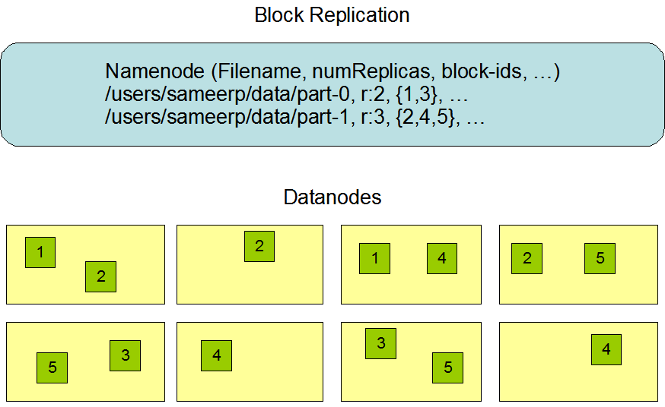
The File System Namespace

Slide 24
HDFS Operations
Starting HDFS
Initially you have to format the configured HDFS file system, open namenode (HDFS server), and execute the following command:
$ hadoop namenode -format

Slide 25
HDFS Operations
After formatting the HDFS, start the distributed file system.
$ start-dfs.sh

Slide 26
HDFS Operations
Listing Files in HDFS-
$ $HADOOP_HOME/bin/hadoop fs -ls <args>

Slide 27
HDFS Operations
Inserting Data into HDFS
Step 1- You have to create an input directory.
$ $HADOOP_HOME/bin/hadoop fs -mkdir /user/input
Step 2- Transfer and store a data file from local systems to the Hadoop file system using the put command.
$ $HADOOP_HOME/bin/hadoop fs -put /home/file.txt /user/input
Step 3- You can verify the file using ls command.
$ $HADOOP_HOME/bin/hadoop fs -ls /user/input

Slide 28
HDFS Operations
Retrieving Data from HDFS
Step 1- Initially, view the data from HDFS using cat command.
$ $HADOOP_HOME/bin/hadoop fs -cat /user/output/outfile
Step 2- Get the file from HDFS to the local file system using get command.
$ $HADOOP_HOME/bin/hadoop fs -get /user/output/ /home/hadoop_tp/

Slide 29
HDFS Operations
Shutting down HDFS
$ stop-dfs.sh

Slide 30
Communication Protocols in HDFS
HDFS communication protocols are layered on top of the TCP/IP protocol.
Client establishes a connection to a configurable TCP port on the NameNode machine. It talks about the ClientProtocol with the NameNode.

Slide 31
Robustness in HDFS
Primary objective of HDFS is to store data reliably even in the presence of failures.
Three common types of failures are-
NameNode failures
DataNode failures and
Network partitions

Slide 32
Advantages of Using HDFS
HDFS is by far the most resilient and fault-tolerant technology that is available as an open-source platform, which can be scaled up or scaled down depending on the needs, making it really hard for finding an HDFS replacement for Big Data Hadoop storage needs.

Slide 33
Advantages of Using HDFS
Distributed across hundreds or even thousands of servers.
Works quite well for data loads that come in a streaming format.
Works exclusively well for large datasets.
Works on the assumption that moving of computation is much easier, faster, and cheaper than moving of data of humongous size.

Slide 34
Advantages of Using HDFS
Accessibility.
Highly Profitable.

Slide 35
Comparison - GFS vs HDFS
HDFS is a simplified version of GFS.
Similarities-
Master and Slaves.
Data blocks and replication.
Tree structure.

Slide 36
Comparison- GFS vs HDFS
File Appends.
Master Failure.
Garbage Collection. (GC)

