Slide 2
After this lecture, you will be able to,
know about cloud collaboration.
understand g-suite and google drive storage capabilities.
learn about the cloud-based word documents.

Slide 3
Cloud Collaboration
Collaboration refers to the ability of workers to work together simultaneously on a particular task.
Cloud collaboration is a way of sharing and co-authoring computer files through the use of cloud computing.

Slide 4
Cloud Collaboration
Cloud collaboration technologies allow users to upload, comment and collaborate on documents and even amend the document itself, evolving the documents.
Businesses in the last few years have increasingly been switching to the use of cloud collaboration.

Slide 5
Cloud Collaboration
Document collaboration can be completed face to face. However, collaboration has become more complex, with the need to work with people all over the world in real time on a variety of different types of documents, using different devices.

Slide 6
Cloud Collaboration
Documents are uploaded to a central "cloud" for storage, where they can then be accessed by others.
Collaboration services include Google, Microsoft, WebEx, Jive Software, eXo Platform, Synaptop, and Salesforce.com.

Slide 7
Cloud Collaboration
A report mapped out five reasons why workers are reluctant to collaborate more:
People resist sharing their knowledge.
Safety issues.
Users are most comfortable using e-mail as their primary electronic collaboration tool.
People do not have an incentive to change their behaviour.

Slide 8
Cloud Collaboration
Teams that want to or are selected to use the software do not have strong team leaders who push for more collaboration.
Senior management is not actively involved in or does not support the team collaboration initiative.

Slide 9
Cloud as Community Benefit
Cloud computing isn’t just for home users.
Cloud has tremendous benefits for the entire community, from neighbourhood groups to sports teams to school organizations.
Any time any group of people in the community needs to communicate and collaborate, web-based applications are the way to go.

Slide 10
Communicating Across the Community
One of the key components of any community collaboration is communication.
Communication on community issues is to use a web-based email program, such as Gmail (mail.google.com), Microsoft Windows Live Hotmail (mail.live.com), or Yahoo! Mail (mail.yahoo.com). These programs can be accessed from any computer connected to the Internet.

Slide 11
Communicating Across the Community
You use your web browser to send and view email messages hosted on the web.
You can send and receive messages at work, at home, or from wherever you happen to be.
Everything you send and receive is stored in the cloud, accessible from anywhere at any time.

Slide 12
Cloud Collaboration Tools
Many cloud service providers created cloud collaboration tools-
Cloud collaboration today is promoted as a tool for collaboration internally between different departments within a firm, but also externally as a means for sharing documents with end-clients as receiving feedback.

Slide 13
Cloud Collaboration Tools
Includes the integration of email alerts into collaboration software and the ability to see who is viewing the document at any time.

Slide 14
Cloud Collaboration Tools
Tools Group Up- All the tools a team could need are put into one piece of software so workers no longer have to rely on an email.
Makes cloud computing a very versatile tool for firms with many different applications in a business environment.

Slide 15
Characteristics of Cloud Collaboration
All platforms can easily be accessed via a web browser.
Offer apps for ease of access from a smartphone or tablet.
Feature a directory structure similar to that of a computer drive; this facilitates navigation and organisation.

Slide 16
Characteristics of Cloud Collaboration
Ease of Access
Access to the personal folders is perceived to be more cumbersome (involves ‘more clicks’).
Many people are always logged into Google (and hence Google Drive) in the back ground, both at home and at school.

Slide 17

Characteristics of Cloud Collaboration
Online Editing
OneDrive and Google Drive offer the possibility of editing documents inside a web browser.
No additional software is needed.
Folders or specific files can be shared with others; this facilitates collaboration.

Slide 18
Characteristics of Cloud Collaboration
Online Collaboration
Documents and folders can be shared with colleagues.
Editing is possible without downloading the document, eliminating the need to email and save multiple versions of the same documents.

Slide 19
Characteristics of Cloud Collaboration
Use real-time commenting & messaging features to enhance speed of project delivery.
Leverage presence indicators to identify when others are active on documents owned by another person.
Allows the users to set permissions and manage other users' activity profiles.
Allows the users to set personal activity feeds and email alert profiles to keep abreast of latest activities per file or user.

Slide 20
Characteristics of Cloud Collaboration
Allows the users to collaborate & share files with the users outside the company firewall.
Comply with company security and compliance framework.
Ensure full auditability of files and documents shared within and outside the organization.
Reduce workarounds for sharing & collaboration on large files.

Slide 21
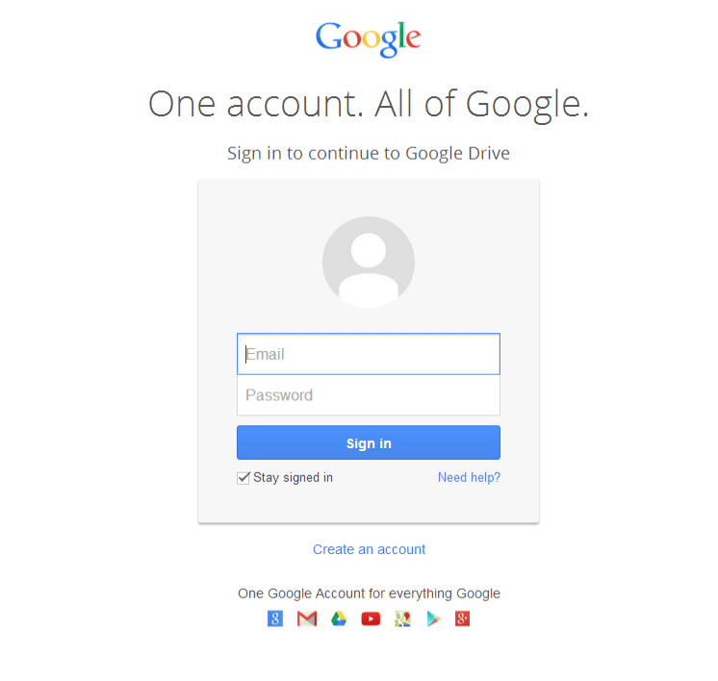
Google Mail
Go to drive.google.com
Google Drive
Select – Sign in

Slide 22
Google Drive
File storage and synchronization service developed by Google.
A key component of G Suite, Google's monthly subscription offering for businesses and organizations.
Launched on April 24, 2012, Google Drive allows users to store files on their servers, synchronize files across devices, and share files.

Slide 23
Google Drive
Offers users 15 gigabytes of free storage through Google One.
Google One also offers 100 gigabytes, 200 gigabytes, 2 terabytes, 10 terabytes, 20 terabytes, and 30 terabytes offered through optional paid plans.

Slide 24
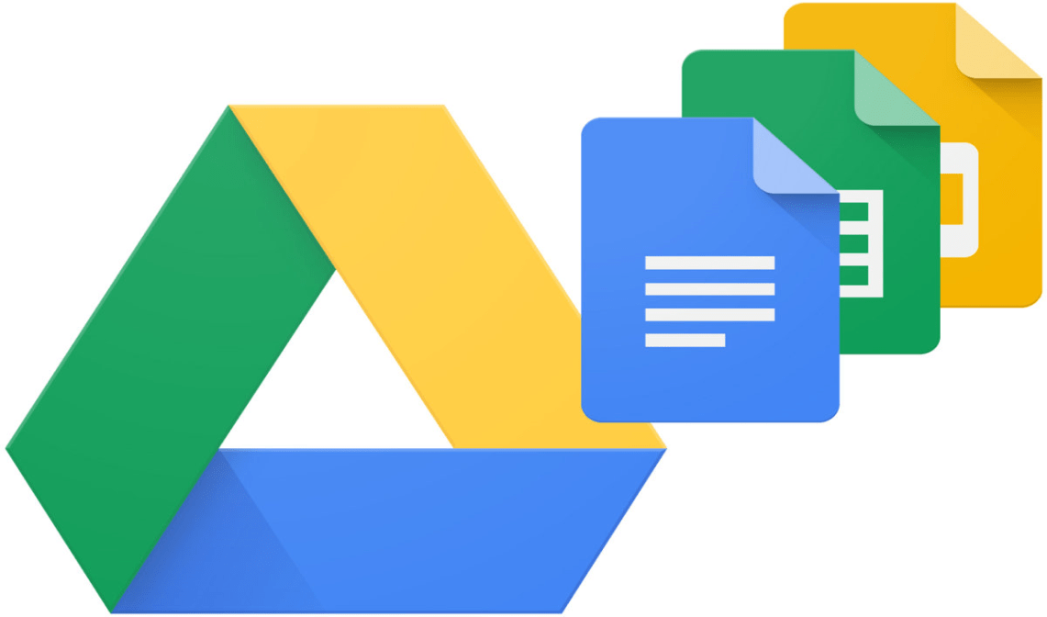
Google Drive Logo

Slide 25
Google Drive
Pure’ cloud computing service, with all the apps & storage found online.
Can be used via desktop top computers, tablets like iPad or on smartphones.
All of Google's services can be considered cloud -based: Gmail, Google Calendar, Google Voice etc.
Microsoft’s OneDrive: Similar to Google Drive.

Slide 26
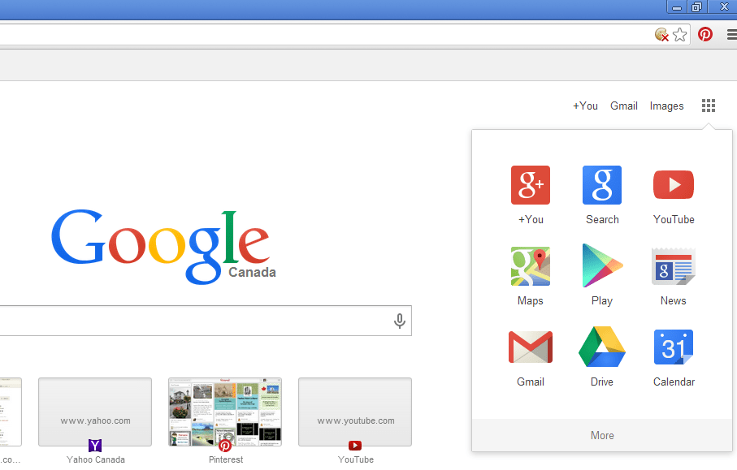
Google Drive
Introduction to Google Drive and Creating Documents
Click Here
From the Google Homepage-Select Drive

Slide 27
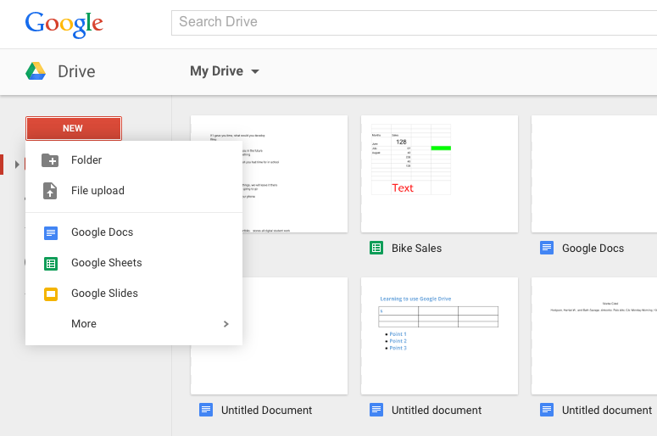
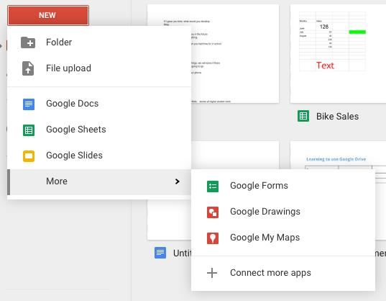
Google Drive
Getting Started
Click on New.
Select your desired program (Docs, Sheets, Slides).
Note: Click on More for Forms and Drawings.

Slide 28
Google Drive
My Drive
Home for all your files
With Google Drive for your PC, you can sync files from your computer to My Drive

Slide 29
Google Drive
Select Docs-
Google’s word processor.
Similar to Microsoft Word.

