Slide 2
After this lecture, you will be able to,
Learn and practically work on the cloud-based word documents.

Slide 3
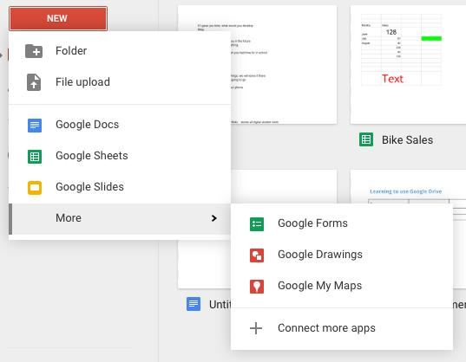
Google Drive
Select Docs-
Google’s word processor.
Similar to Microsoft Word.

Slide 4
Google Docs
Google Drive is the new home for Google Docs.
Setting up a free account and creating and editing documents using Google drive.
Create and share your work online and access your documents from anywhere.
Manage documents, spreadsheets, presentations, surveys, and more all in one location.

Slide 5
Accessing Files
To access all of your files, folders, and Google Docs, you have three options:
Sign into Google Drive on the web at drive.google.com.
Open the Google Drive folder on your computer (created when you install Google Drive for your Mac or PC).

Slide 6
Accessing Files
To access all of your files, folders, and Google Docs, you have three options:
Go to the Google Drive mobile app on your Android or iOS device.

Slide 7
Saving
Because Google Docs, Sheets, and Slides save to a secure, online storage facility, you can create documents, spreadsheets, presentations, and drawings without the need to save to your local hard drive.
You can also access your documents from any computer by signing into your Google Account.

Slide 8
Saving
In the event of a local hard drive crash, you won't lose your saved content.

Slide 9
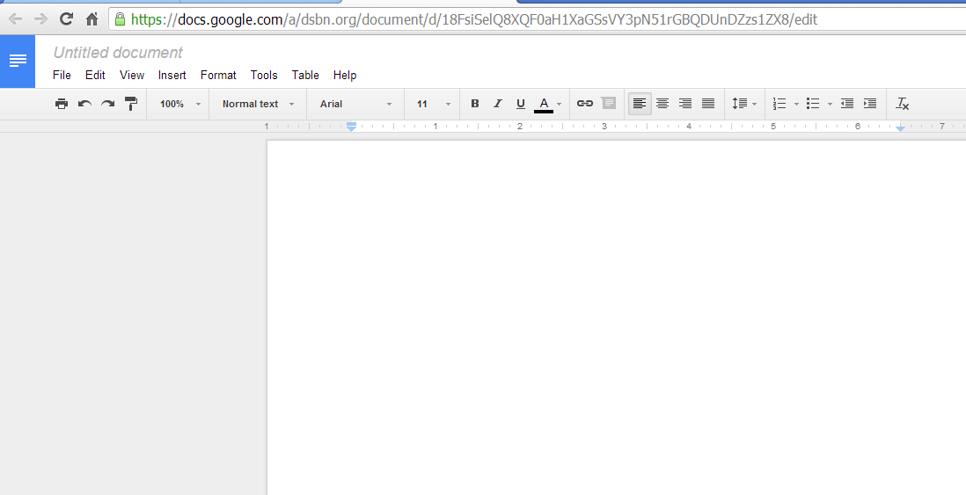


Google Docs- Tool Bar
BOLD, underline and Italics
Bullets and Numbering
Font Style
Font Size
Align, Center, Justify

Slide 10
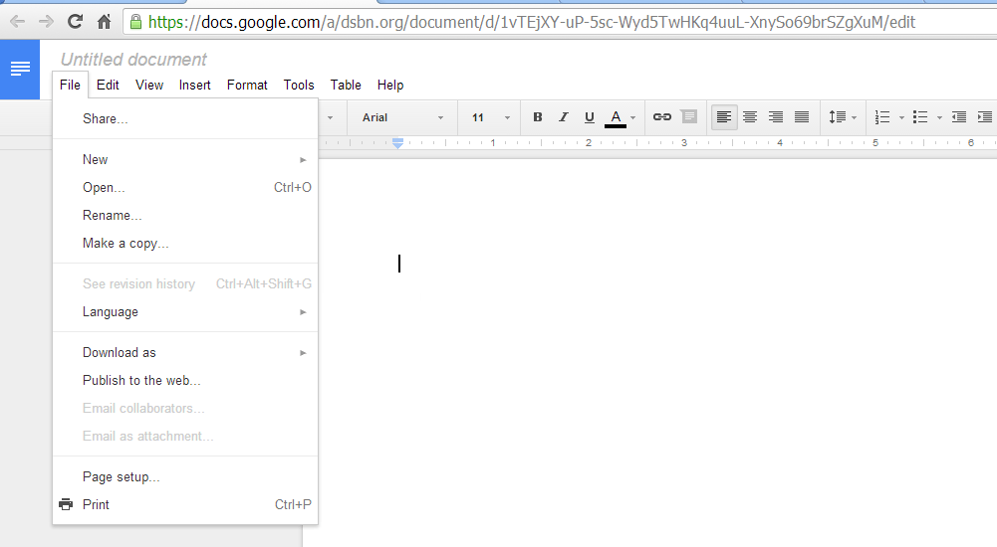
Google Docs Menu- File
New, Share, Open, Print documents and more.

Slide 11
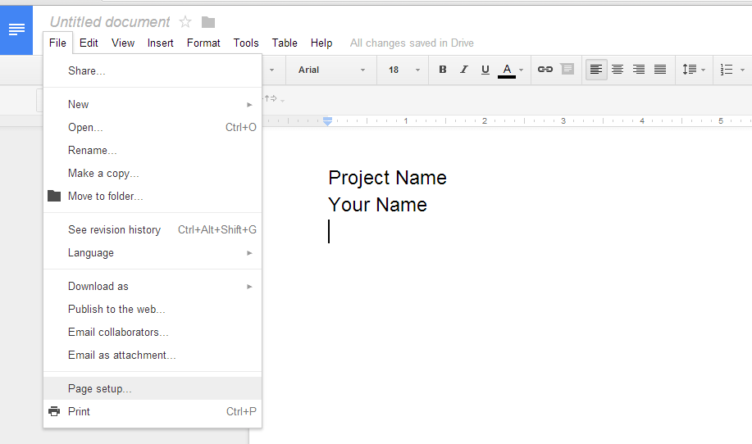
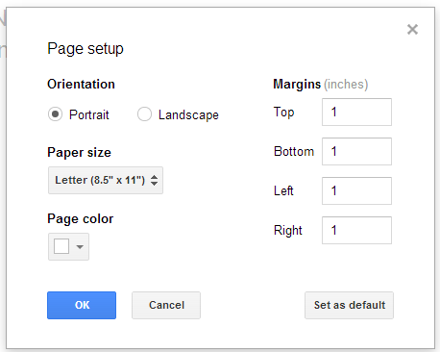
Google Docs Menu- File (Page Setup)

Slide 12
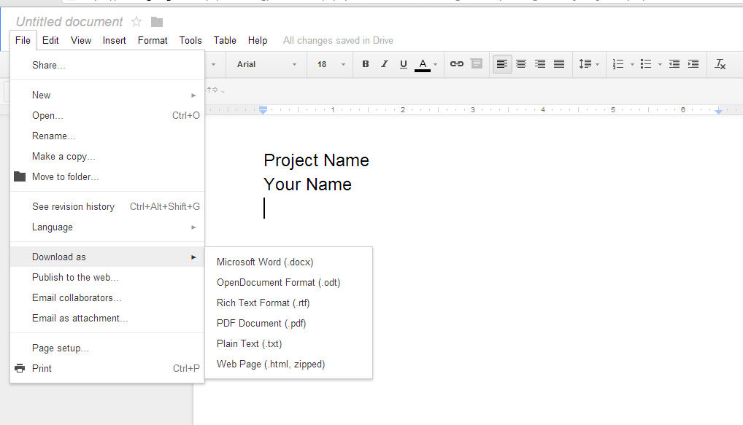
Google Docs Menu- File (Download)
Download your document into one of these file types

Slide 13
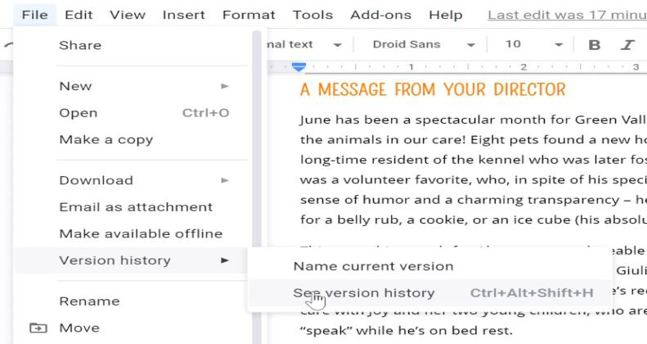
Google Docs Menu- Version History
Google Docs saves every change made to your document through a feature called Version History.
Go to File > Version history > See version history.

Slide 14
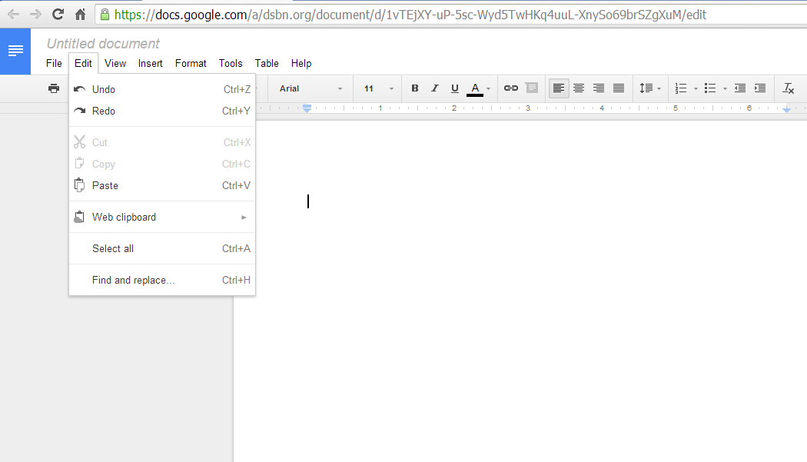
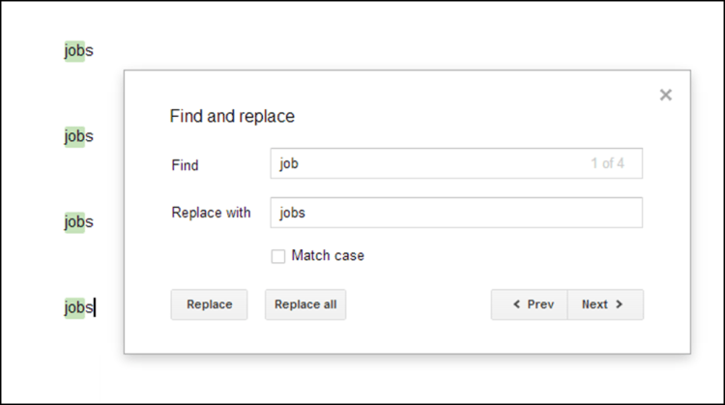
Google Docs Menu- Edit
Actions under this Tab
Undo your previous action
Paste a Picture
Find and replace a word
Find and replace a word in your document
Example shown replaces the word job with jobs.

Slide 15
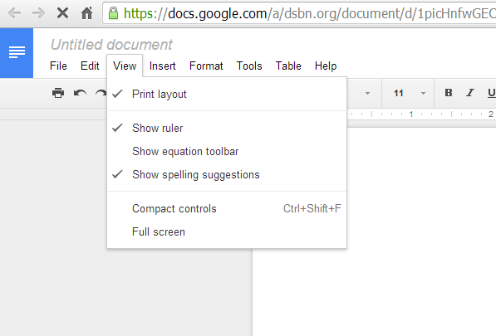
Google Docs Menu- View

Slide 16
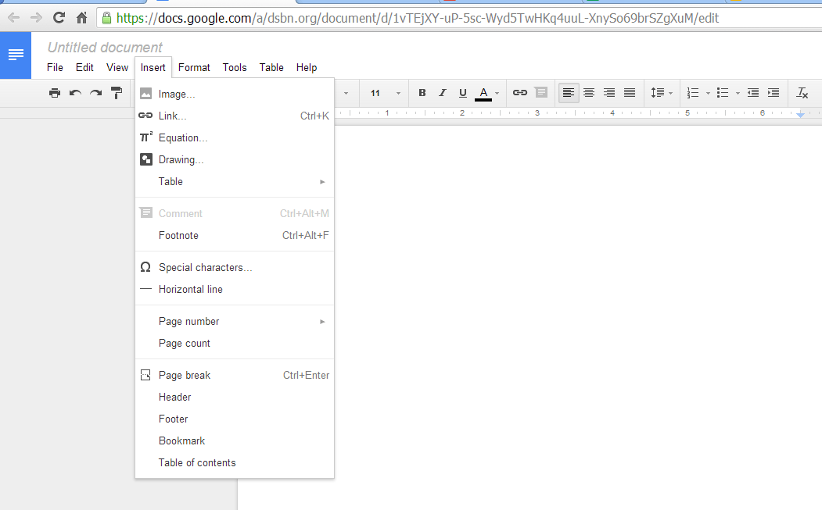


Google Docs Menu- Insert
Image
Equation
Link
Table
Inserting images, links and equations

Slide 17
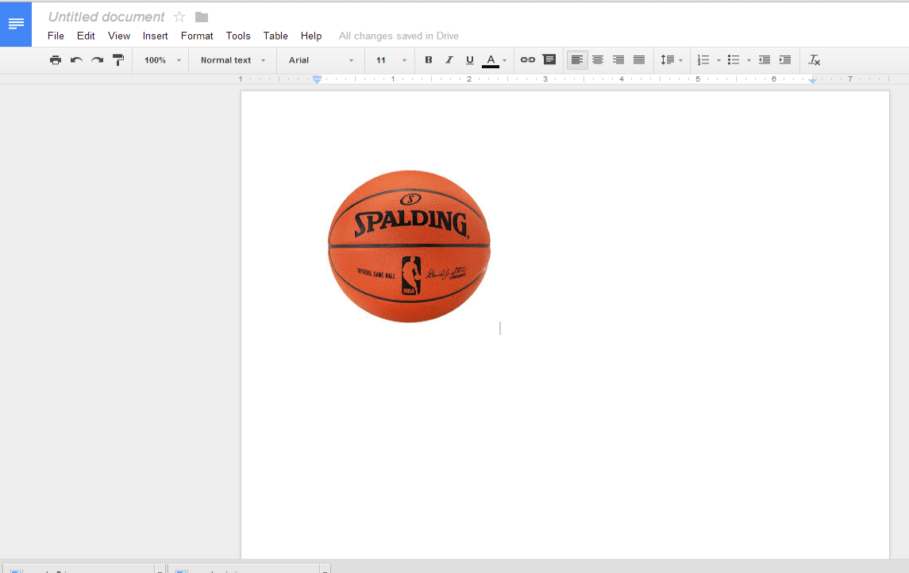
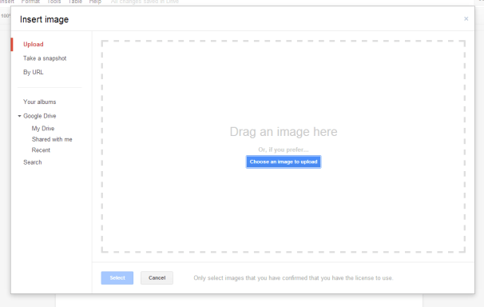
Google Docs Menu- Insert Image
This box appears when insert – image is selected
Find or drag the image into this box
An image saved on your computer
Search Google right there
The image will be inserted onto the page

Slide 18
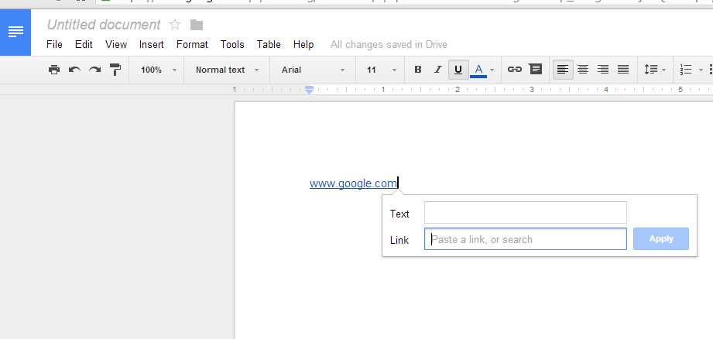
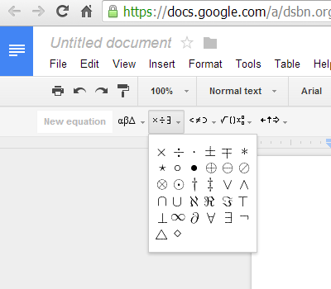
Google Docs Menu- Insert Link
Insert - Link
Insert - Equation

Slide 19
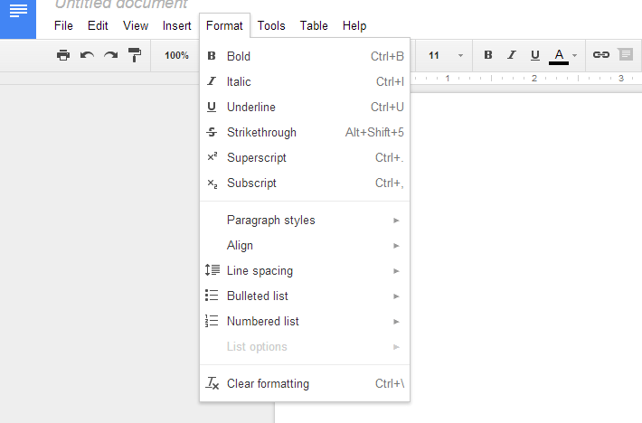
Google Docs Menu- Format
Options include: Bold, Italic, Underline, Align, Line Spacing, Bulleted List, Numbered Lists and more.

Slide 20
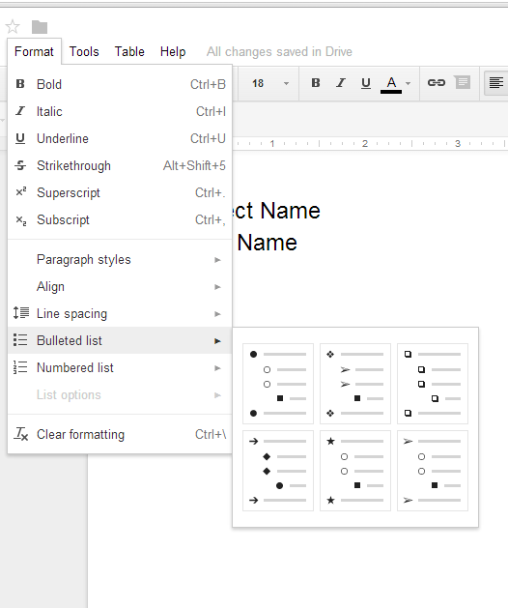
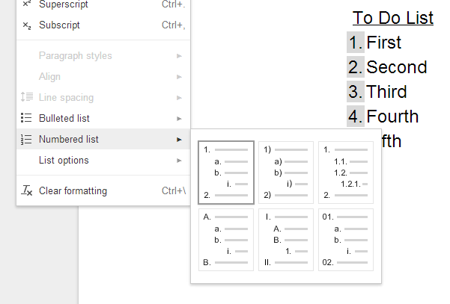
Google Docs Menu- Bullets and Numbered

Slide 21
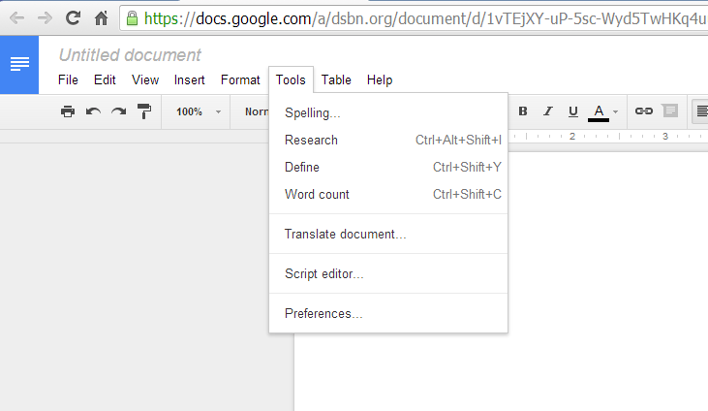
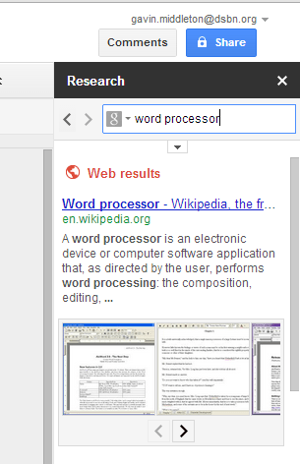

Google Docs Menu- Tools
In this example, word processor was typed into the search area
Check spelling throughout the document

Slide 22
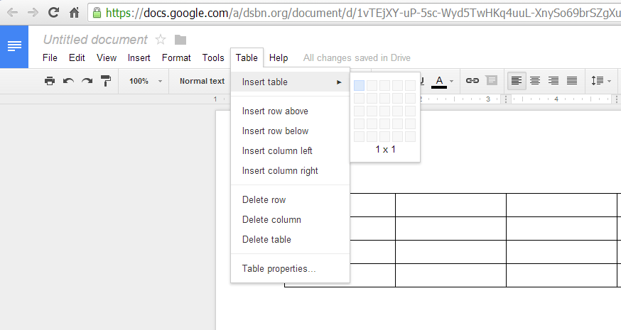
Google Docs Menu- Table
Steps for Creating a Table----
Select Table – Insert table.
Select the appropriate number of rows and columns.
Table will automatically be inserted onto the document

Slide 23
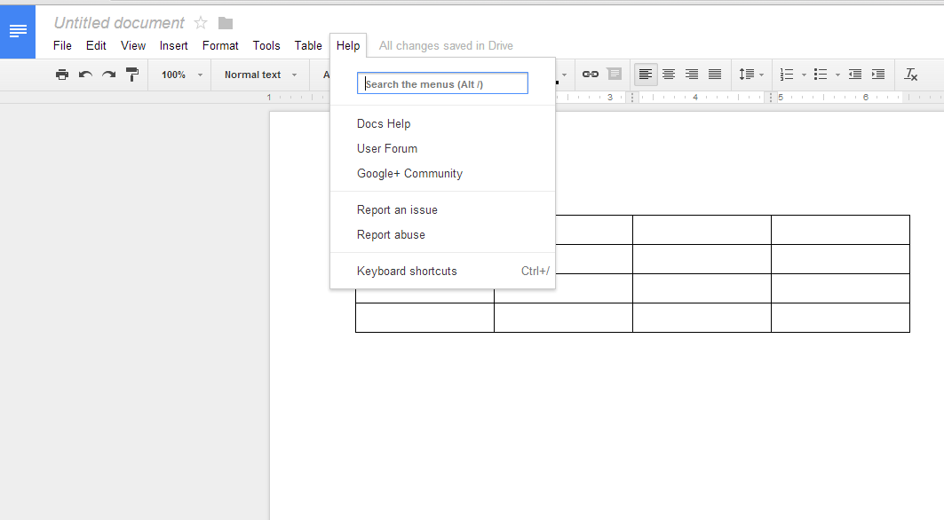
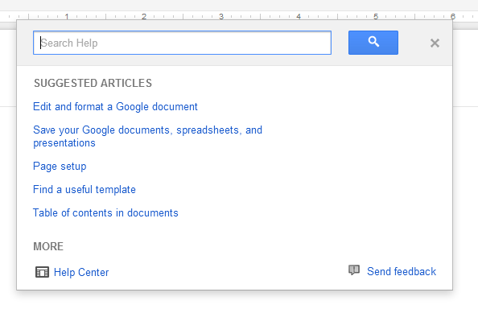
Google Docs Menu- Help
Search a variety of topics that will help you with formatting your document.

Slide 24
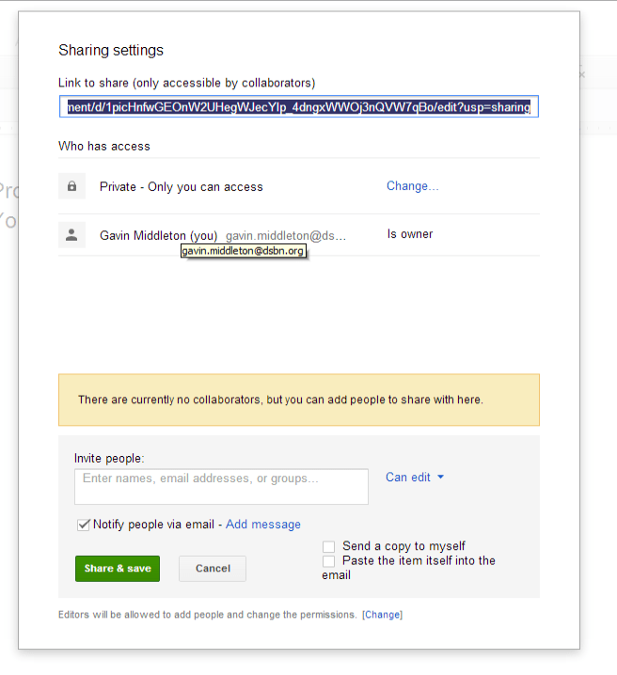
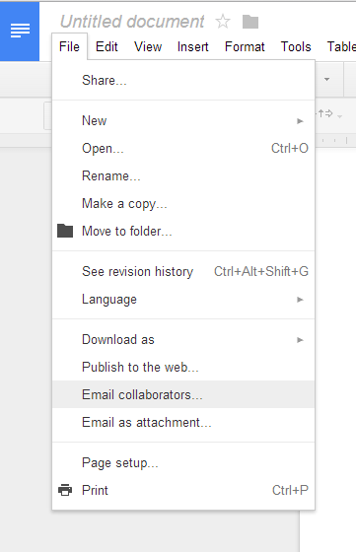
Google Docs Menu- Email Collaborators
Share Documents

Slide 25
Google Docs Menu
Other Options:
Rename the Document
Publish to Web
Templates
Language
Move
Document Details
Permissions and Privileges

