Slide 2
After this lecture, you will be able to,
Learn about Google Sheets.
Empirically explore collaborating on sheets in Cloud.

Slide 3
About Google Sheets
Google Sheets is a free, cloud-based spreadsheet application

Slide 4
About Google Sheets
Web-based spreadsheet that you can use anywhere—no more forgetting your spreadsheet files at home.
Works from any device, with mobile apps for iOS and Android along with its web-based core app.
Bundled with Google Drive, Docs, and Slides to share files, documents, and presentations online.

Slide 5
About Google Sheets
Includes almost all of the same spreadsheet functions—if you know how to use Excel, you'll feel at home in Google Sheets.
You can download add-ons, create your own, and write custom code.
Online and so you can gather data with your spreadsheet automatically and do almost anything you want, even when your spreadsheet isn't open.

Slide 6
About Google Sheets
You open it in your browser window like a regular webpage, but you have all the functionality of a full spreadsheet application for doing powerful data analysis. It really is the best of both worlds.

Slide 7
Getting Started with Google Sheets
Common Spreadsheet Terms-
Cell: Single data point or element in a spreadsheet.
Column: Vertical set of cells.
Row: Horizontal set of cells.
Range: Selection of cells extending across a row, column, or both.
Function: Built-in operation from the spreadsheet app, which can be used to calculate cell, row, column, or range values, manipulate data, and more.

Slide 8
Getting Started with Google Sheets
Formula: Combination of functions, cells, rows, columns, and ranges used to obtain a specific result.
Worksheet (Sheet): The named sets of rows and columns making up your spreadsheet; one spreadsheet can have multiple sheets.
Spreadsheet: Entire document containing your worksheets.

Slide 9
Create a Spreadsheet and Fill It with Data
3 ways to create a new spreadsheet in Google Sheets:
Click the red "NEW" button on your Google Drive dashboard and select "Google Sheets“.
Open the menu from within a spreadsheet and select "File > New Spreadsheet“.
Click "Blank" or select a template on the Google Sheets homepage.

Slide 10
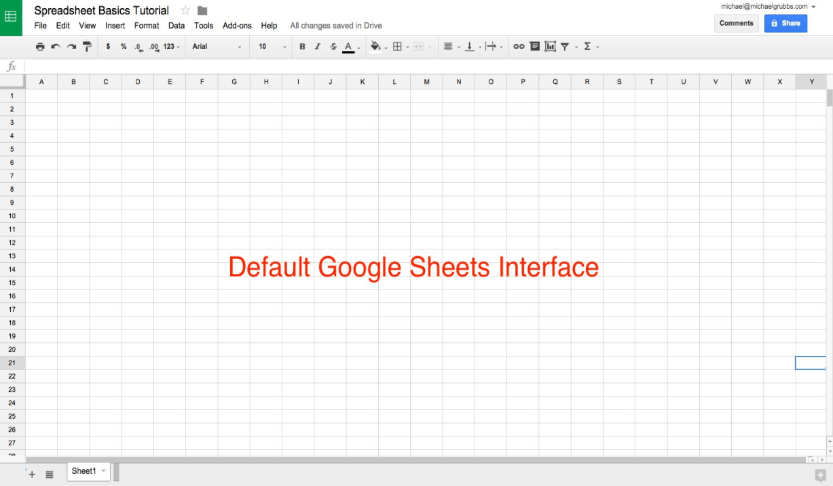
Create a Spreadsheet and Fill It With Data

Slide 11
Adding Data to Your Spreadsheet
An individual square in a spreadsheet is called a cell; they're organized into rows and columns with number and letter IDs, respectively. Each cell should contain one value, word, or piece of data.

Slide 12
Adding Data to Your Spreadsheet
Press ENTER to save the data and move to the beginning of the next row
Press TAB to save the data and move to the right in the same row
Use the ARROW KEYS on your keyboard (up, down, left, and right) to move 1 cell in that direction
Click any cell to jump directly to that cell

Slide 13
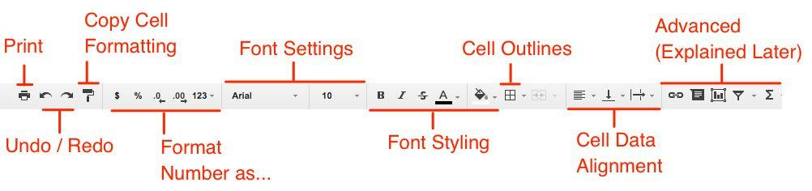
Google Sheet
Format Data for Easy Viewing.
Print, Undo/ Redo, and the Font Settings / Styling function.

Slide 14
Google Sheet
Templates
Other Menu Items (Print, Download, Email)
Importing Files
Version History
Modifying Rows and Columns
Adding new Sheet, Renaming, Coloring, Rearranging

Slide 15
Google Sheet
Freezing
Inserting Images and Charts
Adding Formulas
Conditional Formatting
Filtering (By value and By condition)

Slide 16
Google Sheet- Collaborating and Sharing
Adding Collaborators
Sharing
Giving Permissions and Privileges
Sharing through links

