Slide 2
After this lecture, you will be able to,
know about collaborating on calendars
practically explore the collaborations using Google Calendar

Slide 3
Collaboration on Calendar
Most computer users today have embraced keeping their schedules on their PCs.
Not that the old-fashioned wall-hanging calendar is dead, it’s just that it’s a whole lot easier to track appointments and events electronically; the computer does all the busywork for you.

Slide 4
Collaboration on Calendar
That’s why, instead of using a calendar that’s wedded to a single computer, many users are moving to web-based calendars.
Stores your calendars on the Internet, where they can be accessed from any computer that has an Internet connection.
Are also extremely easy to share with other users in any location, which make them great for collaborative projects.

Slide 5
Collaboration on Calendars - Google Calendar
Most popular web-based calendar today, no doubt due to association with the web’s most-used search engine, is Google Calendar (calendar.google.com).
Free, full featured, and easy to use.
Lets you create both personal and shared calendars, which makes it ideal for tracking business group, family, and community schedules.

Slide 6
Collaboration on Calendar - Google Calendar
Like all web-based calendars, all your events are stored in the cloud (in this case, the cloud created by Google’s own network of servers), not on your own computer.

Slide 7
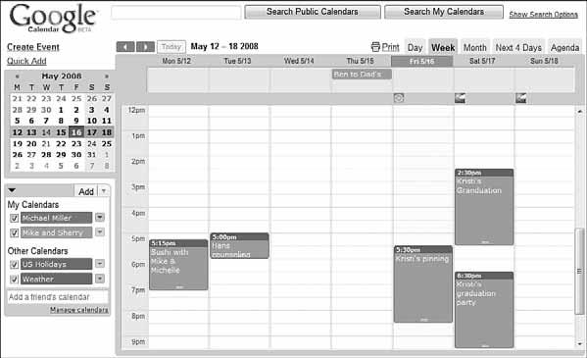
Collaboration on Calendar - Google Calendar

Slide 8
Collaboration on Calendar - Yahoo! Calendar
Yahoo! Calendar
One of Google Calendar’s primary competitors is Yahoo! Calendar (calendar.yahoo.com), hosted by its search competitor Yahoo!

Slide 9
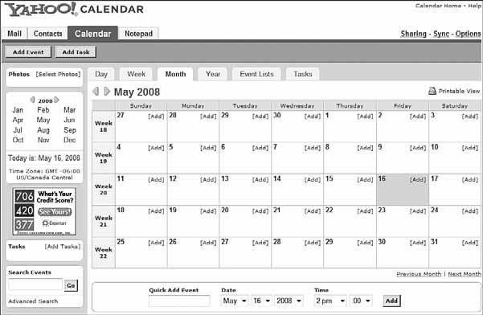
Collaboration on Calendar - Yahoo! Calendar

Slide 10
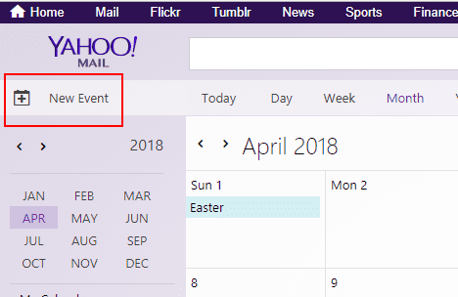
Collaboration on Calendar - Yahoo! Calendar

Slide 11
Collaboration on Calendar - Windows Live Calendar
Windows Live Calendar
Windows Live Calendar (mail.live.com/mail/calendar.aspx) is Microsoft’s web-based calendar, actually part of the Windows Live Hotmail email service.

Slide 12
Collaboration on Calendar - Apple MobileMe
Apple MobileMe Calendar
Apple’s MobileMe (www.me.com) is a new competitor in the web-based apps market.

Slide 13
Collaboration on Calendar - AOL Calendar
AOL Calendar
America Online isn’t quite the powerhouse that it used to be, but it still has millions of users, both paid subscribers and free web users.

Slide 14
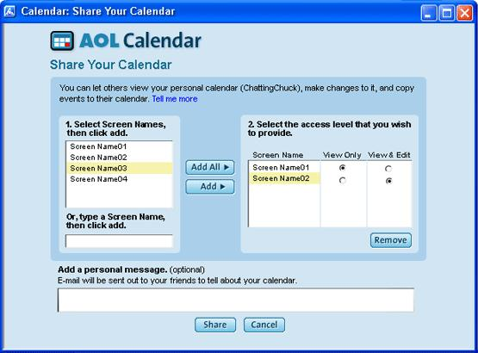
Collaboration on Calendar - AOL Calendar

Slide 15
Collaboration on Calendar - CalendarHub
CalendarHub
Beyond Google, Yahoo!, Apple, and their ilk, many independent sites offer full-featured web-based calendars. Perhaps, the most notable of these is CalendarHub (www.calendarhub.com).

Slide 16
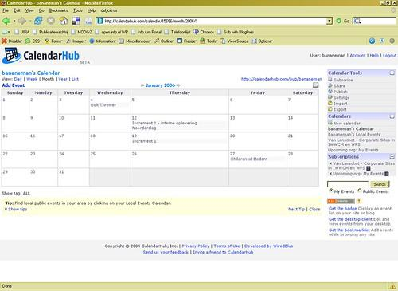
Collaboration on Calendar - CalendarHub

Slide 17
Collaboration on Calendar - HuntCalendars
Hunt Calendars (www.huntcal.com)
Offer event-based web calendars.
Useful features include email reminders, notification of event conflicts, notification of new and updated events, and the like.

Slide 18
Collaboration on Calendar - Famundo
Famundo
If you keep the schedule for a community group, check out Famundo (www.famundo.com).
Offers Famundo for Organizations, a free web-based calendar ideal for schools, churches, sports teams, and the like.

Slide 19
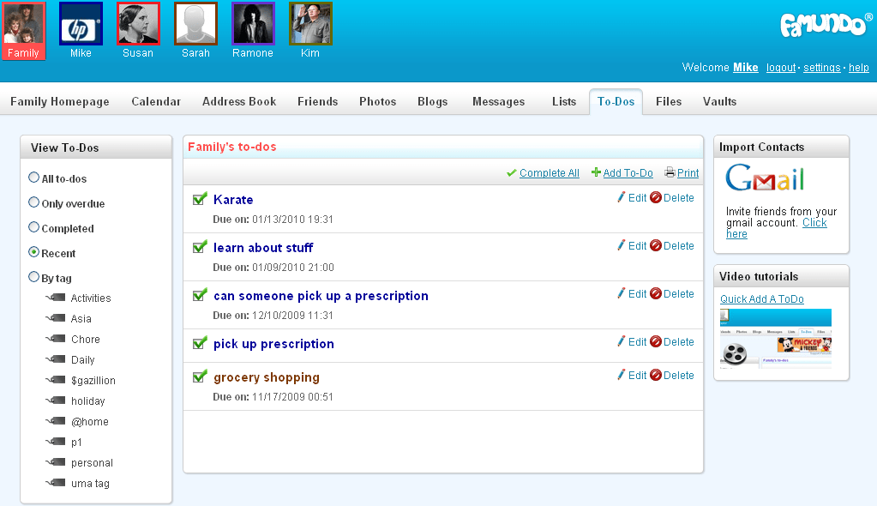
Collaboration on Calendar - Famundo

Slide 20
Collaboration on Calendar - eStudio Calendar
eStudio Calendar
(www.same-page.com/calendar-software.html)
Designed specifically for business use. You get three types of calendars in a single interface:
Member Event calendar
Team Event calendar
Supervisor calendar

Slide 21
Collaboration on Calendar - Trumba
Trumba
Trumba (www.trumba.com) offers web-based calendars ideal for community organizations, schools, and similar public entities.

Slide 22
Collaboration on Calendar - Calendars Net
Calendars Net (www.calendars.net) is a free web-based calendar designed for companies or individuals who want to add interactive calendars to their websites.

Slide 23
Collaboration on Calendar - Jotlet
Another way to add web-based calendar functionality to your website (www.jotlet.net).
A JavaScript API and library that you can use to build rich calendar functionality into any web page.
If you’re skilled in HTML programming, this is a good way to build a calendar-based page.

Slide 24
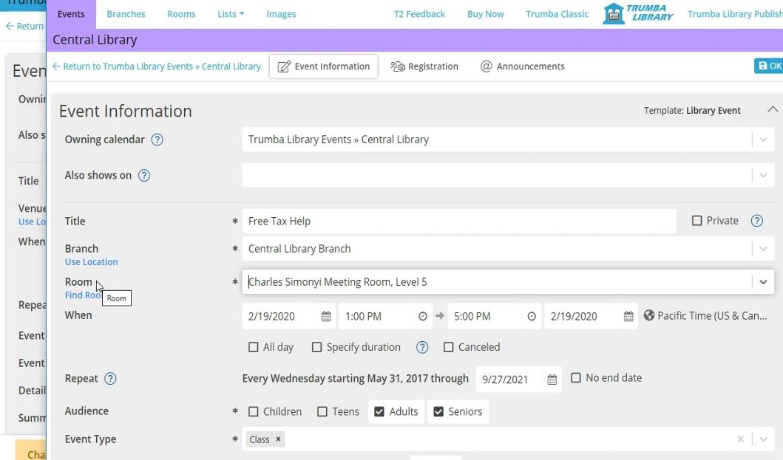
Collaboration on Calendar - Trumba

Slide 25
Collaboration on Calendar - Google Calendar
Opening Calendar
Day, Week, Month, Year, Schedule and 4 Days View
Holidays View
Birthday View

Slide 26
Collaboration on Calendar - Google Calendar
Types of calendars can you create with Google Calendar:
Personal calendars, like your default calendar.
Public calendars, which others can access via the web.
Friends’ calendars, which you import from their Google Calendar web pages.

Slide 27
Collaboration on Calendar - Google Calendar
Types of calendars can you create with Google Calendar:
Holiday calendars, which add national holidays to a basic calendar.

Slide 28
Collaboration on Calendar - Google Calendar
Create Events
Add title
Time-zone settings
Add notifications/ Email notifications
Add location

Slide 29
Collaboration on Calendar - Google Calendar
Customize event timings (Does not repeat etc.)
Setting an all-day Event
Setting colors
Setting visibility of calendar

Slide 30
Collaboration on Calendar - Google Calendar
Adding web-conference
Adding guests
Giving guest permissions

Slide 31
Collaboration on Calendar - Google Calendar
Settings
Trash Tasks
Print Calendar
Search Option

Slide 32
Collaboration on Calendar - Google Calendar
Practical Example-
Create 2 events in Google Calendar out of which 1 is a full-day event.
Add 2 Guests to it.
Add colours to the events.
Add video conferencing to at least 1 event.
Add email notification for the event.

