Slide 2
After this lecture, you will be able to,
learn about management of projects using cloud computing
explore different project management cloud tools and solutions

Slide 3
Project Management
Process of leading the work of a team to achieve all project goals within the given constraints. This information is usually described in project documentation, created at the beginning of the development process.
Primary constraints are scope, time and budget.

Slide 4
Project Management
Managing a large project can be an exhausting task.
Even the smallest project has numerous pieces and parts, all of which have to be completed in a precise order and on an exacting timetable for the project to come in on time and on budget.
If just one piece slips, the whole project goes out of whack.

Slide 5
Cloud-Based Project Management
Such efforts can be made easier with the use of a web-based project management application.
Project members can log in from any location to access the project’s master file; they can add or delete tasks, mark tasks as complete, enter detailed billing information for individual tasks, and so forth.

Slide 6
Cloud-based Project Management
Cloud-based project management software coordinates the planning, collaborating, monitoring, and delivering of a project.
Allows project managers and teams to get work done using a network of tools available within the software, rather than using a plain old whiteboard and sticky notes.

Slide 7
Types of Project Management Software Implementation
Cloud computing has presented options and advantages, project management software vendors offer their subscription-based products over the internet to businesses of all sizes.
Opened the market to more providers offering a variety of systems.

Slide 8
Types of Project Management Software Implementation
Web-based Project Management Software.
On-premise Project Management Software.

Slide 9
Project Management Tools
For almost any company, whether large or small, project management is necessary for getting—and remaining—organized.

Slide 10
Project Management Tools
There are multiple project management tools available to help your business manage resources, project and control costs, communicate effectively with multiple team members, and track progress on any given project.

Slide 11
Project Management Tools - Offerings
Task Management
Team collaboration
Support Documentation
Email Integration
Document Management
Project Portfolio Management
Mobile App

Slide 12
Project Management Tools - Offerings
Task Management
Team collaboration
Support Documentation
Email Integration
Document Management
Project Portfolio Management
Mobile App

Slide 13
Project Management Tools - Offerings
Task Management
Team collaboration
Support Documentation
Email Integration
Document Management
Project Portfolio Management
Mobile App

Slide 14
Project Management Tools - Offerings
Task Management
Team collaboration
Support Documentation
Email Integration
Document Management
Project Portfolio Management
Mobile App

Slide 15
Project Management Tools - Offerings
Task Management
Team collaboration
Support Documentation
Email Integration
Document Management
Project Portfolio Management
Mobile App

Slide 16
Project Management Tools - Offerings
Task Management
Team collaboration
Support Documentation
Email Integration
Document Management
Project Portfolio Management
Mobile App

Slide 17
Project Management Tools - Offerings
Task Management
Team collaboration
Support Documentation
Email Integration
Document Management
Project Portfolio Management
Mobile App

Slide 18
Project Management Tools - Offerings
Third-party Integrations or API
Reporting
Scheduling
Time Management
Visualizations

Slide 19
Project Management Tools - Offerings
Third-party Integrations or API
Reporting
Scheduling
Time Management
Visualizations

Slide 20
Project Management Tools - Offerings
Third-party Integrations or API
Reporting
Scheduling
Time Management
Visualizations

Slide 21
Project Management Tools - Offerings
Third-party Integrations or API
Reporting
Scheduling
Time Management
Visualizations

Slide 22
Project Management Tools - Offerings
Third-party Integrations or API
Reporting
Scheduling
Time Management
Visualizations

Slide 23
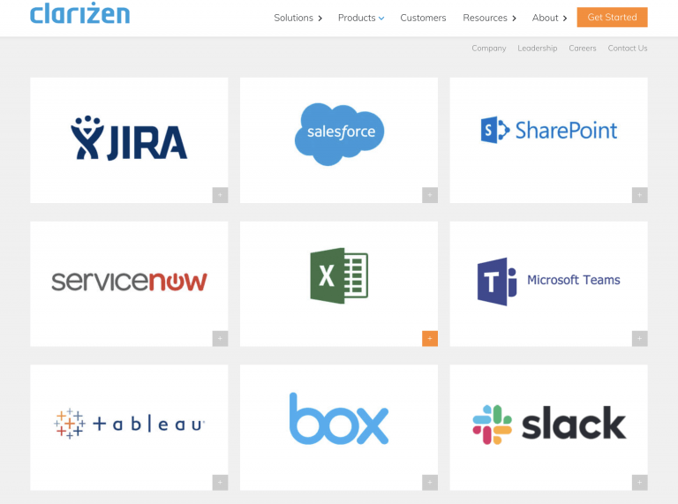
Project Management Tools - Offerings

Slide 24
Benefits of Project Management Tools in the Cloud
Lower Upfront Cost
More Secure than Ever
Accessible from Anywhere
Connected Team
Increased Productivity
Real-time Communication

Slide 25
Benefits of Project Management Tools in the Cloud
Lower Upfront Cost
More Secure than Ever
Accessible from Anywhere
Connected Team
Increased Productivity
Real-time Communication

Slide 26
Benefits of Project Management Tools in the Cloud
Lower Upfront Cost
More Secure than Ever
Accessible from Anywhere
Connected Team
Increased Productivity
Real-time Communication

Slide 27
Benefits of Project Management Tools in the Cloud
Lower Upfront Cost
More Secure than Ever
Accessible from Anywhere
Connected Team
Increased Productivity
Real-time Communication

Slide 28
Benefits of Project Management Tools in the Cloud
Lower Upfront Cost
More Secure than Ever
Accessible from Anywhere
Connected Team
Increased Productivity
Real-time Communication

Slide 29
Benefits of Project Management Tools in the Cloud
Lower Upfront Cost
More Secure than Ever
Accessible from Anywhere
Connected Team
Increased Productivity
Real-time Communication

Slide 30
Benefits of Project Management Tools in the Cloud
Up-to-date, Data-driven Decisions
Simplified IT
Instant Updates
Low Maintenance Technology

Slide 31
Where Cloud PM Software Works
While large corporations tend to stick to the more traditional installed PM software, cloud versions are being embraced by companies that lack million-dollar IT budgets.

Slide 32
Where Cloud PM Software Works
Ideal for:
Startups and entrepreneurs.
Small and mid-sized businesses.
Virtual companies with geographically diverse teams.
Freelance project managers.

Slide 33
Steps for Finding Best Cloud-based Project Management Solution
Conduct a Needs Analysis
Research, Research, Research
Take a Test Drive
Consider Timeline and Process For Implementation
Implement and Train

Slide 34
Best Cloud-based Project Management Solutions
ProofHub
Wrike
Clarizen
Project Manager
Zoho Projects
Mavenlink
Jira
WorkflowMax
Caspio

Slide 35
Best Cloud-based Project Management Solutions
Cloud-based PM software is ground-breaking with the power to fast-track any organization onto the path of success.
In today’s fast-changing business environment, cloud-based software is revolutionizing the traditional workplace.

