Slide 2
After this lecture, you will be able to,
learn about Management of project using a Cloud-based project management tool.

Slide 3
Cloud-based Project Management- Zoho
ZOHO offers online business, network and IT infrastructure management applications and software maintenance and support services.

Slide 4
Zoho Projects
Zoho Projects is a cloud based project management solution designed for small and midsize companies.
Zoho Projects is an online project management software that helps you run your business with ease.

Slide 5
Zoho Projects
Stands as a comprehensive solution to your day-to-day problems in project management and adds value to your business by leaps and bounds.
Offers project scheduling and budgeting, which allows project managers to define project tasks, assign them to their teams, estimate project costs and follow up on in-progress tasks.

Slide 6
Zoho Projects
What does Zoho Projects offer?
Helps you to plan, track, collaborate, and achieve your business targets with ease.

Slide 7
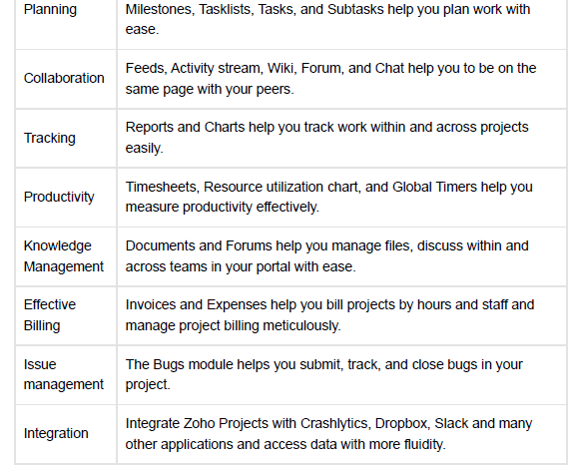
Zoho Projects

Slide 8
Zoho Projects
Automates document processes such as revision tracking, access control and search and retrieval.
Other product features include document management, which provides a portal for sharing documents within the team members.

Slide 9
Zoho Projects
Also, offers issue management features, which help managers resolve errors in the project tasks.

Slide 10
Zoho Projects
Dashboards and reporting module help users prepare business reports and management summaries.
Users can use Gantt charts to get a visual presentation on the progress of tasks in comparison to what was planned.

Slide 11
Zoho Projects
Resource allocation chart helps users know how many team members are free and how many are overloaded with tasks.
Milestones and tasklists help users organize complex projects by breaking them into subtasks.

Slide 12
What can be done with Zoho?
Create a standalone task or group similar tasks into a task list.
Raise bugs if a feature doesn’t work as per the expected functionality.
Define and automate any process workflow in your project using the blueprint.

Slide 13
What can be done with Zoho?
Create a standalone task or group similar tasks into a task list.
Raise bugs if a feature doesn’t work as per the expected functionality.
Define and automate any process workflow in your project using the blueprint.

Slide 14
What can be done with Zoho?
Create a standalone task or group similar tasks into a task list.
Raise bugs if a feature doesn’t work as per the expected functionality.
Define and automate any process workflow in your project using the blueprint.

Slide 15
What can be done with Zoho?
Track your project’s budget and generate invoices with the extensible budget module.
Track and manage the daily or weekly efforts of resources using a timesheet.
Handle all your project related updates and the documents in one place.

Slide 16
What can be done with Zoho?
Track your project’s budget and generate invoices with the extensible budget module.
Track and manage the daily or weekly efforts of resources using a timesheet.
Handle all your project related updates and the documents in one place.

Slide 17
What can be done with Zoho?
Track your project’s budget and generate invoices with the extensible budget module.
Track and manage the daily or weekly efforts of resources using a timesheet.
Handle all your project related updates and the documents in one place.

Slide 18
Zoho Practical
Opening Zoho Portal (Zoho - Cloud Software Suite and SaaS Applications for Businesses)
Creating Account
Login to Zoho Dashboard
Viewing Existing Projects

Slide 19
Zoho Practical
Creating Projects
Creating Milestones
Adding Task List & Tasks
Adding Users
Adding Client Users
Organize Tabs
Documents Uploading

Slide 20
Zoho Practical
Sharing & Adding Collaborators
Gantt & Reports
Settings (Setup)
Manage Users
Data Administration
Importing & Exporting Data

Slide 21
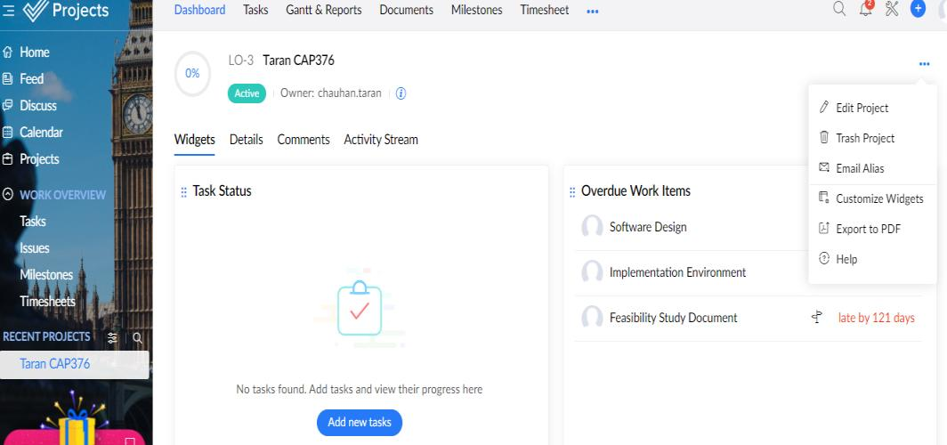
Zoho- Project Settings

