Slide 2
After this lecture, you will be able to,
understand databases and working of databases
Know the working of online databases and cloud database
Explore and evaluate some of the existing web-based databases

Slide 3

What is Data ?
A collection of raw facts & figures.
Raw material that can be processed by any computing machine.
A collection of facts from which conclusions may be drawn.

Slide 4

What is Information?
Systematic and meaningful form of data.
Knowledge acquired through study or experience.
Information helps human beings in their decision making.

Slide 5
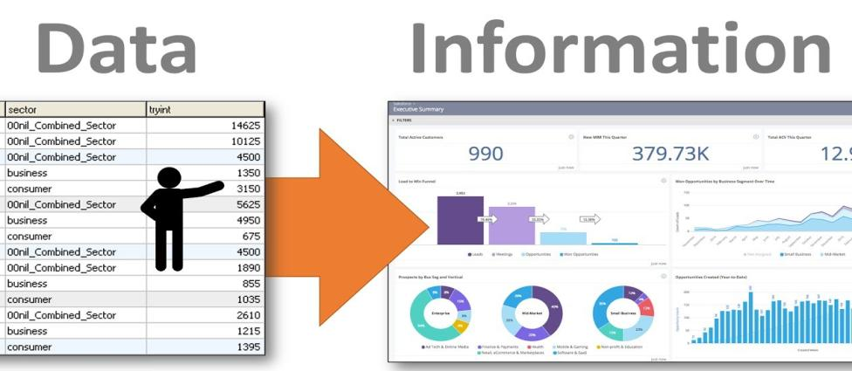
Information
Data that have been processed in such a way as to increase the knowledge of the person who uses the data.

Slide 6
Knowledge
Understanding based on extensive experience dealing with information on a subject.
Example: Mount Everest.

Slide 7
Data to Database
Data is encountered in our day-to-day life everyday.
Difficult to memorise all such information for a large number of individuals.
Example.
To deal with such problems we construct a database.
Arrange all information about students in a tabular form.
Keep all the records.

Slide 8
What is Database ?
A safekeeping of logically related and similar data.
An organized collection of related information so that it can easily be accessed, managed and updated.

Slide 9
Database Classification
Digital databases are managed using database management systems, which store database contents, allowing data creation and maintenance, and search and other access.

Slide 10
Database Classification
A collection of information that is organized so that it can easily be accessed, managed, and updated.
Databases can be classified according to types of content: bibliographic, full-text, numeric, and images.

Slide 11
Database Classification
In computing, databases are sometimes classified according to their organizational approach.
The most prevalent approach is the relational database, a tabular database in which data is defined so that it can be reorganized and accessed in a number of different ways.

Slide 12
Database Classification
Distributed database
Object-oriented programming database
Computer databases
Analytical Database

Slide 13
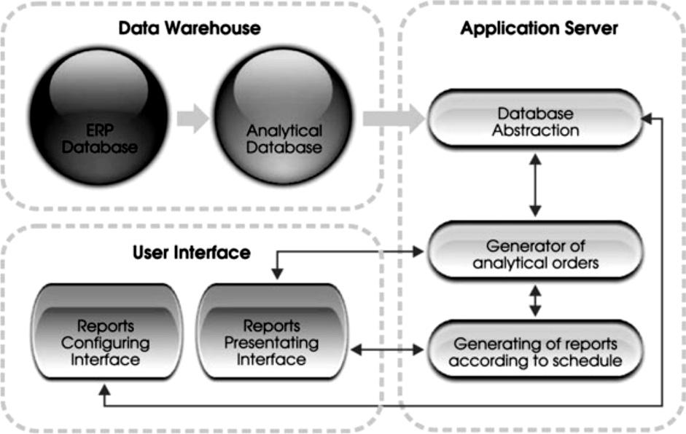
System Architecture of a Database

Slide 14
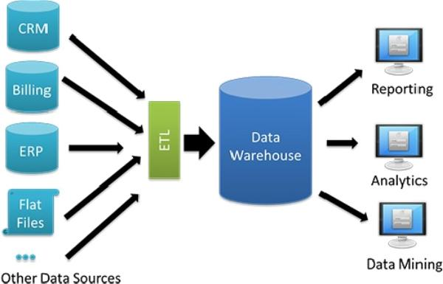
Types of Database
Data Warehouse:
Data Warehouse Architecture

Slide 15
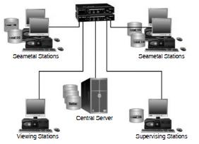
Types of Database
Distributed Database

Slide 16
Types of Database
End-user Database
External Log Database
Hypermedia Log Database
Operational Log Database
Customer databases
Personnel databases
Enterprise resource planning
Financial databases

Slide 17
Database Managers
Provides users the capabilities of controlling read/write access, specifying report generation, and analysing usage.
Are prevalent in large mainframe systems, but are also present in smaller distributed workstation and mid-range systems such as the AS/400 and on personal computers.

Slide 18
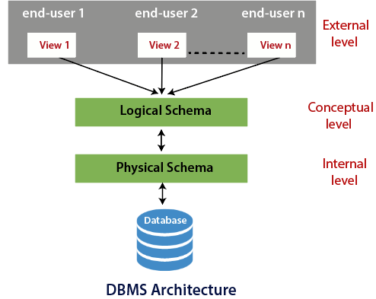
Database: Three Level Architecture

Slide 19
Database: Three Level Architecture
Internal/physical level: Shows how data are stored inside the system. It is the closest level to the physical storage.
Conceptual/logical level: Deals with the modeling of the whole database.
External level: Models a user-oriented description of part of the database.

Slide 20
Three Level Architecture Objectives
Each user should be able to access the same data but have a different customize view of the data.
User should not have to deal directly with physical database storage detail.
DBA should be able to change the database storage structure without affecting the users views.

Slide 21
Three Level Architecture Objectives
The internal structure of the database should be unaffected by changes to the physical aspects of storage.
DBA should be able to change the conceptual structure of the database without affecting all users.

Slide 22
Why Database?
Redundancy can be reduced.
Inconsistency can be avoided.
The data can be shared.
Standards can be enforced.
Security restrictions can be applied; Uniform security, privacy, and integrity controls can be maintained.

Slide 23
Why Database?
Provision of data independence.
Ease of application development.
Data accessibility and responsiveness.
Reduced program maintenance.

Slide 24
Working of Databases
Databases have been a staple of business computing from the very beginning of the digital era.
In fact, the relational database was born in 1970.
Relational databases have grown in popularity to become the standard.
Use of Relational Database
Mathematical relations

Slide 25
Collaborating on Databases
A database does many of the same things that a spreadsheet does, but in a different and often more efficient manner.
Many small businesses use spreadsheets for database-like functions.
Local database
Networked database
Online database

Slide 26
Online Database
An online or web-based database stores data on a cloud of servers somewhere on the Internet, which is accessible by any authorized user with an Internet connection.
Cloud database is also a type of Online database.

Slide 27
Advantages of Online Databases
Data can easily be shared
Users sitting at different location can have easy access.
Synchronization is not an issue.
Oriented toward quick information sharing among members of workgroups.
Simple and intuitive interfaces.

Slide 28
Cloud Database
Collection of informational content, either structured or unstructured.
Resides on a private, public or hybrid cloud computing infrastructure platform.

Slide 29
Cloud Database
“Cloud database” can be one of two distinct things: a traditional or NoSQL database installed and running on a cloud virtual machine, or a cloud provider’s fully managed database-as-a-service (DBaaS) offering.

Slide 30
Benefits of Using a Cloud Database
Accessible from anywhere, scalable from day one,
Offer flexible, affordable, and scalable database management.
Provides a robust and efficient connection to a database.
Functional, flexible, and secure database.

Slide 31
Benefits of Using a Cloud Database
Reliability & Disaster Recovery
Scalability & Performance
Ease of Access & Agility

Slide 32
Benefits of Using a Cloud Database
Reliability & Disaster Recovery
Scalability & Performance
Ease of Access & Agility

Slide 33
Benefits of Using a Cloud Database
Reliability & Disaster Recovery
Scalability & Performance
Ease of Access & Agility

Slide 34
Example of Cloud Database Service
MongoDB Atlas Cloud Database

Slide 35
Exploring Web-Based Databases
Blist
Cebase
Dabble DB
Lazybase
MyWebDB
QuickBase

Slide 36
Exploring Web-Based Databases
Blist
Cebase
Dabble DB
Lazybase
MyWebDB
QuickBase

Slide 37
Exploring Web-Based Databases
Blist
Cebase
Dabble DB
Lazybase
MyWebDB
QuickBase

Slide 38
Exploring Web-Based Databases
Blist
Cebase
Dabble DB
Lazybase
MyWebDB
QuickBase

Slide 39
Exploring Web-Based Databases
Blist
Cebase
Dabble DB
Lazybase
MyWebDB
QuickBase

Slide 40
Exploring Web-Based Databases
Blist
Cebase
Dabble DB
Lazybase
MyWebDB
QuickBase

Slide 41
Exploring Web-Based Databases
TeamDesk
Trackvia
Zoho Creator
Zoho DB and Reports

Slide 42
Exploring Web-Based Databases
TeamDesk
Trackvia
Zoho Creator
Zoho DB and Reports

Slide 43
Exploring Web-Based Databases
TeamDesk
Trackvia
Zoho Creator
Zoho DB and Reports

Slide 44
Exploring Web-Based Databases
TeamDesk
Trackvia
Zoho Creator
Zoho DB and Reports

Slide 45
Evaluating Online Databases
When you’re trying to decide which online database to use, it seems as if there’s QuickBase and then there’s everything else.
If your needs are more modest, however, a number of the applications discussed above can be explored.

Slide 46
Evaluating Online Databases
I’m particularly partial to Zoho’s two offerings, Creator (for smaller needs) and DB & Reports (for larger databases and more sophisticated applications).
There are a lot of differences between the web-based database applications available today

