Slide 2
After this lecture, you will be able to,
learn about virtualization concepts and the need for virtualization
explore the features of virtualization and the working of virtualization in cloud

Slide 3
Virtualization
In recent years, computing has become more complex and requires large infrastructure. Organizations invest a huge amount in buying additional physical infrastructure as and when there is a need for more computing resources.

Slide 4
Virtualization
At the same time, the resource utilization and return on investment (ROI) on buying the additional infrastructure are very low.
To increase the resource utilization and ROI, the companies started using the technology called virtualization where a single physical infrastructure can be used to run multiple Operating Systems (OSs) and applications.

Slide 5
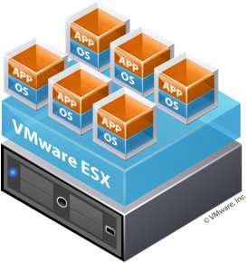
Virtualization
Technology that transforms hardware into software.
Allows to run multiple OSs as virtual machines.
Each copy of an operating system is installed in to a virtual machine.

Slide 6
Virtualization
Technology that enables the single physical infrastructure to function as a multiple logical infrastructure or resources.
Virtualization allows the creation of a secure, customizable, and isolated execution environment for running applications, even if they are untrusted, without affecting other users’ applications.

Slide 7
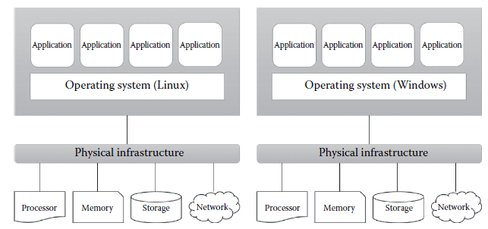
Before and After Virtualization
Before Virtualization

Slide 8
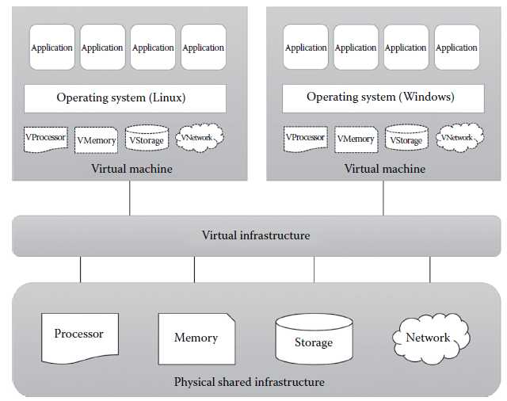
Before and After Virtualization
After Virtualization

Slide 9
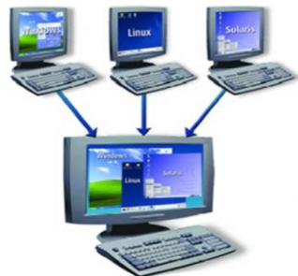
Virtual Machine (VM)
Isolated guest operating system installation within a normal host operating system.
From the user perspective, VM is software platform like physical computer that runs operating systems and apps.
VMs posses hardware virtually.

Slide 10
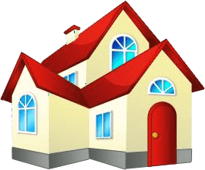

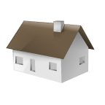
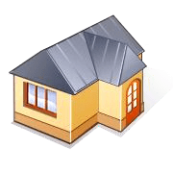
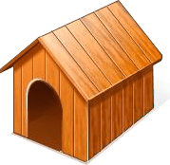
Virtualization Scenario Example

Slide 11
Factors Driving the Need of Virtualization
Increased performance and computing capacity
Underutilized hardware and software resources
Lack of space
Greening initiatives
Rise of administrative costs

Slide 12
Need for Virtualization
Share same hardware among independent users.
Reduced hardware footprint through consolidation
Sandbox/migrate applications
Decouple applications from underlying Hardware

Slide 13
Features of Virtualization
Virtualization Raises Abstraction
Similar to Virtual Memory.
Similar to Hardware Emulators.
No botheration about the physical hardware details.

Slide 14
Features of Virtualization
Virtualization Requirements
Efficiency Property.
Resource Control Property.
Equivalence Property.

Slide 15
Virtualized Environments
Virtualization is a broad concept that refers to the creation of a virtual version of something, whether hardware, a software environment, storage, or a network.

Slide 16
Components of Virtualized Environments
In a virtualized environment, there are three major components:
Guest
Host
Virtualization Layer

Slide 17
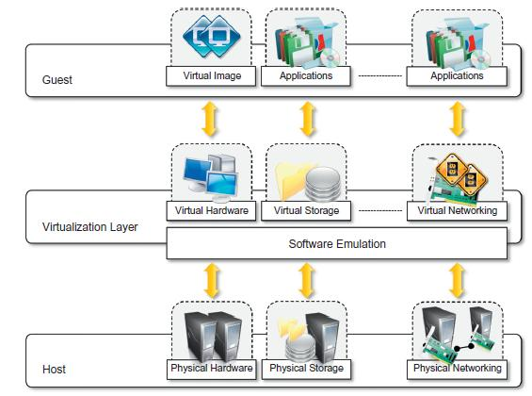
Components of Virtualized Environments

Slide 18
How Does Virtualization Work?
Virtualization layer is installed.
Uses Bare-metal or Hosted Hypervisor architecture.

Slide 19
Virtualization Architecture
Hosted Architecture
Firstly, host OS is installed.
Piece of software called a hypervisor or virtual machine monitor (VMM) is installed on top of host OS.
Allows the users to run various guest OSs within their own application windows.
Example: VMware Workstation, Oracle Virtual Box , Microsoft Virtual PC.
VMM communicates directly with system hardware rather than relying on a host operating system.
Example: VMWARE ESX, VMWARE ESXi, Microsoft Hyper-V.
In this architecture, type1 hypervisor or VMM is installed on the bare hardware.
Bare-Metal Architecture

Slide 20
Hosted Virtualization Architecture
Requires OS (windows or linux) installed on the computer.
Virtualization layer is installed as application on OS.
VMWare Server is free application supported by
windows or Linux.

Slide 21
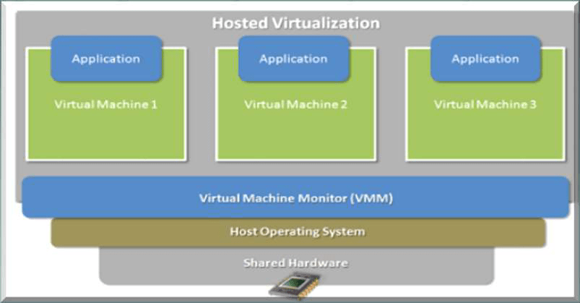
Hosted Virtualization Architecture
Hosted Virtualization
Application
Application
Application
Virtual Machine 1
Virtual Machine 2
Virtual Machine 3
Virtual Machine Monitor (VMM)
Host Operating System
Shared Hardware
Hosted VM Monitor is Installed on Top of Host OS

Slide 22
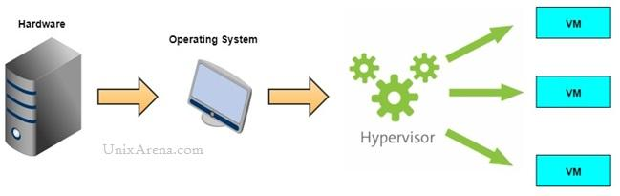
Hosted Virtualization Architecture
Advantages
Disadvantages

Slide 23
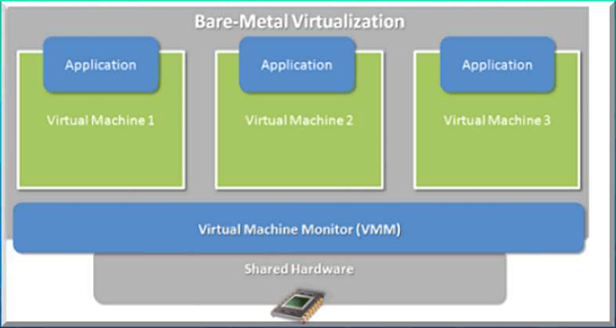
Bare-Metal Architecture
Bare-Metal Virtualization
Application
Application
Application
Virtual Machine 1
Virtual Machine 2
Virtual Machine 3
Virtual Machine Monitor (VMM)
Shared Hardware
Bare-Metal VM Monitor is Installed directly on System
Hardware

Slide 24
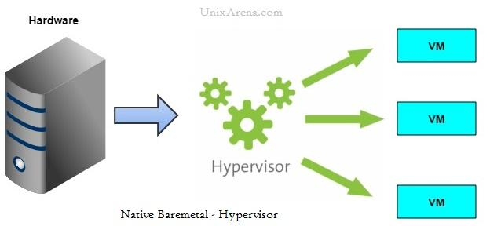
Bare-Metal Architecture
Advantages
Disadvantages

