Slide 2
After this lecture, you will be able to,
know about the different types of virtualization
learn the pros and cons of virtualization

Slide 3
Virtualization and Cloud Computing
Virtualization- Ability to run multiple operating systems on a single physical system and share the underlying hardware resources.
Cloud Computing- Provisioning of services in a timely (near on instant), on-demand manner, to allow the scaling up and down of resources”.

Slide 4
Virtualization and Cloud Computing
Virtualization- Ability to run multiple operating systems on a single physical system and share the underlying hardware resources.
Cloud Computing- Provisioning of services in a timely (near on instant), on-demand manner, to allow the scaling up and down of resources”.

Slide 5
Virtualization Status
Offerings from many companies, example- VMware, Microsoft, Sun, ...

Slide 6
Virtualization Status
Offerings from many companies, example- VMware, Microsoft, Sun, ...
Hardware support
Fits well with the move to 64 bit (very large memories) multi-core (concurrency) processors.
Intel VT (Virtualization Technology) provides hardware to support the VMM layer.

Slide 7
Virtualization Status
Offerings from many companies, example- VMware, Microsoft, Sun, ...
Hardware support
Fits well with the move to 64 bit (very large memories) multi-core (concurrency) processors.
Intel VT (Virtualization Technology) provides hardware to support the VMM layer.
Virtualization is now a well-established technology.

Slide 8
Cloud Computing Takes Virtualization to the Next Step
Renting out spare capacity.
Build data centers where hardware can be outsourced.
You don’t have to own the hardware.
You “rent” it as needed from a cloud.

Slide 9
Goal 1– Cost Control
Cost
Reduce Risk

Slide 10
Goal 2- Business Agility
More than scalability - elasticity!

Slide 11
Goal 3- Stick to Our Business
Most companies don’t want to do system administration.

Slide 12
Types of Virtualization
Virtualization covers a wide range of emulation techniques that are applied to different areas of computing.
A classification of these techniques helps us better understand their characteristics and use.
Protection rings in OSs.

Slide 13
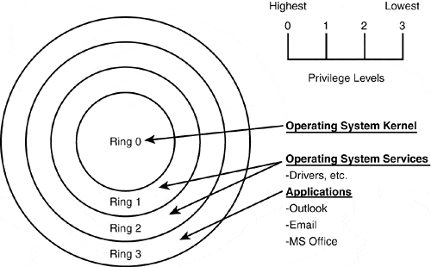
Types of Virtualization
Protection Rings in OSs

Slide 14
Types of Virtualization
Depending on the type of virtualization, the hypervisor and guest OS will run at different privilege levels. Normally, the hypervisor will run at the most privileged level, and the guest OS will run at the least privileged level than the hypervisor.

Slide 15
Types of Virtualization
Full Virtualization or Emulation (Hardware-Assisted/ Binary Translation (Software-Assisted))
Para Virtualization or OS-assisted Virtualization
Processor Virtualization
Memory Virtualization
Storage Virtualization
Network Virtualization

Slide 16
Types of Virtualization
Data Virtualization
Application Virtualization
Hybrid Virtualization
OS level Virtualization

Slide 17
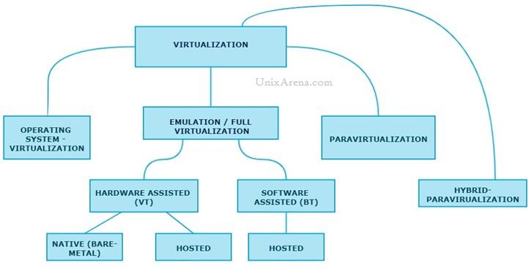
Types of Virtualization

Slide 18
Full Virtualization
Guest OS is completely abstracted from the underlying infrastructure.
Full virtualization uses a special kind of software called a hypervisor. A virtualization layer or virtual machine manager (VMM) or hypervisor fully decouples the guest OS from the underlying infrastructure.

Slide 19
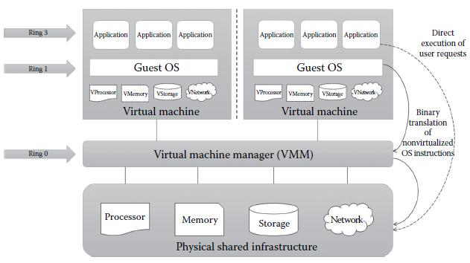
Full Virtualization

Slide 20
Full Virtualization
This approach uses binary translation and direct execution techniques.
Binary translation
Pros
Cons

Slide 21
Full Virtualization
VM simulates hardware to allow an unmodified guest OS to be run in isolation.

Slide 22
Full Virtualization
VM simulates hardware to allow an unmodified guest OS to be run in isolation.
Two type of Full virtualizations in the enterprise market.
Software-assisted Full Virtualization
Hardware-assisted Full Virtualization

Slide 23
Full Virtualization
On both full virtualization types, guest OSs source information will not be modified.

Slide 24
Software Assisted–Full Virtualization (BT–Binary Translation)
Completely relies on binary translation to trap and virtualize the execution of sensitive, non-virtualizable instructions sets.
Emulates the hardware using the software instruction sets.

Slide 25
Hardware Assisted–Full Virtualization (VT)
Hardware vendors like Intel and AMD, offer the support for virtualization, which eliminates much overhead involved in the binary translation and guest OS modification.

Slide 26
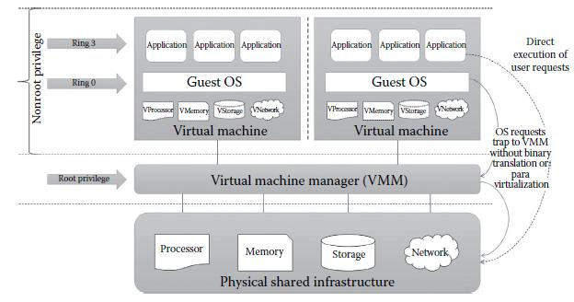
Hardware Assisted–Full Virtualization (VT)

Slide 27
Hardware Assisted–Full Virtualization (VT)
Eliminates the binary translation
Pros
Cons

Slide 28
Para Virtualization
Works differently from the full virtualization.
Also known as partial virtualization or OS-assisted virtualization and provides partial simulation of the underlying infrastructure.

Slide 29
Para Virtualization
Virtual guests are aware that it has been virtualized.
Hypercalls
Para Virtualization vs Full Virtualization

Slide 30
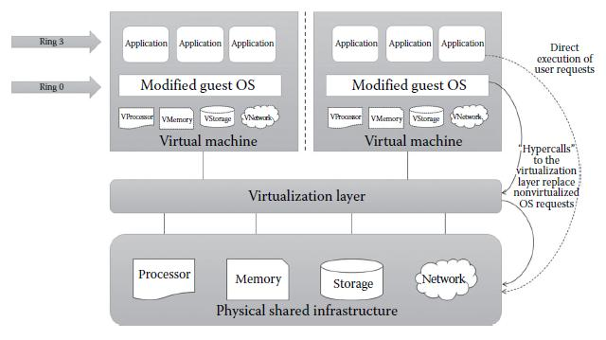
Para Virtualization

Slide 31
Para Virtualization
Pros
Cons
List of products which supports paravirtualization.

Slide 32
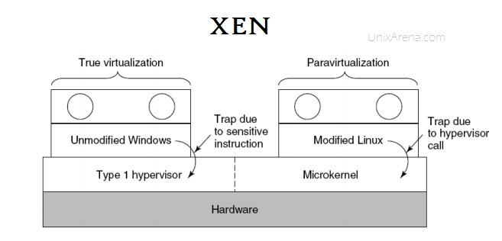
Xen Supports both Full-Virtualization and Para-Virtualization

Slide 33
Xen Supports both Full-Virtualization and Para-Virtualization
Due to the architecture difference between windows and Linux based Xen hypervisor, Windows OS can’t be para-virtualized.
It does for Linux guest by modifying the kernel.
VMware ESXi doesn’t modify the kernel for both Linux and Windows guests.

Slide 34
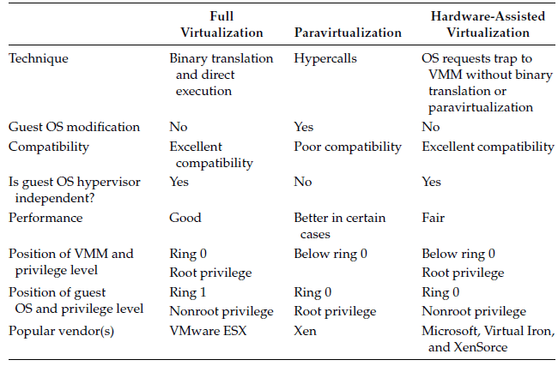
Summary of Different Approaches to Virtualization

Slide 35
Processor Virtualization
Allows the VMs to share the virtual processors that are abstracted from the physical processors available at the underlying infrastructure.
Processor virtualization can also be achieved from distributed servers.

Slide 36
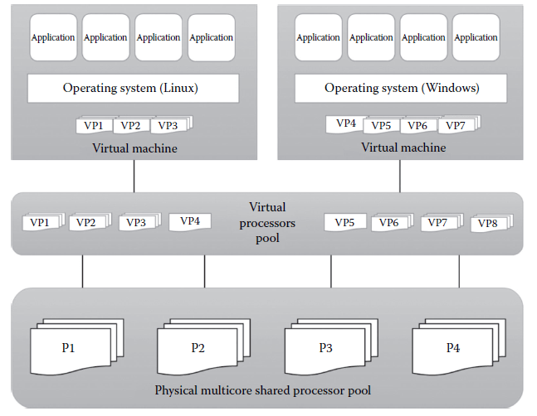
Processor Virtualization
Processor Virtualization from a Single Hardware

Slide 37
Memory Virtualization
Another important resource virtualization technique is memory virtualization.
Process of providing a virtual main memory to the VMs is known as memory virtualization or main memory virtualization.

Slide 38
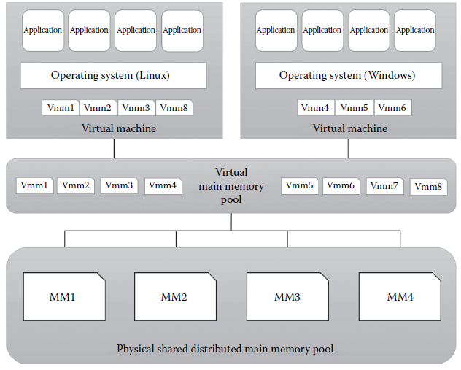
Memory Virtualization

Slide 39
Storage Virtualization
A form of resource virtualization where multiple physical storage disks are abstracted as a pool of virtual storage disks to the VMs (Figure).
Normally, the virtualized storage will be called a logical storage.

Slide 40
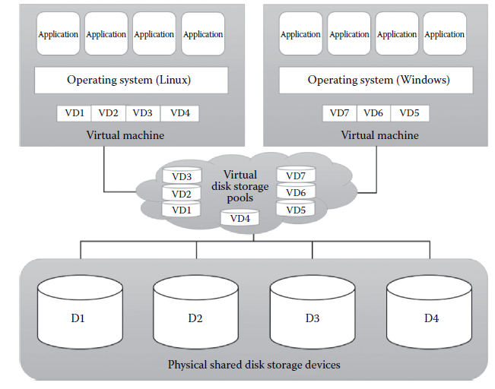
Storage Virtualization
Process of Storage Virtualization

Slide 41
Network Virtualization
Type of resource virtualization in which the physical network can be abstracted to create a virtual network.
Normally, the physical network components like router, switch, and Network Interface Card (NIC) will be controlled by the virtualization software to provide virtual network components.

Slide 42
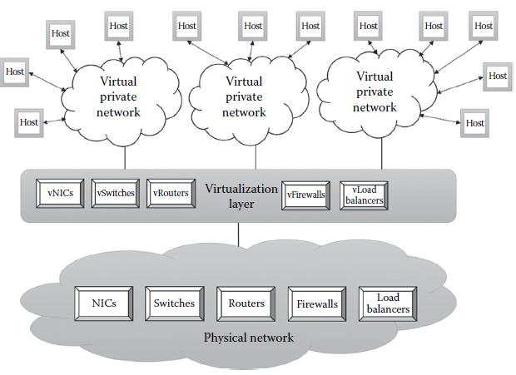
Network Virtualization
Concept of Network Virtualization

Slide 43
Data Virtualization
Ability to retrieve the data without knowing its type and the physical location where it is stored.
Aggregates the heterogeneous data from the different sources to a single logical/virtual volume of data.

Slide 44
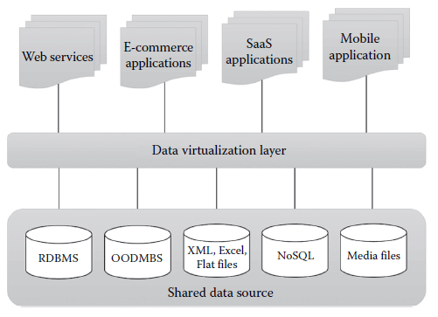
Data Virtualization

Slide 45
Application Virtualization
Application virtualization is the enabling technology for SaaS of cloud computing.
Offers the ability to the user to use the application without the need to install any software or tools in the machine.

Slide 46
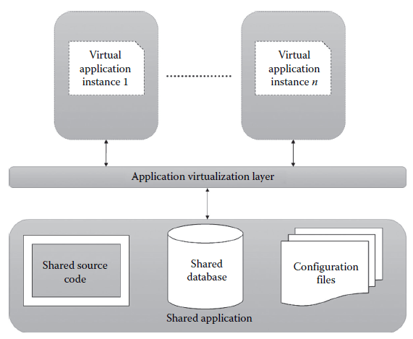
Application Virtualization

Slide 47
Hybrid Virtualization: (Hardware Virtualized with PV Drivers)
In Hardware-assisted full virtualization, Guest OSs are unmodified.
Combination of both Full & Paravirtualization.
Products supporting Hybrid Virtualization.

Slide 48
OS Level Virtualization
Widely used and also known as “containerization”.
Host OS kernel allows multiple user spaces aka instance.
Containers

Slide 49
Pros of Virtualization
Increased Security.

Slide 50
Pros of Virtualization
Increased Security.
Managed Execution.
Sharing
Aggregation
Emulation
Isolation

Slide 51
Pros of Virtualization
Increased Security.
Managed Execution.
Sharing
Aggregation
Emulation
Isolation
Portability.

Slide 52
Pros of Virtualization
Increased Security.
Managed Execution.
Sharing
Aggregation
Emulation
Isolation
Portability.
More Efficient Use of Resources.

Slide 53
Cons of Virtualization
Virtualization also has downsides-
Performance Degradation.
Inefficiency and Degraded User Experience.
Security Holes and New Threats.
Software Licensing Considerations.
Possible Learning Curve.

