Slide 2
After this lecture, you will be able to,
learn about hypervisors and their types
explore different hypervisors such as: HLL VM: Xen, KVM, VMware, VirtualBox, Hyper-V

Slide 3
Hypervisors
VMs are widely used instead of physical machines in the IT industry today.
Virtual environment can be created with the help of a software tool called hypervisors.
Hypervisors are also called Virtual Machine Manager (VMM).

Slide 4
Hypervisors
Key drivers in enabling virtualization in cloud data centers.
Virtual infrastructure means virtual CPUs (vCPUs), virtual memory, virtual NICs (vNICs), virtual storage, and virtual I/O devices.

Slide 5
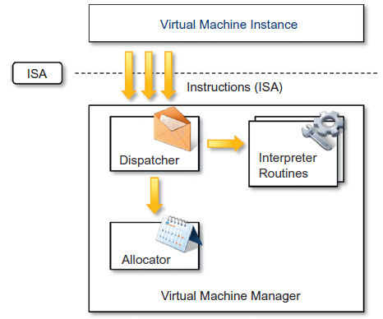
Hypervisors
Internal Organization of a VMM

Slide 6
Hypervisors
Three main modules, dispatcher, allocator, and interpreter, coordinate their activity in order to emulate the underlying hardware.
Dispatcher
Allocator
Interpreter Module

Slide 7
Hypervisors
Design and architecture of a VMM, together with the underlying hardware design of the host machine, determine the full realization of hardware virtualization, where a guest OS can be transparently executed on top of a VMM as though it were run on the underlying hardware.

Slide 8
Hypervisors
The criteria that need to be met by a VMM to efficiently support virtualization were established by Goldberg and Popekin 1974.
Three properties have to be satisfied:
Equivalence
Resource control
Efficiency

Slide 9
Types of Hypervisors
Hypervisors
Before the hypervisors are introduced
After the hypervisors are introduced

Slide 10
Types of Hypervisors
Hypervisors
Before the hypervisors are introduced
After the hypervisors are introduced

Slide 11
Types of Hypervisors
Hypervisors are generally classified into two categories:
Type 1 or bare metal hypervisors

Slide 12
Types of Hypervisors
Hypervisors are generally classified into two categories:
Type 1 or bare metal hypervisors
Type 2 or hosted hypervisors

Slide 13
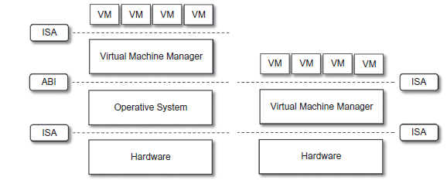
Types of Hypervisors
Hosted (left) and Native (right) VMs

Slide 14
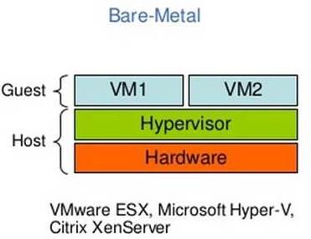
Hypervisors- Type I
Type I Hypervisors run directly on top of the hardware.
Also called a native VM since it runs natively on the hardware.

Slide 15
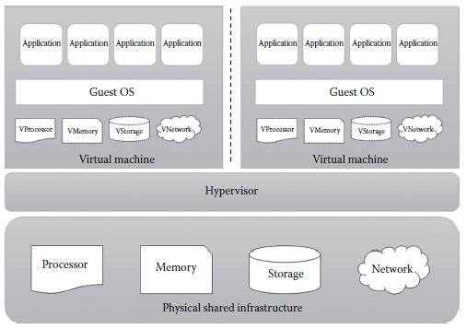
Hypervisors- Type I

Slide 16
Hypervisors- Type II
Type II Hypervisors require the support of an operating system to provide virtualization services.
Also called a hosted or embedded VM since it is hosted within an OS.

Slide 17
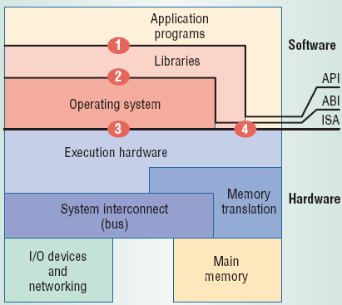
Hypervisors- Type II
Virtualization can take place at these junctures.
ISA – Instruction Set Architecture
ABI – Application Binary Interface
API – Application Programming Interface

Slide 18
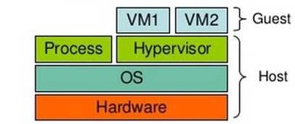
Hypervisors- Type II
Hosted
VM1
VM2
Guest
Process
Hypervisor
OS
Host
Hardware
VMware Workstation, Microsoft Virtual PC, Sun VirtualBox, QEMU, KVM

Slide 19
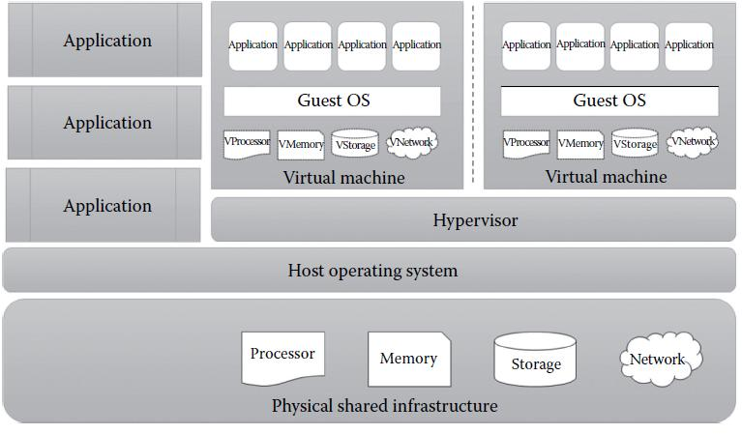
Hypervisors- Type II

Slide 20
Summarized Implementation of Hypervisors
Vary greatly, with options including:
Type 0 Hypervisors
Type 1 Hypervisors
Type 1 Hypervisors
Type 2 Hypervisors

Slide 21
Summarized Implementation of Hypervisors
Vary greatly, with options including:
Type 0 Hypervisors
Type 1 Hypervisors
Type 1 Hypervisors
Type 2 Hypervisors

Slide 22
Summarized Implementation of Hypervisors
Vary greatly, with options including:
Type 0 Hypervisors
Type 1 Hypervisors
Type 1 Hypervisors
Type 2 Hypervisors

Slide 23
Summarized Implementation of Hypervisors
Vary greatly, with options including:
Type 0 Hypervisors
Type 1 Hypervisors
Type 1 Hypervisors
Type 2 Hypervisors

Slide 24
Other Variations Include:
Much variation exists due to breadth, depth and importance of virtualization in modern computing.
Para Virtualization.
Programming-environment Virtualization.
Emulators.
Application Containment.

Slide 25

Xen
An open-source initiative implementing a virtualization platform based on paravirtualization.
Xen is a VMM for IA-32 (x86, x86-64), IA-64 and PowerPC 970 architectures.
Allows several guest OSs to be executed on the same computer hardware concurrently.

Slide 26
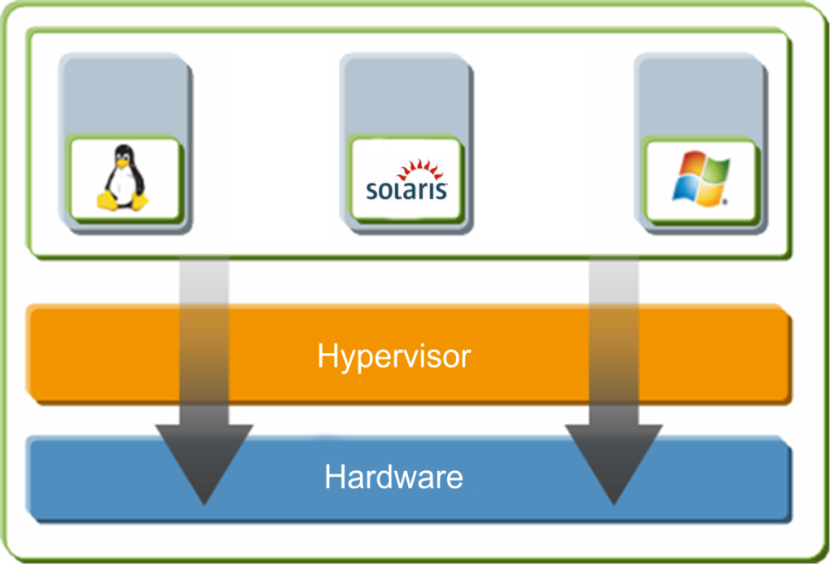
Xen Architecture
Virtual Machine
Layer
Hypervisor Layer
Hardware/ Physical Layer

Slide 27
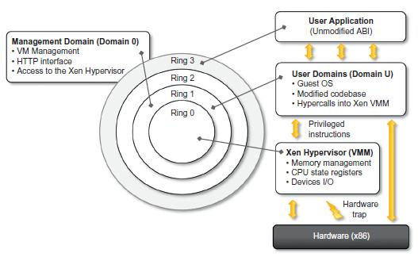
Xen Architecture

Slide 28
KVM
Kernel-based Virtual Machine (KVM).
An open source virtualization technology built into Linux®.
A full virtualization solution for Linux on x86 hardware containing virtualization extensions (Intel VT or AMD-V).

Slide 29
How does KVM work?
KVM converts Linux into a type-1 (bare-metal) hypervisor.

Slide 30
Implementing KVM
You have to run a version of Linux that was released after 2007 and it needs to be installed on X86 hardware that supports virtualization capabilities.

Slide 31
KVM Features
Security
Storage
Hardware Support
Memory Management
Live Migration
Performance and Scalability
Scheduling and Resource Control
Lower Latency and Higher Prioritization

Slide 32
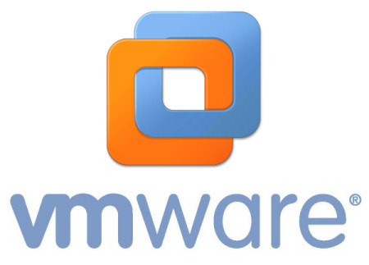
VMware Workstation
VMware Workstation is the most dependable, high-performing, feature-rich virtualization platform for your Windows or Linux PC.
Allows one physical PC to run multiple operating systems at the same time.

Slide 33
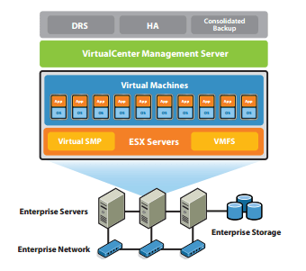
VMware Workstation

Slide 34
VMware Workstation
VMware’s technology is based on the concept of full virtualization, where the underlying hardware is replicated and made available to the guest OS, which runs unaware of such abstraction layers and does not need to be modified.

Slide 35
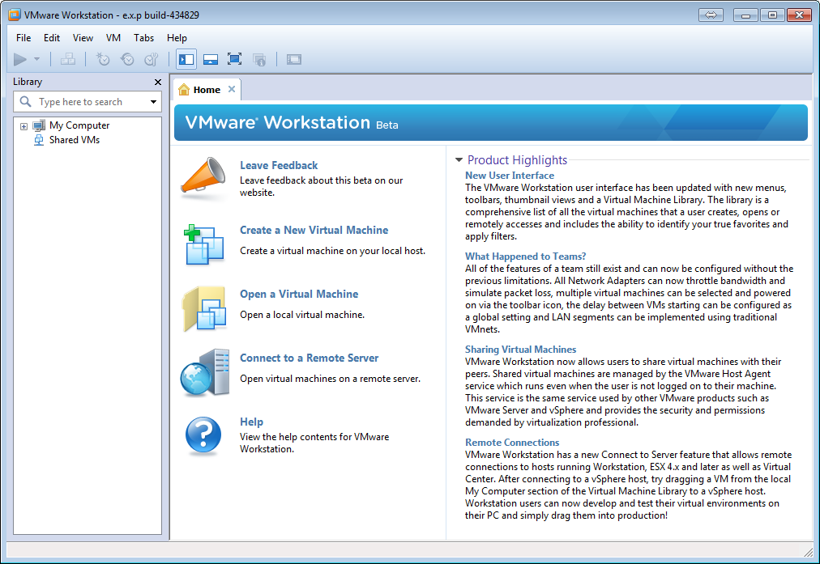
VMware Workstation

Slide 36
Key Benefits of VMware
Access anytime, anywhere.
Run applications in Windows, Linux and other systems at the same time without restarting.
Remotely access VMs running on VMware.
Run as a server to host applications for your team, department or anyone in your organization.
Create VMs that are encrypted, block USB devices and have read-only settings.

Slide 37
VirtualBox
Powerful x86 and AMD64/Intel64 virtualization product for enterprise as well as home use.
An extremely feature rich, high performance product for enterprise customers.
Also, the only professional solution that is freely available as Open Source Software under the terms of the GNU General Public License (GPL) version 2.

Slide 38
VirtualBox
Oracle VM VirtualBox-
Cross-platform virtualization application.
Installs on your existing Intel or AMD-based computers, whether they are running Windows, Mac OS X, Linux, or Oracle Solaris operating systems (OSes).

Slide 39
Microsoft Hyper-V
Primary engine that drives Windows Server 2008 “beyond virtualization” initiative.
Hypervisor-based virtualization platform.

Slide 40
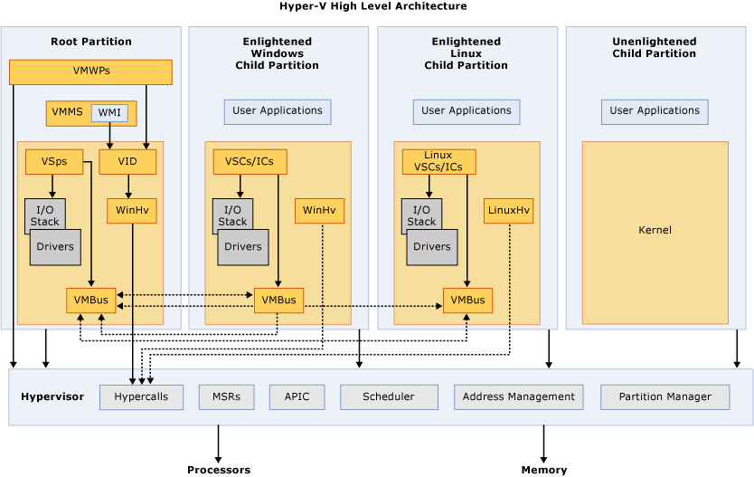
Microsoft Hyper-V High-level Architecture

Slide 41
Microsoft Hyper-V High-level Architecture
Parent partition (also called the root partition)
Child partitions

Slide 42
Microsoft Hyper-V High-level Architecture
Hypercalls Interface.
Memory service routines (MSRs).
Advanced Programmable Interrupt Controller (APIC).
Scheduler.
Partition Manager.

Slide 43
Microsoft Hyper-V Performance Characteristics
Hyper-V
Improved Hardware Sharing Architecture.
Critical Disk Performance for I/O Intensive Applications.
Processor Hardware-assisted Virtualization Support.
Multi-core (SMP) Guest OS Support.
Both 32-bit and 64-bit Guest OS Support.

Slide 44
Microsoft Hyper-V Performance Characteristics
Hyper-V
Improved Hardware Sharing Architecture.
Critical Disk Performance for I/O Intensive Applications.
Processor Hardware-assisted Virtualization Support.
Multi-core (SMP) Guest OS Support.
Both 32-bit and 64-bit Guest OS Support.

Slide 45
Microsoft Hyper-V Performance Characteristics
Hyper-V
Improved Hardware Sharing Architecture.
Critical Disk Performance for I/O Intensive Applications.
Processor Hardware-assisted Virtualization Support.
Multi-core (SMP) Guest OS Support.
Both 32-bit and 64-bit Guest OS Support.

Slide 46
Microsoft Hyper-V Performance Characteristics
Hyper-V
Improved Hardware Sharing Architecture.
Critical Disk Performance for I/O Intensive Applications.
Processor Hardware-assisted Virtualization Support.
Multi-core (SMP) Guest OS Support.
Both 32-bit and 64-bit Guest OS Support.

Slide 47
Microsoft Hyper-V Performance Characteristics
Hyper-V
Improved Hardware Sharing Architecture.
Critical Disk Performance for I/O Intensive Applications.
Processor Hardware-assisted Virtualization Support.
Multi-core (SMP) Guest OS Support.
Both 32-bit and 64-bit Guest OS Support.

Slide 48
Advantages of Microsoft Hyper-V Architecture
Consolidation of Hardware Resources.
Ease of Administration.
Significant Cost Savings.
Fault Tolerance Support through Hyper-V Clustering.
Proven Track Record.
Comprehensive Product Support.
Scalability.

Slide 49
Advantages of Microsoft Hyper-V Architecture
Consolidation of Hardware Resources.
Ease of Administration.
Significant Cost Savings.
Fault Tolerance Support through Hyper-V Clustering.
Proven Track Record.
Comprehensive Product Support.
Scalability.

Slide 50
Advantages of Microsoft Hyper-V Architecture
Consolidation of Hardware Resources.
Ease of Administration.
Significant Cost Savings.
Fault Tolerance Support through Hyper-V Clustering.
Proven Track Record.
Comprehensive Product Support.
Scalability.

Slide 51
Advantages of Microsoft Hyper-V Architecture
Consolidation of Hardware Resources.
Ease of Administration.
Significant Cost Savings.
Fault Tolerance Support through Hyper-V Clustering.
Proven Track Record.
Comprehensive Product Support.
Scalability.

Slide 52
Advantages of Microsoft Hyper-V Architecture
Consolidation of Hardware Resources.
Ease of Administration.
Significant Cost Savings.
Fault Tolerance Support through Hyper-V Clustering.
Proven Track Record.
Comprehensive Product Support.
Scalability.

Slide 53
Advantages of Microsoft Hyper-V Architecture
Consolidation of Hardware Resources.
Ease of Administration.
Significant Cost Savings.
Fault Tolerance Support through Hyper-V Clustering.
Proven Track Record.
Comprehensive Product Support.
Scalability.

Slide 54
Advantages of Microsoft Hyper-V Architecture
Consolidation of Hardware Resources.
Ease of Administration.
Significant Cost Savings.
Fault Tolerance Support through Hyper-V Clustering.
Proven Track Record.
Comprehensive Product Support.
Scalability.

Slide 55
Disadvantages of Using Hyper-V
Hardware Requirements.
Software Requirements.

