Slide 2
After this lecture, you will be able to,
know about security in clouds and Software as a Service Security
explore different security challenges in clouds

Slide 3
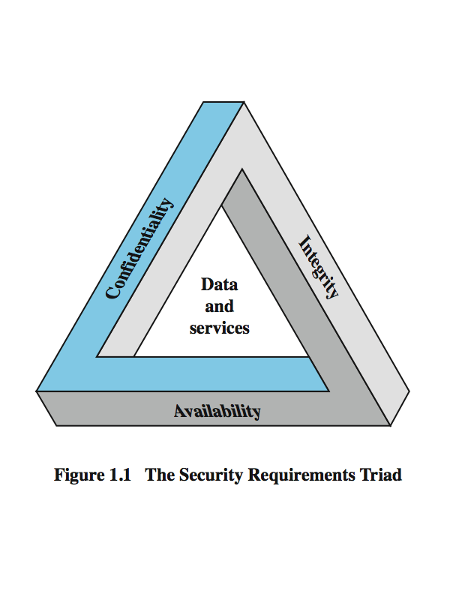
What is Security?
Security is the protection of assets.
Three main aspects are:
prevention
detection
re-action
CIA Triad

Slide 4
Confidentiality
Prevention of unauthorized disclosure of information.
Data confidentiality
Privacy

Slide 5
Integrity
Integrity is the unauthorized writing or modification of information.
Data integrity
System Integrity

Slide 6
Availability
Availability
Assure that systems works promptly, and service is not denied to authorized users.
Denial of service attacks are a common form of attack.

Slide 7
Other Concepts Related to Security
Authenticity
Property of being genuine and being able to be verified and trusted; confident in the validity of a transmission, or a message, or its originator.
Accountability
Generates requirement for actions of an entity to be traced uniquely to that individual to support non-repudiation, deference, fault isolation etc.

Slide 8
Other Concepts Related to Security
Authenticity
Property of being genuine and being able to be verified and trusted; confident in the validity of a transmission, or a message, or its originator.
Accountability
Generates requirement for actions of an entity to be traced uniquely to that individual to support non-repudiation, deference, fault isolation etc.

Slide 9
Security in Clouds
Cloud computing security is the set of control-based technologies and policies designed to adhere to regulatory compliance rules and protect information, data applications and infrastructure associated with cloud computing use.

Slide 10
Security in Clouds
Refers to a broad set of policies, technologies, applications, and controls utilized to protect virtualized IP, data, applications, services, and the associated infrastructure of cloud computing.
Sub-domain of computer security, network security, and, more broadly, information security.

Slide 11
Security in Clouds
Security concerns associated with cloud computing are typically categorized in two ways: as security issues faced by cloud providers (organizations providing software-, platform-, or infrastructure-as-a-service via the cloud) and security issues faced by their customers (companies or organizations who host applications or store data on the cloud).

Slide 12
Security in Clouds
Shared security responsibility model" or “Shared responsibility model.“
Extensive use of virtualization in implementing cloud infrastructure brings unique security concerns for customers or tenants of a public cloud service.

Slide 13
Security in Clouds
Cloud Security Controls
Deterrent controls
Preventive controls
Detective controls
Corrective controls

Slide 14
Security in Clouds
Security Boundaries
A particular service model defines the boundary between the responsibilities of service provider and customer.
Cloud Security Alliance (CSA) stack model defines the boundaries between each service model and shows how different functional units relate to each other.

Slide 15
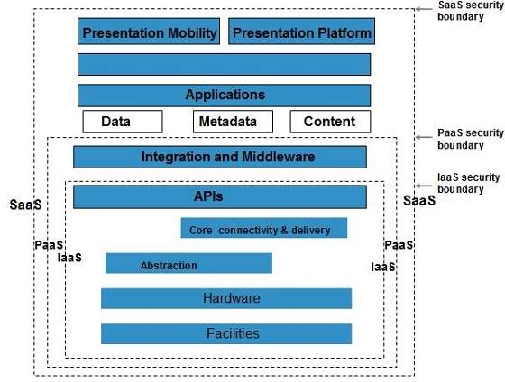
Security in Clouds
CSA Stack Model

Slide 16
Security in Clouds
Key Points- CSA Model
IaaS is the most basic level of service, with PaaS and SaaS next two above levels of services.
Moving upwards, each of the service inherits capabilities and security concerns of the model beneath.

Slide 17
Security in Clouds
IaaS has the least level of integrated functionalities and integrated security while SaaS has the most.
This model describes the security boundaries at which cloud service provider's responsibilities end and the customer's responsibilities begin.

Slide 18
Security in Clouds
Any security mechanism below the security boundary must be built into the system and should be maintained by the customer.

Slide 19
Security Challenges
Number of security challenges associated with cloud computing that must be adequately addressed.
Managing Complex Environments.
Compliance With Rules and Regulations.
Lack of Visibility.
Data Center or Physical Security Issues.
Notes:
19

Slide 20
Other Security Challenges
Organizations are afraid of losing their data stored in the cloud.
Threats to data privacy put cloud computing at risk.
Breaches of confidentiality challenge the integrity of cloud computing.
Changing Service Provider.
Lack of skills.
Data Leakage or Loss.
Lack of Control.
Notes:
20

Slide 21
Software-as-a-Service Security
Cloud computing models of the future likely to combine the use of SaaS (and other XaaS’s as appropriate), utility computing, and Web 2.0 collaboration technologies to leverage the Internet to satisfy their customers’ needs.

Slide 22
Security Issues
Technology analyst & consulting firm “Gartner” lists 7 security issues that need to be discussed with cloud vendor:
Privileged User Access.
Regulatory Compliance.
Data Location.
Data Segregation.
Recovery.
Investigative Support.
Long-term Viability.

Slide 23
Some Security Practices
Security Management and Governance
Risk Management and Risk Assessment
Security Portfolio Management

Slide 24
Some Security Practices
Secure Software Development Life Cycle (SecSDLC)
Investigation
Analysis
Logical design
Physical design
Implementation
Maintenance

Slide 25
Some Security Practices
Physical Security of Data Centres
Physical access control and monitoring.
Environmental controls and backup power.
Policies, processes, and procedures.

