Slide 2
After this lecture, you will be able to,
Know about the open cloud consortium and the distributed management task force.
Understand the cloud standards with detailed exploration of the standards for application developers, Standards for messaging, Standards for security.

Slide 3
Standards in Cloud Computing
In Internet circles, everything eventually gets driven by a working group of one sort or another.
Working group is an assembled, cooperative collaboration of researchers working on new research activities that would be difficult for any one member to develop alone.
Sometimes, they are also referred to as task groups or technical advisory groups.

Slide 4
The Open Cloud Consortium (OCC)
Supports the development of standards for cloud computing and frameworks for interoperating between clouds;
Develops benchmarks for cloud computing; and
Supports reference implementations for cloud computing, preferably open source reference implementations.

Slide 5
The Open Cloud Consortium (OCC)
The OCC is organized into several different working groups-
The Open Cloud Consortium (OCC) Working Groups
Working Group on Standards and Interoperability for Clouds
Working Group on Wide Area Clouds and the Impact of Network Protocols on Clouds
The Open Cloud Test-bed Working Group
Working Group on Information Sharing, Security, and Clouds

Slide 6
Distributed Management Task Force
With more than 3,500 active participants, the Distributed Management Task Force, Inc. (DMTF) is a not-for-profit, vendor-neutral, collaborative body that is leading the development, adoption, and unification of management standards and initiatives for desktop, enterprise, and Internet environments.

Slide 7
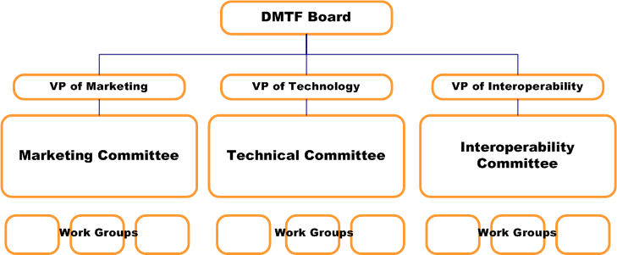
DMTF Organization

Slide 8
DMTF Work Groups and Committees
DMTF Board
Technical Committee
Interoperability Committee
Marketing Committee

Slide 9
DMTF Standards and Initiatives
DMTF is leading the development, adoption, and unification of management standards and initiatives for desktop, enterprise and Internet environments.

Slide 10
DMTF Standards and Initiatives
Some of the approved specifications that the DMTF has made public.
Common Information Model (CIM)
Web-Based Enterprise Management (WBEM)
Systems Management Architecture for Server Hardware (SMASH) Initiative

Slide 11
DMTF Standards and Initiatives
Some of the approved specifications that the DMTF has made public.
Alert Standard Format (ASF
System Management BIOS (SMBIOS)
Virtualization Management Initiative (VMAN)
Open Virtualization Format (OVF)

Slide 12
Standards for Application Developers
Purpose of application development standards is to ensure uniform, consistent, high-quality software solutions.
Browsers (Ajax)
Data
XML- Extensible Markup Language (XML)
JavaScript Object Notation (JSON)
Solution Stacks
LAMP
Linux, Apache, PostgreSQL, and PHP(or Perl or Python)

Slide 13
Standards for Messaging
A message is a unit of information that is moved from one place to another.
Simple Message Transfer Protocol (SMTP)
Post Office Protocol (POP)
Internet Messaging Access Protocol (IMAP)
Syndication (Atom, Atom Publishing Protocol, and RSS)
Web Services (REST)- Representational State Transfer
SOAP (Simple Object Access Protocol)
Communications (HTTP, SIMPLE, and XMPP)

Slide 14
Standards for Security
Define the processes, procedures, and practices necessary for implementing a security program.

Slide 15
Standards for Security
Security Assertion Markup Language (SAML)
Open Authentication (OAuth)
OpenID
SSL/TLS

