Slide 2
After this lecture, you will be able to,
know about end user access to cloud computing and End-user Computing
explore the different applications of cloud service in various areas of life

Slide 3
End User Access to Cloud Computing
In today’s world, many organizations have incorporated public cloud services into their workspace strategy.

Slide 4
End User Access to Cloud Computing
Switch from CAPEX to OPEX procurement.
Security has dramatically improved.
Organizations are able to reduce complexity and risk.

Slide 5
End User Access to Cloud Computing
End-user computing (EUC) refers to computer systems and platforms that help non-programmers create applications. However, there is a lot more to EUC and its related technology, VDI, which essentially hosts desktop environments on a central server.
Can be considered a form of desktop virtualization.

Slide 6
End User Access to Cloud Computing
End-user computing (EUC) refers to computer systems and platforms that help non-programmers create applications. However, there is a lot more to EUC and its related technology, VDI, which essentially hosts desktop environments on a central server.
Can be considered a form of desktop virtualization.

Slide 7
End User Access to Cloud Computing
From Desktop as Software to Desktop-as-a-Service

Slide 8
End User Access to Cloud Computing
Why use EUC?
Remote Offices.
Remote Workers and BYOD Users.
Changing Requirements.
Compliance and Licensing Control.
Work smarter with End-user Computing Solutions.

Slide 9
End User Access to Cloud Computing
Why use EUC?
Remote Offices.
Remote Workers and BYOD Users.
Changing Requirements.
Compliance and Licensing Control.
Work smarter with End-user Computing Solutions.

Slide 10
How Cloud Computing Can Empower End Users?
Users access cloud computing using networked client devices, such as desktop computers, laptops, tablets and smartphones. Some of these devices - cloud clients- rely on cloud computing for all or most of their applications to be essentially useless without it.

Slide 11





How Cloud Computing Can Empower End Users?
Applications/ successful SaaS offerings that are proving beneficial to the end users:
YouTube
Zimbra
Facebook
Zoho
Dimdim

Slide 12
How Cloud Computing Can Empower End Users?
Reasons for Wide Adoption of Cloud Model-
Consumer-driven innovation
Rise of power collaborators.
Changing economics.
Lowering of barriers to entry.

Slide 13
How Cloud Computing Can Empower End Users?
Lower Computer Costs.
Improved Performance.
Reduced software costs.
Instant software updates.
Improved document format compatibility.

Slide 14
How Cloud Computing Can Empower End Users?
Unlimited storage capacity.
Increased data reliability.
Universal document access.
Latest version availability.
Easier group collaboration.
Device independence.

Slide 15
Applications of Cloud Service in Various Areas of Life
Cloud computing offers distributed; agile; transparent; seamless integration and delivery of services to the users and thus extends a wide horizon of opportunities for supporting highly pervasive technological progress and innovations.

Slide 16
Applications of Cloud Service in Various Areas of Life
Prominent cloud-based ventures include:
Amazon Web Services (AWS)
Google AppEngine
Microsoft Windows Azure
Platform
Salesforce.com

Slide 17
Applications of Cloud Service in Various Areas of Life
Product | Type Description
Amazon Web Services (AWS) | A collection of large number of web services facilitating computing, storage and other advanced services especially for IaaS services.
Google AppEngine | Supports development of simple and scalable web applications
Microsoft Azure | A kind of cloud operating system enabling development of scalable applications.
SalesForce.com | A SaaS solution for creating CRM applications vested on Force.com platform.
RightScale | A management platform for cloud providing scalable infrastructural support.

Slide 18
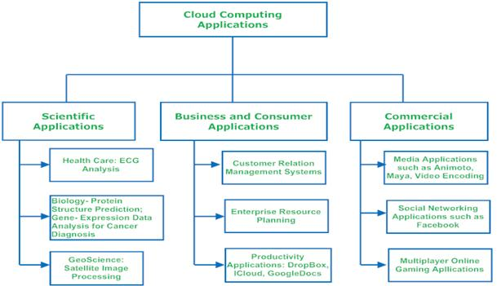
Applications of Cloud Service in Various Areas of Life

Slide 19
Applications of Cloud Service in Various Areas of Life
Cloud computing can lucratively host pervasive applications ranging from scientific consumer and business domains driven by its capability to liberally map existing applications to it without much alterations.
Scientific applications.
Business and consumer applications.
Media applications and social networks.

Slide 20
Applications of Cloud Service in Various Areas of Life
Cloud computing in E-commerce
Cloud computing in Education
Cloud computing in E-Governance
Cloud Computing in Healthcare

Slide 21
Applications of Cloud Service in Various Areas of Life
Cloud Computing in Entertainment.
Cloud Computing in Art Sector.
Cloud Computing in Management.
Cloud Computing in Social Networks.

