Slide 2
After this lecture, you will be able to,
know about Internet of Things (IoT), Cloud of Things (CoT), and mobile IoT.

Slide 3
Internet-of-Things (IoT)
Network of physical objects or "things" embedded with electronics, software, sensors, and network connectivity, which enables these objects to collect and exchange data.

Slide 4
Internet-of-Things (IoT)
“Thing” in context of IoT:
An entity or physical object that has a unique identifier, an embedded system & ability to transfer data over a network.

Slide 5
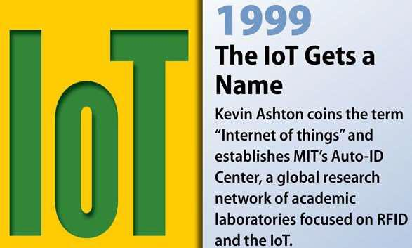
History of IoT

Slide 6
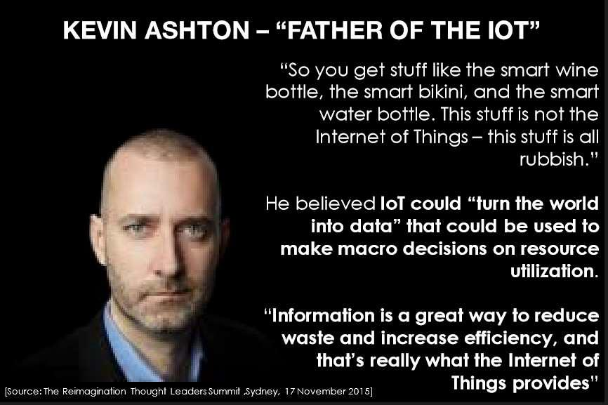
History of IoT

Slide 7
Growth of IoT
In 2008, the number of things connected to the Internet was greater than the people living on Earth.
Within 2020, the number of things connected to the Internet has crossed about 50 billion.

Slide 8
How IoT Works?
Also, called Internet of Everything (IoE) or Machine-to-Machine (M2M), Skynet.
Consists of all the web-enabled devices that collect, send and act on data they acquire from their surrounding environments using embedded sensors, processors & communication hardware.

Slide 9
How IoT Works?
COLLECT
COMMUNICATE
ANALYZE
ACT
IoT Lifecycle

Slide 10
Structure of IoT
Tagging Things
Feeling Things
Shrinking Things
Thinking Things

Slide 11
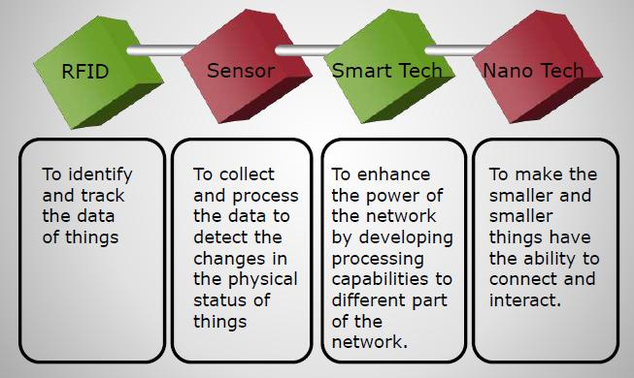
Structure of IoT

Slide 12
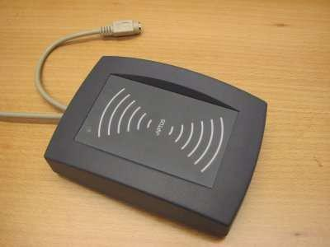
Structure of IoT- RFIDs
Radio-frequency identification (RFID) uses electromagnetic fields to automatically identify and track tags attached to objects.

Slide 13
Structure of IoT- WiFi
Widely used both in indoor and outdoor environments.

Slide 14
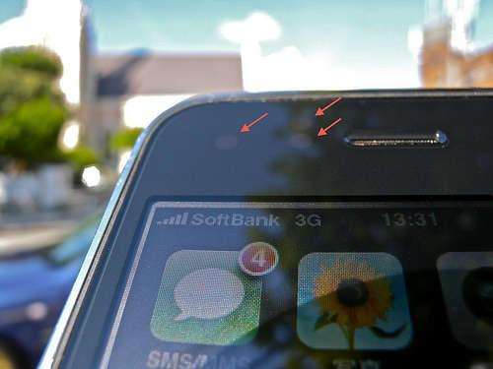
Structure of IoT- Sensors and smartphones

Slide 15
Characteristics of IoT
Intelligence
Connectivity
Dynamic nature
Enormous scale
Sensing
Heterogeneity
Security

Slide 16
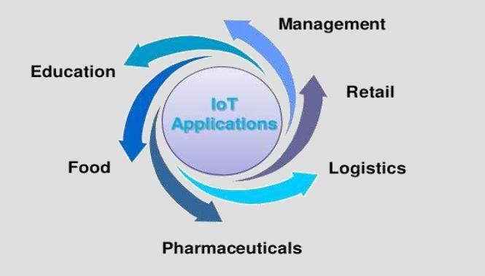
Applications of IoT

Slide 17
Applications of IoT
IoT in Food Industry
IoT in Education
IoT in Pharmaceuticals
IoT in Retail
IoT in Logistics
IoT in Management

Slide 18
Cloud of Things (CoT)
Integration of Internet of Things (IoT) with Cloud Computing (CC).
A high-performance cloud-based IoT application platform which allows to remotely monitor, manage and control the IoT enabled devices.
Can be used to connect devices and machines and monitor and manage it.

Slide 19

Cloud of Things (CoT)
Why CoT is required?
Role of Cloud computing in CoT?

Slide 20
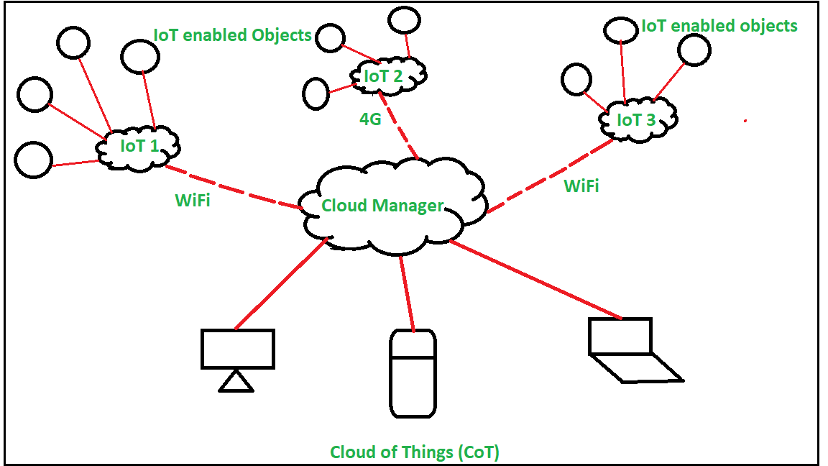
Cloud of Things (CoT)

Slide 21
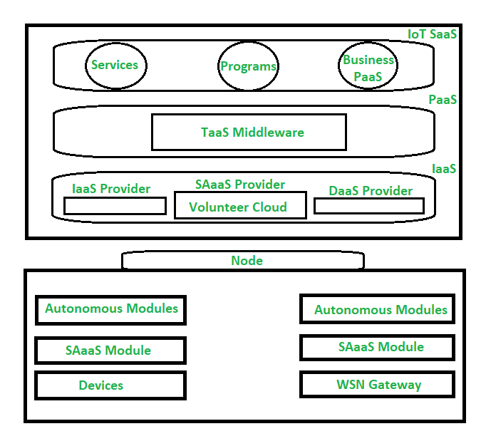
Architecture of Cloud of Things (CoT)

Slide 22
Cloud of Things (CoT)
Application areas of Cloud of Things (CoT):
Healthcare
Smart home
Smart city
Smart energy
Smart mobility
Smart surveillance
Smart logistic
Environmental monitoring

Slide 23
Mobile Internet of Things (Mobile IoT)
Refers to low power wide area (LPWA) 3GPP standardised secure operator managed IoT networks in licensed spectrum. In particular, LPWA networks designed for IoT applications that are low cost, use low data rates, require long battery lives and often operate in remote and hard to reach locations. Existing cellular networks have evolved to deliver service to billions of new devices providing complete IoT connectivity.
Mobile IoT= Trusted IoT
GSMA Mobile IoT

Slide 24

Mobile Internet of Things (Mobile IoT)
Why do we need low power wide area networks?

Slide 25
Mobile Internet of Things (Mobile IoT)
Example of Mobile IoT Provider- BeWhere Inc.

