Slide 2
After this lecture, you will be able to,
explore the concepts of edge computing, fog computing, and blockchain technologies.

Slide 3
Edge Computing
Distributed computing framework that brings enterprise applications closer to data sources such as IoT devices or local edge servers.

Slide 4
Edge Computing
Distributed computing framework that brings enterprise applications closer to data sources such as IoT devices or local edge servers.
This proximity to data at its source can deliver strong business benefits, including faster insights, improved response times and better bandwidth availability.

Slide 5
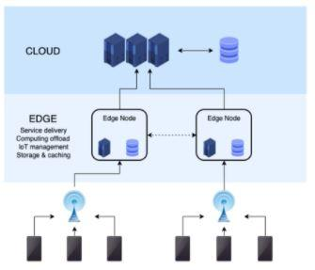
Edge Computing
The “edge” is where the device communicates with the Internet

Slide 6
Edge Computing
“Edge” in Edge Computing-
Edge can be the router, ISP, routing switches, integrated access devices (IADs), multiplexers, etc.

Slide 7
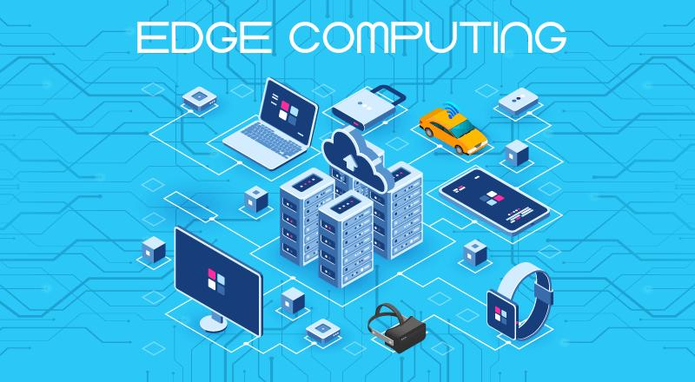
Edge Computing

Slide 8
Edge vs Traditional Computing Concept
Edge Computing brings the decentralization of networks.
Early computing | Applications run only on one isolated computer
Personal computing | Applications run locally either on the user’s device on in a data center
Cloud computing | Applications run in data centers and processed via the cloud
Edge computing | Applications run close to the user; either on the user’s device or on the network edge

Slide 9
Cloud Computing vs Edge Computing
Edge Computing | Cloud Computing
Good to be used for those organizations that have a limited budget to invest in financial resources. So, mid-level organizations can use edge computing. | Generally recommended for processing and managing a high volume of data that is complex and massive enough. Thus, such organizations that deal with huge data storage use cloud computing.
Can use different programming languages on different platforms, each having different runtime. | Works for one target platform using one programming language only.

Slide 10
Cloud Computing vs Edge Computing
Edge Computing | Cloud Computing
Security in edge computing needs tight and robust plans such as advanced authentication methods, network security, etc. | No high and advanced security methods needed.
Processes time-sensitive data. | Process that data that is not driven by time, i.e., not time-driven.
Processes data at remote locations and uses the Decentralization approach. | Processes and deals with data at centralized locations by using a centralized approach.

Slide 11
Why Edge Computing?
Edge computing harnesses growing in-device computing capability to provide deep insights and predictive analysis in near-real time.

Slide 12
Why Edge Computing?
Edge computing harnesses growing in-device computing capability to provide deep insights and predictive analysis in near-real time.
Edge Computing is a new type of technology that not only saves time but also save the cost of servicing and other charges too.

Slide 13
Benefits of Edge Computing
Edge computing has emerged as one of the most effective solutions to network problems associated with moving huge volumes of data generated in today’s world. Some of the most important benefits of edge computing:
Eliminates Latency
Saves Bandwidth
Reduces Congestion

Slide 14
Applications of Edge Computing
Edge Computing Applications
Transportation
Healthcare
Manufacturing
Grid Edge Control and Analytics
Remote monitoring of Oil and Gas
Traffic Management

Slide 15
Fog Computing
“
a system-level horizontal architecture that distributes resources and services of computing, storage, control and networking anywhere along the cloud-to-things continuum. It supports industry verticals and application domains, enables services and applications to be distributed closer to the data-producing sources, and extends from the things, over the network edges, through the cloud and across multiple protocol layers.
“
- IEEE 1934

Slide 16
Fog Computing
Fog Computing is the term coined by Cisco that refers to extending cloud computing to an edge of the enterprise’s network.
Also known as Edge Computing or Fogging.

Slide 17
Fog Computing
Fog Computing is the term coined by Cisco that refers to extending cloud computing to an edge of the enterprise’s network.
Also known as Edge Computing or Fogging.

Slide 18
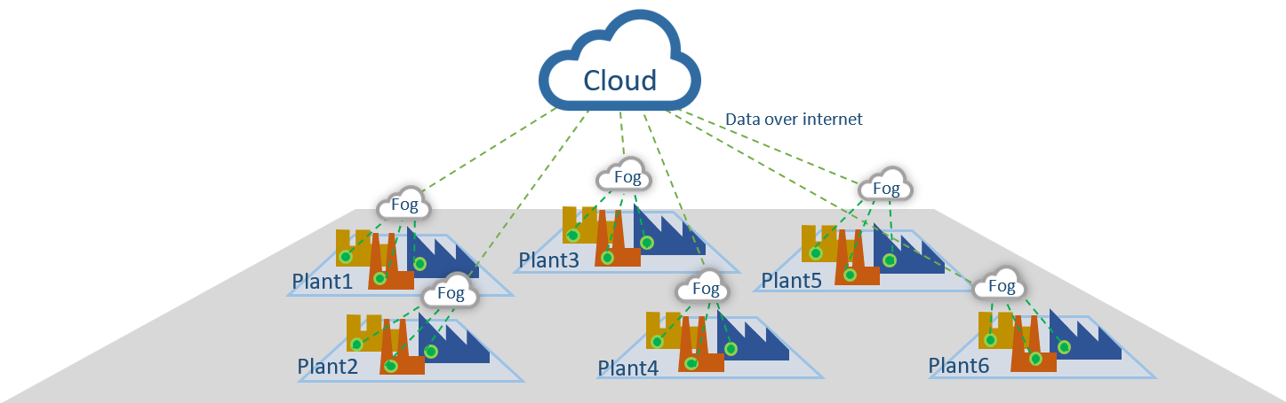
Architecture of Fog Computing

Slide 19
Benefits of Fog Computing
Fog computing helps in:
Reduce network latency and data traffic
Increase the effective network bandwidth
Vertically isolate the network
Scale up the deployment easily and efficiently
Control privacy and data security

Slide 20
Blockchain
Technology that permits transactions to be gathered into blocks and recorded; allows the resulting ledger to be accessed by different servers.

Slide 21
Three complementary definitions of blockchain
Blockchain has technical, business & legal definitions.
Technically
Business-Wise
Legally

Slide 22
Three complementary definitions of blockchain
Blockchain has technical, business & legal definitions.
Technically
Business-Wise
Legally

Slide 23
Three complementary definitions of blockchain
Blockchain has technical, business & legal definitions.
Technically
Business-Wise
Legally

Slide 24
Blockchain
No banks!, no government!, no intermediaries of any kind!
Blockchain is a potentially revolutionary technology that promises to dramatically change the world.

Slide 25
Blockchain
Blockchain is a meta technology because it affects other technologies, and it is made up of several technologies itself it is comprised of several pieces: a database, a software application, a number of computers connected to each other, clients to access it, a software environment to develop on it, tools to monitor it, and other pieces.

Slide 26
Blockchain
Blockchain is a Data Structure
Blockchain is a Decentralized Ledger

Slide 27
Distributed Ledger
Node A
Node B
Node C
Node D
Node E

Slide 28
Centralized Ledger
CLIENT A
BANK
CLIENT B
CLIENT C
CLIENT D

Slide 29
Working of Distributed Ledger
Users Initiate Transactions Using Their Digital Signature
Users Broadcast Their Transactions To Nodes
One or More Nodes Begin Validating Each Transaction
Nodes Aggregate Validated Transaction Into Blocks
Nodes Broadcast Blocks to Each Other
Consensus Protocol
Block Reflecting “True State” is chained to prior Blocks

Slide 30
Blockchain- Features
Public blockchain has some characteristic features:
Write-only, immutable, transparent data storage.
Decentralized, no need for intermediaries.
Consistent state across all participants.
Resistant against malicious participants.
Open to everyone.
Similar to World Wide Web (WWW).

Slide 31
Private vs Public Blockchain
Public blockchain is open and interoperable, like the internet, and a private blockchain is closed & limits the people who are granted access, like an intranet.

Slide 32
Advantages of Private Blockchain
Easy to Manage
Cheap Transaction
Trustful & Fault Handling is Worthy

Slide 33
Advantages of Public Blockchain
Privacy
Abstraction
Useful

Slide 34
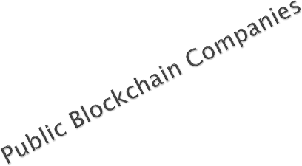
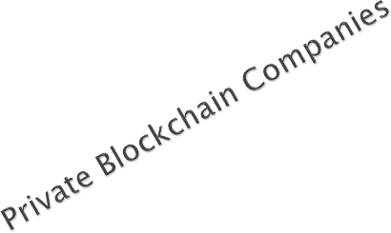
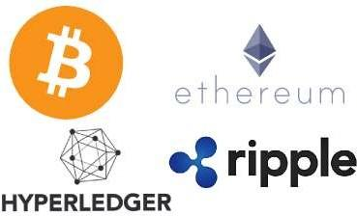
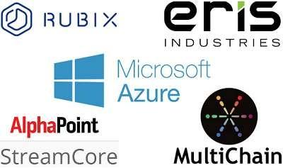
Blockchain Companies

Slide 35
Overall Advantages of Blockchain
Transparency
Reduced transaction costs
Faster transaction settlements
Decentralization
User-controlled networks

Slide 36
Overall Advantages of Blockchain
Transparency
Reduced transaction costs
Faster transaction settlements
Decentralization
User-controlled networks

Slide 37
Overall Advantages of Blockchain
Transparency
Reduced transaction costs
Faster transaction settlements
Decentralization
User-controlled networks

Slide 38
Overall Advantages of Blockchain
Transparency
Reduced transaction costs
Faster transaction settlements
Decentralization
User-controlled networks

Slide 39
Overall Advantages of Blockchain
Transparency
Reduced transaction costs
Faster transaction settlements
Decentralization
User-controlled networks

Slide 40
Applications of Blockchain
Smart Contracts
Paying Employees
Electronic Voting
Cloud Storage

