Slide 2
After this lecture, you will be able to,
learn about cloud server.
know about the cloud storage.
explore database storage offered through cloud computing.

Slide 3
Cloud Server
A powerful physical or virtual infrastructure that performs application- and information-processing storage.
Created using virtualization software to divide a physical (bare metal) server into multiple virtual servers.
Key Features.

Slide 4
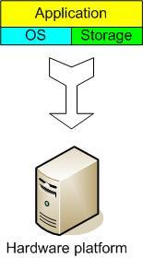
Traditional Server Concept
Web Server
Windows
IIS
App Server
Linux
Glassfish
DB Server
Linux
MySQL
EMail
Windows
Exchange

Slide 5
And If Something Goes Wrong ...
Web Server
Windows
IIS
App Server
DOWN!
DB Server
Linux
MySQL
EMail
Windows
Exchange

Slide 6
Traditional Server Concept
System Administrators often talk about servers as a whole unit that includes the hardware, the OS, the storage, and the applications.
Pros and Cons.

Slide 7
Cloud Server
Why Cloud Server-
Cost Effectiveness

Slide 8
Cloud Server
Why Cloud Server-
Cost Effectiveness
Scalability

Slide 9
Cloud Server
Why Cloud Server-
Cost Effectiveness
Scalability
Integration

Slide 10
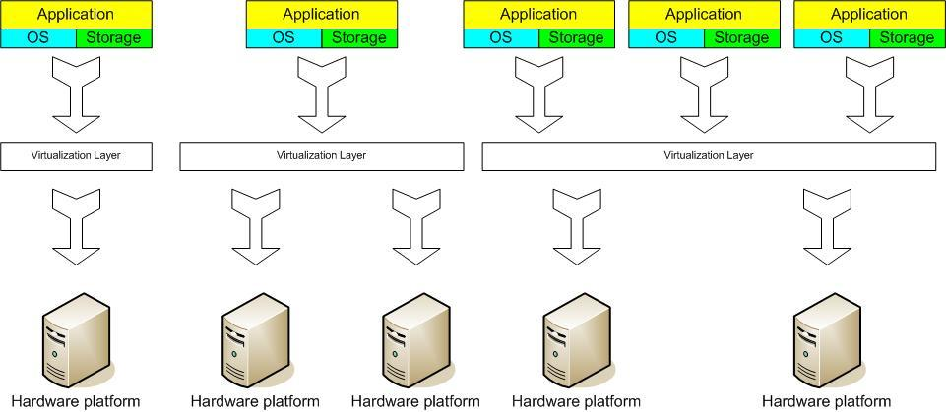
Cloud Virtual Server Concept
Virtual Machine Monitor (VMM) Layer Between Guest OS and Hardware

Slide 11
Cloud Virtual Server Concept
Clustering
Service Console
Server
1
Guest OS
Server
2
Guest OS
VMM (Virtual Machine Monitor)
x86 Architecture
Intercepts hardware requests

Slide 12
Cloud Virtual Server Concept
Virtual servers seek to encapsulate the server software away from the hardware.
Includes the OS, applications, and storage for that server.

Slide 13
Cloud Virtual Server Concept
Virtual servers can be scaled out easily.
Server templates can be created in a virtual environment to be used to create multiple, identical virtual servers.
Virtual servers themselves can be migrated from host to host almost at will.

Slide 14
Cloud Virtual Server Concept
Pros
Resource pooling.
Highly redundant.
Highly available.
Rapidly deploy new servers.
Easy to deploy.
Reconfigurable while services are running.
Optimizes physical resources by doing more with less.

Slide 15
Cloud Virtual Server Concept
Cons
Slightly harder to conceptualize.
Slightly more costly (must buy hardware, OS, Apps, and now the abstraction layer).

Slide 16
Considerations- Virtual Servers vs Physical Servers
Physical (bare metal) servers are best for data-intensive workloads.
Virtual servers are better for highly variable workloads.

Slide 17
Cloud Storage
Most innovative technology to store, access, and collaborate through scalable cloud technology.
Cloud computing model that stores valuable data through the web and operates it through a storage as a device service.
Delivered on-demand.
Pay-as-you-go model.
Third-party vendors.

Slide 18
Traditional Storage
Storage option in which we use local physical drives to store the data at the primary location of the client.
User generally uses the disk-based hardware to store data and these are used for copying, managing, and integrating the data to software.
Features of Traditional Storage.

Slide 19
Cloud Storage vs Traditional Storage
Storage Location
Payment
Accessibility
Backup Option
Flexibility

Slide 20
Features of Cloud Storage
Easily be accessed via a web browser.
Offer apps for ease of access.
Facilitates navigation and organisation.
Ease of Access.
Online Editing.
Online Collaboration.

Slide 21
Considerations for Storing Data to Cloud
Various parameters that need to be taken into account whilst saving data on the cloud include:
Security
Availability

Slide 22
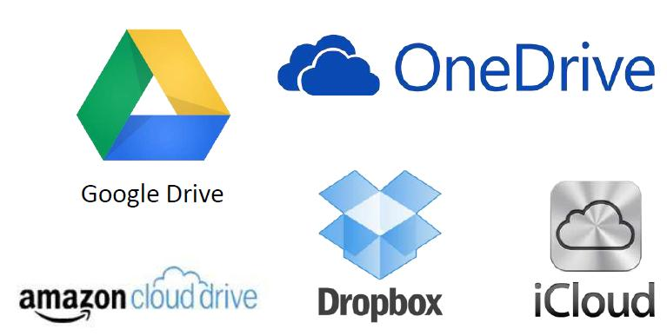
Examples of Cloud Storage

Slide 23
Examples of Cloud Storage- Google Drive
‘Pure’ cloud computing service, with all the apps & storage found online.
Can be used via desktop top computers, tablets like iPad or on smartphones.
All of Google's services can be considered cloud -based: Gmail, Google Calendar, Google Voice etc.
Microsoft’s OneDrive: Similar to Google Drive.

Slide 24
Examples of Cloud Storage- Dropbox
Commonly used to store documents and images.
One can set his/her phone to automatically send all pictures taken with it into their Dropbox account, so that even if one loses their phone, the pictures will still be available to him/her up in space.

Slide 25
Examples of Cloud Storage- Apple iCloud
Apple's cloud service is primarily used by Apple users for online storage and synchronization of user’s mail, contacts, calendar, and more.

Slide 26
Common Features of Google Drive, Dropbox, iCloud
All three platforms are third party services.
All offer a basic amount of free storage:
Dropbox: 5 GB
OneDrive (linked to Microsoft live account): 7 GB
Google Drive (linked to Gmail account): 15 GB
Post, user has to pay yearly or monthly subscription fee.
Example: Google Drive: 100 GB - $4.99/month; 200 GB - $9.99/month.

Slide 27
Cloud Database
Collection of informational content, either structured or unstructured.
Resides on a private, public or hybrid cloud computing infrastructure platform.

Slide 28
Cloud Database
“Cloud database” can be one of two distinct things: a traditional or NoSQL database installed and running on a cloud virtual machine, or a cloud provider’s fully managed database-as-a-service (DBaaS) offering.

Slide 29
Cloud Database
Where an on-premises database is connected to local users through a corporation's internal local area network (LAN), a cloud database resides on servers and storage furnished by a cloud or database as a service (DBaaS) provider and it is accessed solely through the internet.

Slide 30
Cloud Database
Cloud DBaaS is natural database equivalent of software-as-a-service (SaaS).
Running own self-managed database in a cloud environment.

Slide 31
How Cloud Databases Work
Relational
Cloud Databases
Non-Relational

Slide 32
Benefits of Using a Cloud Database
Reliability & Disaster Recovery
Scalability & Performance
Ease of Access & Agility

Slide 33
Benefits of Using a Cloud Database
Overall cost
Flexible Solutions
Mobile Access
Disaster Recovery
Safe & Secure
Scaling & Managing Database is Easier

Slide 34
Disadvantages of Using Cloud Database
Vendor Lock-In
Cost Concerns
System Vulnerabilities
Connection Downtime
Maintenance

Slide 35
Considerations for Moving Database to Cloud
What is current database hosting infrastructure?
Are you expanding the capabilities of the applications you are creating?
Is 24/7 availability essential for your business’s applications?
Does your business build applications that require large datasets to operate efficiently?

Slide 36
Example of Cloud Database Service
MongoDB Atlas Cloud Database

