Slide 2
After this lecture, you will be able to,
Know about different services offered by Amazon Web Services (AWS).

Slide 3
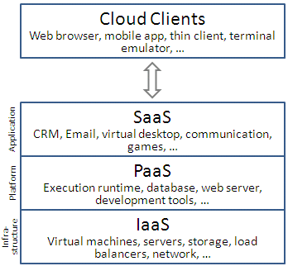
Infrastructure-as-a-Service (IaaS)
Category of cloud services which provides capability to provision processing, storage, intra-cloud network connectivity services, and other fundamental computing resources of the cloud infrastructure.

Slide 4
Highlights of IaaS
On demand computing resources
Eliminate the need of far ahead planning
No up-front commitment
Start small and grow as required
No contract, Only credit card!

Slide 5
Highlights of IaaS
Pay for what you use
No maintenance
Measured service
Scalability
Reliability

Slide 6
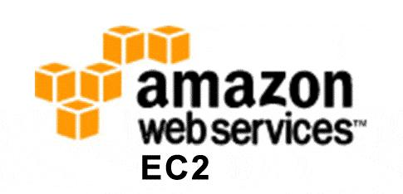
Infrastructure-as-a-Service (IaaS)- Amazon EC2

Slide 7
AWS EC2
Amazon Elastic Compute Cloud (EC2) is a web service that provides resizeable computing capacity that one uses to build and host different software systems.
Designed to make web-scale computing easier for developers.
A user can create, launch, and terminate server instances as needed, paying by the hour for active servers, hence the term "elastic".
Provides scalable, pay as-you-go compute capacity
Elastic - scales in both direction

Slide 8
EC2 Concepts
AMI & Instance
Region & Zones
Storage
Networking and Security
Monitoring
Auto Scaling
Load Balancer

Slide 9
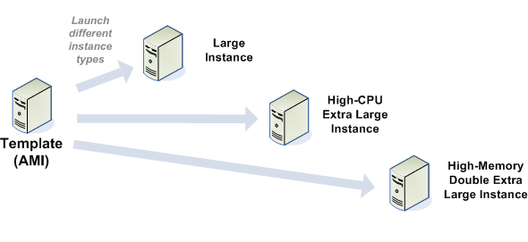
Amazon Machine Images (AMI)
An immutable representation of a set of disks that contain an operating system, user applications and/or data.
From an AMI, one can launch multiple instances, which are running copies of the AMI.

Slide 10
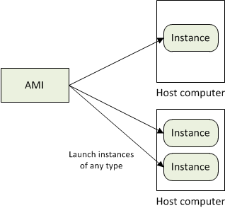
AMI and Instance
Amazon Machine Image (AMI) is a template for software configuration (Operating System, Application Server, and Applications).
Instance is a AMI running on virtual servers in the cloud.
Each instance type offers different compute and memory facilities.

Slide 11
Region and Zones
Amazon have data centers in different region across the globe
An instance can be launched in different regions depending on the need.
Closer to specific customer
To meet legal or other requirements

Slide 12
Region and Zones
Each region has set of zones
Zones are isolated from failure in other zones
Inexpensive, low latency connectivity between zones in same region

Slide 13
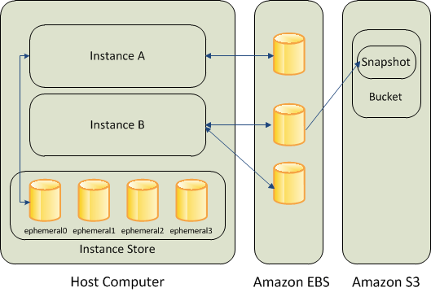
Storage
Amazon EC provides three type of storage option:
Amazon EBS
Amazon S3
Instance Storage

Slide 14
Networking and Security
Instances can be launched on one of the two platforms
EC2-Classic
EC2-VPC
Each instance launched is assigned two addresses a private address and a public IP address.
A replacement instance has a different public IP address

Slide 15
Networking and Security
Instance IP address is dynamic:
new IP address is assigned every time instance is launched
Amazon EC2 offers Elastic IP addresses (static IP addresses) for dynamic cloud computing
Remap the Elastic IP to new instance to mask failure
Separate pool for EC2-Classic and VPC
Security Groups to access control to instance

Slide 16
Monitoring, Auto Scaling and Load Balancing
Monitor statistics of instances and EBS
CloudWatch (monitor, manage and publish various metrics; configure alarms based on metrics)

Slide 17
Monitoring, Auto Scaling and Load Balancing
Automatically scales amazon EC2 capacity up and down based on rules
Add and remove compute resource based on demand
Suitable for businesses experiencing variability in usage

Slide 18
Monitoring, Auto Scaling and Load Balancing
Distribute incoming traffic across multiple instances
Elastic Load Balancing

Slide 19
Amazon S3
S3 stands for = Simple Storage Service
SOA– Service Oriented Architecture which provides online storage using web services.
Allows read, write and delete permissions on objects.
Uses REST and SOAP protocols for messaging.

Slide 20
Amazon SimpleDB
Amazon SimpleDB is a highly available, flexible, and scalable non-relational data store that offloads the work of database administration.
Creates and manages multiple geographically distributed replicas of your data automatically to enable high availability and data durability.
The service charges you only for the resources actually consumed in storing your data and serving your requests.

Slide 21
AWS Lambda
Truly Serverless.
You know longer have the overhead of administration.
No need to manage any servers.
Focus is entirely on your business logic.

Slide 22
AWS DynamoDB
Database that delivers single-digit millisecond performance at any scale.
Fully managed, cost effective, durable, multi-region NoSQL database.

Slide 23
AWS Amazon API Gateway
Fully managed service.
Simple way to create, publish, maintain, monitor, and secure APIs at any scale. RESTful APIs and WebSocket APIs are types of APIs you can create using API Gateway.

Slide 24
AWS EC2 Practical
Launching an Instance
Connecting
Terminating
Stop
Budget & Preferences setting

Slide 25
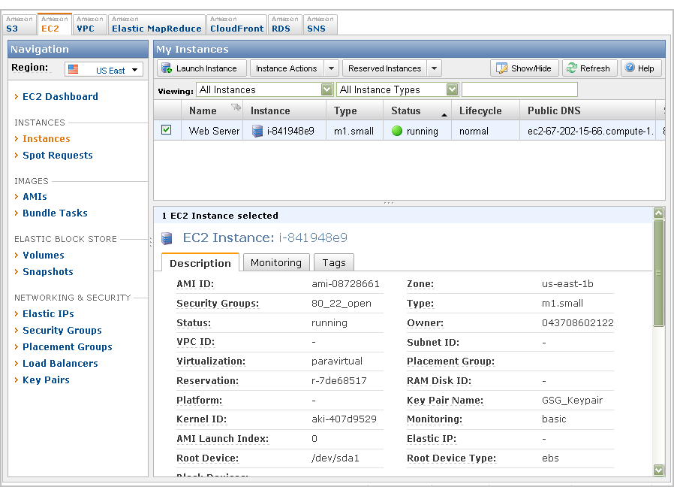
AWS Management Console

Slide 26
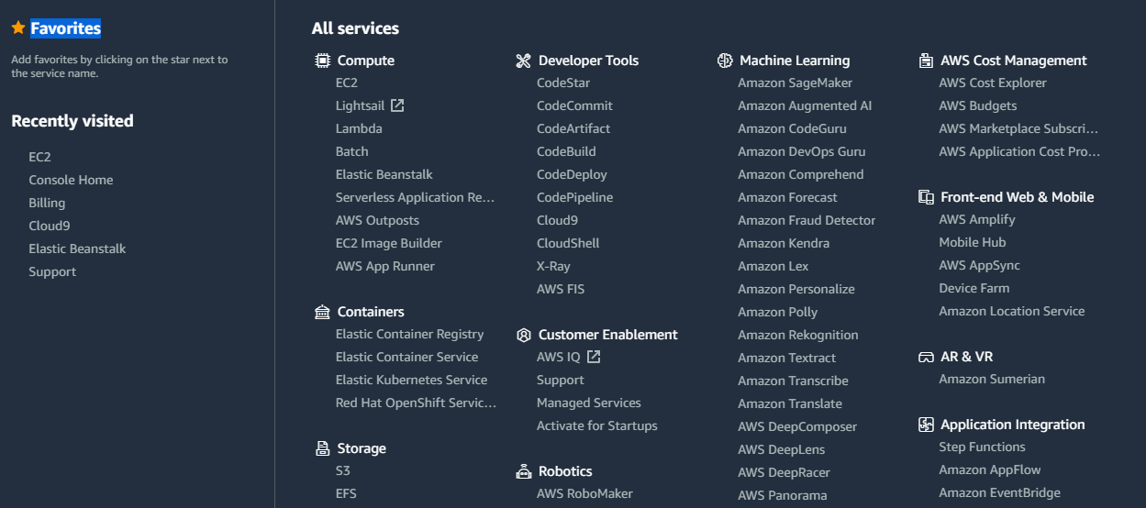
AWS Management Console- All Services

